Slide 1


Muon lifetime at rest and in flight
Emmanuel Chaniotakis,
Ellinogermaniki Agogi
FRONTIERS e- Summer School, 12-16 July 2021

Slide 2
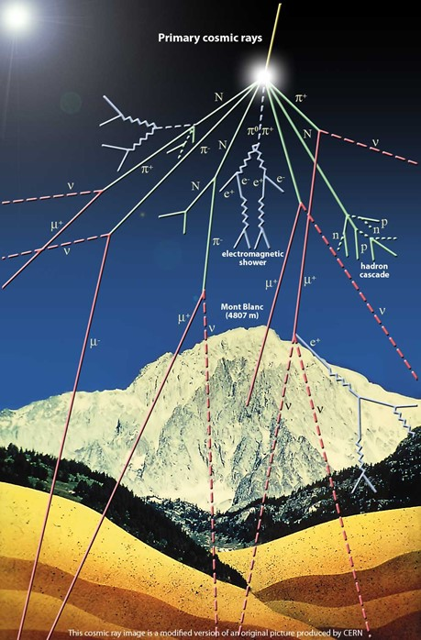
Introducing cosmic rays
Particles from outer space zooming in our atmosphere and colliding with it producing secondary showers of particles that can be detected from the ground.
https://www.youtube.com/watch?v=91801Y1lsCg
Timeline:
https://timeline.web.cern.ch/timeline-header/146/export

Slide 3

Enter the muon!

Slide 4
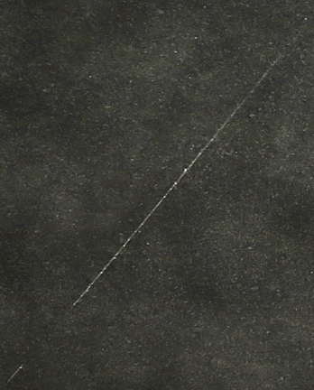
Some history..
It was 1936 when Carl Anderson and Seth Neddermeyer of Caltech discovered a new particle: the Muon. Without any theory predicting its existence, this new particle was met with so much surprise, that the Nobel Prize Winner Isidor Rabi quoted: “Who ordered that?”
The muon is a “heavier cousin” of the electron with mass equal to 105,66 MeV/c² (200 times heavier than the electron) and negative charge equal to that of the electron
(q_{e}=-1,6*10⁻¹⁹ C). Muon has an antiparticle: the anti-muon which has the same mass as the muon and positive charge of equal absolute value.

Slide 5
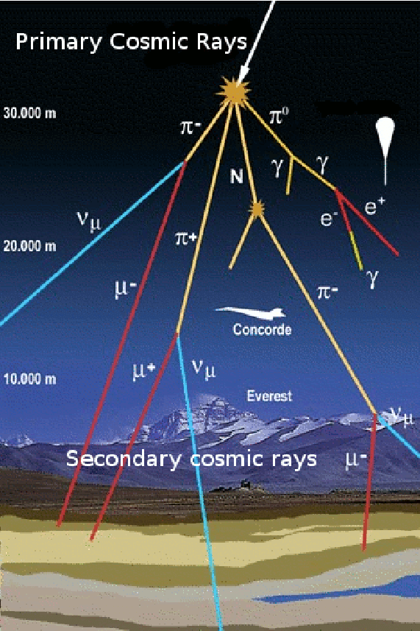
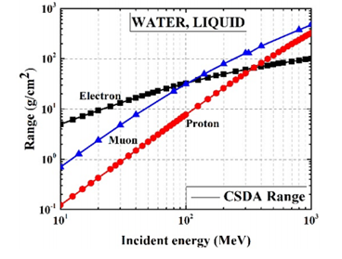
Muons have a long range in matter
… Because they don’t lose much energy per cm of their track in matter.
Due to their penetrating nature, muons are the most frequent cosmic ray particles detected at sea level (1 per cm² per minute) or below sea level..

Slide 6
Muons decay!
If there are so many muons out there, why aren’t we made of them? Because muons decay!
Like minuscule bombs, the muons have a finite mean lifetime of 2,2 billionths of a second – or μs. Some decay quicker, some slower. By stopping a big quantity of muons and observing their decay rate, the mean will be of the order of 2.2 μs.
Imagine an internal “clock” ticking inside them - and once this is over, they decay by transforming to three new particles which were not constituents of the parent muon: an electron and two other neutral particles called neutrinos.
As momentum and energy are always conserved, the daughter particles share the momentum and the energy of their parent particle.

Slide 7
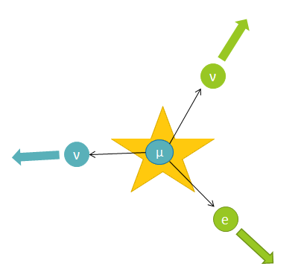
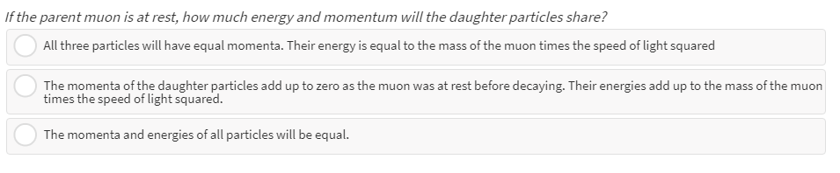

Slide 8
Let’s consider muon decay a bit..
Muon decay is a random process obeying the law of radioactive decay.The most striking characteristic of radioactive decay is its inherent randomness, which is pretty astounding by itself, and is a core feature of quantum mechanical systems. You can consider that muon decay (at rest) resembles a bit cooking pop corn!
https://www.youtube.com/watch?v=LG8308AMudI
Therefore, if you “catch” two muons and measure how long it will take them to decay you may find totally different results. If you take data on the decay of many muons and average them over many single decay events, you will be able to find the characteristic time – or lifetime of the muon.

Slide 9
This is the main difference between a clock which needs two readings to define a time interval and a “radioactive clock” which needs a collection of events from which the characteristic time will be calculated.
Physics predicts that if the “mechanism” behind the decay is strong then the decay will probably happen fast: Our collection of muons will deplete quickly.
If the mechanism is weak, our collection of muons will gradually deplete over a much longer timescale.

Slide 10
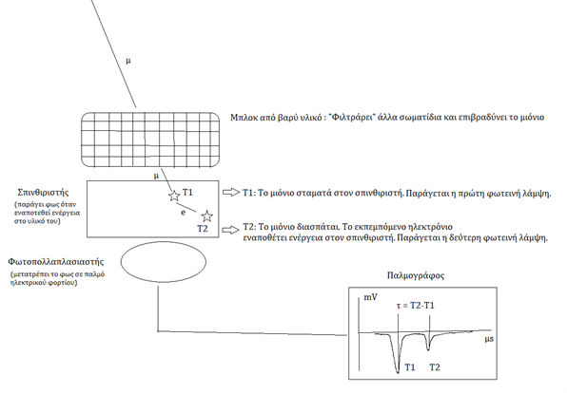
How do we measure muon decay?
A block of high Z material. It filters out other particles and can help slow down muons
Scintillator
T1: The muon stops in the scintillator. First flash occurs
T2: The muon decays. The emitted electron deposits its energy in the scintillator. Second flash occurs
Photomultiplier
Oscillioscope

Slide 11
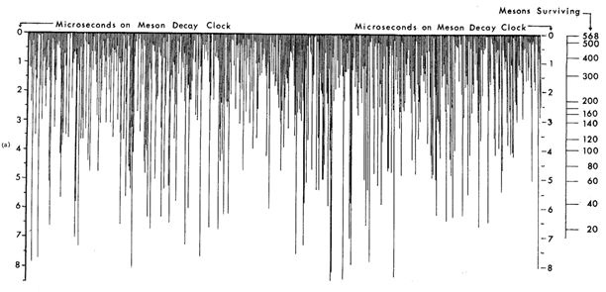
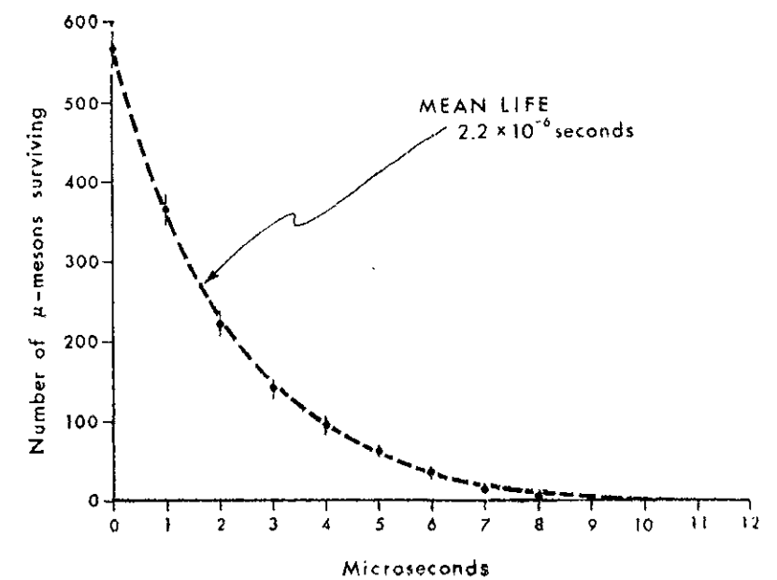
Measurement of Muon Decay at rest
Distribution of decay times for muons. The vertical axis measures the decay interval of stopped muons in microseconds whereas the ruler on the right calculates how many muons have survived for the corresponding time interval.
(Figures Adapted from “Measurement of the Relativistic Time Dilation Using μ-Mesons” David H. Frisch and James H. Smith. Citation: American Journal of Physics 31, 342 (1963); doi: 10.1119/1.1969508)

Slide 12
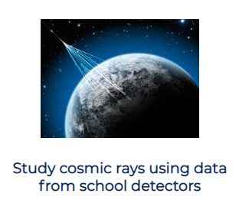
Student activity to measure muon decay at rest
http://inspiringscience.rdea.gr/delivery/view/index.html?id=228690c20d7141fc9ecfe69221302584&t=p

Slide 13
We know now how to measure muon decay at rest.. What about decay in flight?

Slide 14
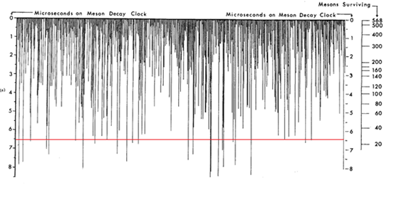
Result: For every 568 muons collected at a 1910 m altitude with average velocity equal to 0.992c, 27 were expected to be observed at sea level.
After that, the researchers took their experimental setup at sea level and performed the one hour long measurement of muon decay at rest again.
What would you expect them to observe?
https://www.youtube.com/watch?v=rVzDP8SMhPo
Let us make a calculation
Assume that the muons observed in Mt. Washington travel 1910 m vertically to the level of the sea.
How long should a muon live in order to be able to travel the 1910m distance? Assume that its velocity is equal to 0.992c (c = 3.10⁸m/s)
Can you estimate the number of muons you expect to reach the sea level in an hour if we assume that initially: 568 muons were created at 1910 m altitude?

Slide 15
To understand what happens with a (bad) analogy, imagine 568 humans who enter a spaceship immediately after their birth and go to a space voyage with speed almost equal to the speed of light. The distance they travel is 110 light years. Therefore the spaceship will take a little more than 110 years to travel to its destination.
As we know, the mean life expectancy of a human is ~70 years and the oldest person ever alive lived for 122 and a half years. How many people would you expect to be still alive by the end of the journey?
Definitely not the majority. According to the muon experiment, we would expect less than 30 people to have survived. Imagine our surprise if more than 400 of these people survives!
In other words, muons in flight seem to live longer than they live at rest!
Classical physics cannot explain this phenomenon.
This is where the special theory of relativity enters the stage!!

Slide 16
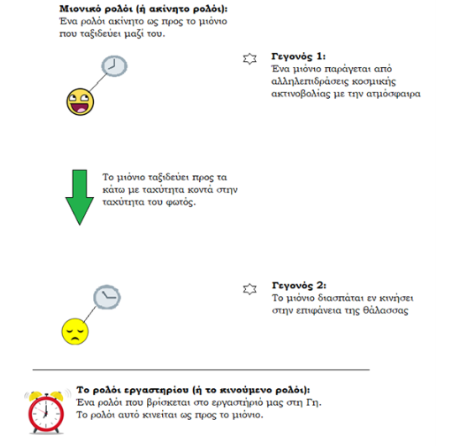
Muon wristwatch: A clock at rest with respect to the muon
Event 1:
A muon is produced from cosmic ray interactions with the atmosphere
The only available explanation is that: “The muon lifetime at rest is different from the muon lifetime in flight”
Muon travels downwards with speed close to c
Event 2: The muon decays in flight
Lab clock:
A clock at rest in our lab. Clock is moving with respect to the muon

Slide 17
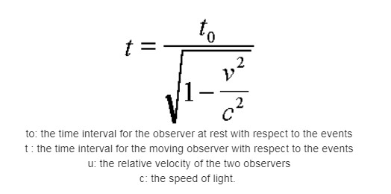
Enter Einstein!
According to Einstein’s Special Theory of Relativity:
Assuming that two observers move with relative uniform velocity close to the speed of light:
The time interval between two events taking place at the same place with respect to an observer is called proper time and is shorter than the time measured by an observer for who the events will take place in different places.
This phenomenon is called relativistic time dilation.
https://www.youtube.com/watch?v=nxQ0kz_qWmc

Slide 18
Question:
An observer sitting on the muon measures its lifetime to be equal to 2.2μs (as the muon is at rest with respect to him). The muon travels a 2km distance from the top of a mountain towards the sea level.
Αccording to him, a 0.99c muon would have to decay after travelling 650m. However, the muon is still there after travelling 2km towards the ground. Is this a paradox?
Answer:
The answer is no. As the observer on earth measures the muon to live longer than 2.2μs, the muon itself measures the elapsed distance to be shorter than 2km!
This phenomenon is length contraction.

Slide 19
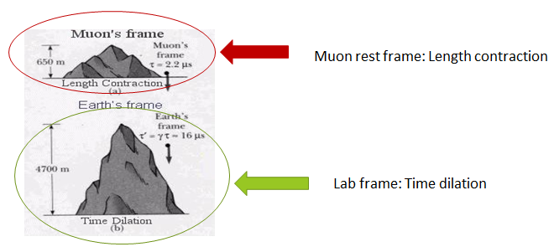

Slide 20
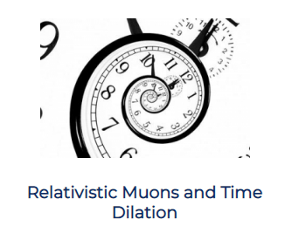
Investigating muon decay in flight in the classroom
http://inspiringscience.rdea.gr/delivery/view/index.html?id=824f83b230e5488ca86f27ced9d39762&t=p
(Interactive app in Flash: Visible only through Internet Explorer)

Slide 21

The idea of the activity is based on..
https://www.youtube.com/watch?v=rbzt8gDSYIM

Slide 22
THANK YOU VERY MUCH!
Contact Details:
Emmanuel Chaniotakis,
Ellinogermaniki Agogi
email: echaniot@ea.gr
FRONTIERS :
www.frontiers-project.eu
social media: www.facebook.com/frontierseu

