Slide 1









Astro Party Calls
an eTwinning project
Céline Winter, Nídia Fidalgo, Marco Nicolini, Kalle Vahaheikkila, Emmanuel Chaniotakis, Emanuel Bettencourt

Slide 2
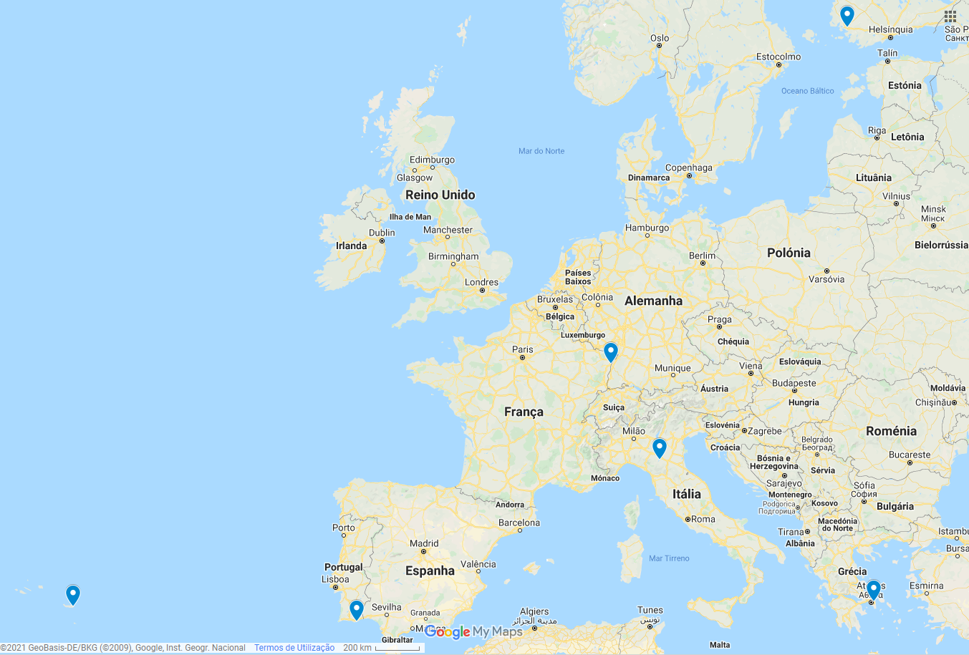
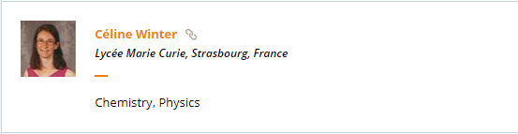
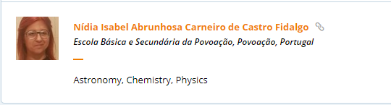
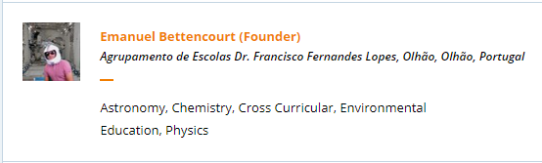
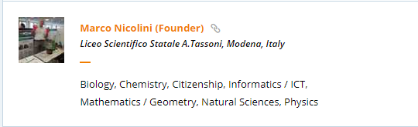
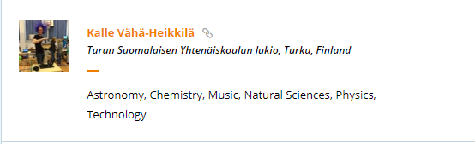
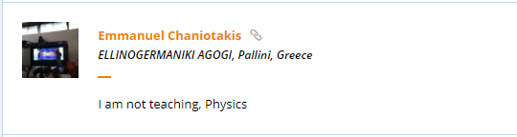



Project members

Slide 3


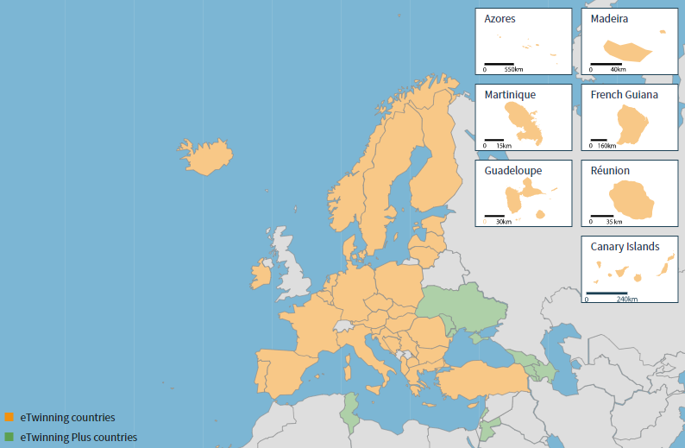
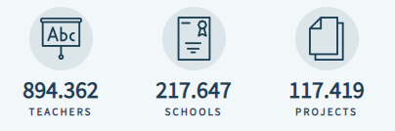
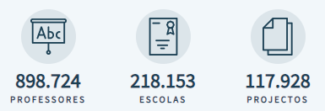
www.etwinning.net
eTwinning is the community FOR schools in Europe.
FOR school staff (teachers, head teachers, librarians, …), working in a school in one of the European countries.
(FOR) a platform to communicate, collaborate, develop projects, share and, in short, feel and be part of the most exciting learning community in Europe.
Collaboration, professional development, recognition
Since 2005 and from 2014 co-funded by the Erasmus+, the European program for Education, Training, Youth and Sport.

Slide 4
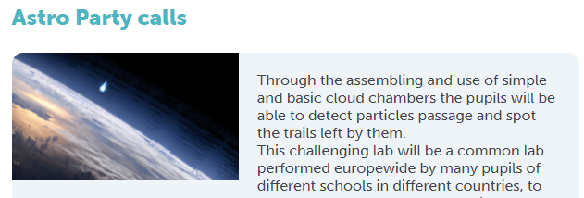
Astro Party calls project
About the project
Through the assembling and use of cloud chambers, pupils will be able to detect particles passage and spot the trails left by them.
This challenging lab will be a common lab performed Europe wide by pupils of different schools in different countries, to be able to compare the observations and exchange the experiences and skills got during this activity.
AIMS
Share ideas on how to present modern physics or part of it to our students.
Propose a shared Europe wide cloud chamber activity that allows pupils to detect astroparticles and see traces of their passage.
Compare detected traces in the cloud chambers at different latitudes, longitudes, altitudes.

Slide 5
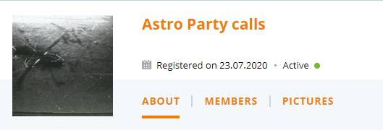
Astro Party calls project
WORK PROCESS
select approximately 15 students (a club, a class or part of it);
build simple cloud chambers based on dry ice (one each 4/5 students);
record observations with cameras to get videos, if possible slow-motion videos or time-lapse;
data analysis and discussions on what has observed will take place in all schools;
observations, videos and conclusions will be shared amongst schools;
the project will take place during the 2020-2021 school year;
teachers will always be in contact and syncronize the activities each month.

Slide 6
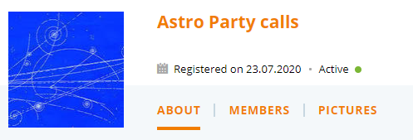
Astro Party calls project
EXPECTED RESULTS
A paper on the utilization of simple cloud chambers will be written at the end of the activity by all the teachers, with which the experience will be shared, with results, troubleshooting, observations, validation, educational value, student's workbook and teacher guide.
The idea is to prepare a hands-on activity ready to be used for all physics teachers (but also astronomy and chemistry), that can be implementd in any school where physics is taught, so that some parts of modern physics are easily accessible or at least approachable to students.
Improve student's knowledge about astroparticles physics and nobel prizes.

Slide 7
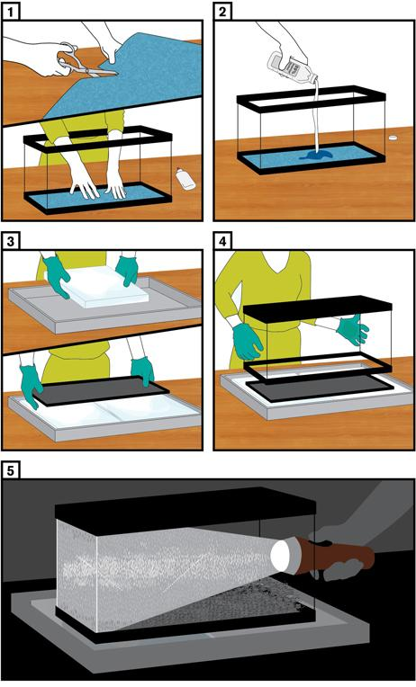
Timeline
1st quarter
2nd quarter
3rd quarter
Project Evaluation
  Quizzes
  Lab plan
  4th to 10th oct
  Students presentations
  Construction
  1st tests
  New test
  Data analysis
  Scientific posters
  Results
Teacher meet
Introduction to students
WSW 2020
Videoconference
Cloud chamber
Cloud chamber
vidoeconference
Cloud chamber
Videoconference

Slide 8
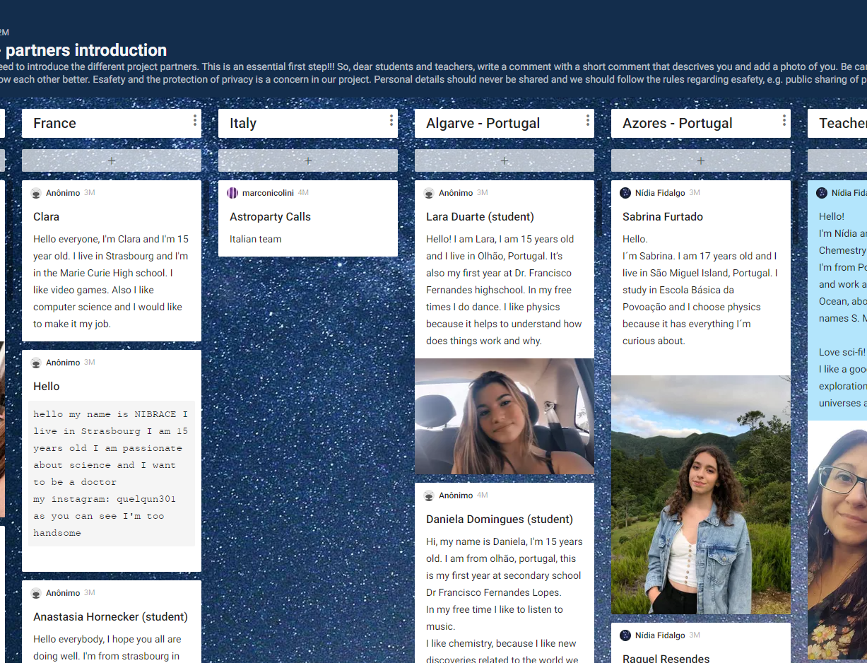
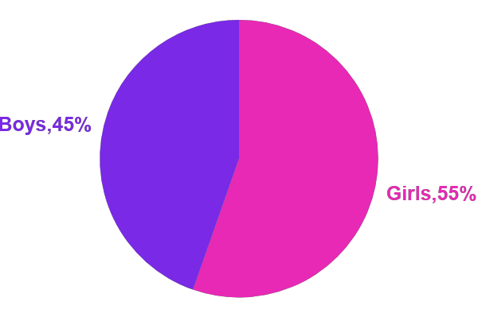
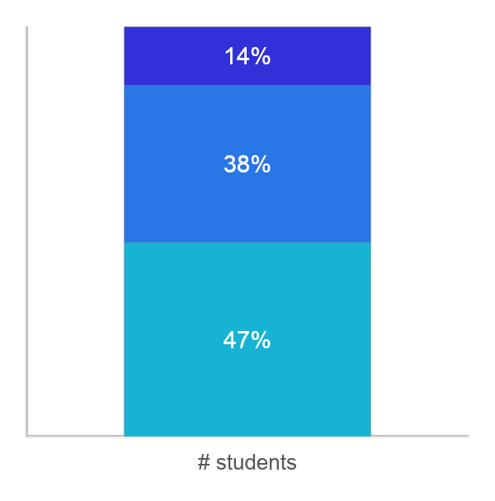

Partners presentation
12th
11th
10th

Slide 9
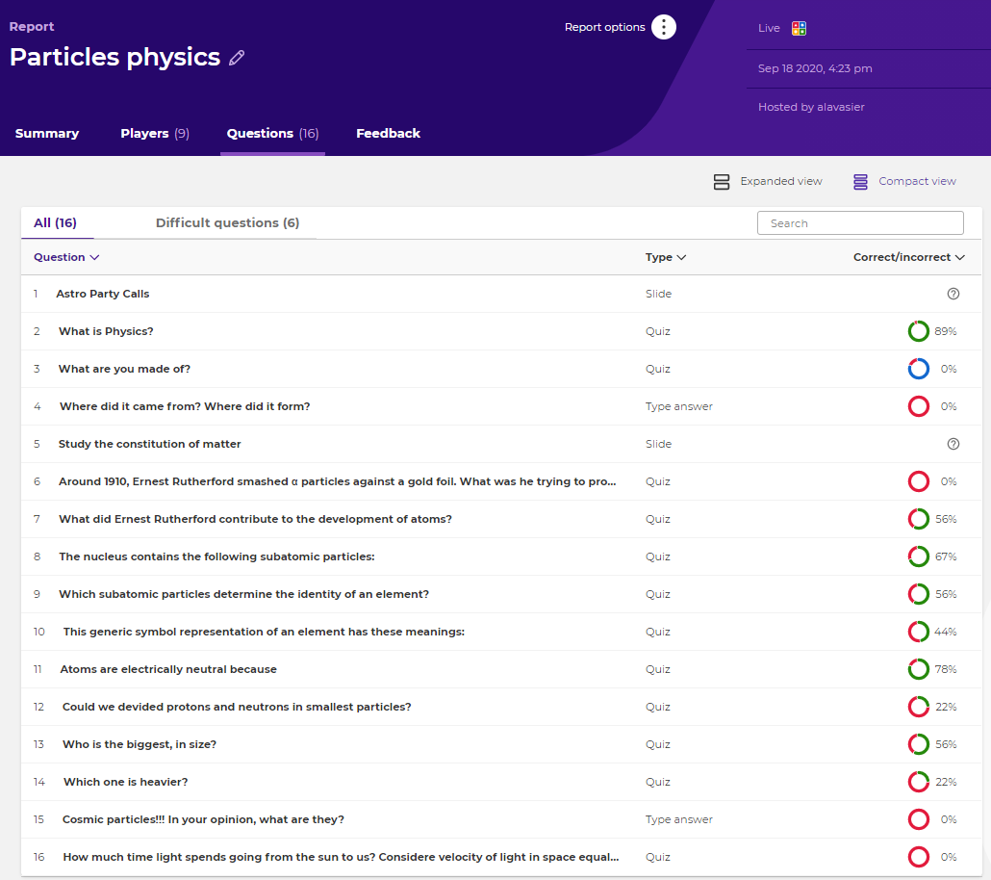
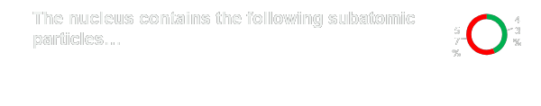
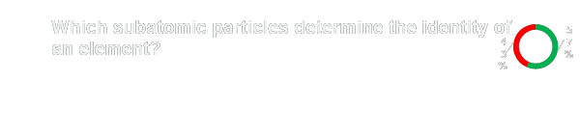
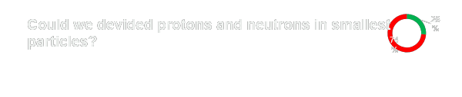
Quiz – Kahoot!

Slide 10
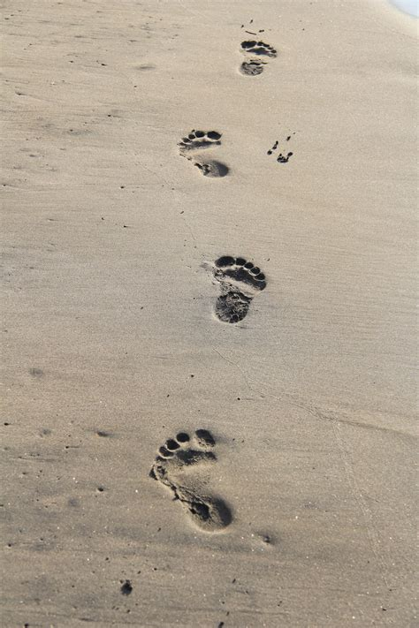
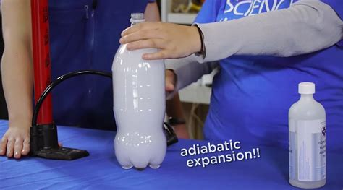
Demonstrator Inspiring Science Education
We can’t see the particles ...but their tracks :
We try to make clouds :

Slide 11
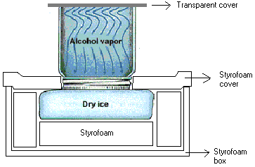
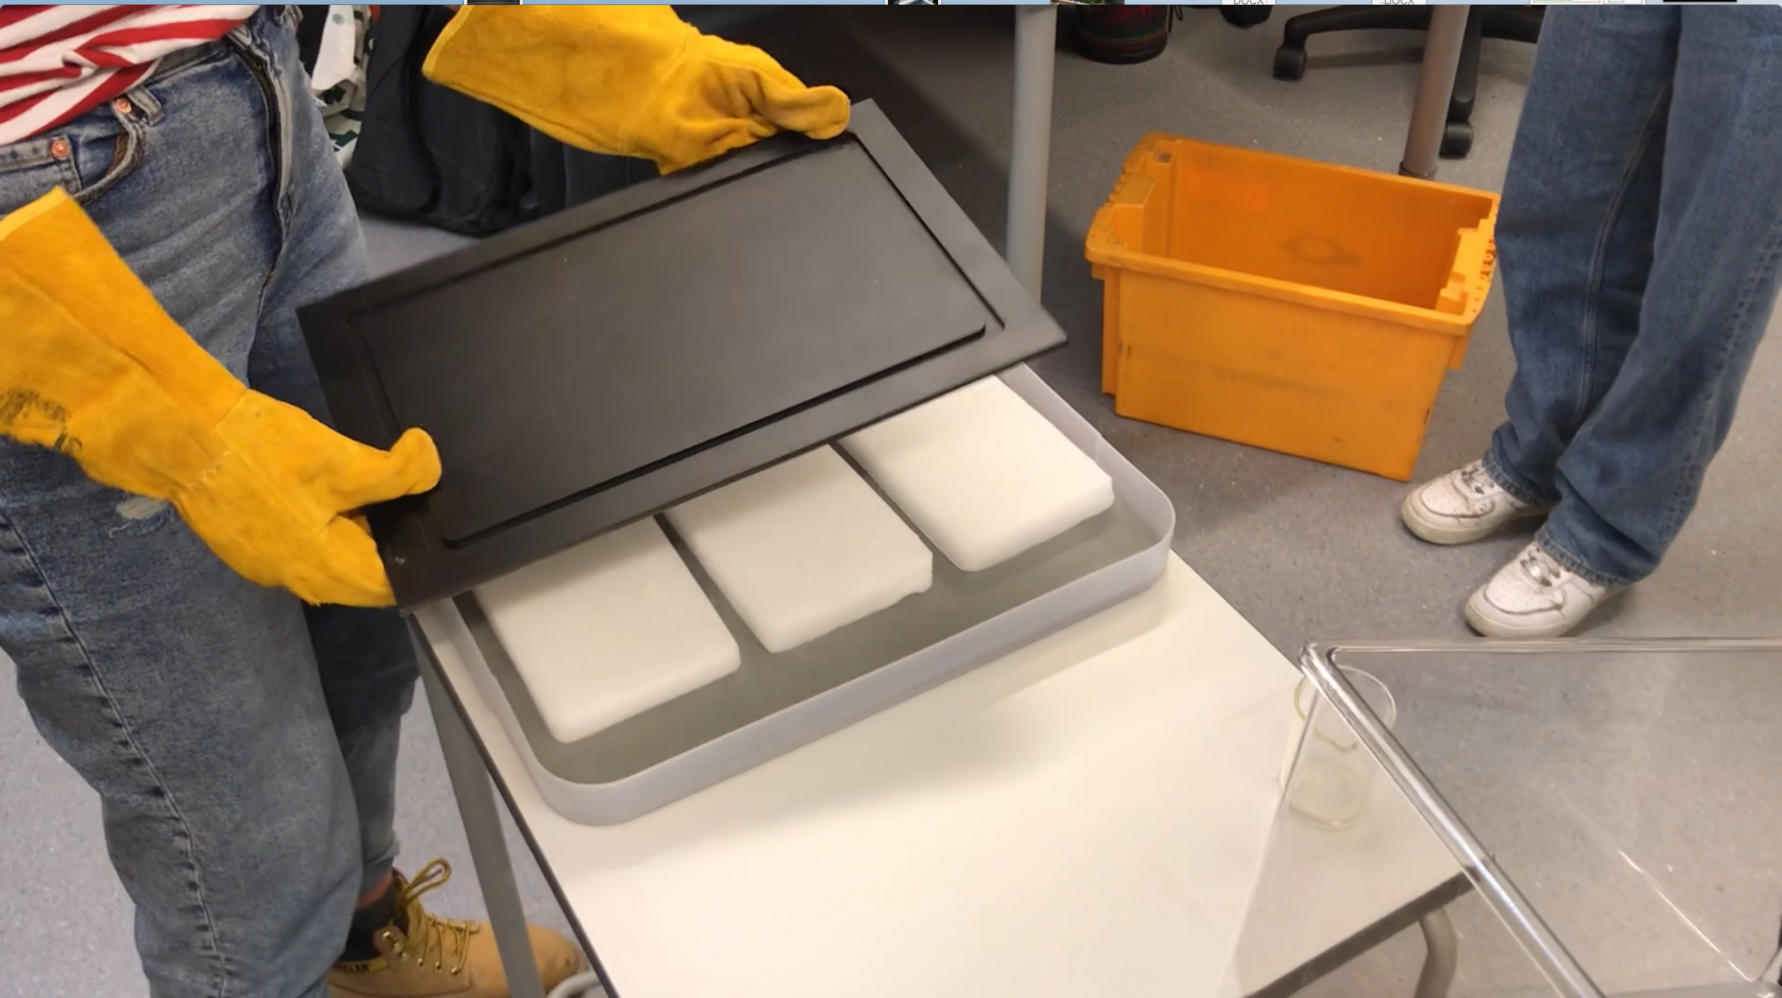
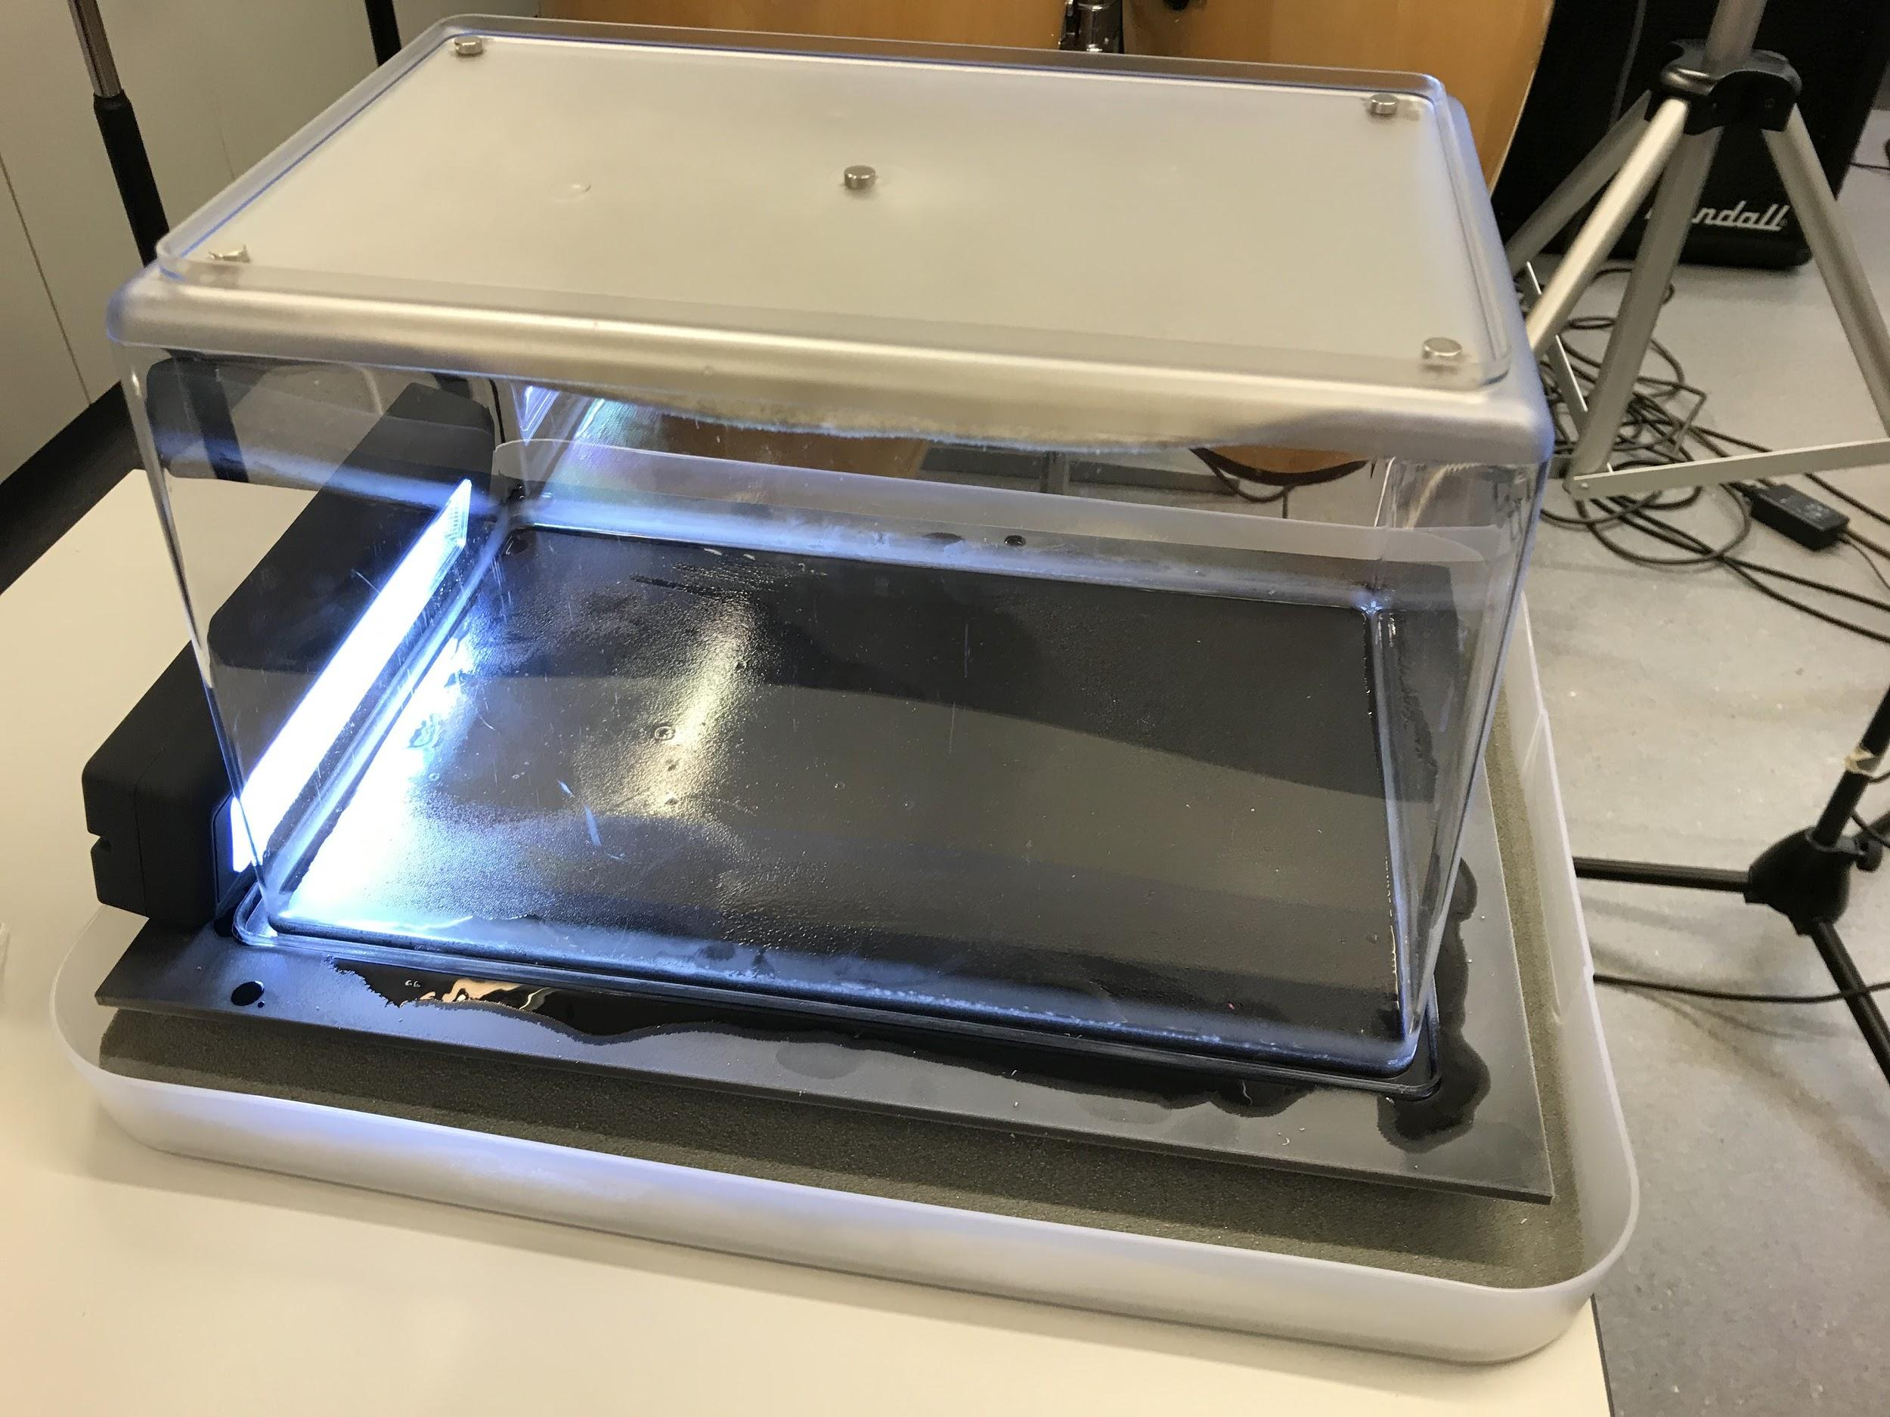
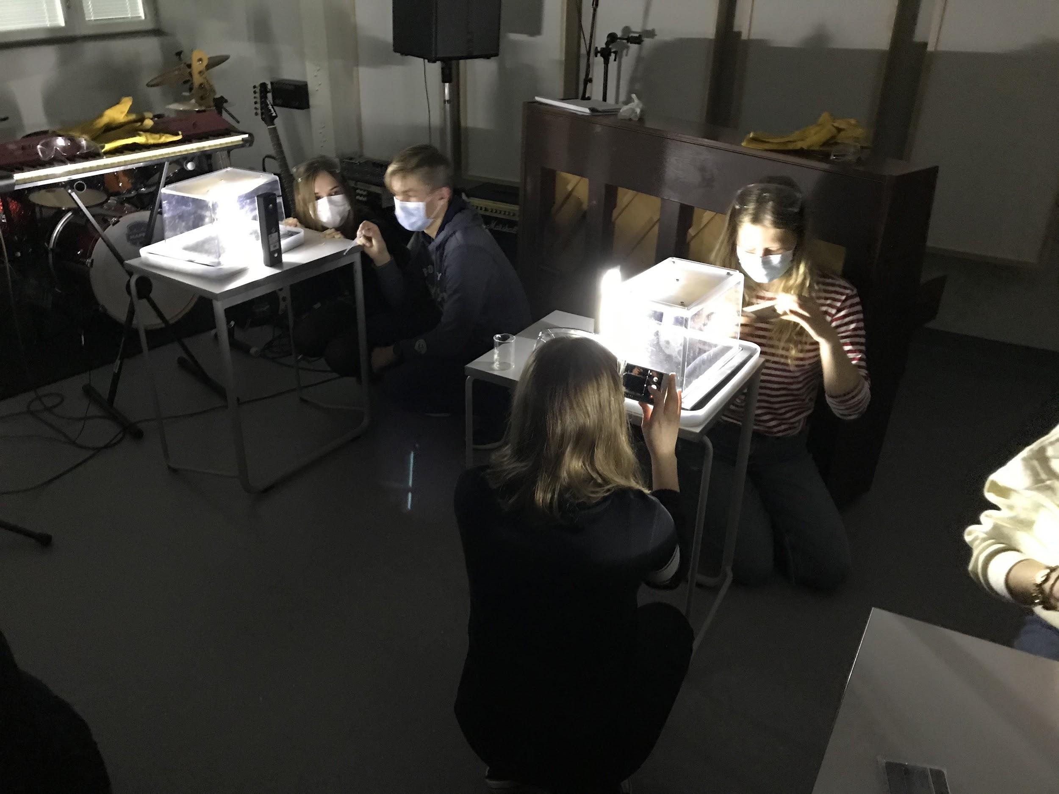
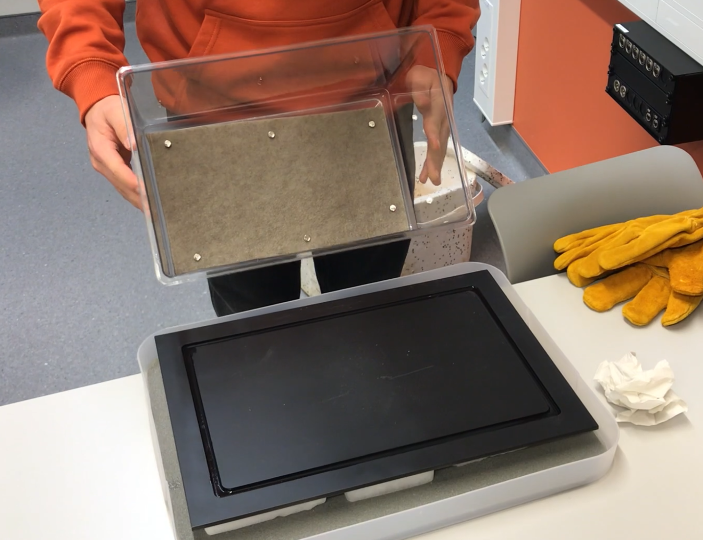
Build the chamber :

Slide 12
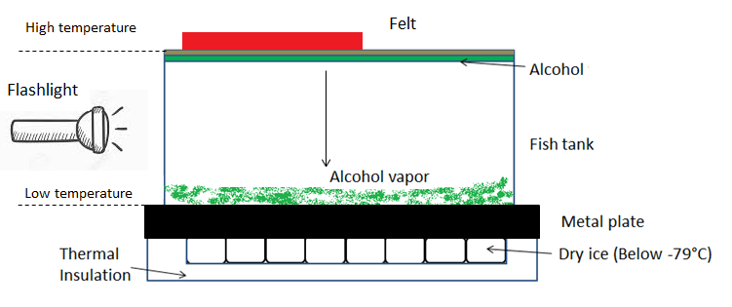
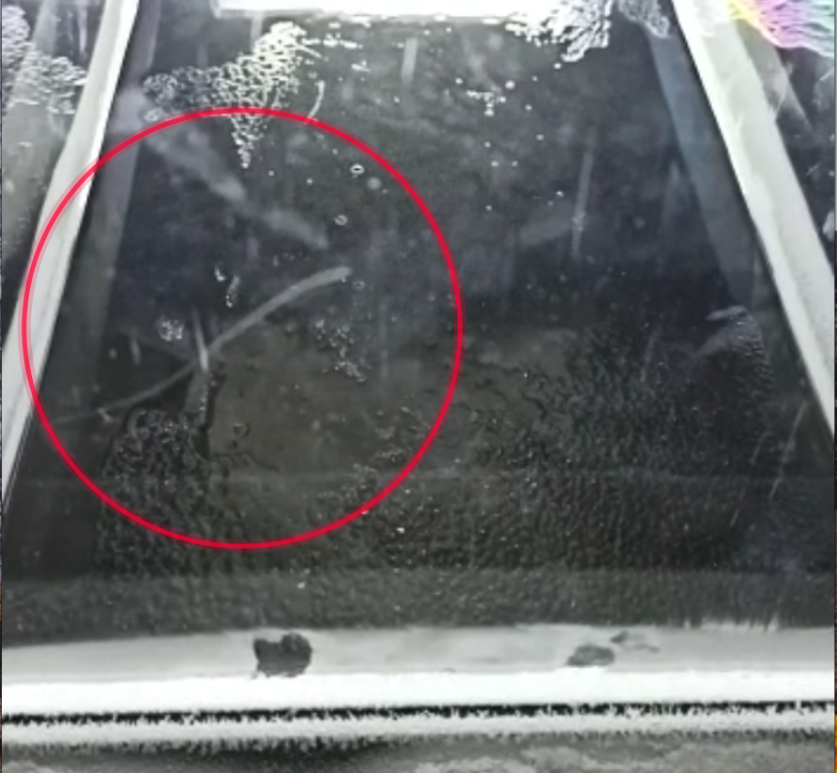
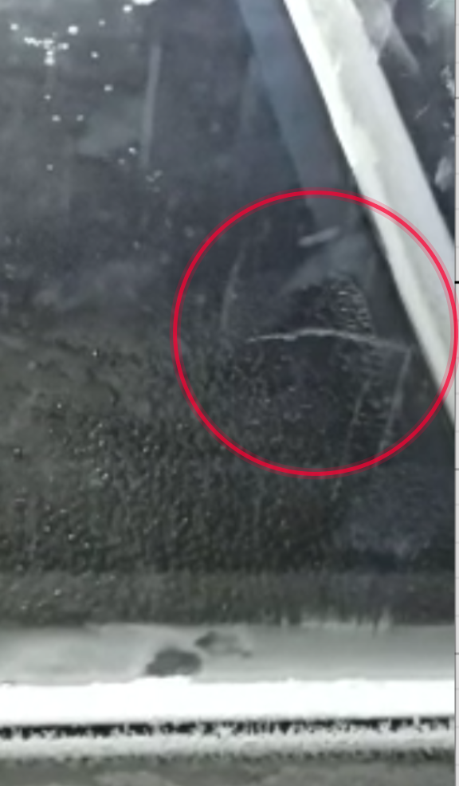
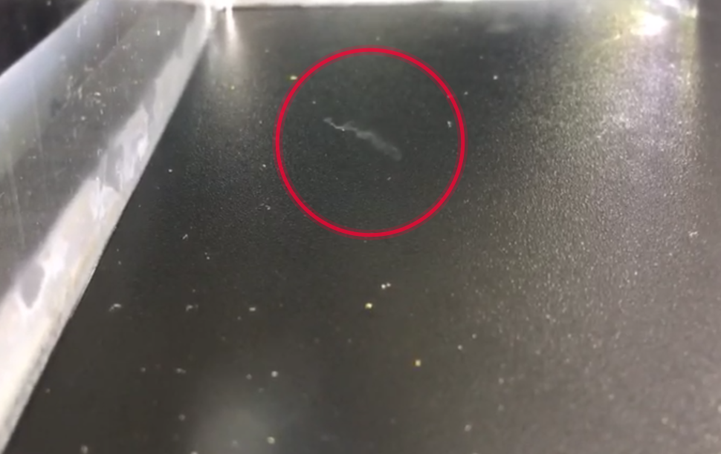
Observations
Particles
alpha electron muon/antimuon

Slide 13
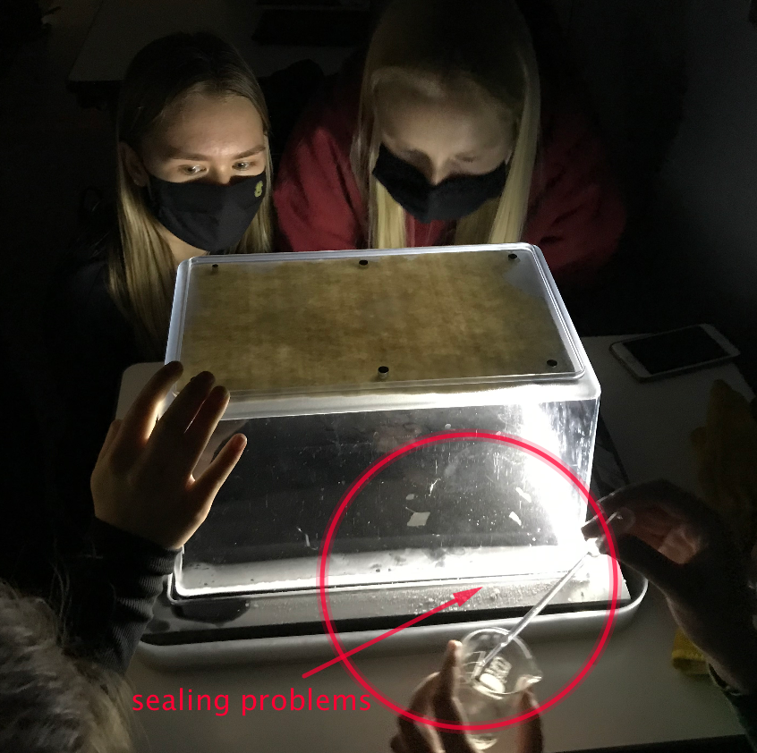
Constraints
Dry ice.
  Not so easy to get specially in Azores
  The most expensive material
  Need to be order in advance
  Need to be properly store
Liquid nitrogen
  Not much literature about its appliance in this activity
Hermetically sealing
  Ventilation of the room moves air -> air flows to chamber
Pandemy and confinement

Slide 14
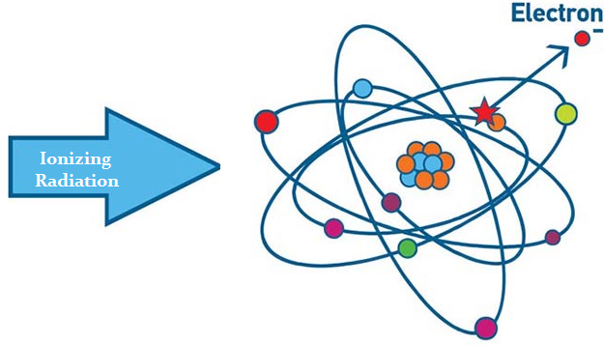
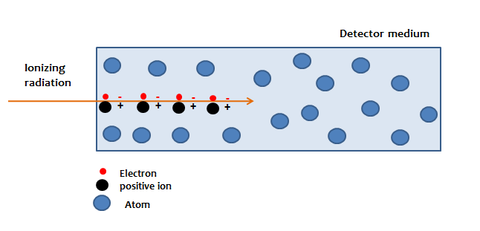
Explanation
Tracks come from ionizing radiations :
the alcohol vapor can condense :

Slide 15
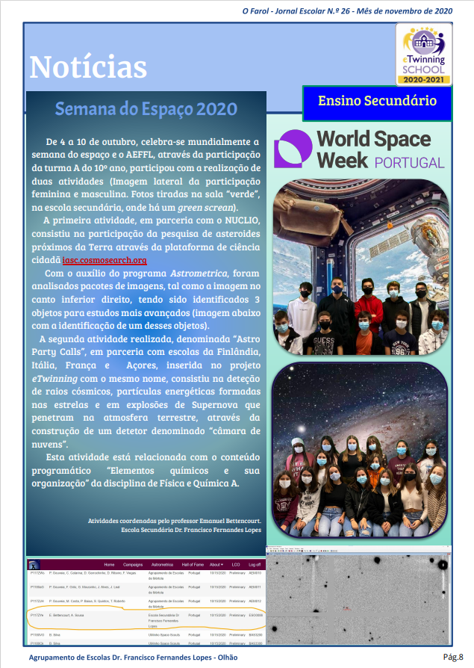
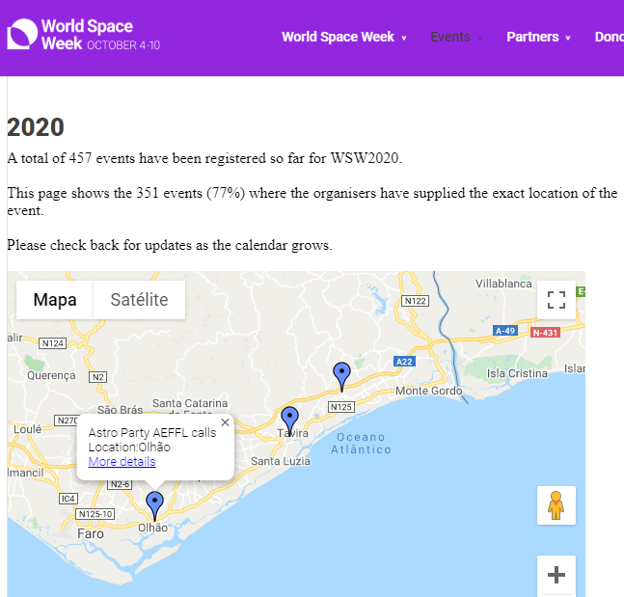
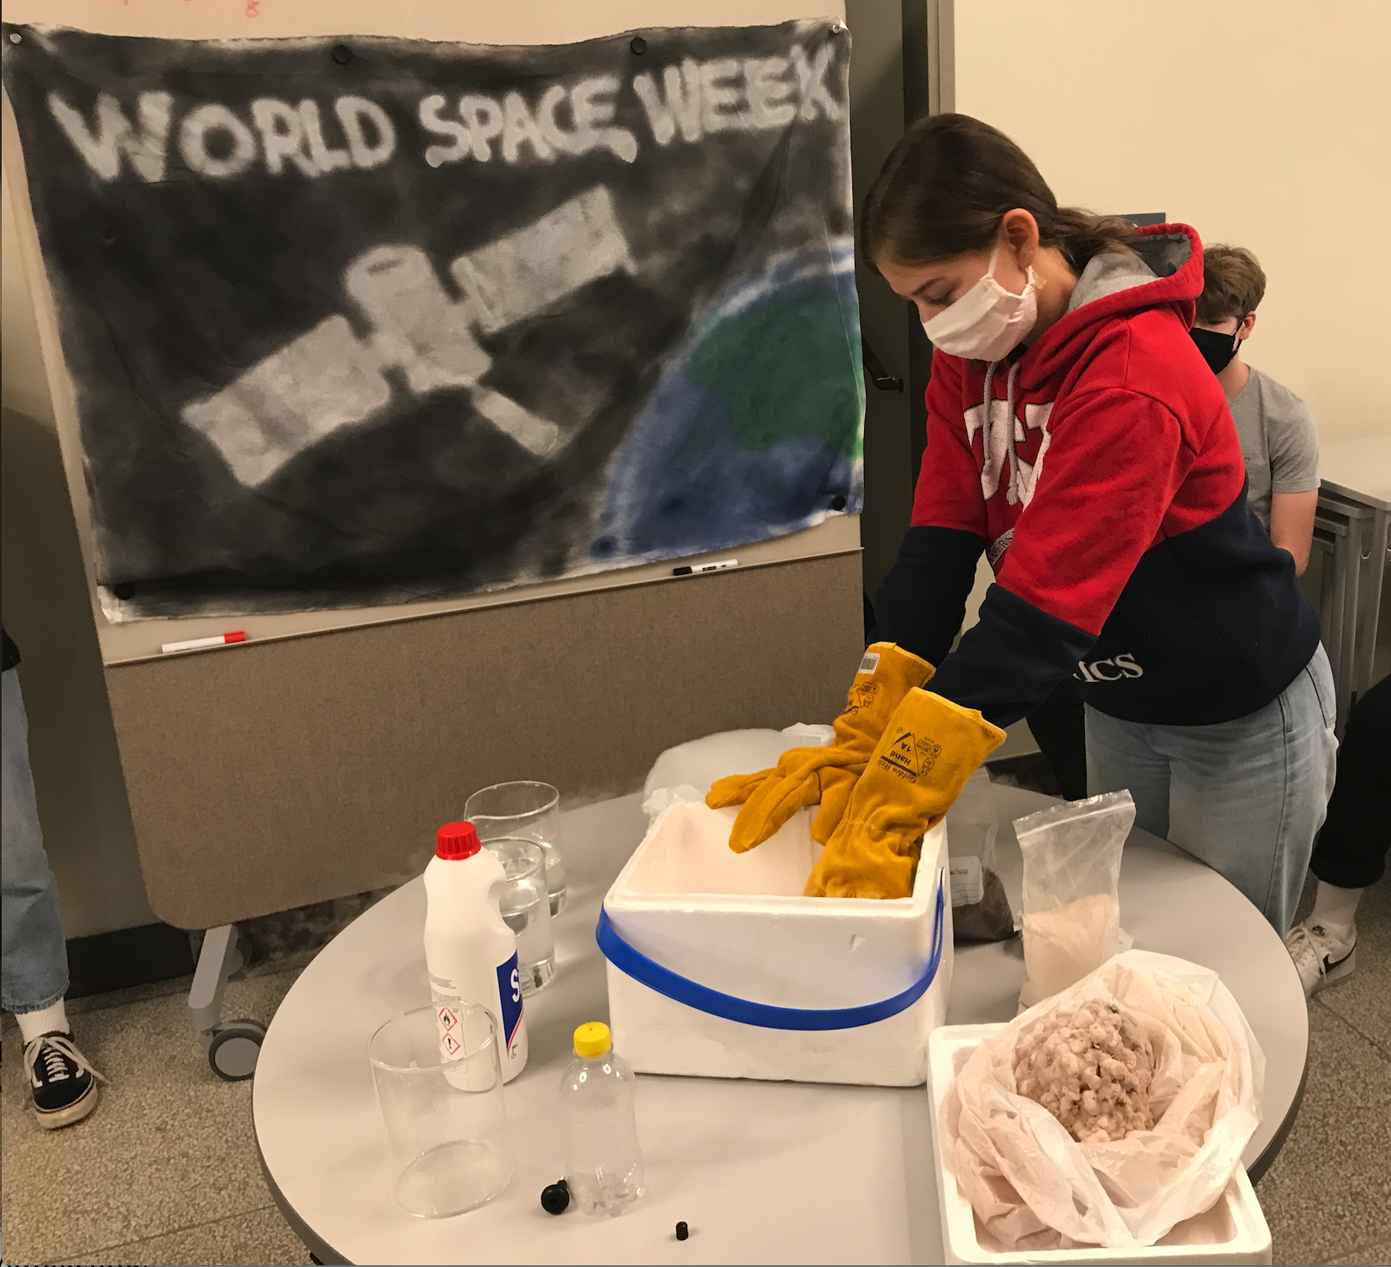
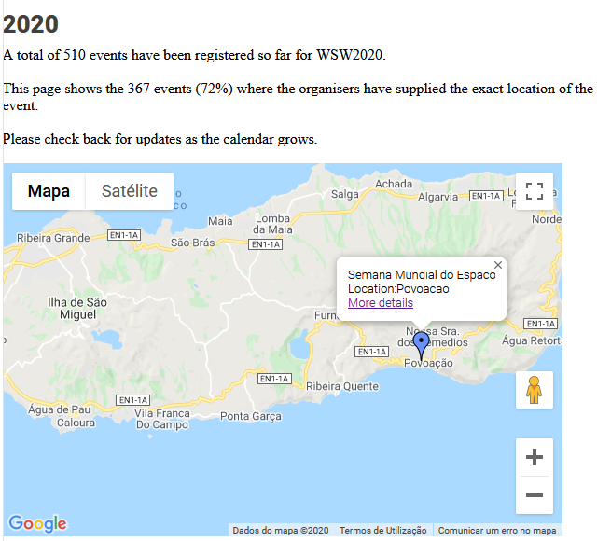
Outreach
School journal
https://www.lycee-mariecurie.org/index.php/2021/03/02/activites-scientifiques-au-lycee-marie-curie/
WSW webpage/event
Twinspace

Slide 16
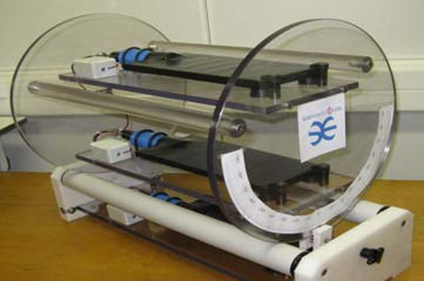
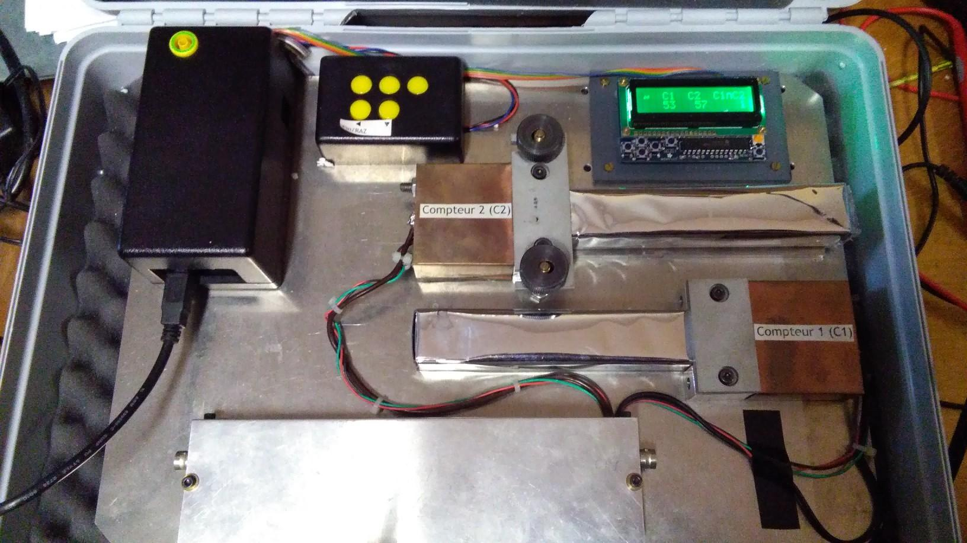
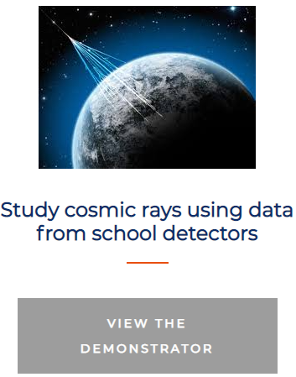
Next
Repeat the experiments designed
Students online interaction
Scientific poster
Paper or labbook
Public oral presentations
Escape game

Slide 17
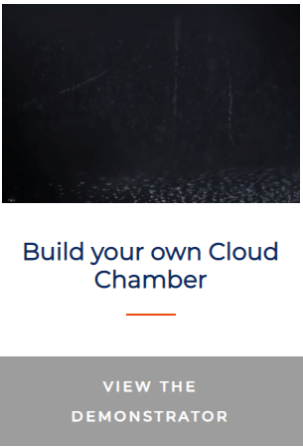


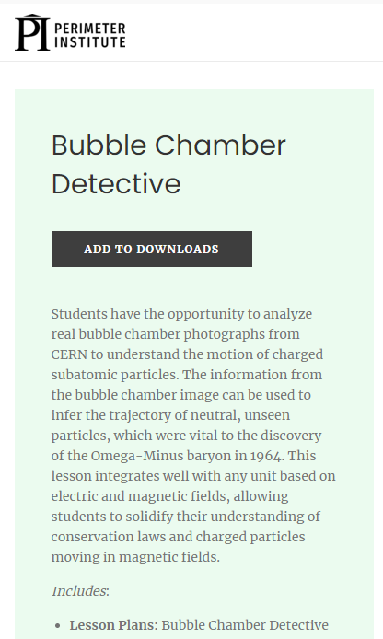

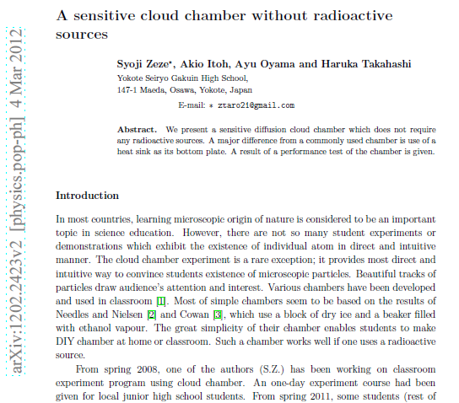
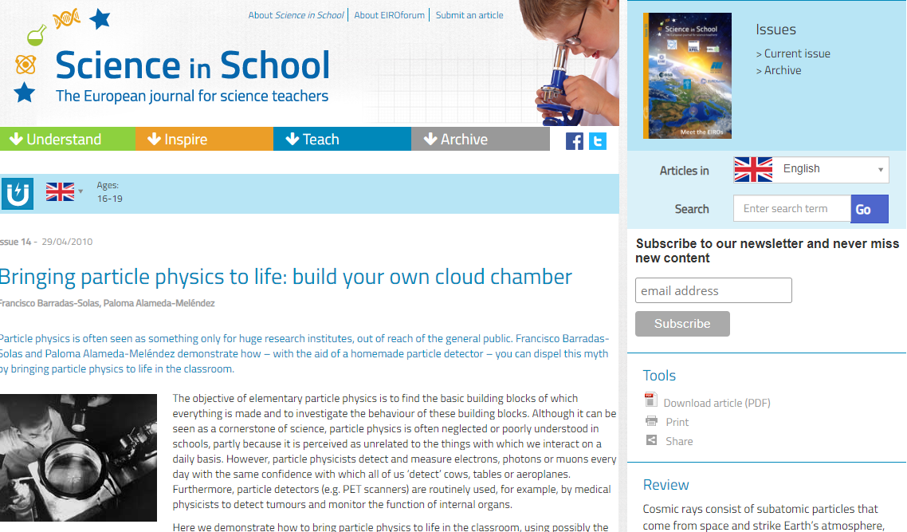
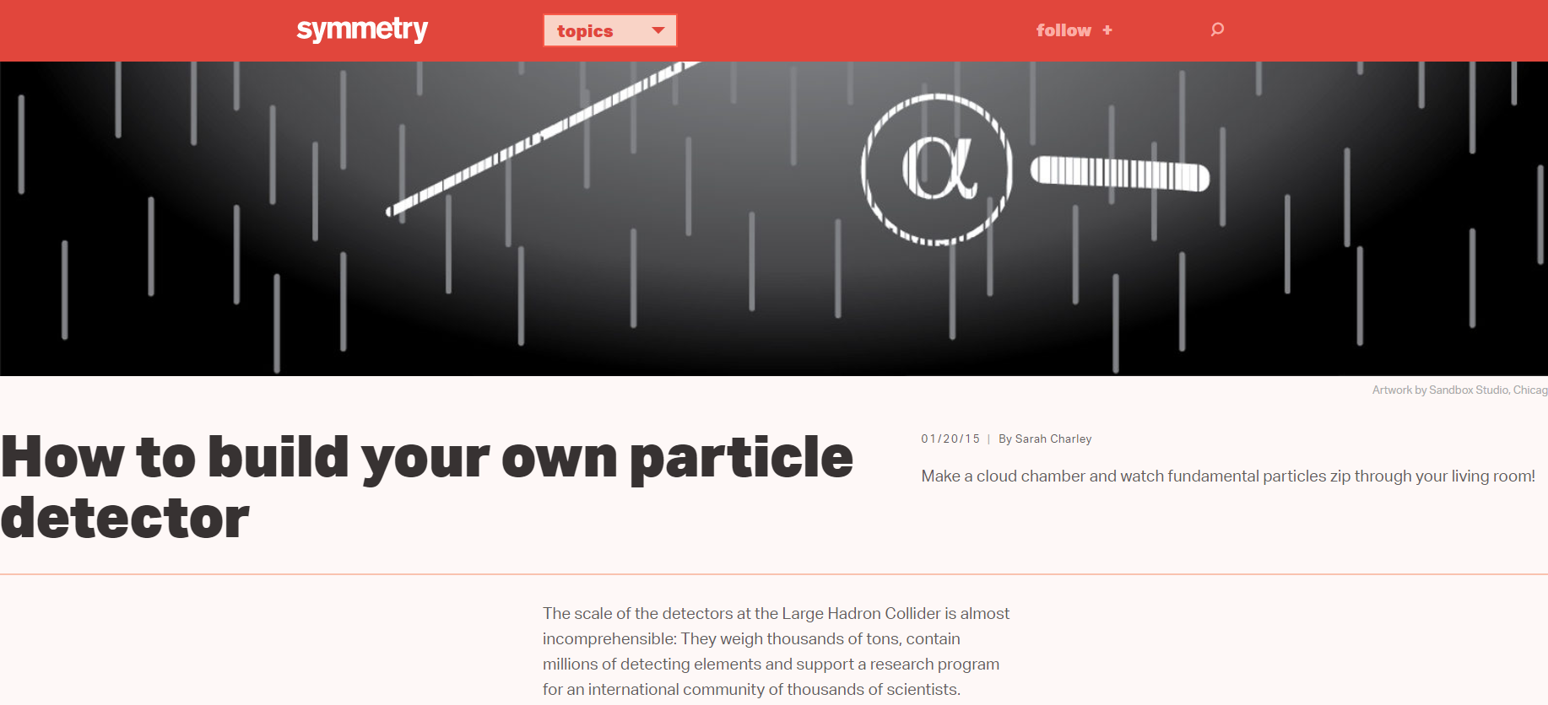
Thank you!!!

