Slide 1

Exploring cosmos with the AAS worldwide telescope
Maria Eleftheriou
High School of Limenos Hersonisou

Slide 2
Short description: We use the AAS worldwide telescope where students can easily zoom in the sky and observe stars, galaxies, or other celestial objects. Also, students can identify the shape of different galaxies using the Zooniverse and more specifically the galaxy zoo.
Age:12-18
Duration: 45 minutes
Cognitive Objectives: Visualization of the celestial objects, identify different stars, space missions.
Affective: Students cooperate in groups, positive interest in science

Slide 3
worksheet
Open the link http://worldwidetelescope.org/
Observe the upper menu
Click on the button Explore and search for Mars
Observe the main window and navigate with the cursors in the sky. Do you notice any changes in the lower menu.
Observe the lower menu and try change the option Look, e.g. insert solar system

Slide 4

After getting familiar with AAS…
Zoom in and zoom out in the solar system and observe the tracks of the planets. Are the planet tracks located in a surface plane?
In the lower panel click on the Sun and afterwards zoom in. Are there any hot spots?
In the lower panel click on different planets and try to find similarities or differences between them. Write your findings on the padlet.

Slide 5
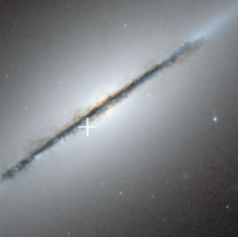
Galaxies
Find Search on the menu and write the name a galaxy e.g., Messier 87, NGC 3344, NGC 1427, NGC 5866 etc.
Crop images and make a map with the different categories of galaxies, i.e. elliptical, irregular, spiral, lenticular etc.

Slide 6

Zooniverse: Galaxy Zoo
Now you can identify the shapes of the galaxies! Open https://www.zooniverse.org/projects/zookeeper/galaxy-zoo/ and get started! You observe images from a telescope in Chile
NEXT STEPS: FAULKES TELESCOPE…..

