Slide 1
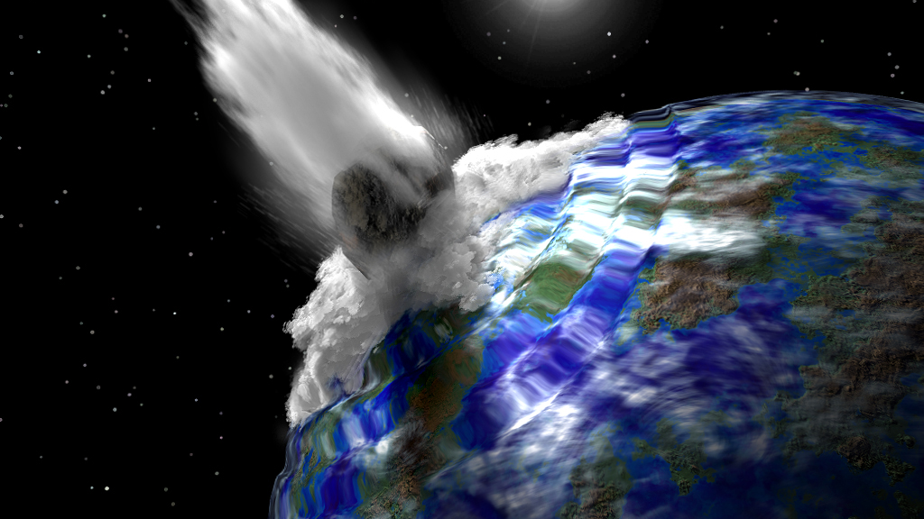
Don’t Look Up! Measuring Impacts from Space
Dr Sarah Roberts
Notes:
Good morning, bore da pawb – in the next 30 moins I’m going to go through my first demonstrator that I wrote for the LaSciL project and it’s all about Impacts from space.

Slide 2
Notes:
Inspired by the Netflix film, ‘Don’t Look up” – wanted to base it on something the students would be familiar with at the moment.
Based on workshops and talks I’ve given in the past – students love the 3 D’s – death , destruction and dinosuars

Slide 3
Summary of activity
Students use the Down2Earth Impact Calculator to investigate what happens when an asteroid or comet it hits the Earth.
Through the investigation, students become acquainted with kinetic energy and frequency of impacts from space while also practicing making graphs.
Notes:
In this activity, students investigate the effects of impacts of asteroids/comets on life on Earth, and look at what affects the results of these impacts. At the end they discuss how scientists and technology can be used in the event that a comet is discovered to be on a collision course with the Earth (as is the premise of the recent Netflix film, Don’t Look up). They present their ideas on methods that can be used to save the planet in this scenario and reflect on the methods and tools they used.

Slide 4
Structure of the demonstrator
Orienting and Asking Questions
Hypothesis Generation and Design
Planning and Investigating
Analysis and Interpretation
Conclusion and Evaluation
Notes:
This is the basis of any scientific investigation whether you’re a pupil in a school or whether you’re a professional scientist.
I broke down my demonstrator into these topics and I’ll go through each one now

Slide 5
Orienting and Asking Questions
Notes:
Start with what they know - If you look up at our night sky, what can we see?
Stars, planets and the Moon.
What does the Moon look like? Can you describe it? Take a look at this image if you need help:

Slide 6
Notes:
If you look up at our night sky, what can we see?
Stars, planets and the Moon.
What does the Moon look like? Can you describe it? Take a look at this image if you need help:
What features can you see on the Moon?
There are mountains, valleys, ridges…what are these dark patches? And what about these circular features? Do you know what they are? The circular features are craters, and the dark patches are called the Mare, or ‘Seas’ on the moon. The seas on the Moon don’t contain water like our seas on Earth do - they are basically larger impact craters where something has smashed into the Moon in the past and liquid rock flowed into the crater, creating what we see today.

Slide 7
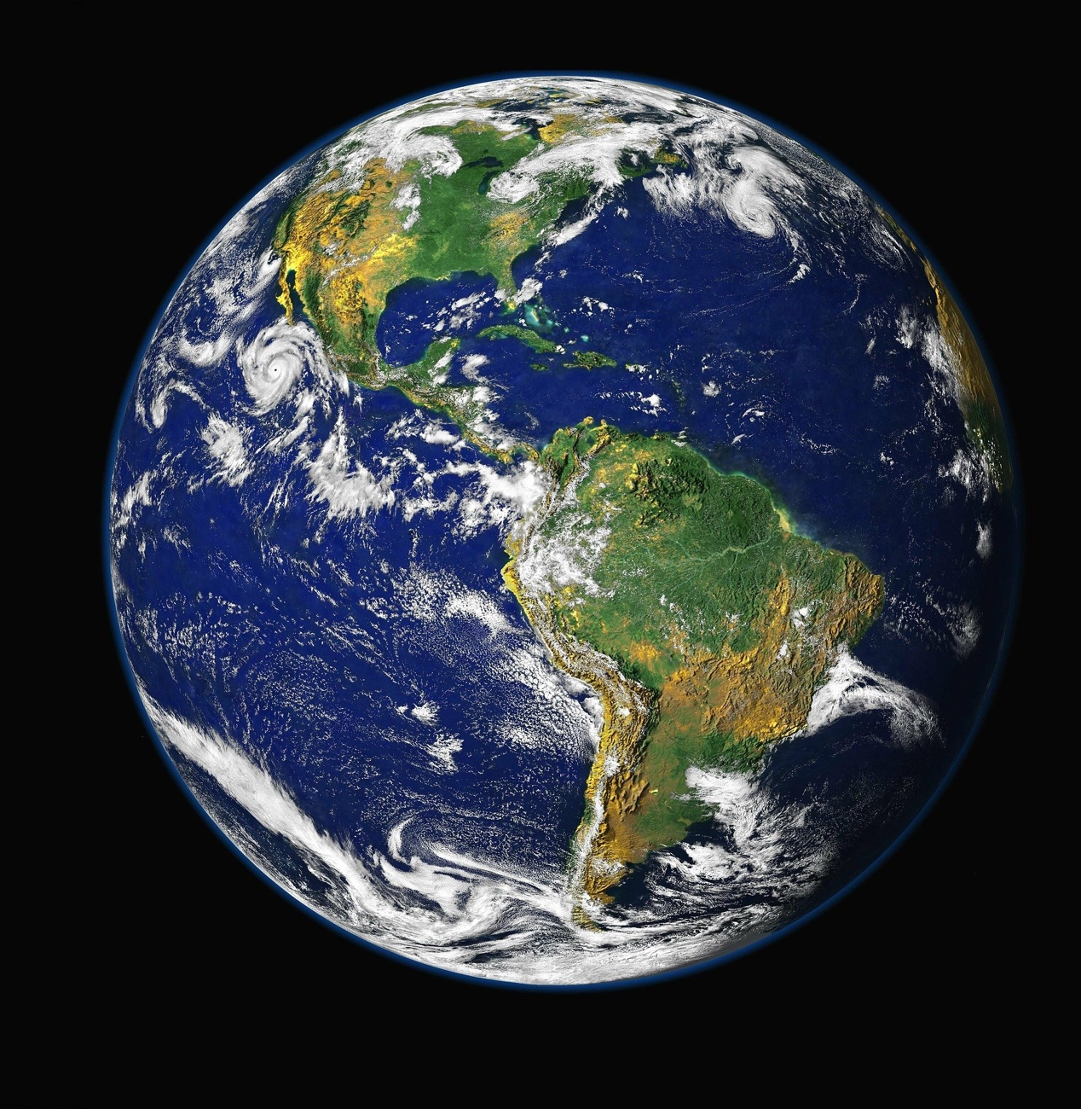
Notes:
So, there’s evidence on the Moon that it has been hot (or impacted) by objects in the Solar System in the past. But can we see the same thing on the Earth?
Take a look at this picture of the Earth – what do you see? How does it differ from the picture of the Moon?
We can see that over 70% of the Earth is covered in water. The white patches swirling across the planet is cloud – so we have weather on the Earth (unlike on the Moon where there is no weather). We have land and deserts and also ice caps too. And if you look closely, you can also see a thin blue fuzzy ring around the Earth – do you know what that is? It’s the atmosphere. This acts as a protective blanket around our planet so that if anything falls from space onto the Earth, it burns up (but maybe not totally) in the atmosphere.
How else does the picture of the Earth differ to the picture of the Moon? The craters are not really visible on this image. So does that mean that we don’t have craters on the Earth, or that we haven’t been hit by anything from space in the past?

Slide 8
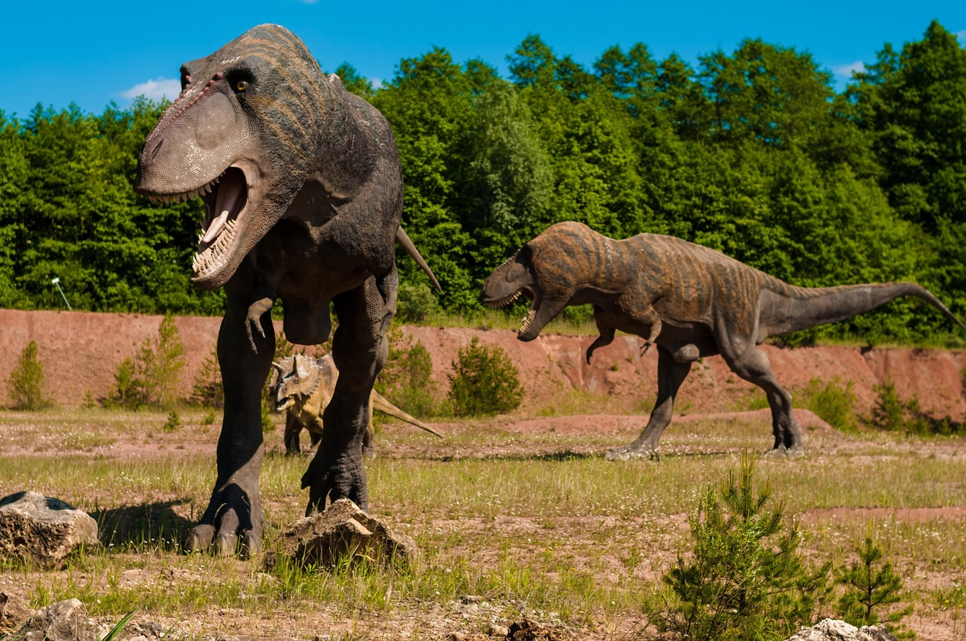
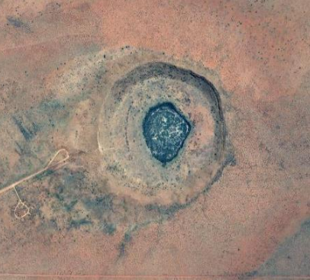

Slide 9
Notes:
Added links to videos to excite them in the topic. Then introduce impact calculator.
https://www.youtube.com/watch?v=dpmXyJrs7iU

Slide 10
Hypothesis generation and design
What parameters should we take into consideration when investigating asteroid/comet collisions?
What happens when a piece of space rock/ice/metal hits the Earth?
How often does this happen?
What affects the size of the crater that these impacts create?
Can we quantify the effects of a giant impact on our planet?
Notes:
In this activity you are exploring the effects of impacts from space. But what do we need to think about to help us investigate this? What questions can you think of that you would like to answer? Take some time to think about possible questions and how this may form a hypothesis.

Slide 11
An example hypothesis should contain a statement and then an explanation.
e.g. Larger sized objects make larger craters. This is because large objects have more mass and therefore have a larger kinetic energy and will therefore make a bigger crater on the Earth. This could be tested by running the impact calculator for a range of sizes, but keeping all other parameters the same. The size of the resulting crater can be measured and my hypothesis tested.

Slide 12
Planning and Investigating
Plan your Investigation:
Think of the question you want to answer - you should have written this down and thought about how you can test this (i.e. what parameters will you keep the same in your simulation and what will you change?)
Perform Investigation:
(http://simulator.down2earth.eu/input.html?lang=en&planet=Earth)
Notes:
For example, if you were investigating how the the size of an impactor affects crater size, you might want to think about the questions below:
a) How would you plan to do this?
b) What parameters would you change and what would you keep the same in the Impact Calculator?
c) For the parameter(s) that you would change, what increments would you use (i.e. in steps of 1, 2, 5, 10 etc.)?
d) What will you record? (hint: think about what you are investigating). Would it be useful to create a table to record your results?
Remember to record the parameters you are changing, what is staying the same, and your results, ready to analyse.

Slide 13
Analysis and Interpretation
Looking at the results in your table, did you notice a pattern emerge? How do your results fit with your hypothesis?
Notes:
In the data view window of the impact calculator, more information is given regarding the energies involved in each simulated impact, aswell as the frequency of such events. There is also information on what would happen on the Earth e.g. tsunamis, fires, destruction etc.
With this in mind – what conclusions can you draw about whether we should be worried about impactors of varying parameters, hitting the Earth – what would be the worst/best for us? Think about this for the next section.

Slide 14
Conclusion
Communicate your results via a poster/presentation to your class
Might need further research e.g. what do scientists propose for how to mitigate any effects of impacts from space?
Notes:
An important part of the scientific process is to communicate your results. Put together a poster or presentation that summarises and displays your methodology, results (including graphs) and conclusions of the activity.
At this point you might want to look at the various ideas that scientists have put forward for how they could mitigate any effects of impacts from space, or prevent them from happening altogether – this can be included in your presentation

Slide 15
Evaluation/Reflection
Comment on how well your investigation went. Think about:
How accurate do you think the software is?
Does it have any limitations?
If you were to repeat this investigation, how would you improve it?

Slide 16
Over to you…

