Slide 1
Authoring environments and digital tools for engagement
Maria Panagopoulou, Physicist
Research and Development Department, Ellinogermaniki Agogi
The LaSciL project has been co-funded with support from the Erasmus+ funding scheme of the European Commission with grant agreement: 2020-1-UK01-KA226-SCH-094579
The project was supported by the Hellenic Foundation for Research and Innovation (H.F.R.I.) under the “3rd Call for Action “Science and Society” “Research, Innovation and Dissemination Hubs”” (Project Number: 02181).

Slide 2
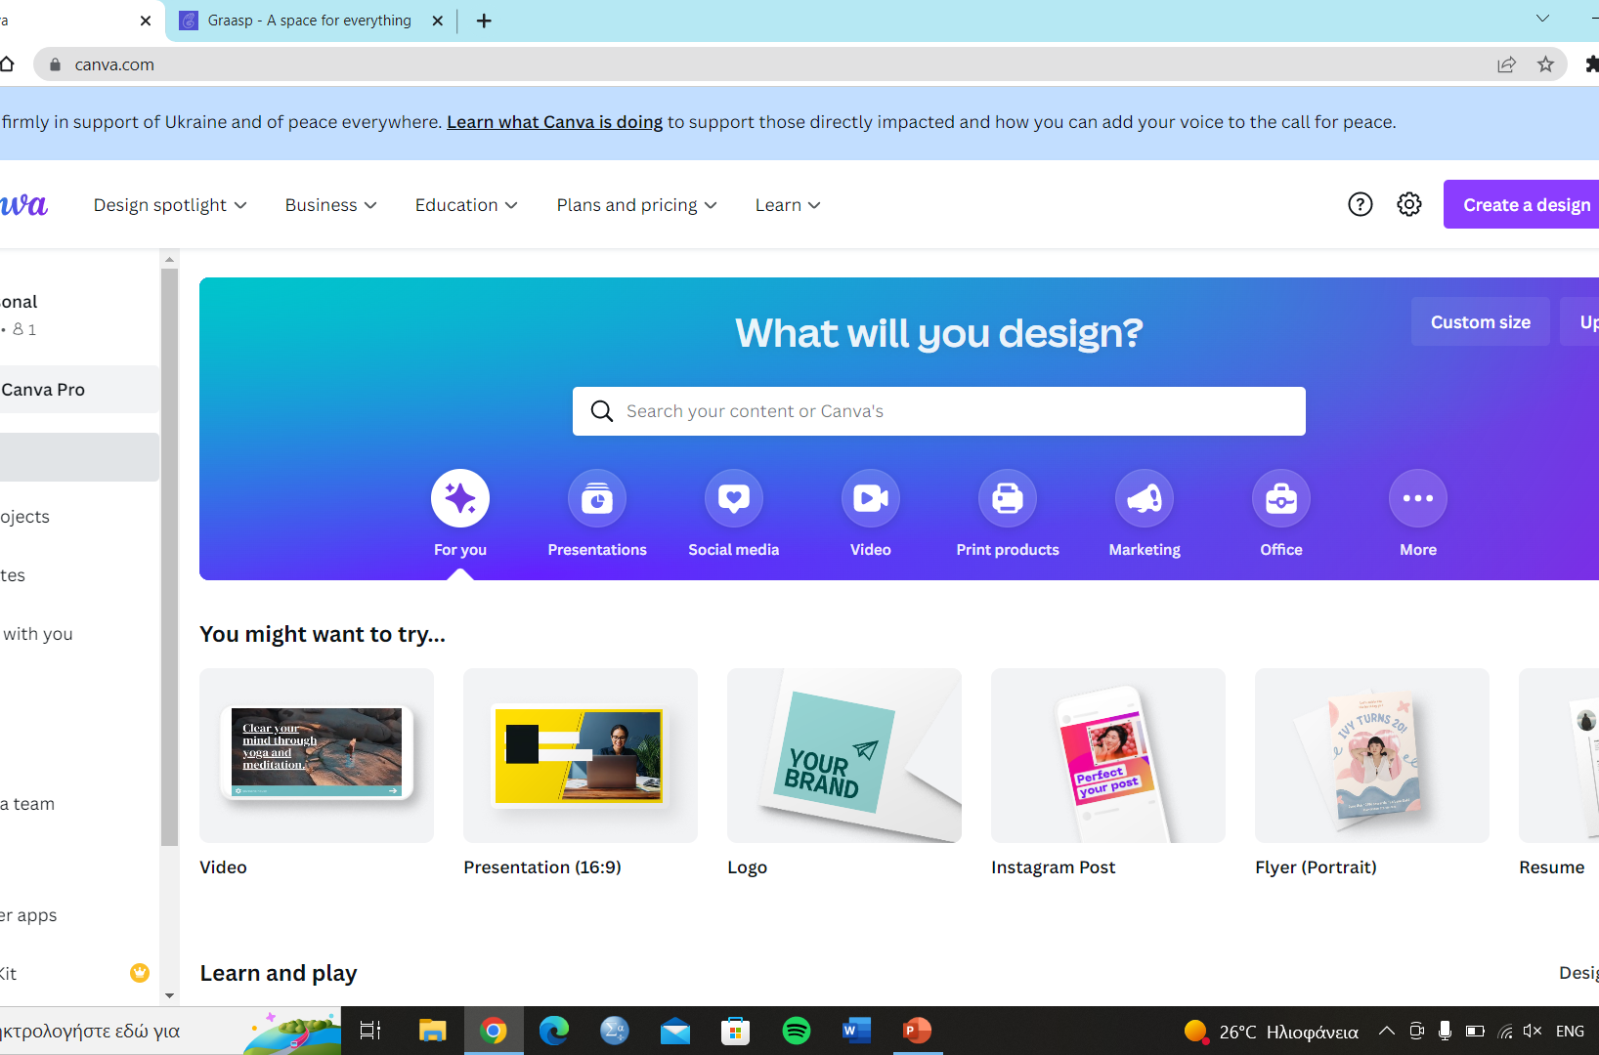
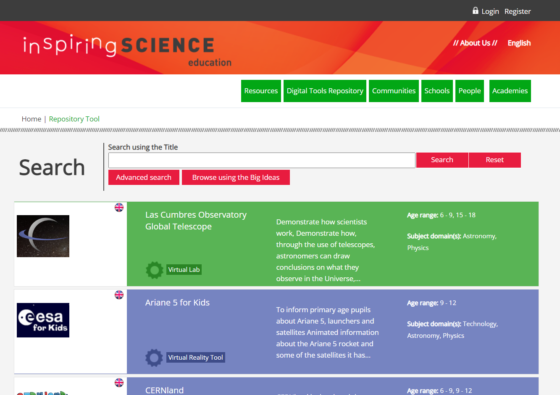
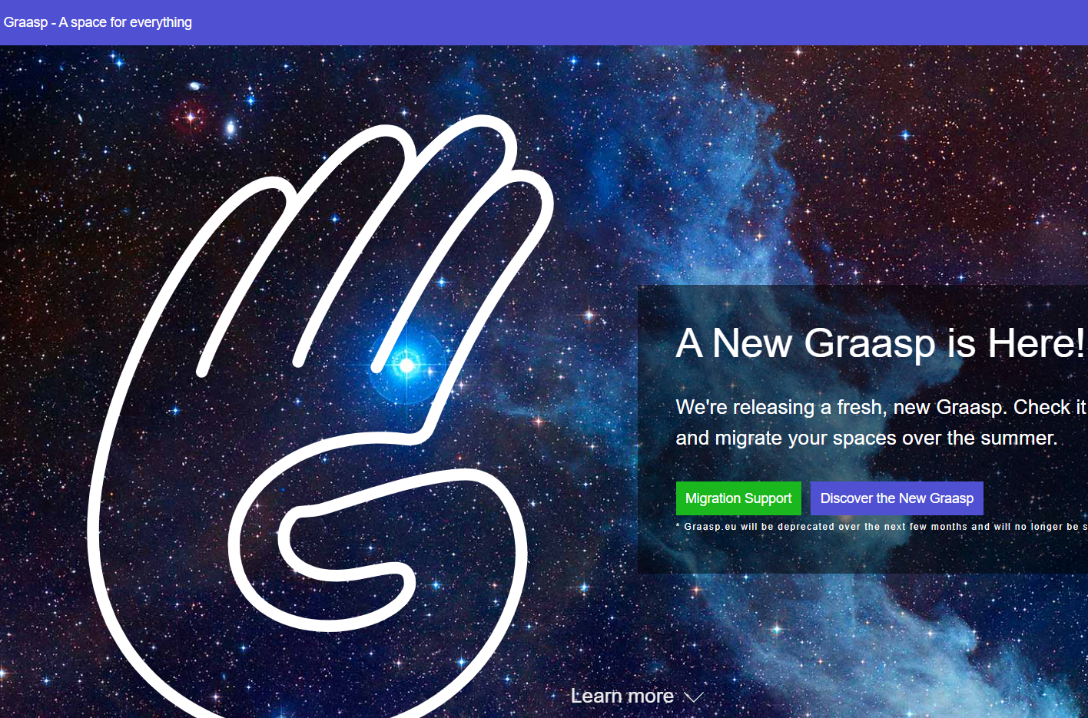
Authoring environments
Canva (https://www.canva.com/)
ISE (https://portal.opendiscoveryspace.eu/en/repository-tool)
Graasp (https://graasp.eu)
Etc.

Slide 3
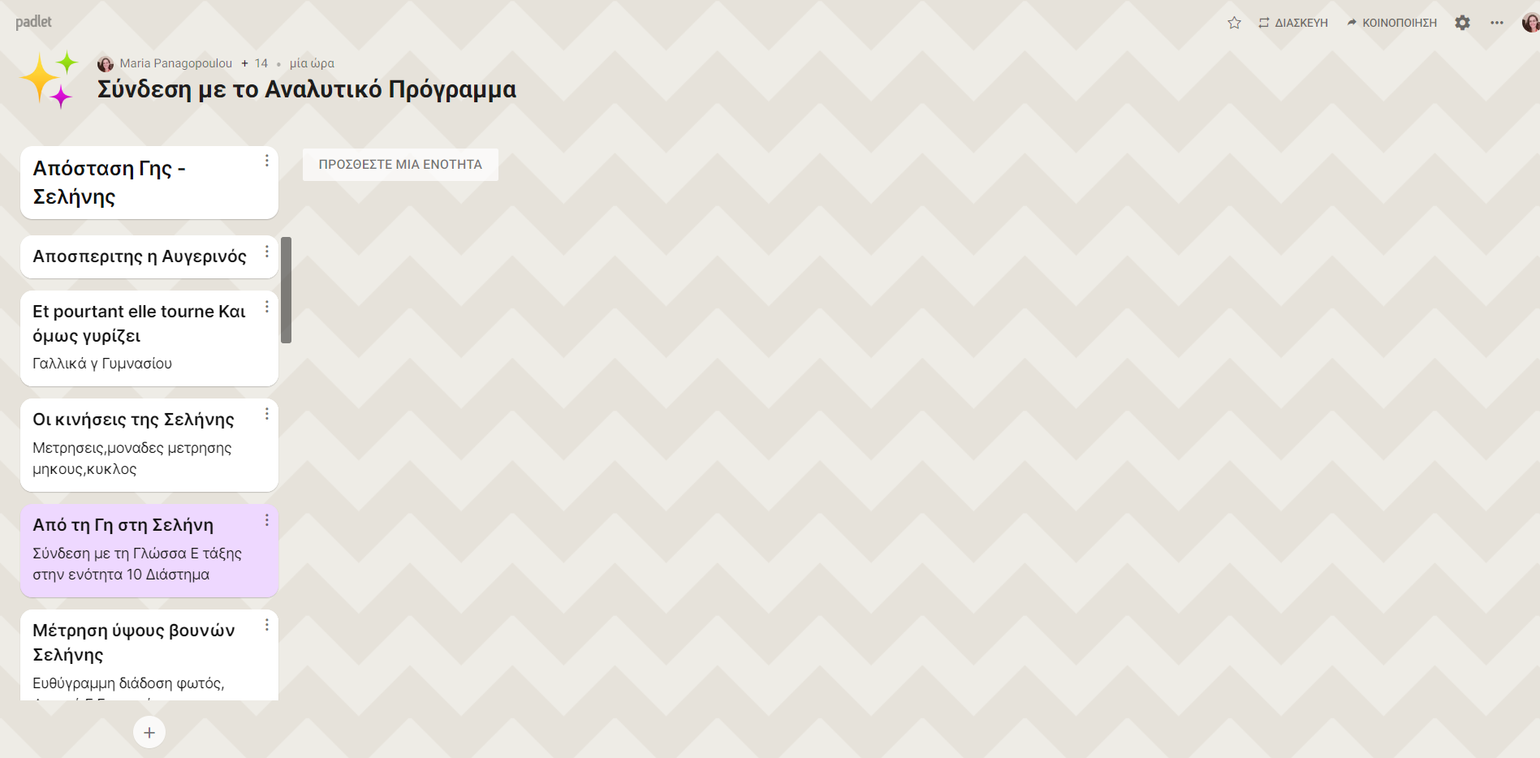
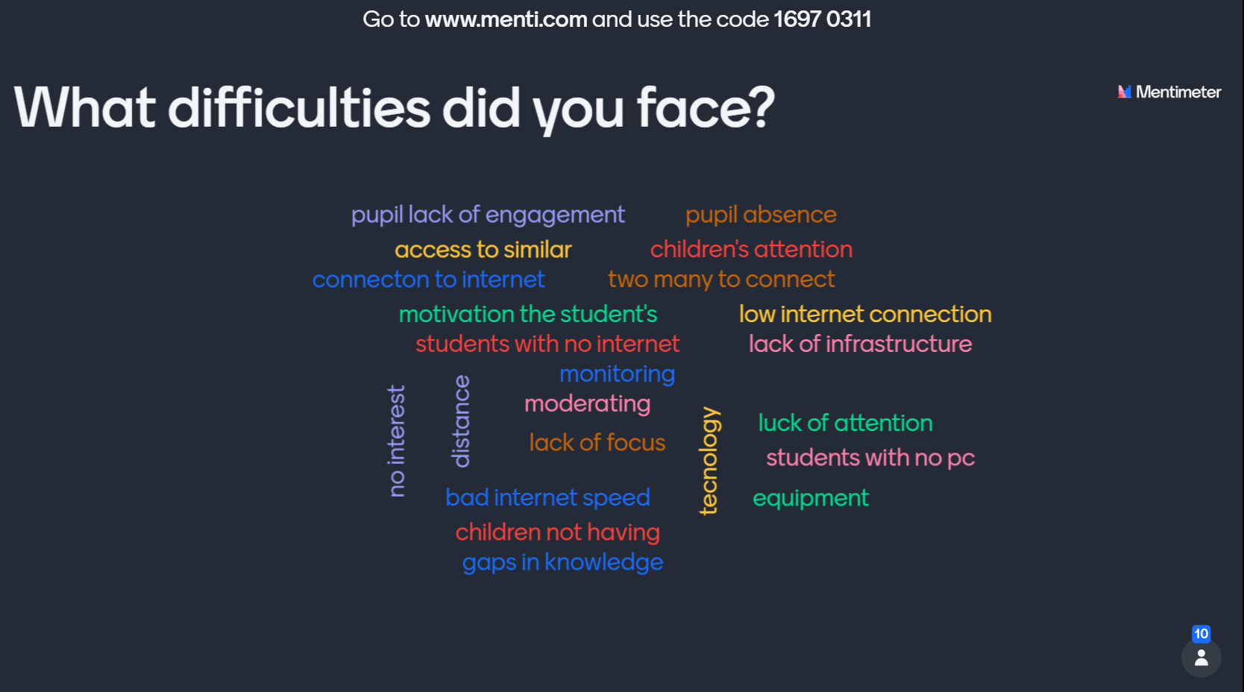
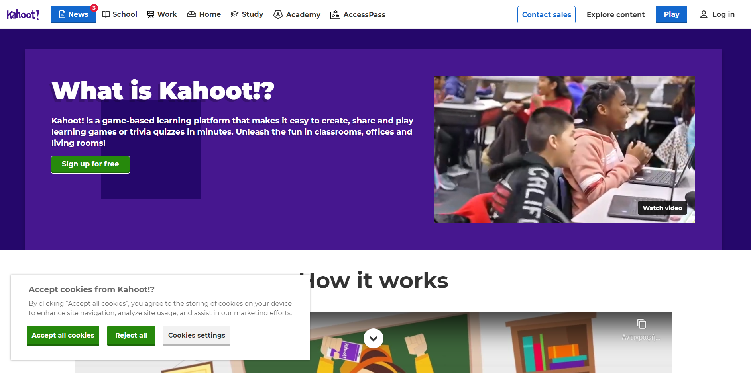
Digital tools for engagement
Padlet (https://el.padlet.com/dashboard)
Mentimeter (https://www.mentimeter.com/)
Kahoot (https://kahoot.com/what-is-kahoot/)
Etc.

