Slide 1

SalsaJ
(Such a Lovely Software for Astronomy)
Practical Session

Slide 2
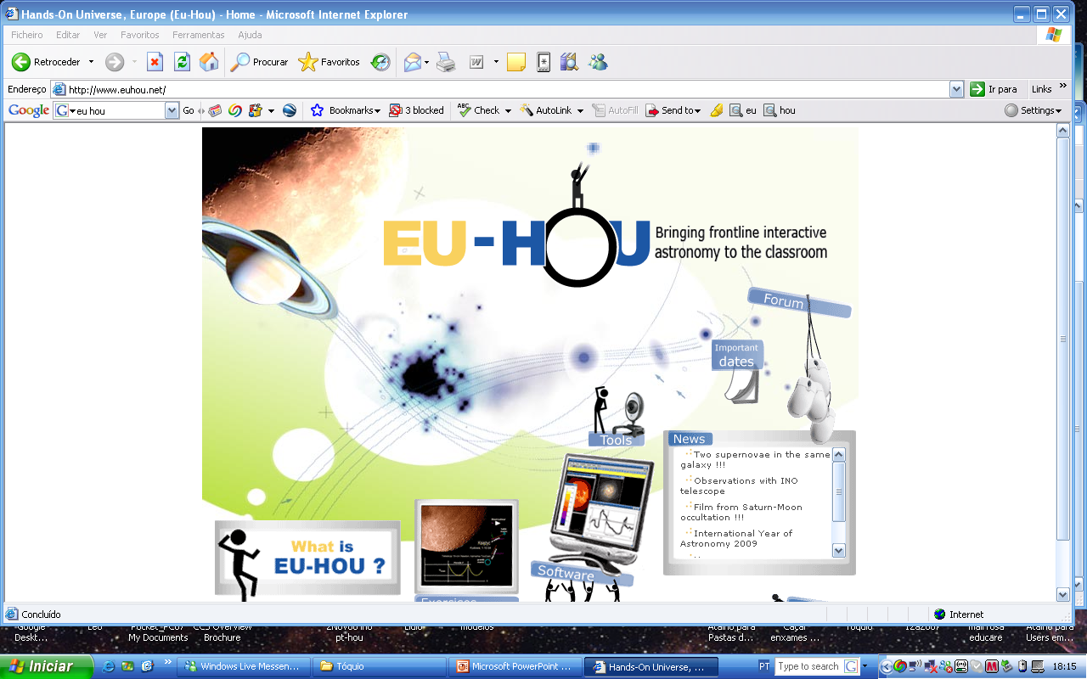
Installation
Open the webpage http://www.euhou.net/ and click on software

Slide 3
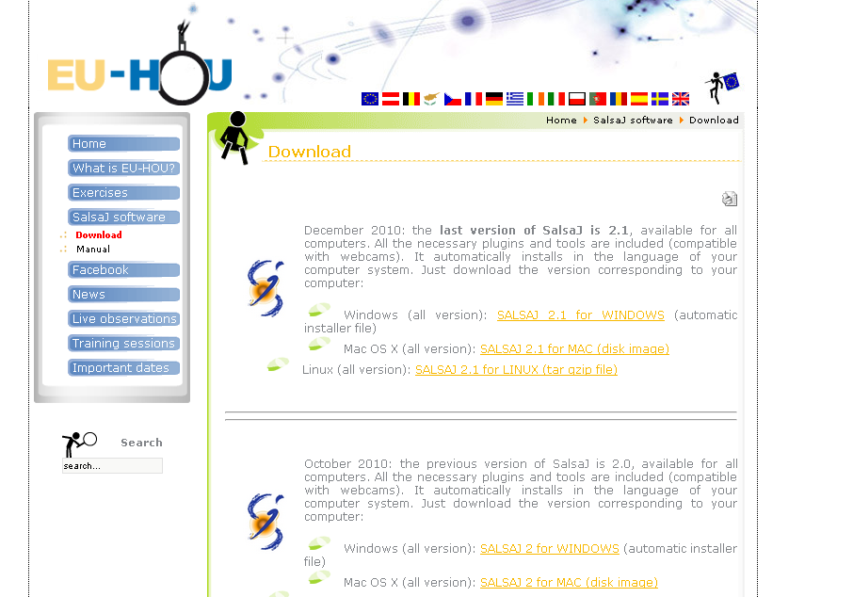
Installation
Choose the adequate version

Slide 4
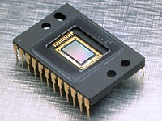
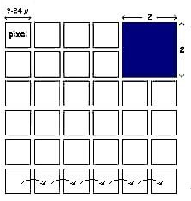
How to measure Light
A CCD (Charge Coupled Device) converts photons in electrons criating na electric current.
CCDs are detectors made our of silicon. Each element is a pixel (picture element).

Slide 5

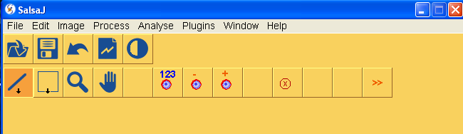
Open the SalsaJ program
After completing the installation click on this icon :

Slide 6
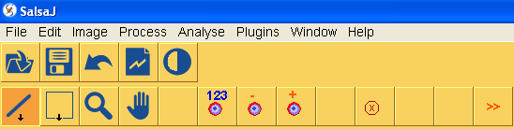
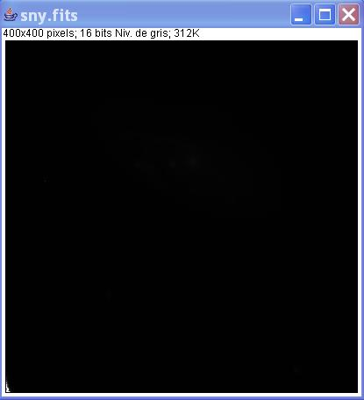
Image brightness
Click on the icon or click on ‘Open’ in the ‘File’ menu
Choose your image, e.g. the image ‘ sny.fts ’:
How to adjust the image brightness?
Notes:
Ouverture d’une image

Slide 7
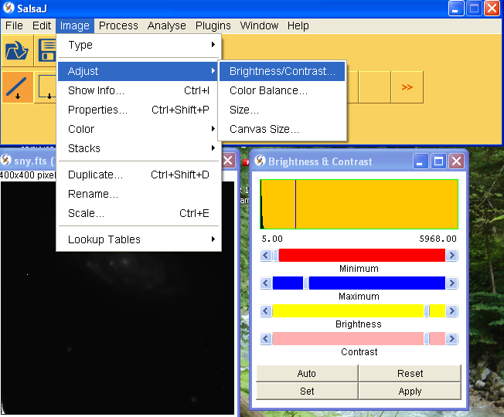
Image brightness
Click on the icon or on ‘Image’ menu of the toolbar, choose “Adjust” and “Brightness/Contrast”
Notes:
Aluster l’mage

Slide 8
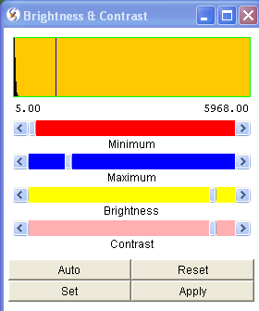
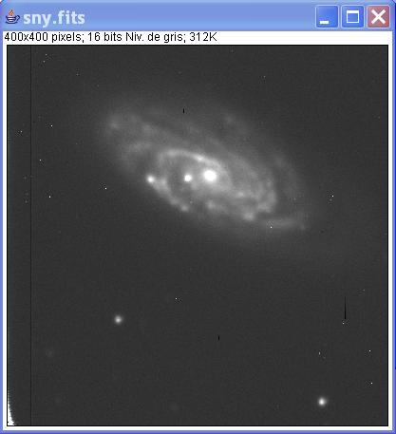
Image brightness
A new window will be displayed
click ‘Auto’
Notes:
Aluster l’mage

Slide 9
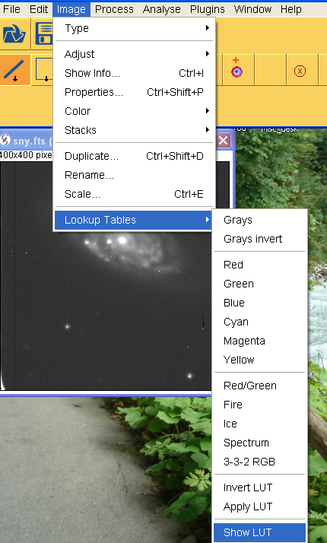
Display the Look-Up Table

Slide 10
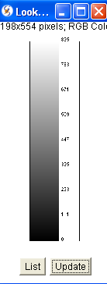
Display the Look-Up Table
The Look-Up Table (LUT) represents the relation between color and intensity of stars.
Select the option ‘Show LUT’ in the ‘Image’ menu.

Slide 11
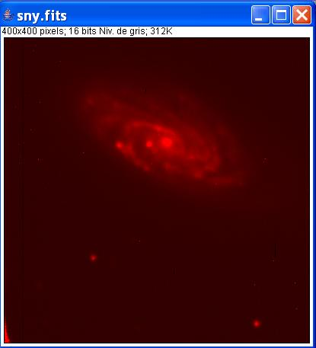
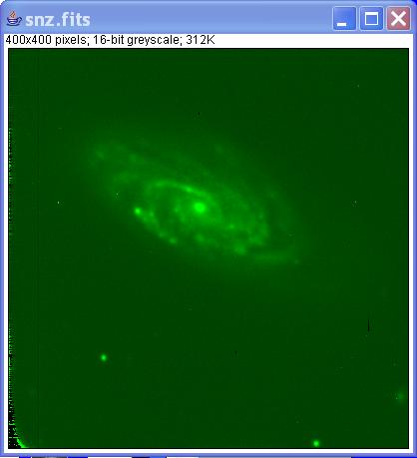
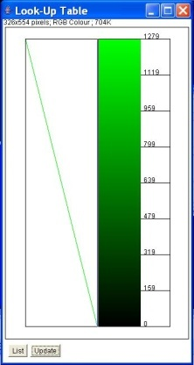
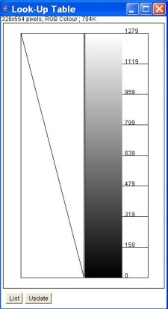
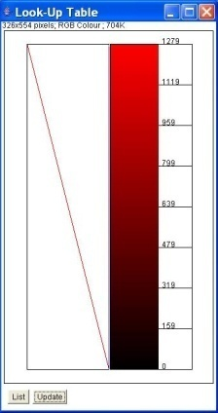
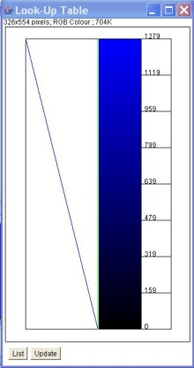
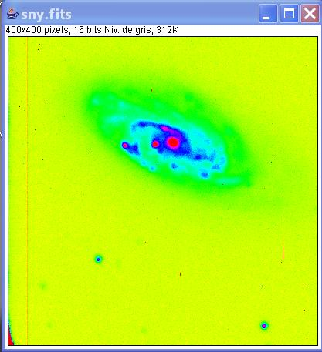
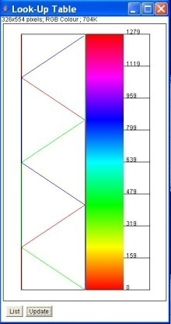
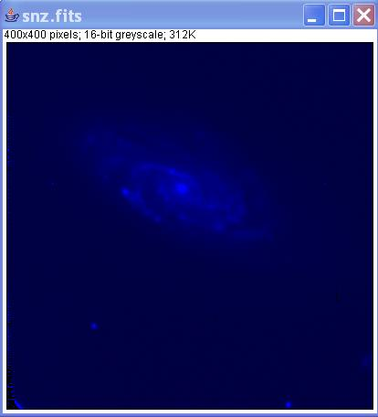
Change the Look-Up Table
Select the option ‘Lookup Tables’ in the ‘Image‘ menu, for example ‘Red’, ‘Green’, ‘Blue’ or multi-color LUT ‘Spectrum’.

Slide 12
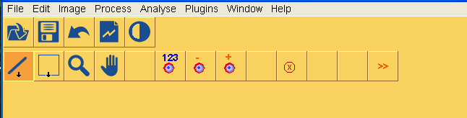
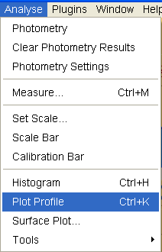
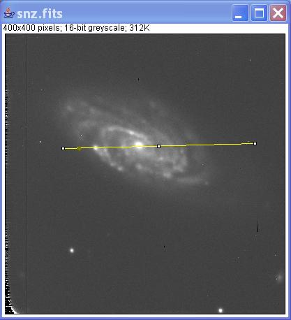
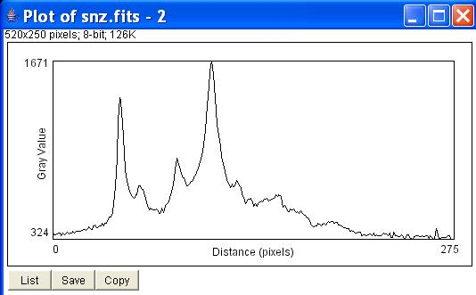
Make a profile
The cursor on the segment displays the actual position on the profile.
Plot a segment on the image to get the corresponding plot profile.

Slide 13
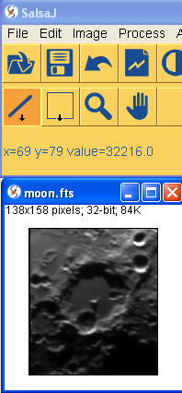
About the Display
  Open a moon image
x and y are the coordinates of the cursor.
In this example x and y are the coordinates of the central spike of the biggest crater.
Value is the number of counts of the pixel which coordinates are displayed (brigthness)

Slide 14
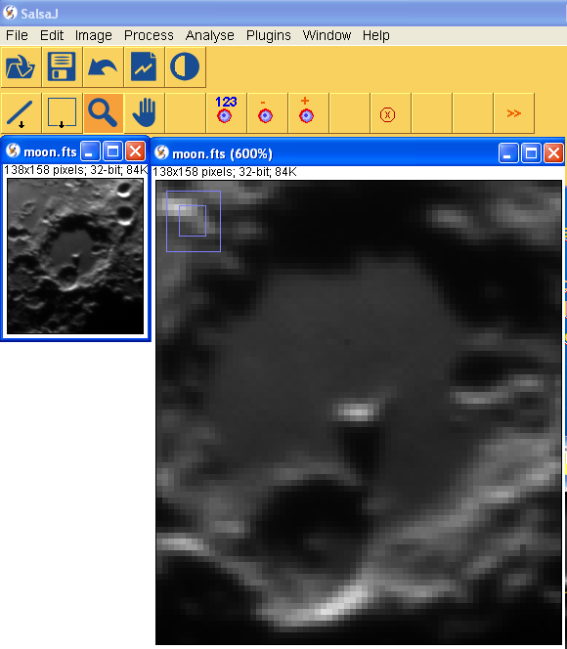
Zoom
In SalsaJ, you can “zoom” the image using the magnifying glass tool in the tool bar.
Just click anywhere in the image and it zoom in.
To “zoom out” hold down Ctrl key while clicking on the image or use the right side or your mouse.

Slide 15
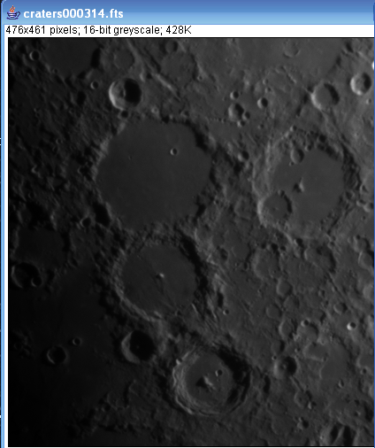
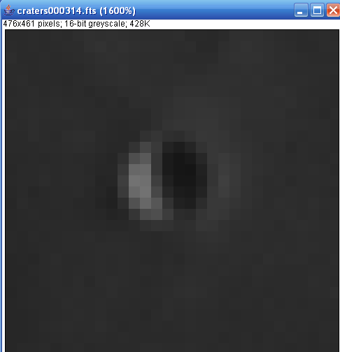
Measuring size with images
Open an image and zoom in
Open an image and zoom in
Each square is a pixel (picture element)

Slide 16
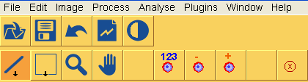
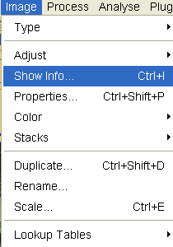
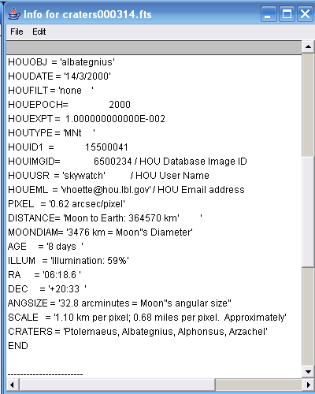
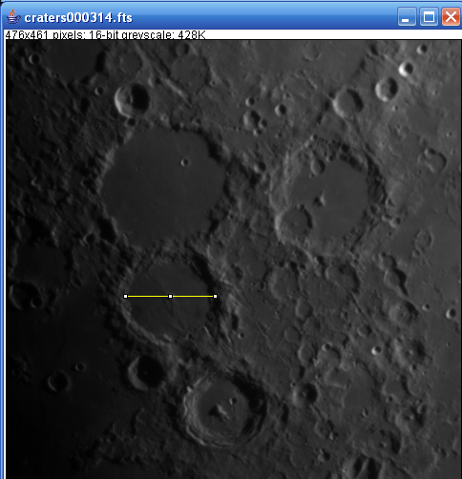
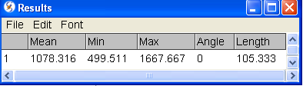
Measuring size with images
Find a crater as big as your town.
Open image
Craters000314.fits
Finnaly in “Analyse” menu choose ‘measure’
diameter/2=radius
radius x 1.1km
Area=πradius²

Slide 17
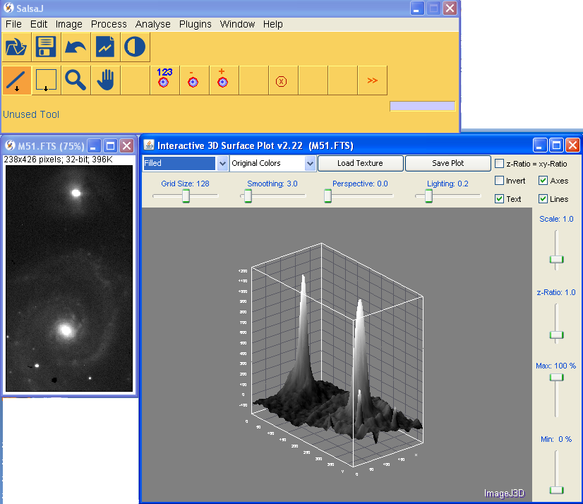
Make a surface plot
Select a region in image “M51.fits” to obtain the correspondent surface plot or just measure the whole image
Open the “Analyze” menu and choose “Surface plot” and accept the default options.

Slide 18
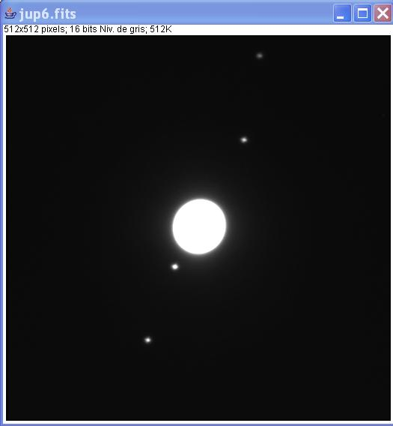
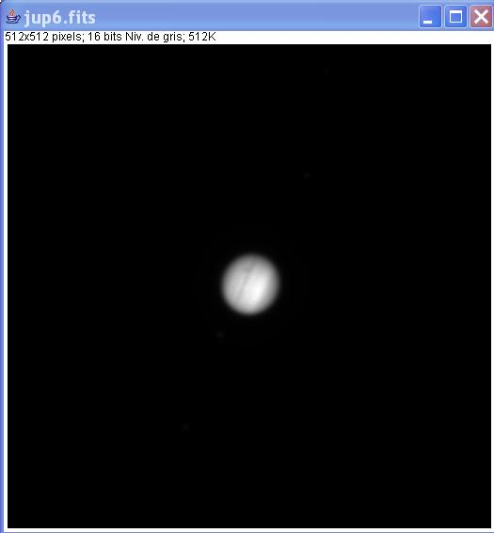
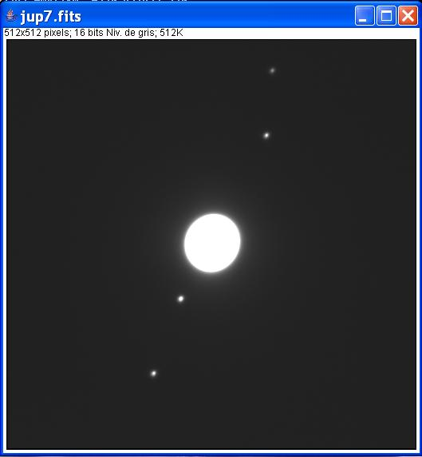
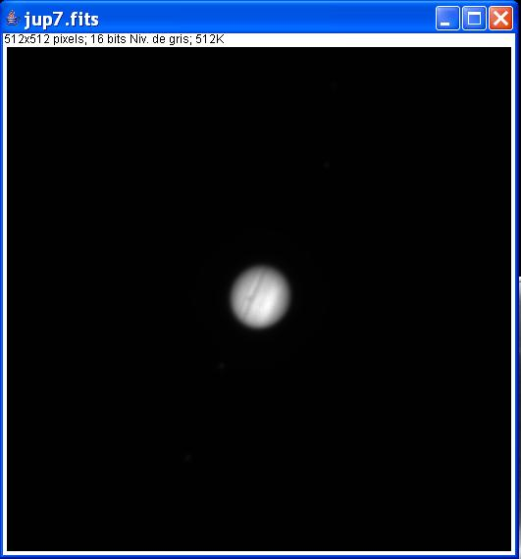
Basic operations
Open two images to make some basic operations :
Adjust images with ‘Auto’

Slide 19
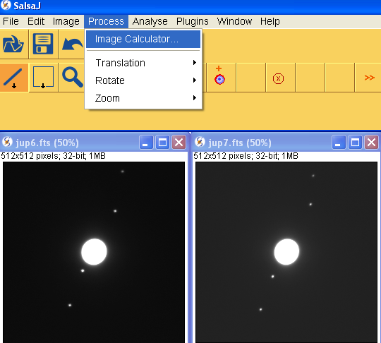
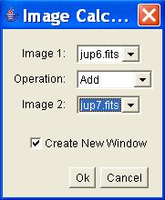
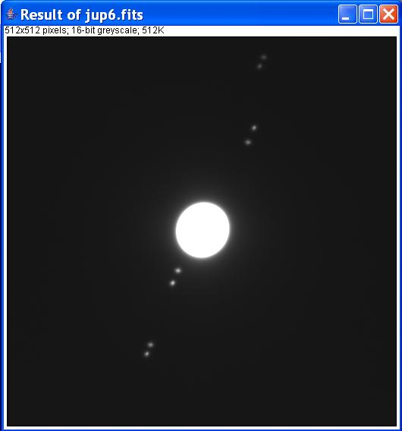
Add two images
To compare two images, it is interesting to add them : Select in the ‘Process’ menu the option ‘Image Calculator…’, the result will be created in a new window.
Choose the images,
the operation and
click ‘OK’

Slide 20
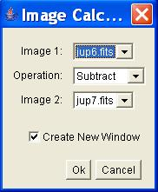
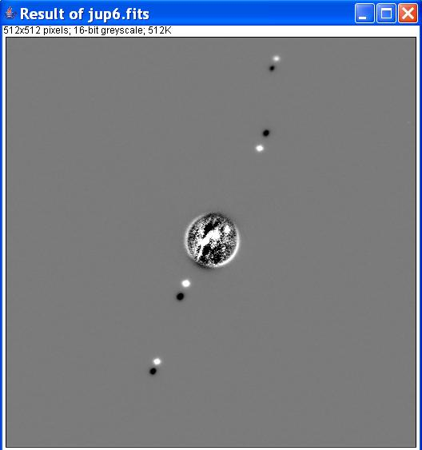
Subtract two images
It is also interesting to subtract them :

Slide 21
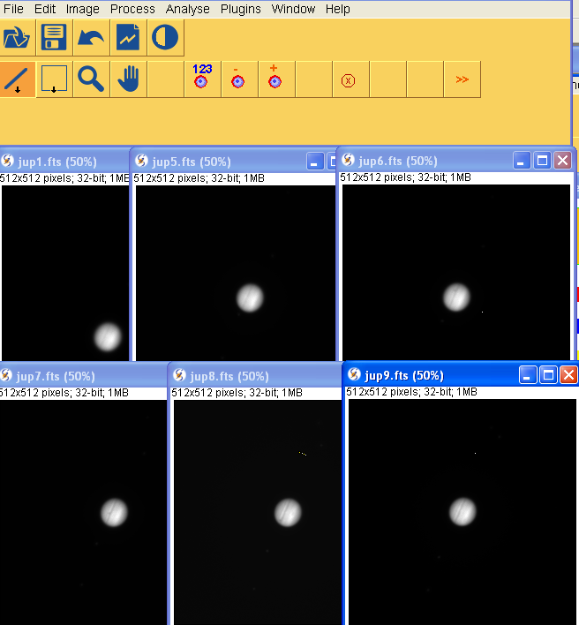
Make a movie
To make a movie open all the images and chose in the Image menu the option Stacks followed by Images to Stack
Open all Jupiter files

Slide 22
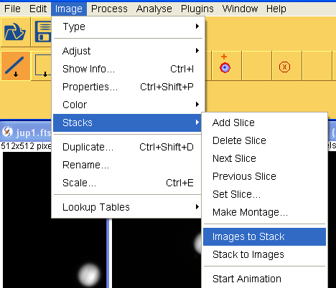
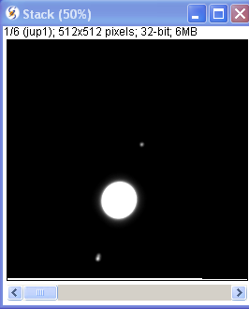
Make a movie
Convert images to stack. Adjust brightness and contrast to be able to see the Moons
Identify the image that doesn’t belong to the sequence
Manually scroll to see the animation. Or Start animation
You can save the stack as and .avi file

Slide 23
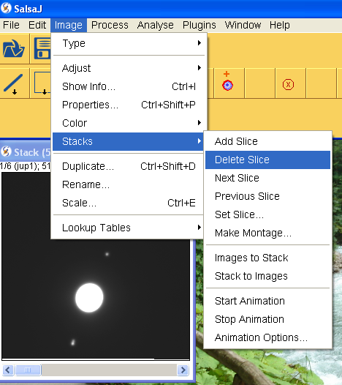
Delete a slice
Manually position in the slice you want to delete

Slide 24
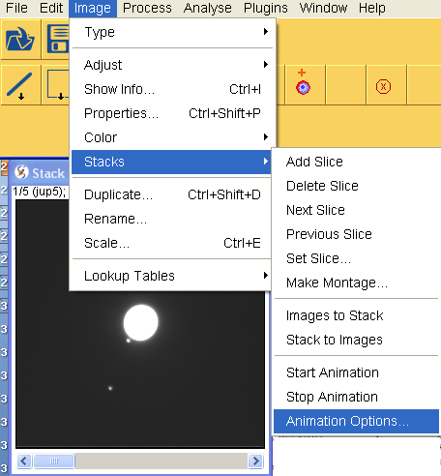
Change the Speed

Slide 25
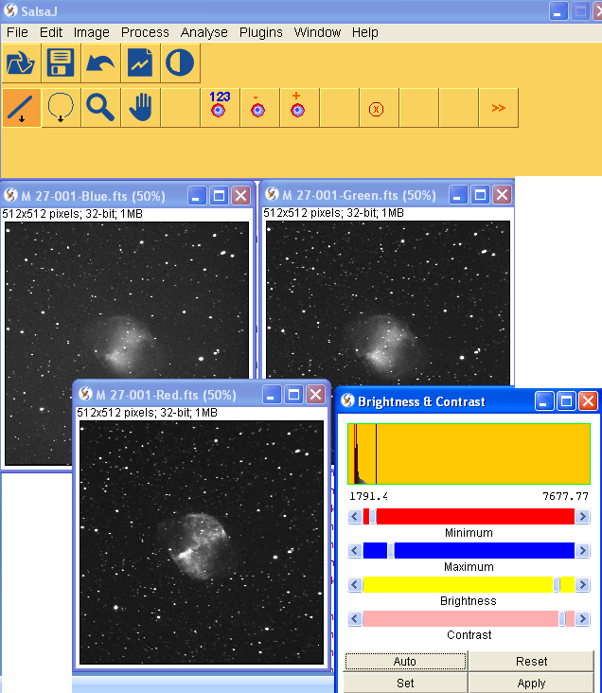
Color Images with SalsaJ
Open M27 blue, green and red images. Remember to adjust brightness and contrast

Slide 26

color images with SalsaJ
After zooming each image to the maximum, verify the coordinates of the pixel with higher counts (value) and use the function ‘translation’ in “Process” menu to correct the shift…if needed … you will not need it in this example.

Slide 27

Color Images with SalsaJ
Build a color image using ‘RGB Merge’ of ‘color’ in “Image” menu.

Slide 28

Color Images with SalsaJ
On the displayed box choose the correspondent image and remember to check the option ‘keep source stacks’.

Slide 29

Color Images with SalsaJ
Usually the filter is not part of the name of the image. To find this check the image info.
Att.: jpeg images don’t have this type of info associated to it. This is a FITS feature
FITS or Flexible Image Transport System is a digital file format used to store, transmit, and manipulate images.

Slide 30

color images with SalsaJ
If the result is good save the image.

Slide 31

Open the ZetaOph images W2, W3 and W4 fromWISE telescope one by one and change the type to 8 bit to reduce the size if needed

Slide 32

Make your color image

Slide 33

Play with the image

Slide 34

Making a movie
Open the images of the Sun

Slide 35

Making a movie

Slide 36

Making a movie
Invert the color of the images

Slide 37


Other alternative to invert the color

Slide 38


Making a movie
Stack -> Convert images to Stack

Slide 39

Making a movie
Change the animation options if needed

Slide 40

Making a movie
Change the animation to 1 frame/seg and start animation

Slide 41

\
Measuring the size of a sunspot
Open Image with sunspots

Slide 42

Measuring the size of a sunspot
Measure the size of the solar disk in pixels

Slide 43

Measuring the size of a sunspot
Zoom in to measure the spot in pixels

Slide 44

COUNTING
SUNSPOTS
WITH PLOT PROFILE

Slide 45


Slide 46

COUNTING
SUNSPOTS
WITH SURFACE PLOT

Slide 47


Slide 48

Measuring the size of a sunspot
Zoom in to measure the spot in pixels.
Select the straight line and draw it across the spot.
Then Select : Analyse and Measure from the menu.
In this case the value is approx. 8 pixels

Slide 49

Measuring the diameter
of the Sun
Select the straight line and draw it across the Sun.
Then Select : Analyse and Measure from the menu.
In this case the value is approx. 486 pixels

Slide 50





Photometry
The photometry tool enables to measure the brightness of stars.
Click on the object you want to measure.
The result appears in the second window.
With the right button of your mouse choose the circle

Slide 51

Photometry
You can make adjustments in the photometry parameters

Slide 52
Measureing the size of a sunspot
Knowing that the sun has a diameter of approx. 690 000 km you can calculate the size of the spot. In this case
Solar disk ~ 690.000 km <-- > 400,39 pixels
Sunspot x < -- > 5 pixels
Sunspot size ~ 8 616 km

