Slide 1
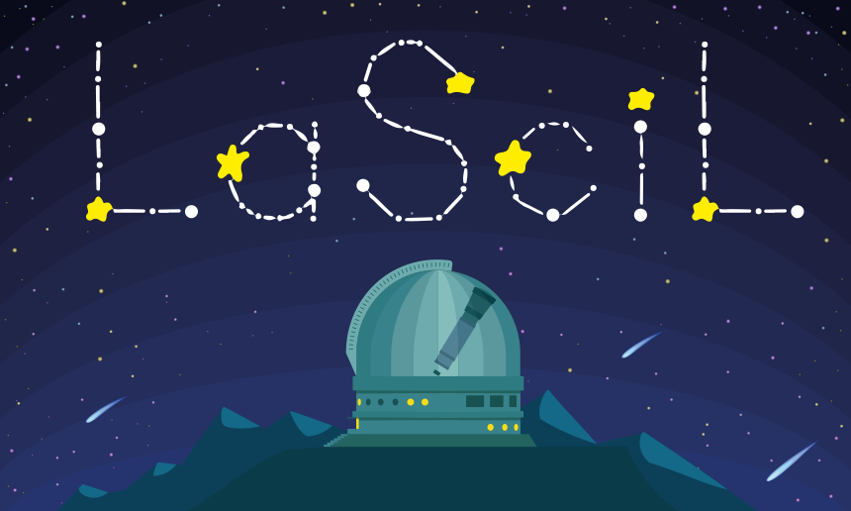
LaSciL Demonstrators Today, I am William Herschel!
Gustavo Rojas NUCLIO
LaSciL Summer School, July 3-8 2022

Slide 2
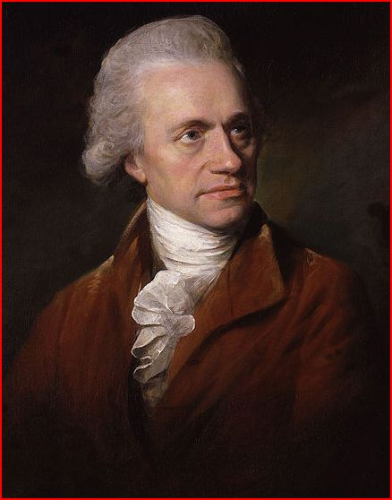
Summary
Students explore the concepts of triangulation, parallax and angular displacement and how one can use them to derive distances to astronomical objects. Then, they simulate the historical observations of William Herschel that led to the discovery of Uranus, and use the results to derive its orbital distance and period.

Slide 3
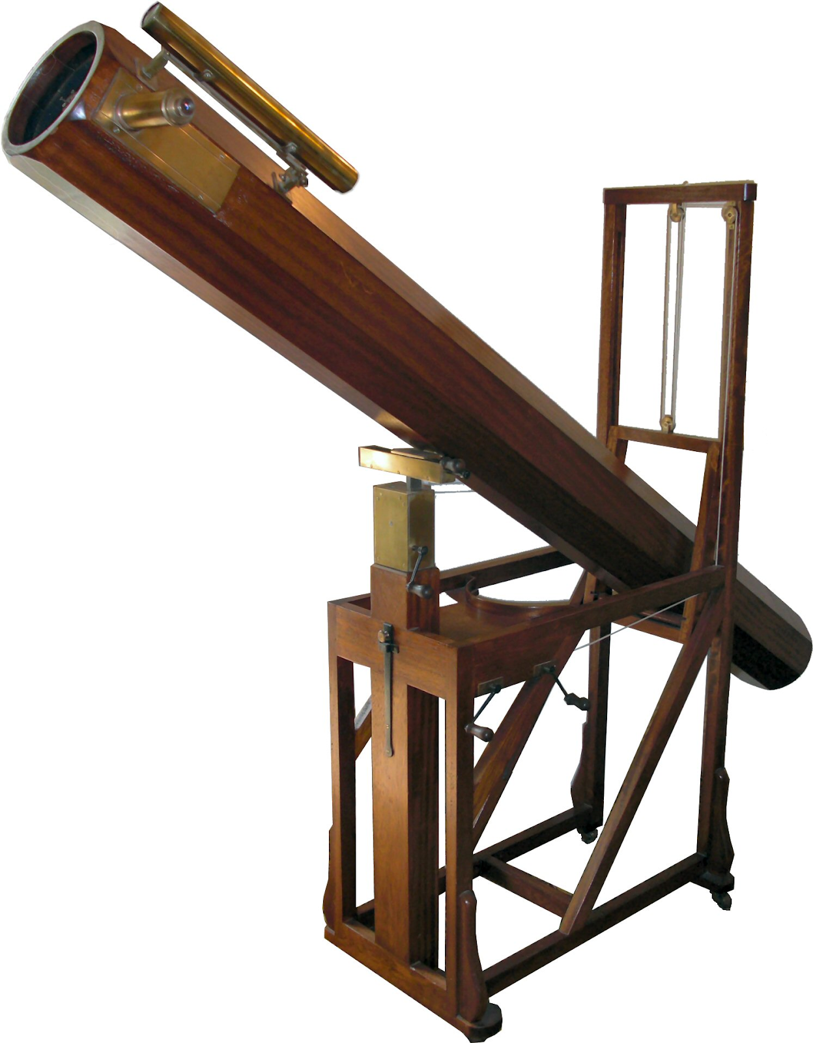
Background
The year was 1781. William Herschel, a professional musician who decided to become an astronomer at age 35, was scouting the heavens in the Taurus constellation region with his home-built 15-cm telescope.
On March 13, he accidentally found an uncommonly bright object that had a well-defined disk, unlike stars, and moved slowly from one night to another against the background stars.

Slide 4
Background
An account of a comet’ (1781)

Slide 5
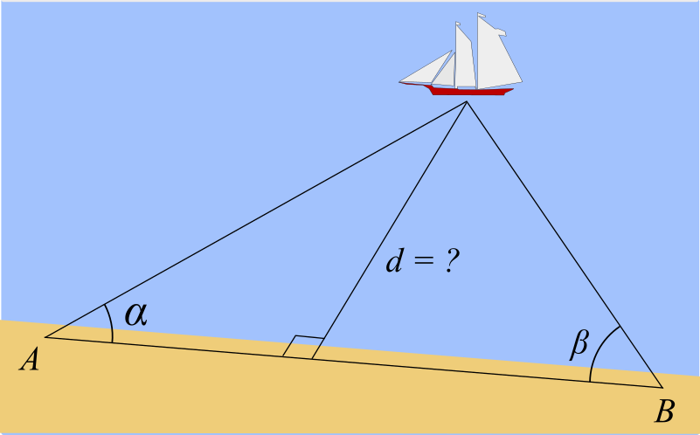
Orienting Questions
How we measure the distance to distant objects?

Slide 6
Activity Suggestion
Measuring the height of a tree

Slide 7
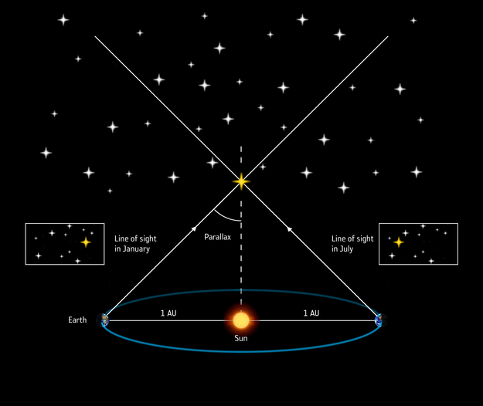
Orienting Questions
How we measure the distance to the stars?

Slide 8
Hypothesis Generation and Design
How can we differentiate planets from stars?

Slide 9
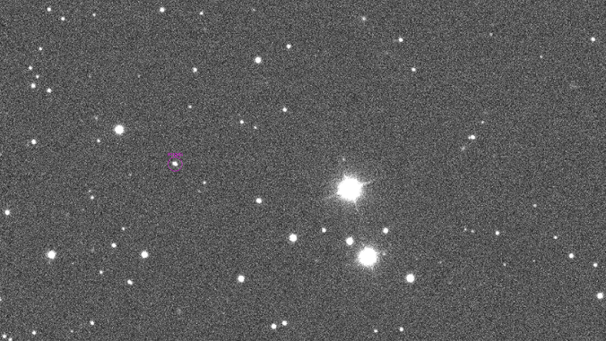
Hypothesis Generation and Design
What factor is the most relevant to the magnitude of apparent motion?

Slide 10
Kepler’s Law

Slide 11
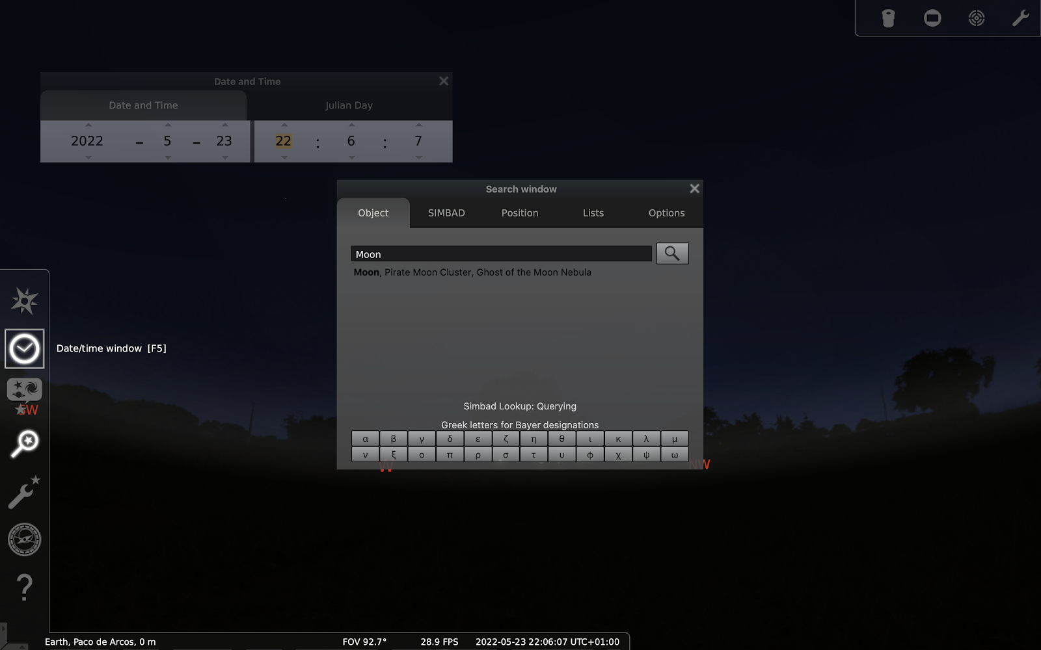
Design/Model
Use Stellarium to simulate the Moon and Jupiter’s apparent motion.

Slide 12
Plan your investigation
Astronomers do not need to observe a full revolution of a celestial object around the Sun to calculate its orbital period.
How can you use Stellarium to simulate observation arcs of Jupiter and Saturn?
Estimate these planets’ orbital period and distance.

Slide 13
Comparing the results
Planet | Orbital Period (years) | Orbital Radius (AU)
Jupiter | 12 | 5.2
Saturn | 29 | 9.5

Slide 14
Perform Investigation!
Use the method to recreate Herschel’s discovery and estimate Uranus’ orbital period and distance.
Location: Bath, England Date: March 13, 1781

Slide 15
Analysis & Interpretation
Discuss with your colleagues how many nights Herschel would need to observe that sky region to perceive Uranus’ apparent motion.
Compare your estimates with the actual values.

Slide 16
Conclude and communicate!

Slide 17
Thank you for your attention!
For further details :
www.lascil.eu
@lascil.project
lascil@nuclio.org

