Slide 1
Welcoming and presentation of the organisers
Panagiotis Evangelopoulos
Astrophysicist, Public outreach of IA - FORTH
The project was supported by the Hellenic Foundation for Research and Innovation (H.F.R.I.) under the “3rd Call for Action “Science and Society” “Research, Innovation and Dissemination Hubs”” (Project Number: 02181).
Notes:
Very warm greetings to all the participants and the audience here for this seminar. Good Afternoon. I am more than grateful to stand here and welcome you all to this Summer school of our two projects (LaSciL and d-space). Today I, Panagiotis Evangelopoulos shall be walking you through the seminar. Before I invite the orators, I would like to introduce you to the proceeding of the event.
Firstly, I would like to thank the director of Institute of Astrophysics for helping at the whole process of organizing this summer school for the benefit of the educators and teachers. With your continuous efforts and will to do something for educational society and move up towards a successful and fulfilling world, we all had the opportunity to be present here, together. This face-to-face event will not only guide us all but also educate us regarding a variety of this pertaining to enhance teachers’ digital competence by supporting high-quality science teaching in the classroom from a distance as well as introducing Astronomy to the classroom in the context of the curriculum. You learn from us and we learn from you. Don’t forget that! We all are surely grateful for this prospect.
On behalf of the Institute of Astrophysics of FORTH, I would like to welcome you all and inform you that the summer school will completely enlighten you pertaining to the introduction of Astronomy to the classroom. All the vital aspects regarding the topic will be conveyed to you all. You shall wrap up the week with zero doubts as our educators will ensure that they answer all your queries.

Slide 5
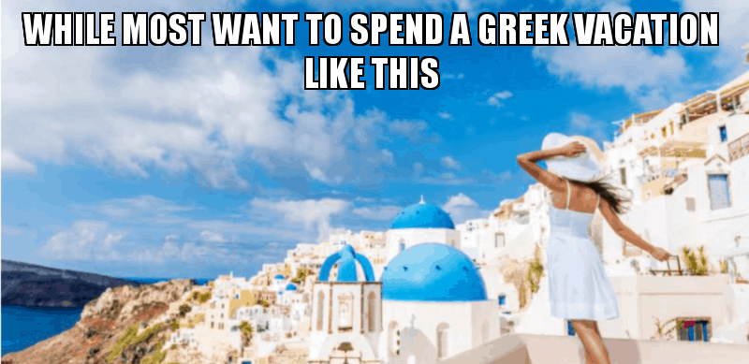

Slide 6
I LIVE THE MYTH IN GREECE LIKE THIS

Slide 7
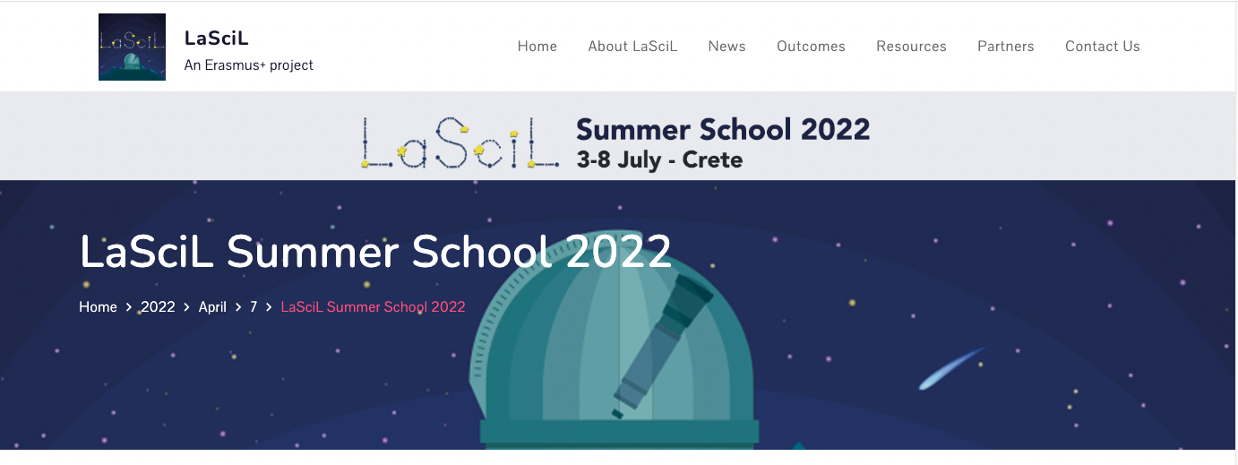

Slide 8
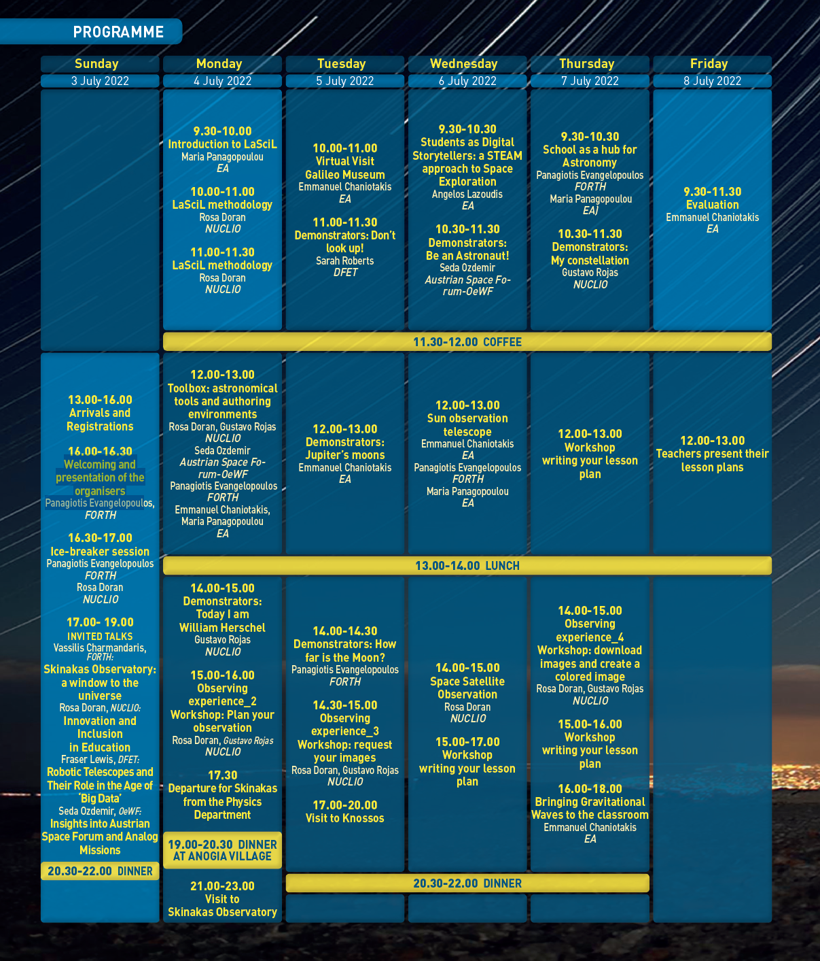
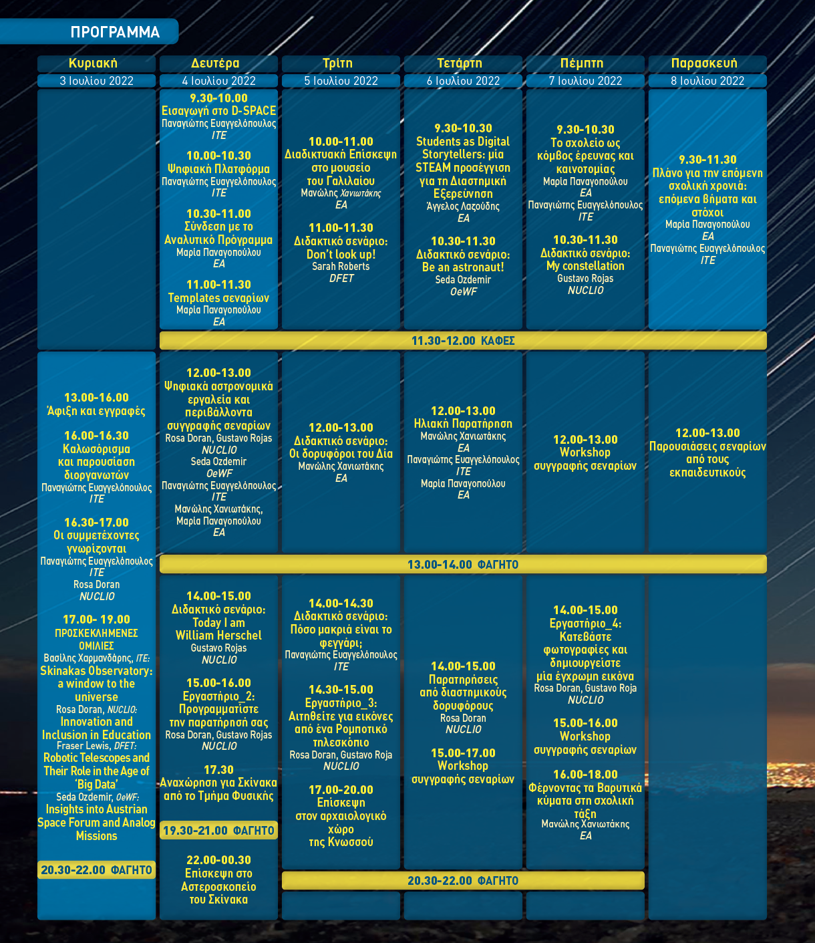

Slide 9
NUCLIO is a non-governmental organisation that trains teachers in the use of new technologies, innovative methodologies, promotion of real research in the classroom where students are introduced to the scientific methods using robotic telescopes, data mining, and other advanced tools for science learning. NUCLIO is the coordinator of one of the largest astronomy education efforts in the world, the Galileo Teacher Training Program.

Slide 10
Parent organization -> the Dill Faulkes Educational Trust (DFET), Faulkes Telescope Project lead the EU Erasmus+ project called LaSciL
DFET is a charitable company limited by guarantee, founded by Dr M C (Dill) Faulkes to support projects inspiring young people through science and maths. DFET established the Faulkes Telescope Project (FTP) allowing schools to take part in real science through free-of-charge access to robotic telescopes. Since 2005, FTP has been an education partner of Las Cumbres Observatory (LCO), which operates a worldwide network of 21 telescopes, including the 2-m Faulkes Telescopes (in Hawaii and Australia). These research-grade facilities are available in both real-time and queue-scheduled mode. Follow-up observations are often made of new and/or interesting targets. Teachers and students participate fully in the scientific process; from target selection to observing to data analysis.

Slide 11
The Austrian Space Forum is one of the leading institutions conducting Mars analog missions, thus paving the way for the future human exploration of the Red Planet. Experts from a broad variety of disciplines as well as the spaceflight sector constitute the core of the OeWF’s continued endeavor.
The OeWF in collaboration with national and international institutions from science and industry is working at the cutting edge of scientific research. In addition the OeWF also contributes significantly to inspiring and educating young people in the sectors of science, technology and engineering.

Slide 12
Ellinogermaniki Agogi is one of the most innovative schools in Europe with 2300 students (ages 5 to 18) and 250 teachers. The school continuously modernizes STEM education by promoting and creating learning environments for students and offering numerous opportunities for teachers’ professional development enabling them to thrive in the landscape of unprecedented challenges and opportunities in the 21st century.

Slide 14
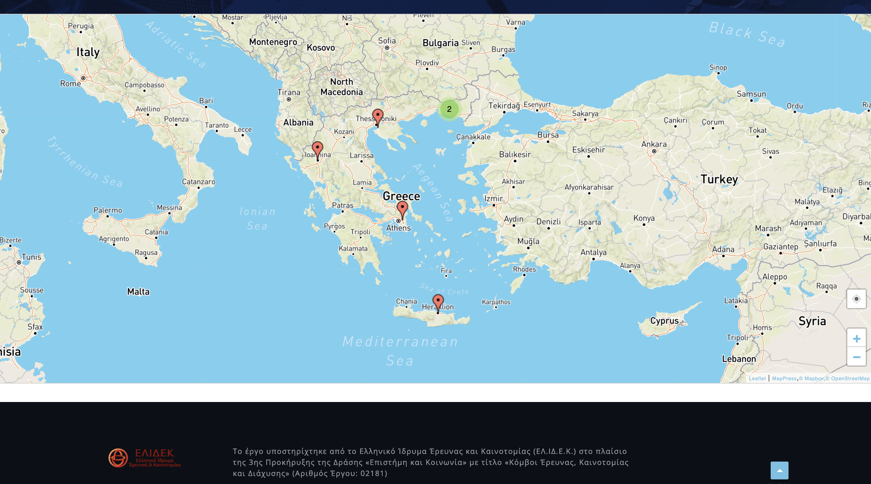

Slide 15
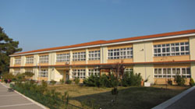
Junior high School of Intercultural Education of Sapes
In 1996 it was classified as Intercultural
Its main operating purpose is to create common student identities with rich material from the roots of the residents (linguistic, religious, cultural).
It has participated in many National and European Projects. Last year many school activity projects are implemented, the 2 projects are related to astronomy. For the school year 2019-2020 they have already taken place astronomical events, for the "World Astronomy Week" Oct 2019 and the ”Transit of Mercury" Nov 2019.

Slide 16
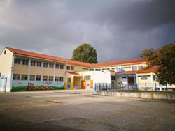
9th Primary School of Komotini
The 9th Primary School was founded in 1977 and is located in the eastern part of city ​​of Komotini.
A "Planetarium" was permanently set up at the school, which made by children. In the Planetarium there are presentations for students of the school as well and to other interested schools in the Prefecture of Rodopi. In this school there is an Diagnosis Committee of learning difficulties. It has also participated in ROLE MODELS-Erasmus/IKY(Foundation for State scholarships) also during the present school year at Erasmus+Healthy.
MissionX Train Like an Astronaut

Slide 17
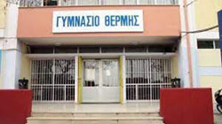
1st junior high school of Thermi
It is one of the largest schools in Secondary Education of Eastern Thessaloniki
The school leadership and the person in charge of the Integration Departments promote and propose to the Teachers' Association a broader teaching framework, which is based on discovery-inquiry (IBSE) method and project-based learning (PBL) so that, on the one hand, promotes inclusive STEM education and, on the other hand, to 'open' our school to society, building a safe learning environment of tolerance, acceptance and creation

Slide 18
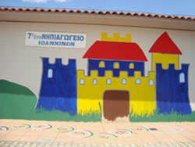
7th Kindergarten of Ioannina
It has been chosen to represent Epirus several times on the Board of Representatives of Helmepa Junior (2015, 2017 and 2019) and also has won the Silver Panda three times from WWF for the project "Better Life at School" (2015, 2016, 2017) and twice the Silver Award at the Education Leadership Awards (2017 and 2018). In 2018 was awarded the GOLD Award in the same competition in the category "Educational robotics, STEAM Education and the digital world". It implements innovative, among many schools, educational projects of E‐Twinning and Erasmus+ partnerships, in which it has been honored many times with a European and national label quality.

Slide 19
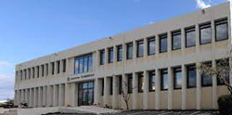
The "PAGRETION" School was founded in 1963 in a spirit of creation and renewal. "Education must escape from conservatism and enter more into the knowledge of life and the struggle for a proper freedom of the spirit", wrote the first historical brochure of the school at the time.
The students of the school participate and excel in many scientific and artistic competitions
STEM Education
Participation in pioneering research programs - Regular cooperation with research institutions and leading companies in the field of new technologies for education

Slide 20
The Institute of Astrophysics – FORTH in the island of Crete, Greece, manages Skinakas Observatory and its prime goals are: to perform cutting edge research in select areas of theoretical and observational astrophysics, to train students and early stage researchers in acquiring technical and analytical skills so as to address outstanding open questions in astrophysics and beyond, and to engage with the local community in educational and public outreach activities.

Slide 21
These schools are so great thanks to the teachers who are the soul of the projects as well as the bridge between us and the most valuable cell of society, the students!

Slide 22
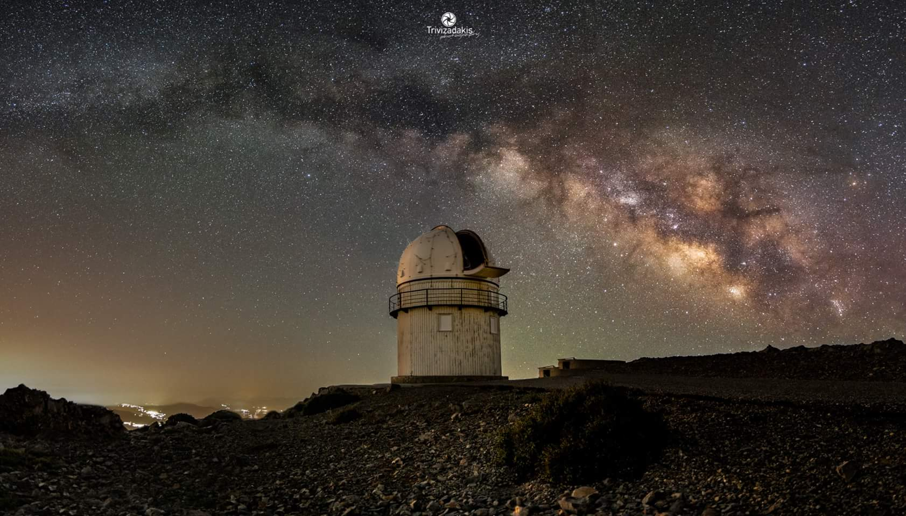
Email: pevangelop@ia.forth.gr , info@ia.forth.gr
Thank you!
The project was supported by the Hellenic Foundation for Research and Innovation (H.F.R.I.) under the “3rd Call for Action “Science and Society” “Research, Innovation and Dissemination Hubs”” (Project Number: 02181).

