Slide 1


Designing Effective Outreach Programmes
Mick Storr
CERN and University of Birmingham
Accelerating Science and Innovation
Notes:
1

Slide 2
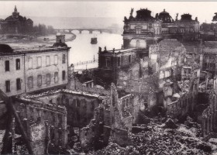
1945 l’Europe après deux guerres dévastatrices
en moins de 30 ans
Les chercheurs quittent l’Europe pour USA

Slide 3
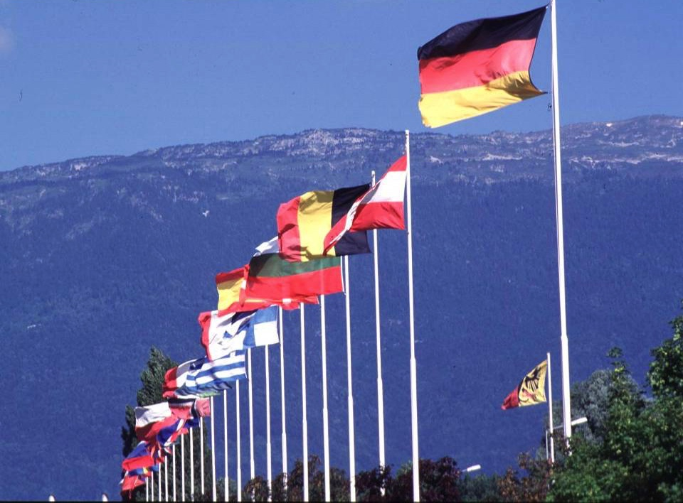

CERN: founded in 1954: 12 European States
“Science for Peace”
Today: 23 Member States
~ 2’500 staff
~ 1’800 other paid personnel
~ 13’000 scientific users
Budget (2019) ~ 1’300 MCHF
Member States: Austria, Belgium, Bulgaria, Czech Republic, Denmark, Finland, France, Germany, Greece, Hungary, Israel, Italy, Netherlands, Norway, Poland, Portugal, Romania, Serbia, Slovak Republic, Spain, Sweden, Switzerland and
United Kingdom
Associate Member States: Croatia, India, Latvia, Lithuania, Pakistan, Turkey, Ukraine
Associate Members in the Pre-Stage to Membership: Cyprus, Estonia, Slovenia
Non-Member States with co-operation agreements: 61
Observers to Council: Japan, Russian Federation, United States of America;
European Union, JINR and UNESCO
3
Notes:
3
----- Meeting Notes (09/01/2013 14:16) -----
nnn

Slide 4
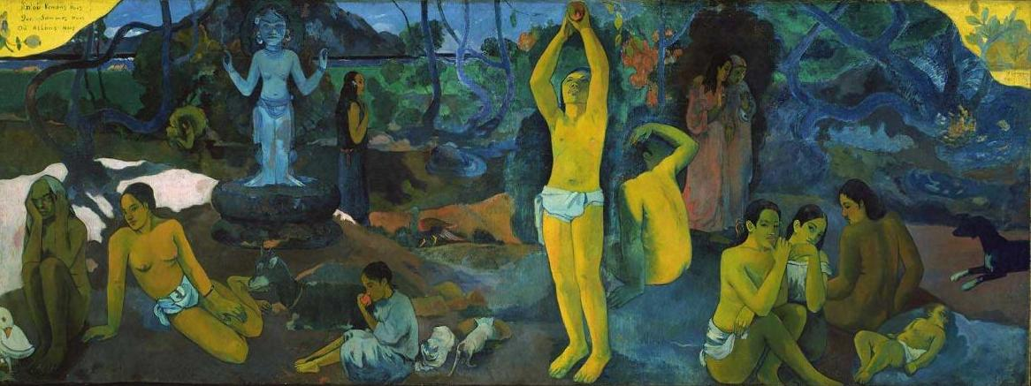

Slide 5
The aim of particle physics, CERN & the LHC:
What is the Universe made of?
“Where do we come from?
What are we?
Where are we going?”

Slide 6
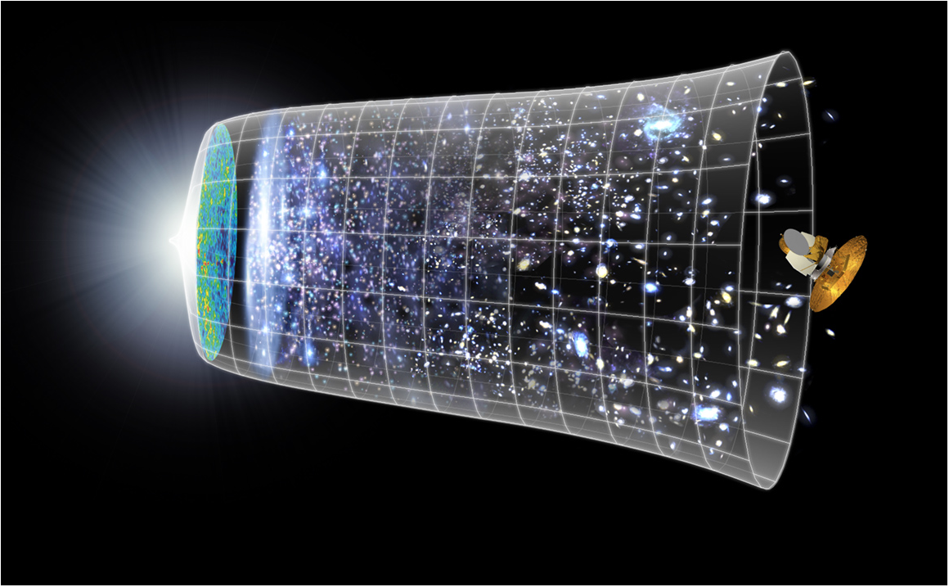
Scientific Challenge:
to understand the very first moments of our Universe after the Big Bang
Big Bang
WMAP
13.82 Billion Years
Today
10²⁸ cm

Slide 7
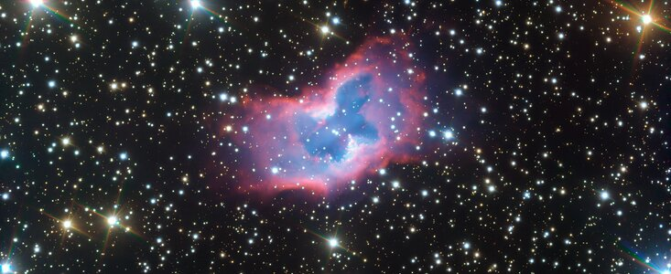
Resembling a butterfly with its symmetrical structure, beautiful colours, and intricate patterns, this striking bubble of gas — known as NGC 2899 — appears to float and flutter across the sky in this new picture from ESO’s Very Large Telescope (VLT).
This object is located between 3000 and 6500 light-years away in the Southern constellation of Vela (The Sails).
https://www.eso.org/public/news/eso2012/?lang

Slide 8
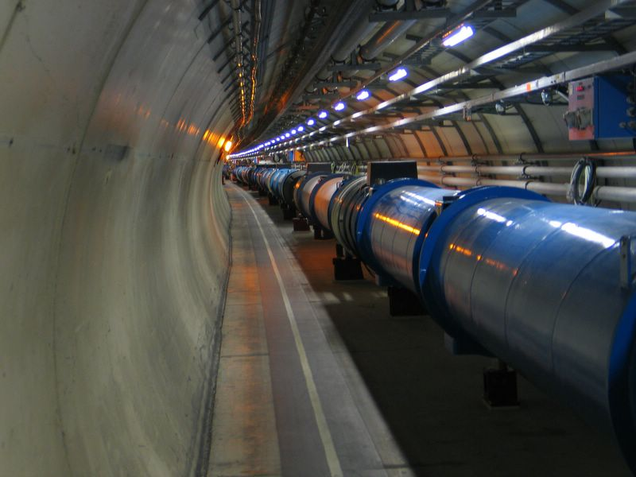
The Large Hadron Collider (LHC)
Proton- Proton Collider
Primary targets:
Origin of mass
Nature of Dark Matter
Primordial Plasma
Matter vs Antimatter
1,000,000,000 collisions/second
6.5 TeV +
6.5 TeV

Slide 9
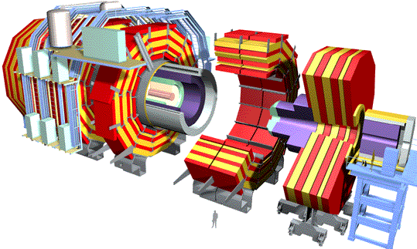
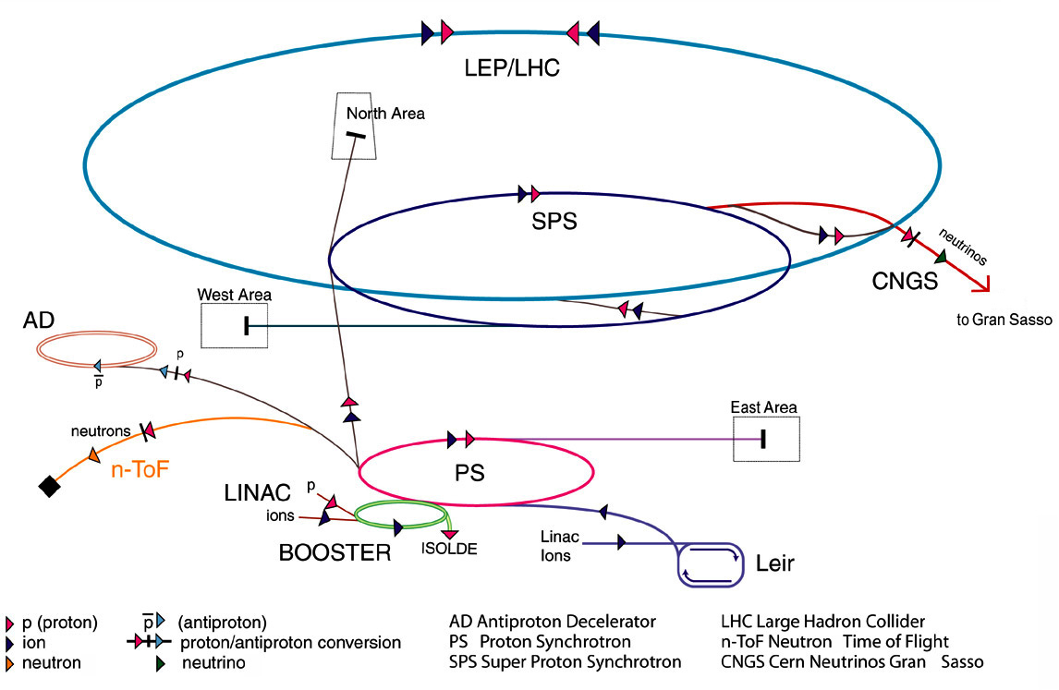
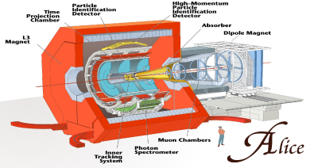
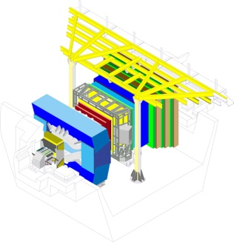
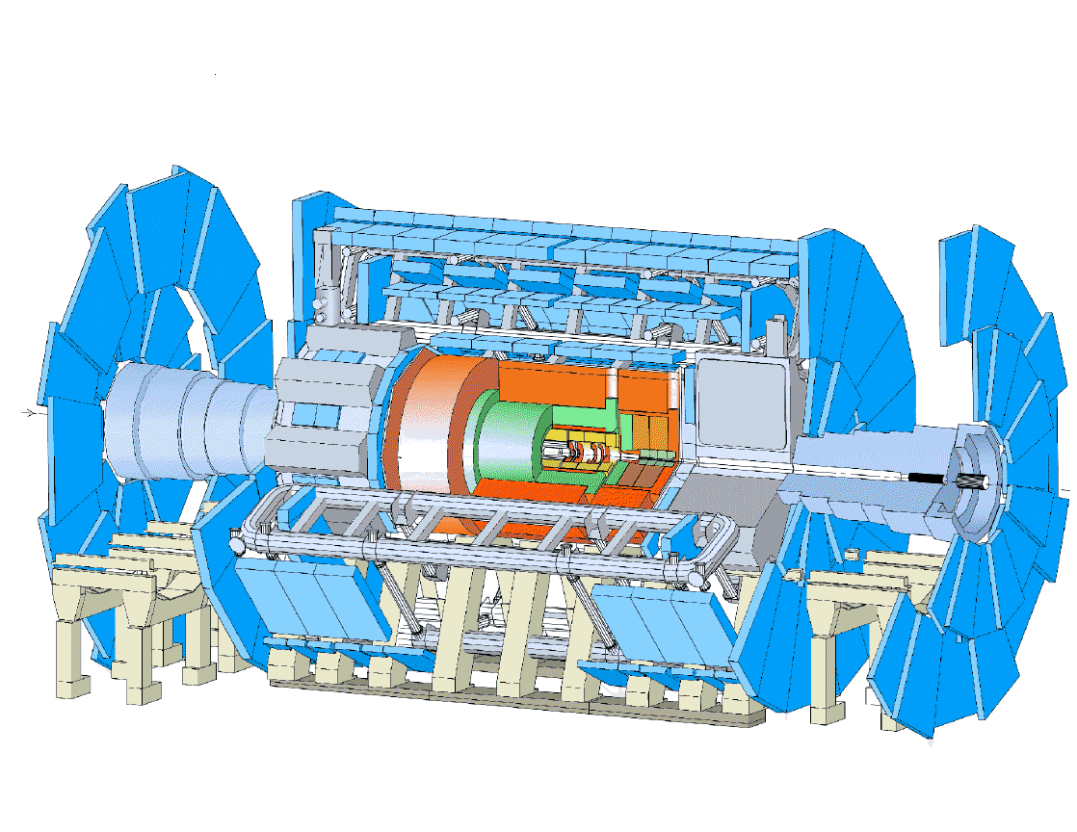
Large Hadron Collider
Collision of proton beams…
…observed in giant detectors
CMS
ALICE
LHCb
ATLAS
Notes:
In the LHC the hadronic particle beams will be accellerated
inside an ultra-vacuum pipe till relativistic velocity and kept in orbit thanks to superconducting magnets;
the collisions between particles will be studied inside the detectors (ATLAS, Alice,CMS, LHCb).

Slide 10
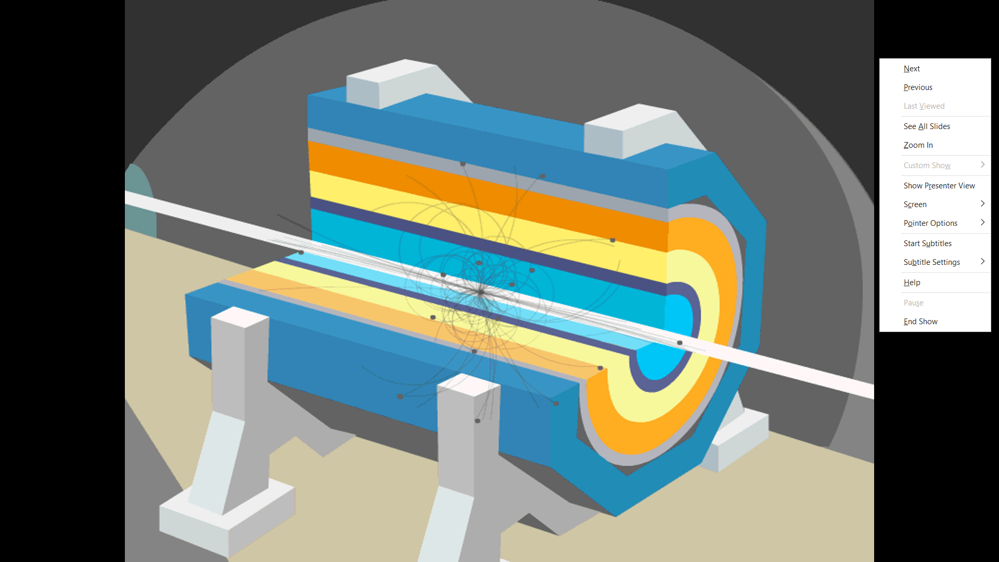
Typical Particle Detector

Slide 11
Searching for new particles requires selection and analysis of enormous quantity of data from LHC detectors
New particle ???
Notes:
11

Slide 12
New particle ???
Notes:
12

Slide 13
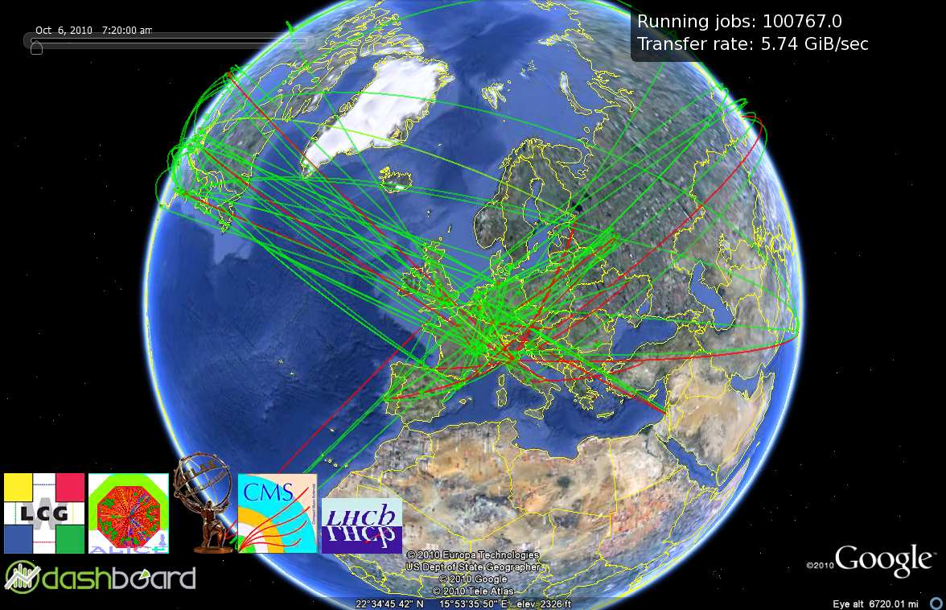
LCG-LHC Computing GRID

Slide 14
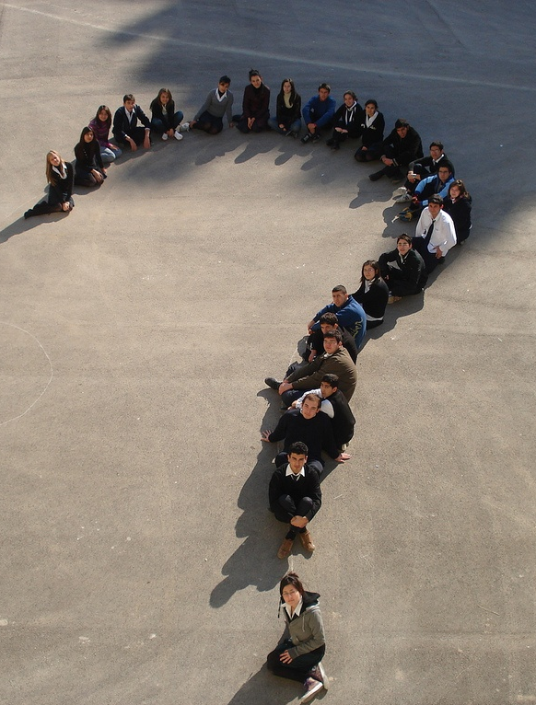
Personnel

Slide 15
Workforce
Physicists
  Experimental
  Theoretical
Applied Physicists and Engineers
Technicians
Craftsmen
Administrative personnel
Fellows
Doctoral Students
Technical Students
Associates
Summer Students
Employees of CERN
Users
People like you !

Slide 16
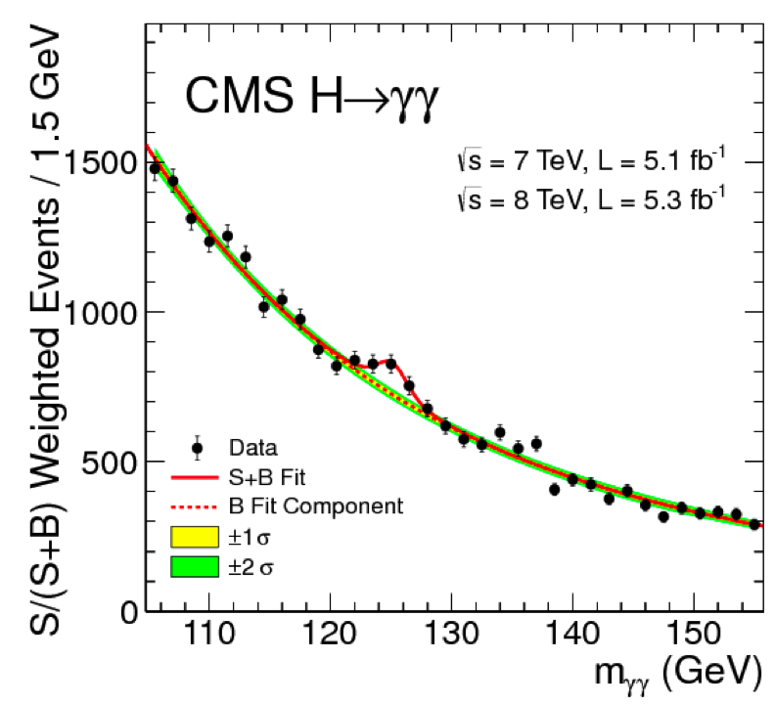
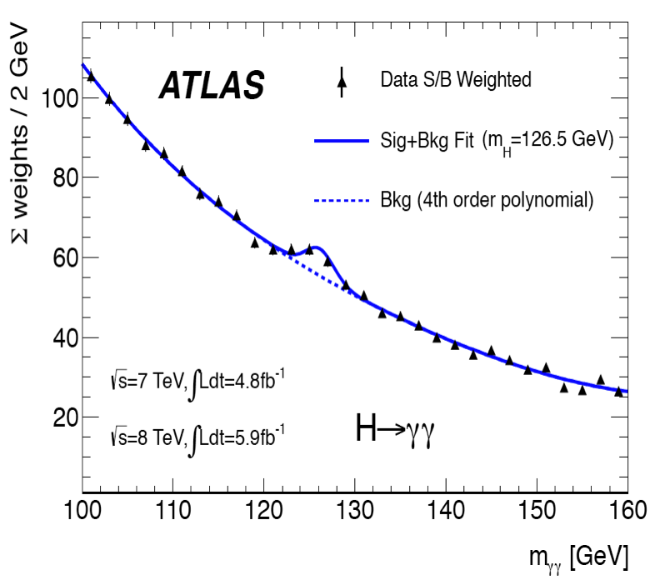
Higgs decay to γγ, ATLAS and CMS, summer 2012 data

Slide 17
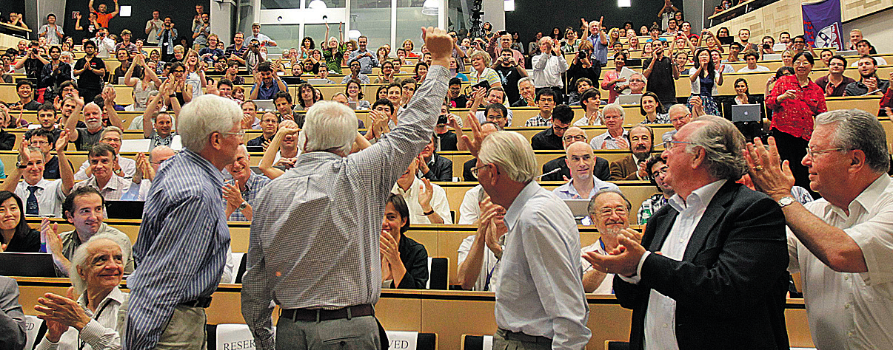
July 4th 2012 at CERN

Slide 18
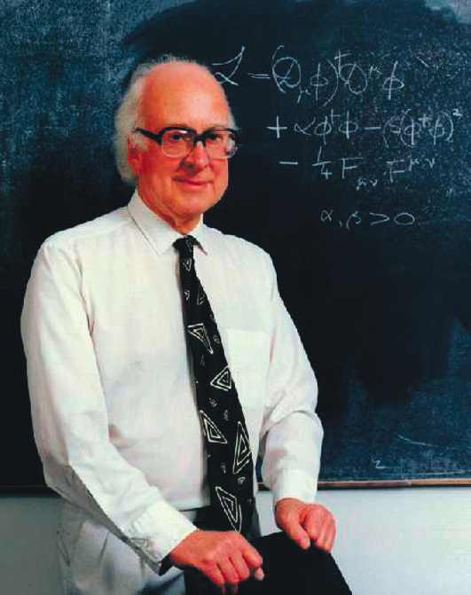
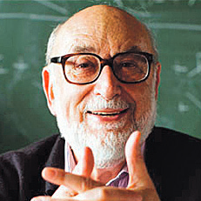
Peter Higgs and Francois Englert

Slide 19
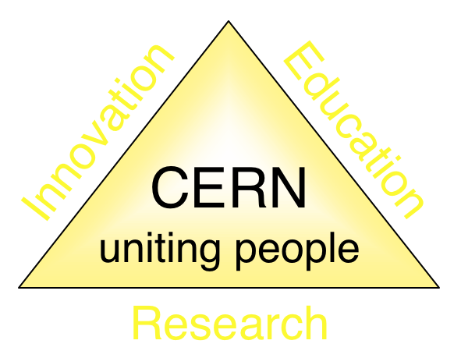
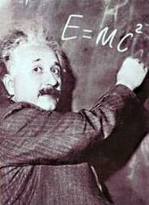



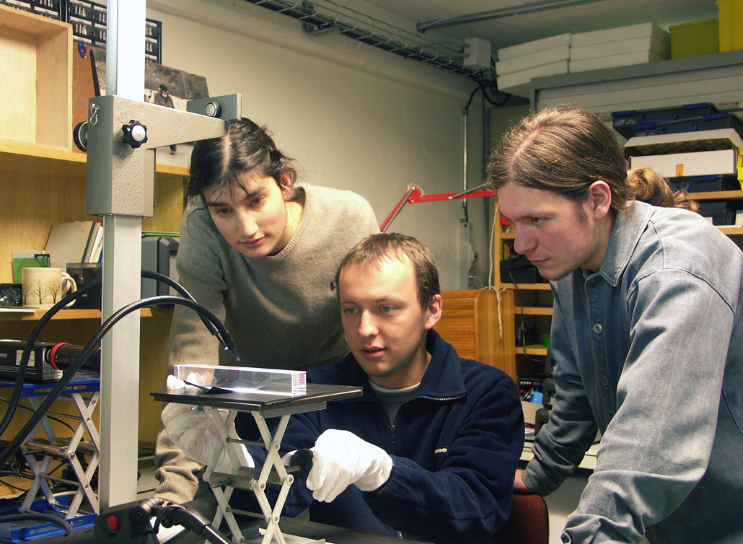
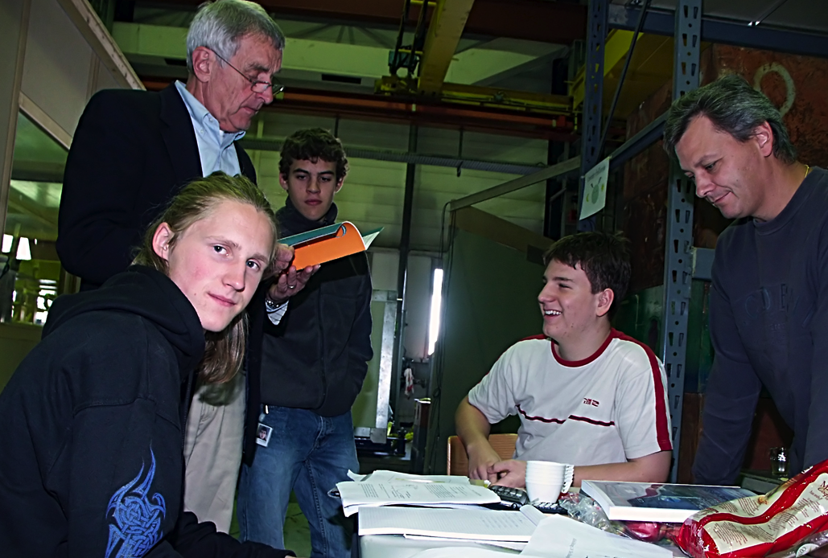
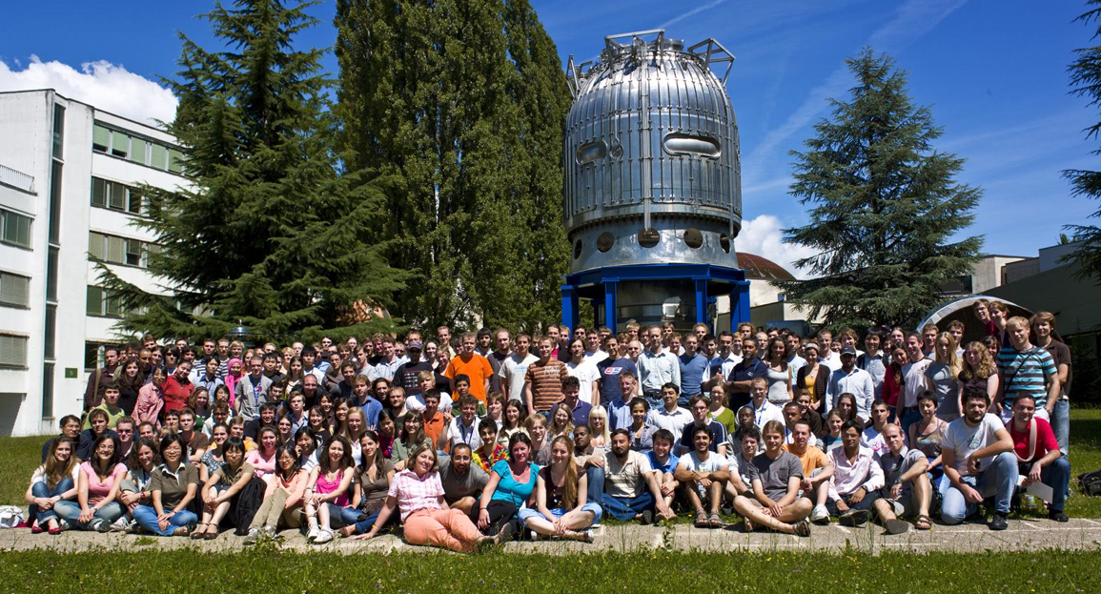
Summary
Understand the universe
Answer the 3 questions
Develop new technologies for accelerators and detectors
Information technology - the World Wide Web
Medicine – imaging and treatment
Inform, inspire, encourage, train
scientists and engineers of tomorrow
Unite people from different countries and cultures – peaceful collaboration
Notes:
19

Slide 20
Outreach/Reach Out Programmes
In the beginning – little/nothing
Gradual awareness
Motivation
  Responsibility to transfer knowledge, inspire, educate
  Support – political, financial
What ?
  Encourage/welcome/organise visits
    Colleagues, collaborators, friends, locals, public
  Support, organize, workshops, programmes
    Colleagues, students, educators, public
How ?
  Initially ad hoc
  Re-use/adapt staff training programmes

Slide 21
Effective ?
Define objectives
  Inform/educate
  Inspire
Identify target audiences
    Public
    Schools (teachers, students)
Deliver
  Experts
    Train
Create/ Adapt/ Publish material
Support structure
  Specialised units
Collaborate
Feedback

Slide 22
Result
Academic Training Programme (scientific community)
Summer Student Training Programme
International Teacher Training Programme (1000+/year, 20+ languages)
Visits Service (100000+/year, international)
Exhibitions (2 on-site, major addition in 2023)
Involvement of ALL experimental facilities
  Freely participate
Mission critical
  Want all ‘visitors’ to become ambassadors
  Science, Physics, Particle Physics, and CERN
Exported beyond the site boundaries

Slide 23
Innovate
Listen/Learn
Collaborate
  Build network/Include new partners
  Invent
    SciArtEdu
  Multiplicative factors
    Teachers
    Citizens
(Pandemic => extensive virtual capability)
The extra (s)mile
It’s OK to be vague
But be exciting !

