Slide 1
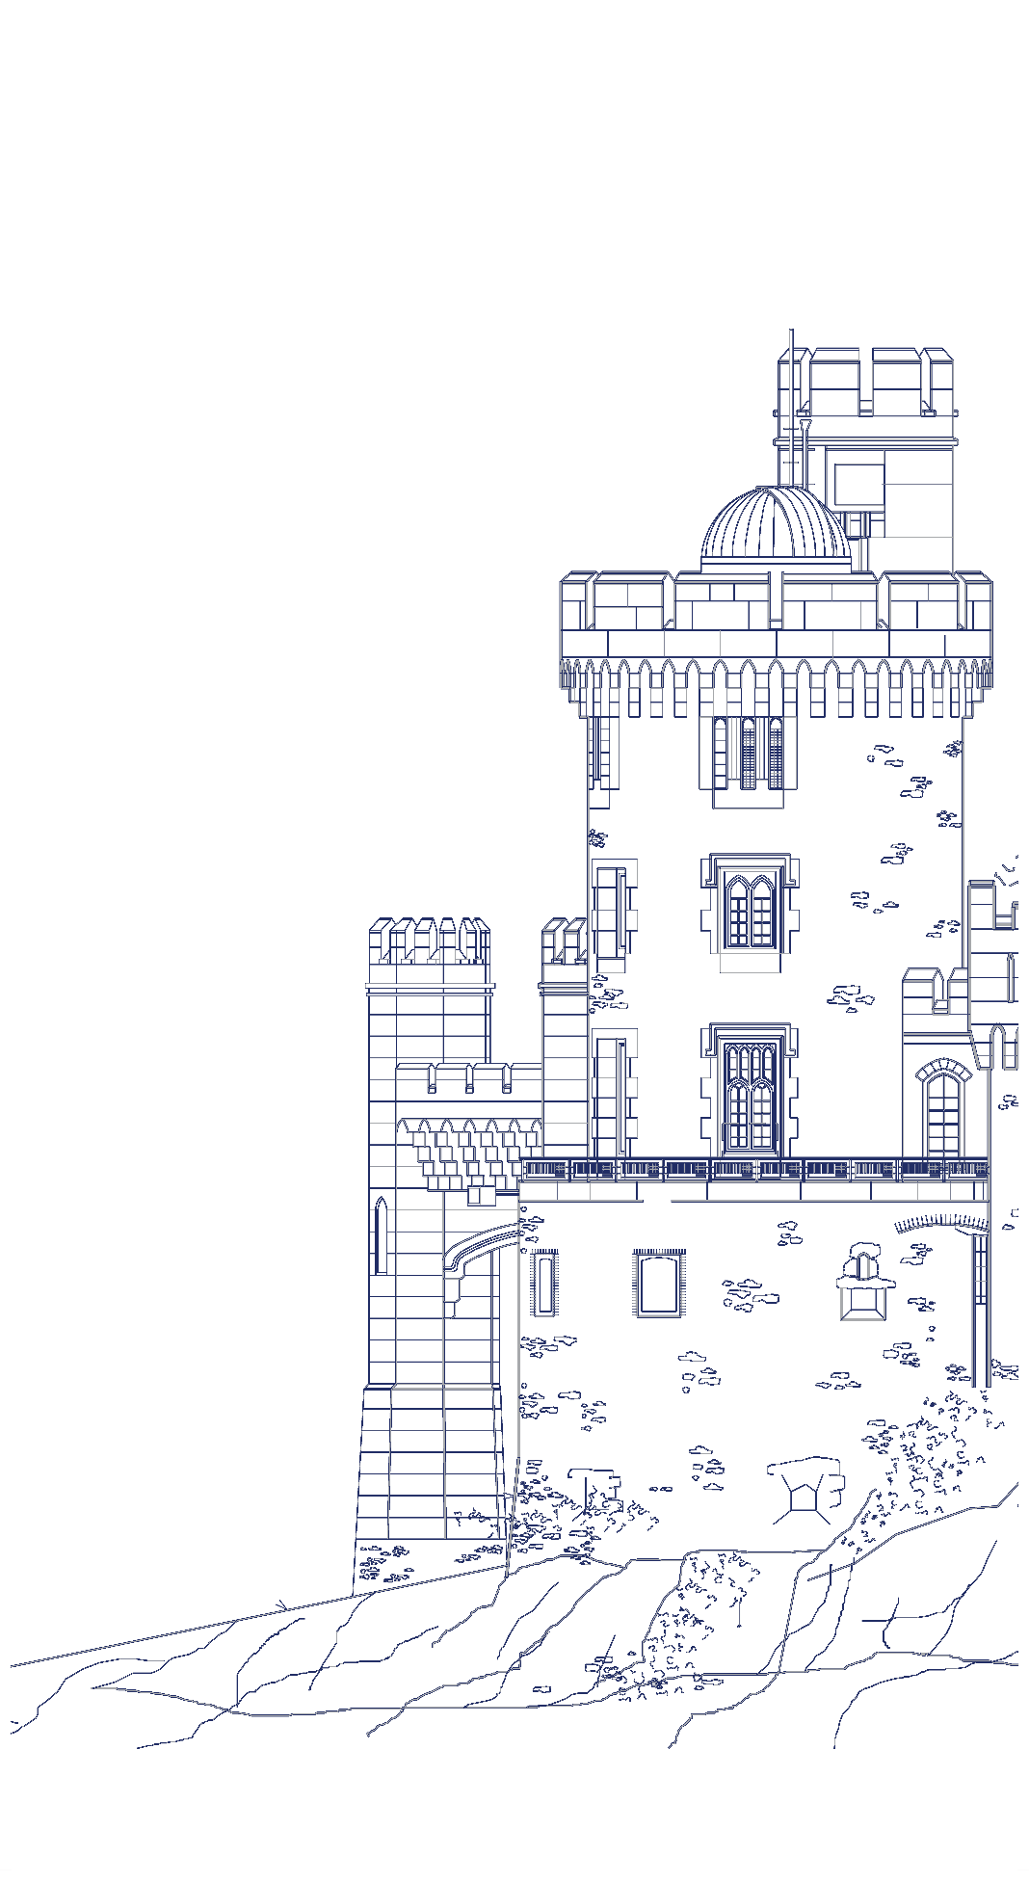
Star Activities
Frances McCarthy

Slide 2
Today’s activities – all from http://polar-star.ea.gr/polar-star-kit-activities
Gravitational Waves: Modelling Rotating Black Holes
Image Making in the Solar System
Observing the Skies with a Space Telescope
Notes:
Note – we explored Gravitational Waves and Observing the Skies with a Space Telescope.

Slide 3
Thank you for your attention!
More information:
http://polar-star.ea.gr/

