Slide 1
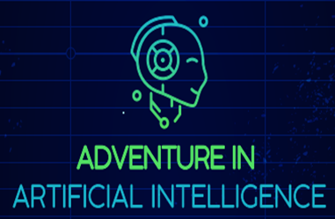
“Adventure in Artificial Intellingence”
Dimitra Dimitrakopoulou
13.07.2022
Athens

Slide 2
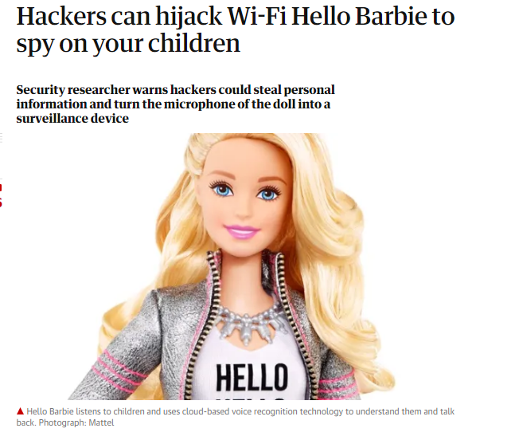
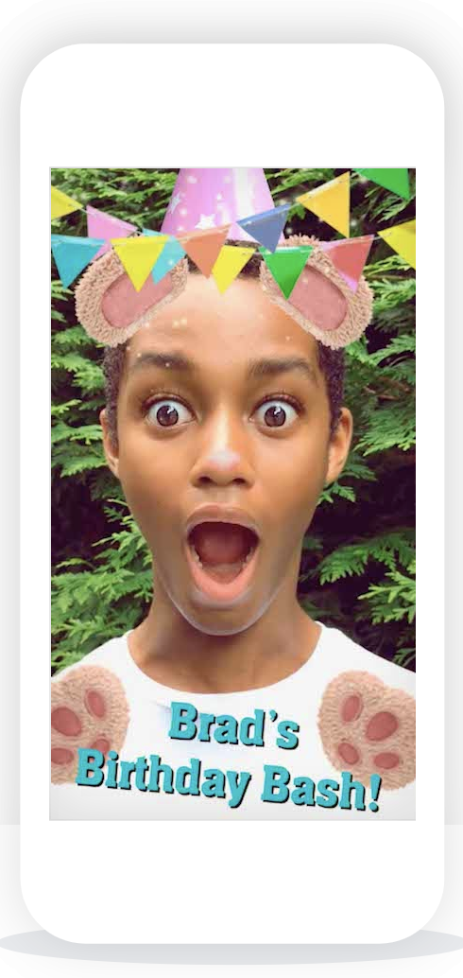
AI Literacy. Why?
Children interact with AI systems even before preschool
YouTube
Netflix
Google Search
Face recognition
Smart Toys
Smart Homes
Self-driving cars
…
Recommendation systems
Systems that collect information (e.g., voice, images, actions) and respond accordingly

Slide 3
AI Literacy. Why?
“Machines” (computer systems) behave more like “social beings” than before
They communicate through voice or non-verbal cues (e.g., face expressions)
They recognise human faces
They learn our preferences
They develop new skills, they learn to solve problems
Children have a different relation with technology than before (differences according to country and technology literacy)
What are the perceptions of children about AI? What do they think about “smart” systems?
Issues of privacy and security. Are the children aware? (e.g., when interacting with smart toys)

Slide 4
What do children think about AI systems?
A robot is smarter than me..
It is like a human
It is not an object or a computer. It is something else..
It is like a human, but not as smart as me…
They have feelings (e.g., social robots)
They have intentions (e.g., it wants to go right) (psychological interpretation of robot behaviour, instead of mechanical interpretation e.g., it is going forward, turning left)
See also this study: Druga, S., Williams, R., Breazeal, C., & Resnick, M. (2017). ‘Hey Google is It OK if I Eat You?’: Initial Explorations in Child-Agent Interaction. Proceedings of the 2017 Conference on Interaction Design and Children, 595–600. https://doi.org/10.1145/3078072.3084330

Slide 5
Children become (informed? active?) citizens
Children are not “digital natives”
Fluent users of technology ≠ Fluent thinkers
Technologies are not neutral means (e.g., algorithmic bias)
We need to equip children to understand and critique them

Slide 6
AI Literacy for Preschool Children
Existing material (books, games, activities) for AI literacy for children
Discussions about ethics and technology
“The Complete Guide to Artificial Intelligence for Kids”
https://store.maththrills.com/products/the-complete-guide-to-artificial-intelligence-for-kids

Slide 7
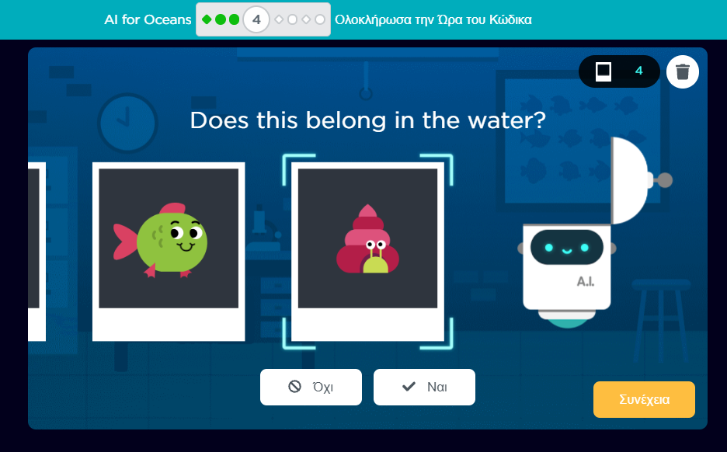
Activities for Children. AI for Oceans
Train your robot to recognise
Fish and garbage
Creatures that live in the sea
Different types of fish
Scary and not scary fish?
Ugly and pretty fish?
Introduction to machine learning, training data, and bias
Exploration of ethical issues
Understanding how AI can be used to address world problems
Available in +23 languages, ages +3
Includes lesson plans and activities
AI for Oceans
https://code.org/oceans

Slide 8
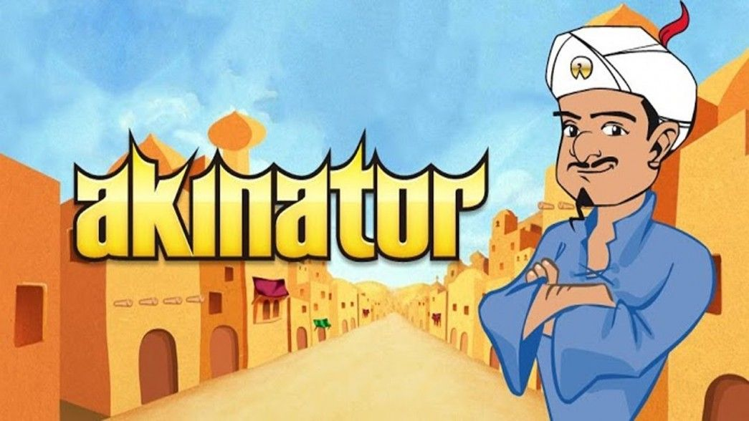
Activities for Children. Akinator
The game recognises who do you have in mind (e.g. a cartoon figure, a super hero, an animal) through yes/no questions
It has been fed different data (characters, celebrities) with their attributes (how do the look, what do they do)
Then, uses Classification Algorithms to figure out the character you are thinking of.
https://en.akinator.com/theme-selection

Slide 9
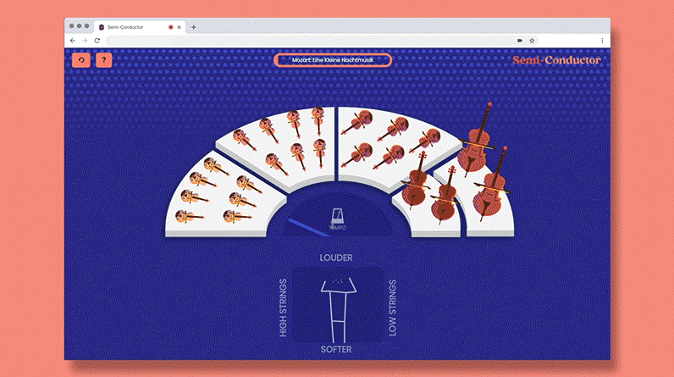
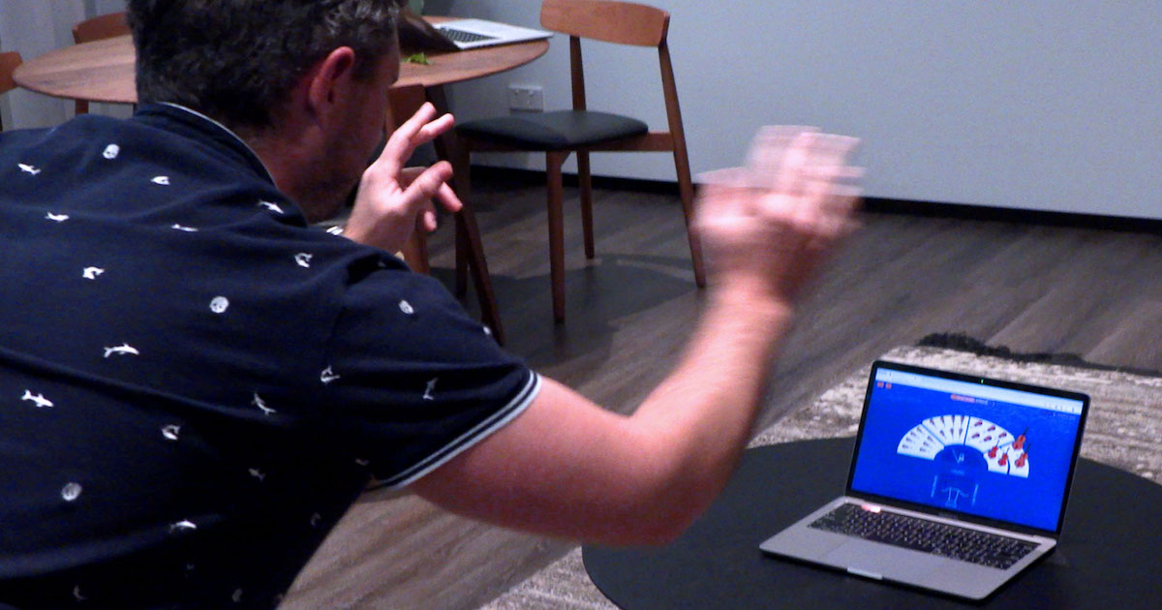
Activities for Children. Semi Conductor
Become a maestro of your own orchestra
Direct the orchestra using your body
The system recognises pose and hand movement (through your camera) and the orchestra plays accordingly.
Semi Conductor https://semiconductor.withgoogle.com/

Slide 10
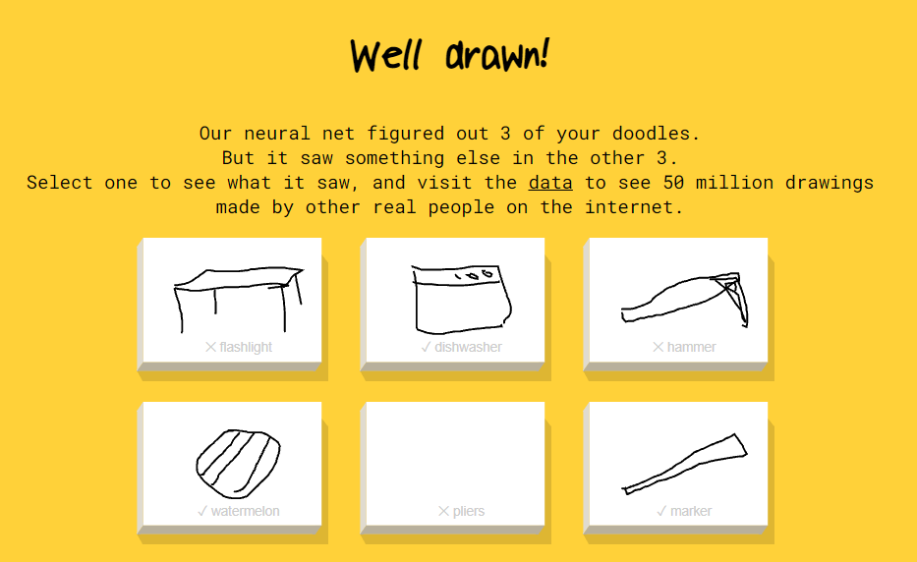
Activities for Children. Quick Draw
Start doodling, and let the system recognise what you are going to doodle
A neural network learns to recognize doodling (Machine Learning)
Using drawings of previous users
Quick Draw
https://quickdraw.withgoogle.com/

Slide 11
GAME IDEA
The game takes place somewhere in the future. A space adventurer (character played by the player) gets stranded on an uncharted planet.
The player’s objective is to fix the space ship and get the correct coordinates for his/her safe return home.
The planet has 2 regions – one that is pro-AI and one AI free zone – enabling to explore and make clearer the advantages and implications of using AI (e.g. how more efficient the production processes are, opposed to some security risks)
Introductory video:
https://www.youtube.com/watch?v=5SfLMNw-Cvo
Link of the Game:https://liluo.io/instant-builds/1c3a2f80-a832-4f2a-978d-a0cfe1cda13c

Slide 12
GAME OBJECTIVES
The Digital Game main objective is to increase children’s AI Literacy and consequently eradicate the misconceptions around AI and create an all-inclusive ecosystem where all members of the community are equipped with the basic skills needed to pursue further learning to better adapt to a changing world where AI will be prevalent.
Thus, the Game should promote a basic understanding of what AI is, the language surrounding the technological and social aspects of AI, how AI works and how it is currently playing a role in our daily lives (and children’s lives in particular), the risks and opportunities AI bares and AI’s potential impact in jobs and other areas of society.

Slide 13
THANK YOU
Website http://www.ai-adventure.eu/
Questionnaire
https://docs.google.com/forms/d/e/1FAIpQLSdV8BJuW2dQ5ngjhmkzvD1jtlEpcRuSYbZ9XPjoLERcdn4HlA/viewform

