Slide 1
“Bringing computational Thinking in Class”
Dimitra Dimitrakopoulou
13.07.2022
Athens

Slide 2
What is Computational Thinking?
Problem
Solution
?
“solving problems, designing systems, and understanding human behavior, by drawing on the concepts fundamental to computer science” (Wing, 2006)
“… solutions are represented in a form that can be effectively carried out by an information-processing agent” (Cuny et al, 2010)
“the ability to think with the computer-as-tool” (Berland & Wilensky, 2015)
“The ability to understand information and communication technologies and their key concepts, methods and tools to purposefully utilize those for problem solving” (Pawlowski, 2019)

Slide 3
Computational thinking some examples:
Decomposition – taking a problem and cutting it to smaller pieces to solve them

Slide 4
Pattern recognition
Even though problems are different, you can recognise the similarities and use the patterns that have worked well before to solve them

Slide 5
Algorithmic thinking
Problem: How to leave the room?
(create a set of rules in a sequence)
Stand up
Turn around
Walk to the door
Open it
Go through it
You have left the room!

Slide 6
Why teach computational thinking at schools?
Future competences
4
Future jobs

Slide 8
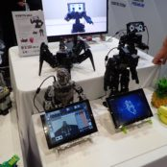
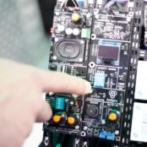
Physical computing?
“A holistic enabling approach to building programming competencies including haptic experiences accompanied by physical activities”
Physical Output: Devices such as small robots are used to create haptic, tangible experiences
Physical Transfer: ICT should be connected with physical (“unplugged”) real-life activities to avoid that computers are just perceived as a passive activity.

Slide 9
SURVEY 41 Teachers, head masters, educators interviewed in 4 countries

Slide 10
Identified needs

Slide 11
Barriers of teaching CT in schools

Slide 12
Barriers to teaching CT by countries

Slide 13
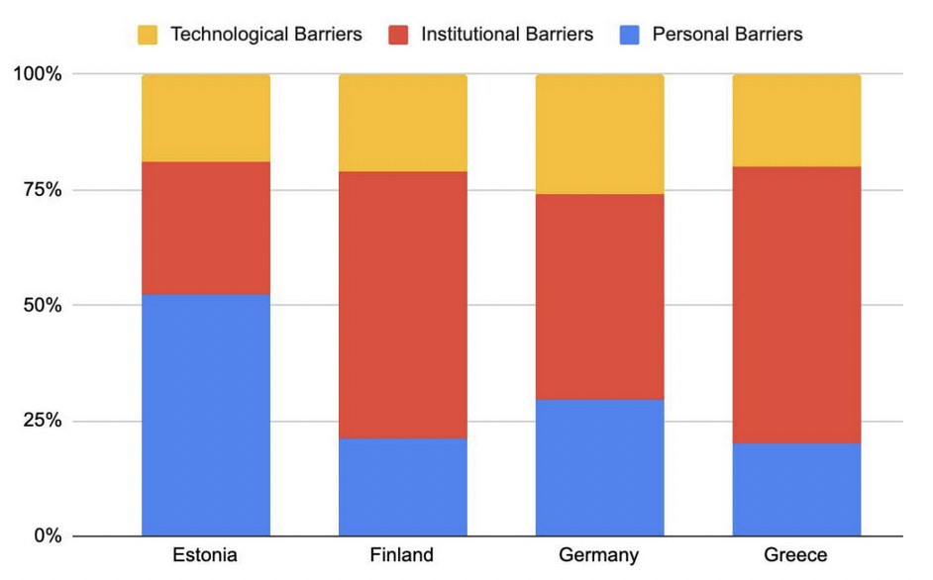
Barriers to teaching CT by countries

Slide 14
What is Computational Thinking?
The ability to understand technologies
to help you use them to solve a problem

Slide 15
COMPETENCE FRAMEWORK

Slide 17
CoTA Website https://cotaproject.wpcomstaging.com/
Οpen Learning Scenarios
Open Educational Resources (OER)

Slide 18
Learning Scenario Template
Learning Scenario Identity
Title & Creator
Main Idea / Description
Target Group (Students’ age, learning level, background, disabilities)
Curriculum & Learning Subjects
Competencies ( References to the CoTA competencies)
Learning Scenario Framework
Pedagogical Method
Software & Materials
Evaluation Tools
Learning Scenario Implementation
Learning Activities (Description, duration, worksheets….)

Slide 19
TOOLS SCHOOL SUBJECTS
Scratch junior
Scratch 3
3D Printer
3D Pen
Arduino
Sketch Up
Tinkercad
0nline Python Interpreter:repl.it
Οffline Kodu Game Lab
LEGO WeDo 1
LEGO WeDo 2
Lego Ev3
Physics
Mathematics
History
Music
Language
Geography
Computer Science

Slide 20
Connection to the Greek curriculum
The Greek curriculum refers to basic programming structures (sequence structure, selection structure, loops and variables).
However, there is no reference to computational thinking.

Slide 21
Learning Scenario Identity | Learning Scenario
Title | “Creating the story “The Rabbit and the Turtle”, (Aesopus fiables)
Creator | Dimitra Dimitrakopoulou
Main Idea / Description | Students represent the fiable of Aesopus “The Rabbit and the Turtle” by using the Scratch junior software. The main idea of this scenario is students to learn to use the motion and the speed blocks. Specifically, by representing the race of the rabbit and the turtle students understand how to move, to speed up and slow down a character in the software.
Target Group (students’ age, learning level, background, disabilities) | Primary school, ^{3rd} grade, students with no special needs

Slide 22
Learning Scenario Framework
Pedagogical Method | Technology Assisted Learning
Software & Materials (Games, blog, videos, forum, maps, web links, other tools) | Scratch Junior software
Evaluation Tools | Worksheets, Scratch Junior software, Discussion

Slide 23
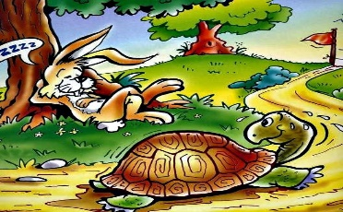
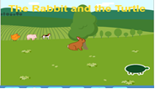
 | Description: Introduction: Teachers can read the book “Τhe Rabbit and the Turtle” to students. Students are divided in groups of 2-3 children (15 minutes). Worksheets -Activity 1: Students open the scratch junior software and create the story of “The Rabbit and the Turtle”. Firstly, they should add the setting and characters. (30 minutes) Worksheets -Activity 2: Students bring into life the story by programming the characters to move. (20 minutes) Discussion: A discussion takes place in class and students freely talk about their experience. (What they found interesting, if they face any difficulties etc.). They also discuss the programming. Each group present its work in class. (20 minutes) Worksheets -Activity 3: Students think and write another story in which they could use the speed block. (15 minutes) Discussion: Students talk about their new stories in class (Activity 3). (10 minutes) Worksheets (https://docs.google.com/document/d/1fUVelHpza8tx-_fuwcabj4-MkzHHQLU5T8buMXALvoQ/edit) 1. Open the Scratch Junior Software and Create the story “The Rabbit and the Turtle”. - Choose or draw a background that is related to our story. - Choose or draw the characters of the story (Rabbit, Turtle). - Choose or draw a tree in the middle of the road. 2.Program your characters A. Turtle 1.Program the turtle to move slowly until it arrives at the end of the road. (Use the motion and the speed blocks). 2. Program the turtle to jump twice because it’s the winner! (Use the motion blocks) B. Rabbit 1. Program the rabbit to move fast until it arrives at the tree where it falls asleep. (Use the motion and the speed blocks). 3.Think of another story… Can you think of another story that you could use the speed blocks?

Slide 24
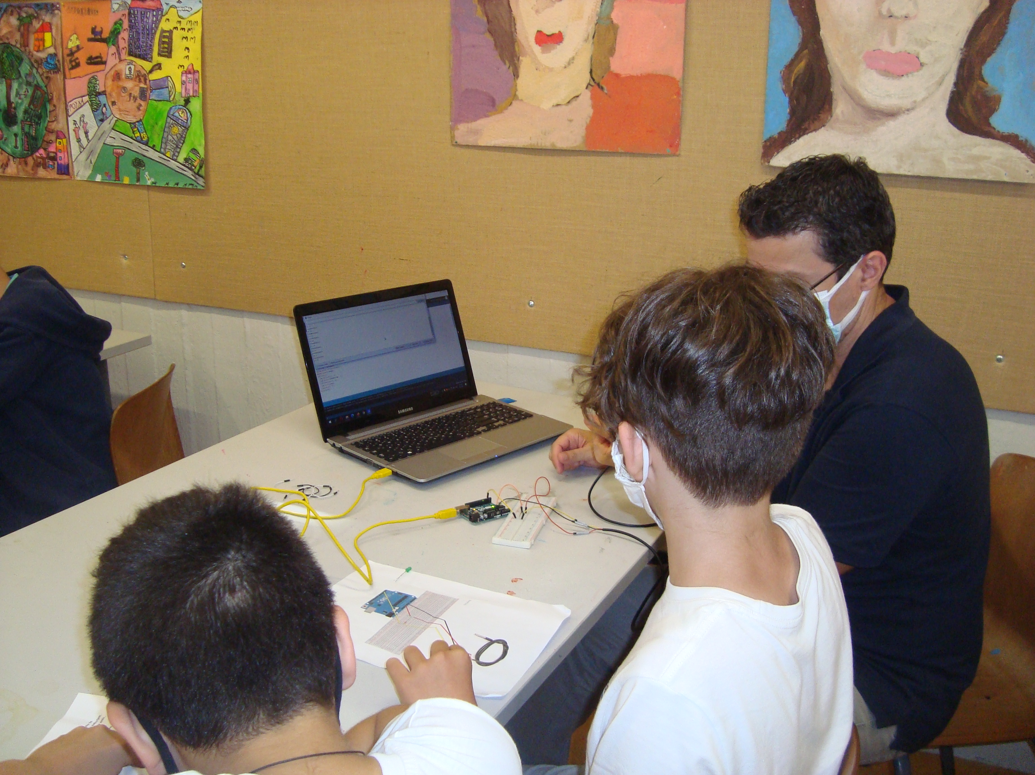
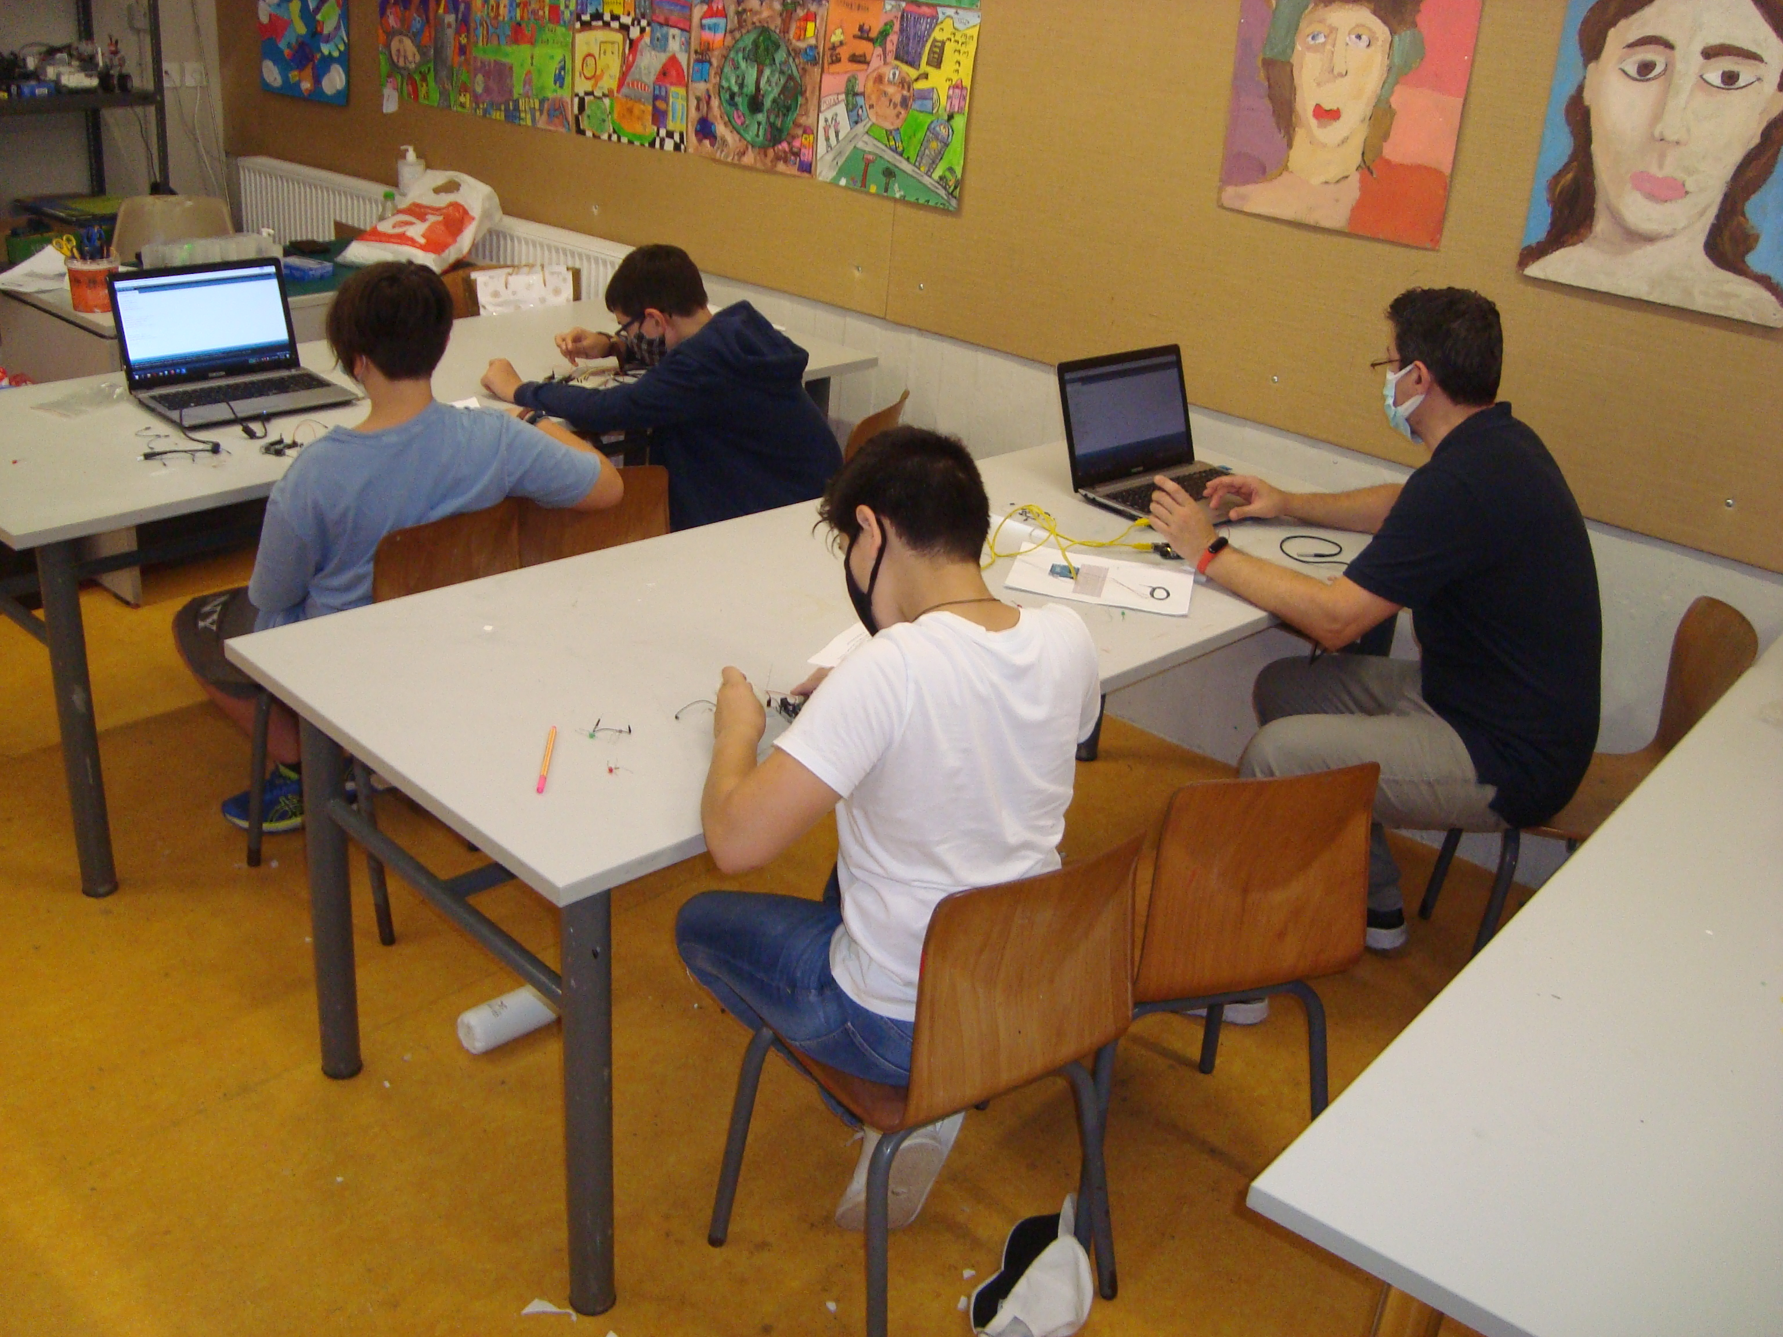
1st Pilot Testing in EA Primary school
Robotic class (Extra- curriculum activity)
1 computer science teacher and 10 students aged 9-11 years old participated

Slide 25
“Digital Thermometer” (Arduino)
Each student has a kit with Arduino, a digital thermometer sensor, a resistance and some wires.
Teacher share to all students worksheets with view to help them connect the sensor to Arduino.
At the end of the session students read a worksheet about the program (Arduino sketch). As an alternative we can use Tinkercad drag and drop online software so the students can create from scratch their Arduino program(sketch).

Slide 26
Main Goals
The main goal of this session was to introduce to students the basic of electronics and programming.
Students learn problem Identification and Decomposition by splitting a problem into two different parts. The first thing was to connect the sensor to Arduino and the other was to program it.
By creating the program students understand how important is to write algorithms.
When they run the program they realize how important is debugging.
At the end of the session students realized that its very easy to create and program a sensor detector in order to collect data from the environment.
In general,
they understood the basic of computing.

Slide 27
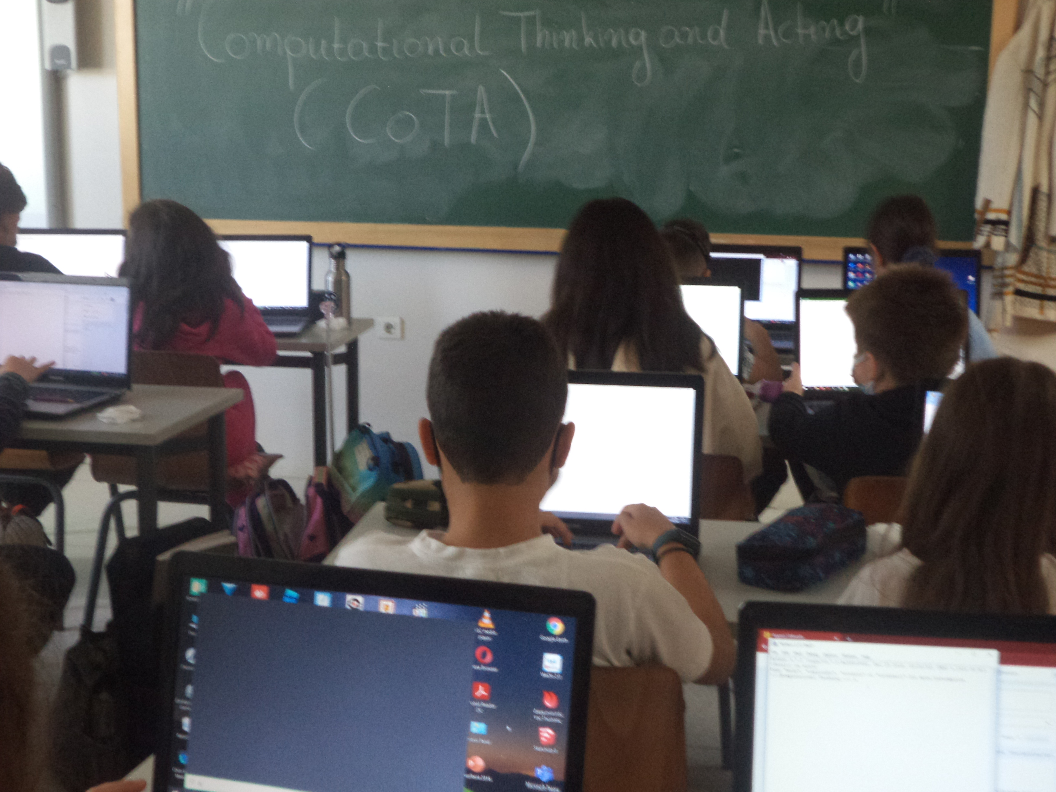
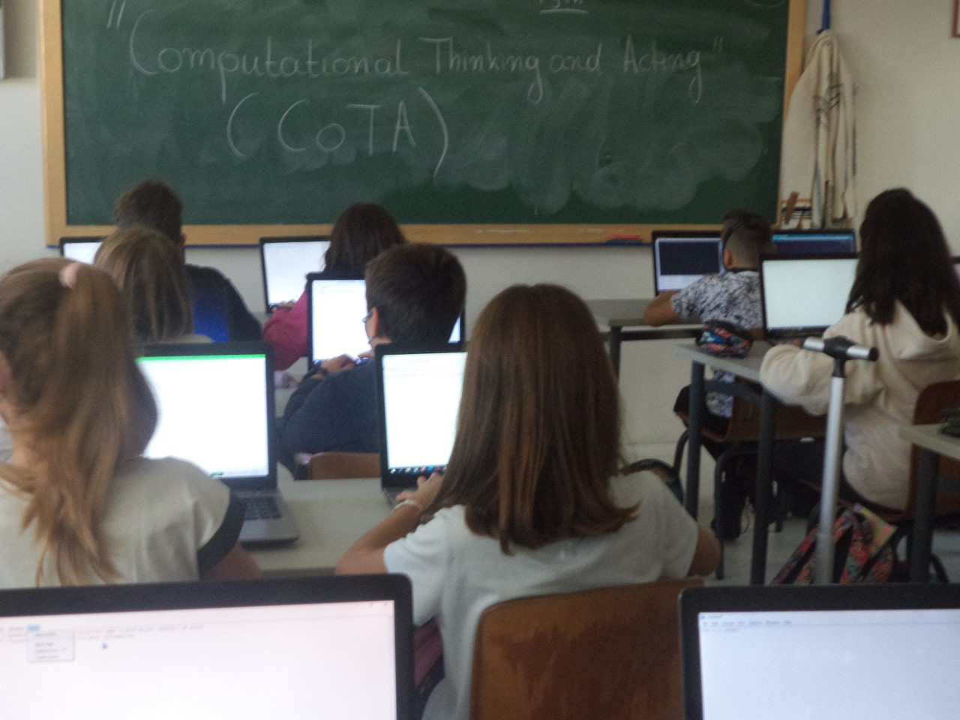
2nd Pilot Testing in EA Primary school
School Subject:Computer Science
Participation:1 computer science teacher, 6 classes (150 students)
Grade 5th

Slide 28
“Crack the code” ( Python)
At this session we can either use an online Compiler or an offline (Idle Python).
We explain to students the basic commands and we watch a video about Brute Force Algorithm and problem solving. (https://www.youtube.com/watch?v=SaAwW-6wV_Q&feature=emb_logo )
At the end of the session we can use the count and the break command in order to understand ​​the number of repetitions the logarithm performs until it solves the problem without the break and how many with it.

Slide 29
SCRIPT
Result

Slide 30
Aim of this session
Students through the “Brute Force Algorithm”
learn the basics of Python
Specifically, students learn:
problem Identification and Decomposition by splitting the problem into smaller parts.
to remove unnecessary information and focus on the main problem.
( Abstraction).
to create correct and efficient algorithms.
debugging and generalizatiοn

Slide 31
Results of the Pilot Testing
Students’ Questionnaires

Slide 32
“The class activities were interesting”
“The class activities were fun”
“I would like to learn more about programming robots”
“I understood better what algoritms are”

Slide 33
“I understood better what a variable means”
“I understood better what a "condition expression" means”
“I understood better what a loop means”
“I understood better how a task can be divided into steps”

Slide 34
Thank you

