Slide 1
POLAR kit Activities: Arctic Research in the school classroom
Agata Goździk

Slide 2
Menti.com
Enter the code 39 40 25 in mentimeter and answer this question.
Why talk about Arctic science in your classroom?

Slide 3
Why the Arctic?

Slide 4
Permafrost

Slide 5
Let’s guess, what permafrost is…
Have you ever heard about permafrost? Do you know, what it is? Or could you guess the meaning from the name? You may try to give your definition based on the parts - "perma" and "frost".
The name 'permafrost" comes from two words:
permanently + frozen.
Permafrost is permanently frozen ground. It is soil, rock, or organic material that remains at 0°C or below for at least two consecutive years.

Slide 6
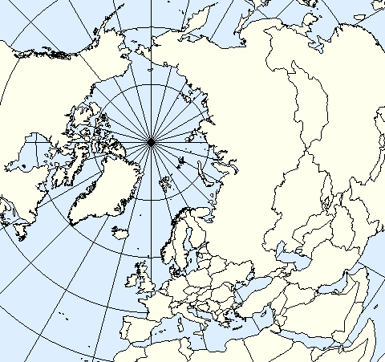
Where does it occur?
In the Northern Hemisphere, regions in which permafrost occurs occupy approximately 25% (23 million km²) of the land area. The thickness of permafrost varies from less than one metre to more than 1500 meters.
Permafrost occurs not only in the Polar region, but also in high mountains.
Notes:
Ask your students to colour the map and indicate all areas, where they think permafrost occurs.
The contour map is based on the map prepared by Sean Baker.

Slide 7
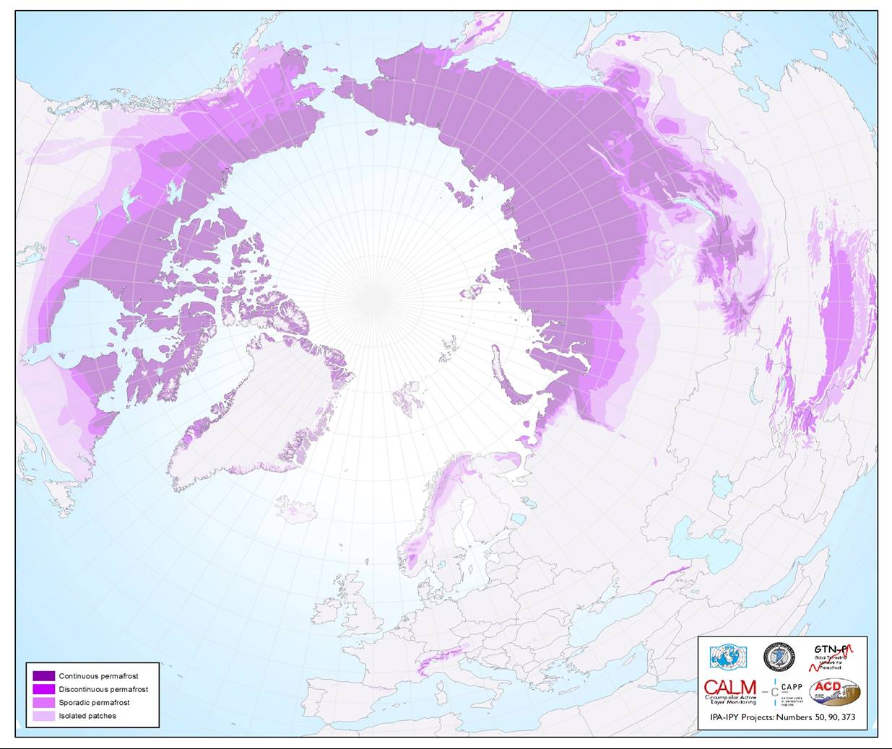
Where does it occur?
In the Northern Hemisphere, regions in which permafrost occurs occupy approximately 25% (23 million km²) of the land area. The thickness of permafrost varies from less than one metre to more than 1500 meters.
Permafrost occurs not only in the Polar region, but also in high mountains.
Source: https://ipa.arcticportal.org
Notes:
Then, let them compare answers with the map of distribution of permafrost.

Slide 8
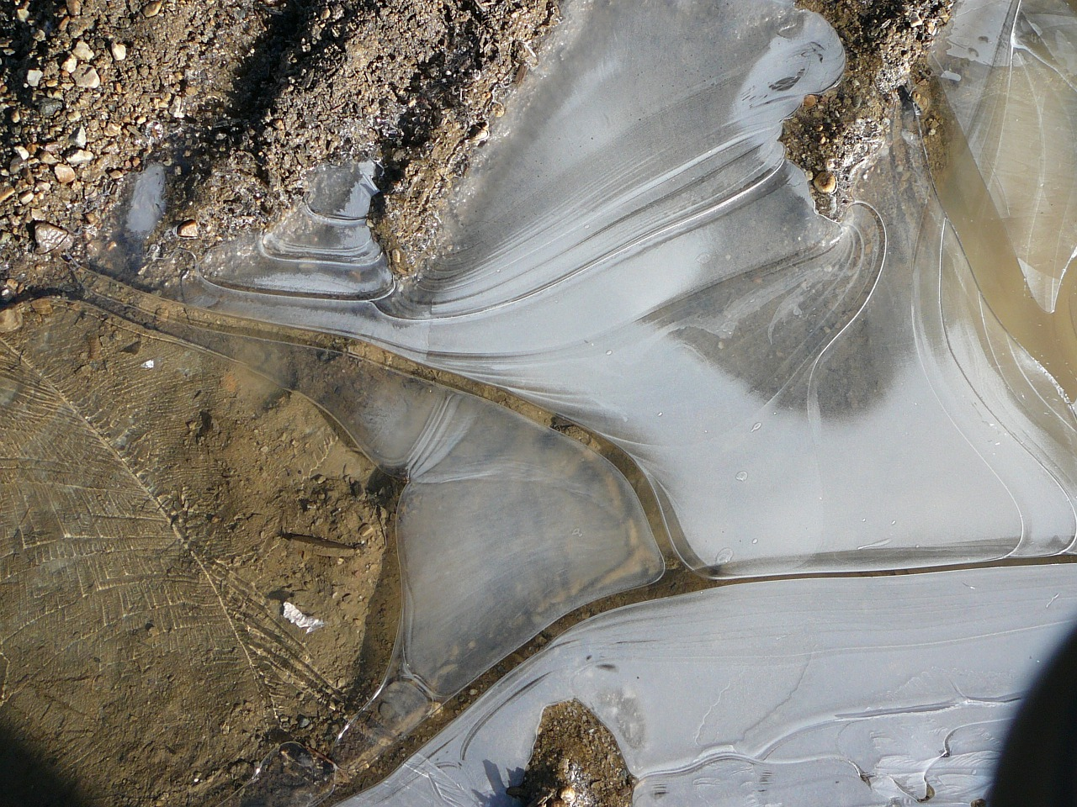
When was it created?
Most of the permafrost existing today formed during cold glacial periods, even 30,000 years ago. And it has persisted through warmer interglacial periods.
Some relatively shallow permafrost (30 to 70 metres) formed during the second part of the Holocene (last 6 000 years) and some during the Little Ice Age (from 400 to 150 years ago).
Notes:
Then, let them compare answers with the map of distribution of permafrost.

Slide 9
Permafrost demonstration
What happens with ice, when the temperature rises above 0 degrees Celsius?
And what happens with frozen ground? Let's check it!
Notes:
Before you do the experiment, ask students to try to guess, what happens with frozen ground, when the temperature is above 0 C.

Slide 10
Let’s connect with Daga!

Slide 11
Arctic Amplification

Slide 12
What is albedo?
Albedo is a measure of surface reflectivity; in case of the Earth, it says how much sunlight (energy) is reflected back to space – it is a ratio of irradiance reflected to the irradiance received by a surface.
Albedo depends on the colour of the surface. Think about about wearing white or black clothes in the summer. Which colour heats up faster? Which colour reflects more sunlight?

Slide 13
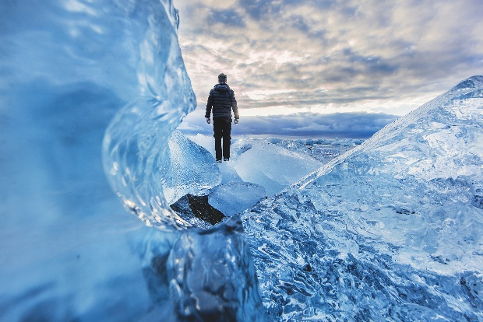
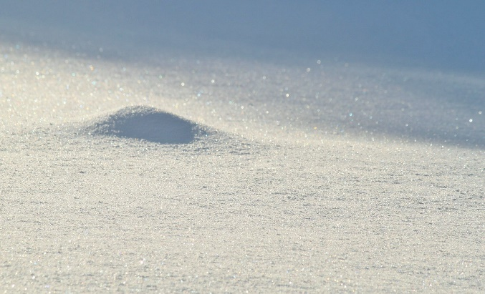
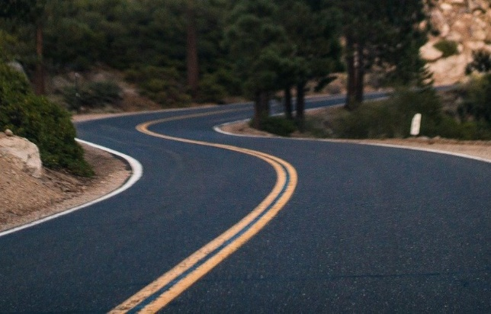
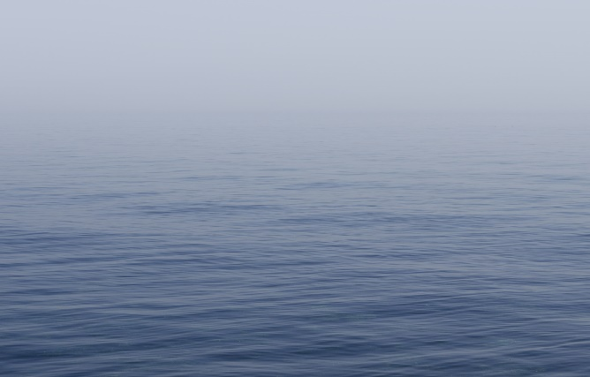
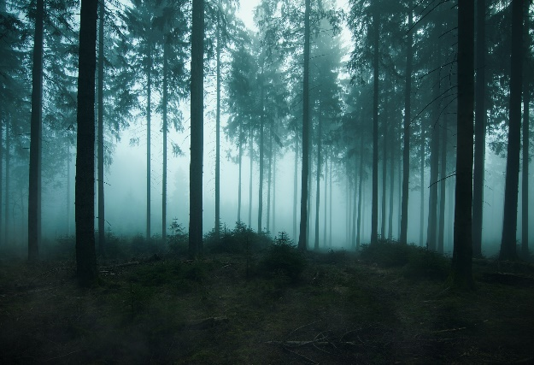
Low or high albedo?
Rank types of surface from lowest to highest albedo: Ice, fresh snow, asphalt, water, forest
Notes:
You may also ask students to guess values of each Ssrface. On the next slide they will be able to read them from the graph. While showing the correct answer, you may also inform students about the values.

Slide 14
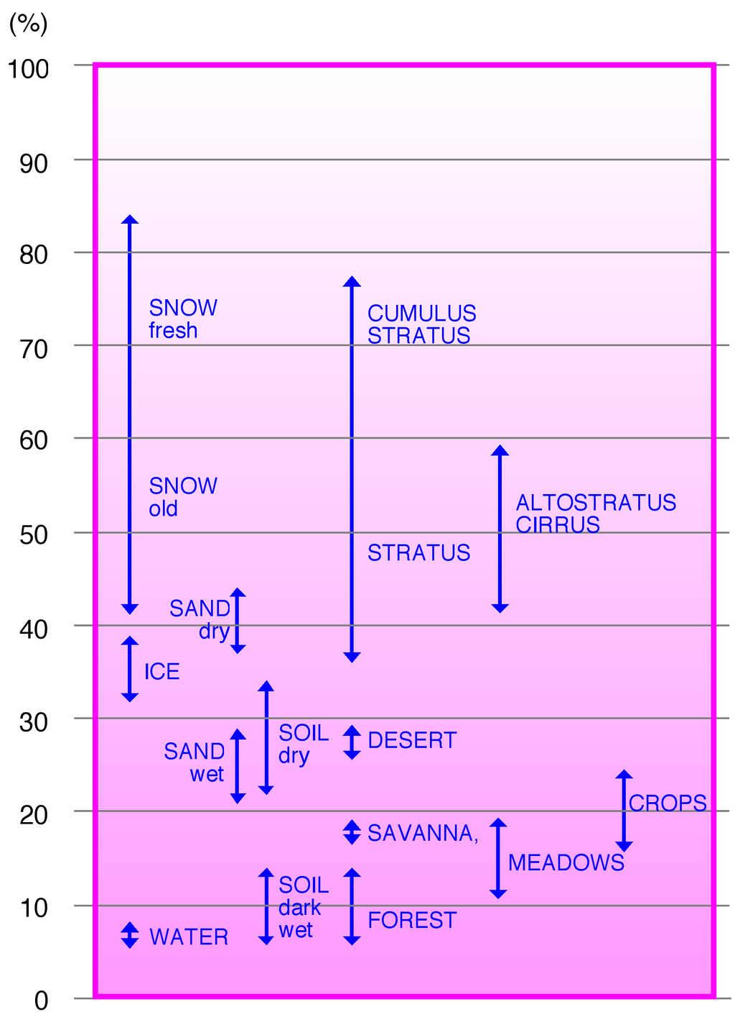
Low or high albedo?
Albedo - Percentage of reflected sun light in relation to the various surface conditions of the Earth
By Hannes Grobe, Alfred Wegener Institute for Polar and Marine Research, Bremerhaven, Germany
Notes:
Showing the figure you may aks students, how they may explain the differences. E.g. dry soils has albedo 22-33% - it depends on the type of the soil – for example its colour and moisture. The biggest difference is for snow – the clean and fresh snow has the highest albedo. Whereas for old and dirty snow albedo reduces to even 45%.

Slide 15
Low or high albedo?
from lowest to highest albedo:
< < <
Asphalt water forest
<
Ice
Notes:
Asphalt has the lowest albedo ca. 5-10%
Water's albedo differs depending on the Sun elevation. It is usually ca. 10%
Forest has albedo ca. 15%.
Sea ice has albedo ca. 36-50%.
Fresh snow has the highest albedo. It reaches even 95%.

Slide 16
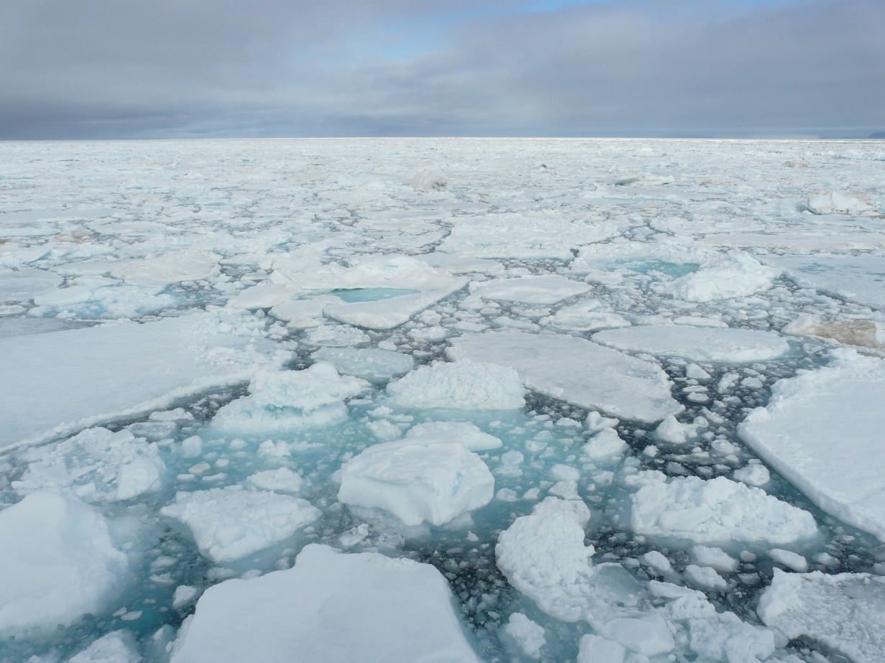
The sea ice extent (area covered by the sea ice) differs over season. It varies from ca. 6.3 to 15.5 million km² on average.
When (month) do you expect the lowest extent and why?

Slide 17
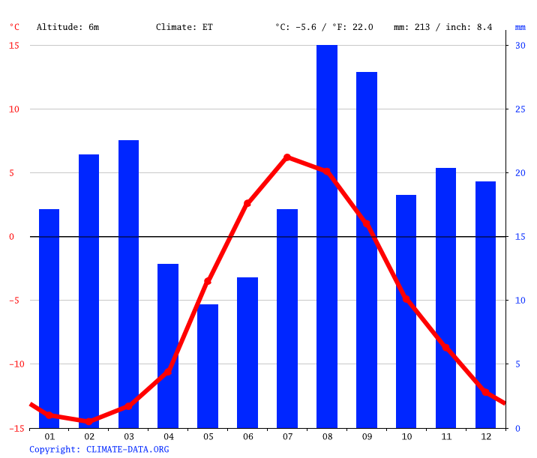
Climate-graph – Longyearbyen (Svalbard)
Notes:
The lowest coverage is stricly related to the moment when average daily temperaturę falls below zero. Then the proces of melting ice stops and the sea ice extent starts to increase.

Slide 18
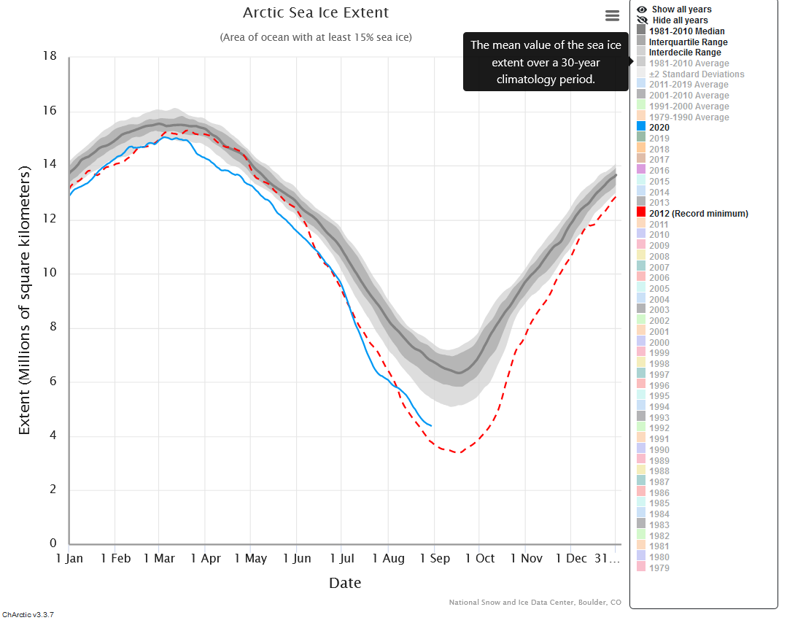
Notes:
Using the graph you may check the sea ice extent in various years, starting form 1979, where satelite observations of the sea ice started. You may choose the year by simply clicking on it in the right menu. Let students play with the graph online: https://nsidc.org/arcticseaicenews/charctic-interactive-sea-ice-graph/
They may now work with the worksheet no. 1.

Slide 20
Let’s do some calculations!

Slide 21
Melting ice
?
What do you think will happen if ice in the Arctic melts more than usual in terms of the albedo effect?
How it may affect the rate of melting ice? Does it faster of slower the process?
Do you know, how we call such effect?

Slide 22
Positive feedback loop
A positive feedback loop occurs in nature when the product of a reaction leads to an increase in that reaction.
Positive feedback loops enhance or amplify changes; this tends to move a system away from its equilibrium state and make it more unstable.

Slide 23
Positive feedback loop
Which processes describe a positive feedback loop?
The photosynthesis in plants speeds up in response to increased levels of carbon dioxide.
Ice melts leading to decreased albedo.
Ice melts leading to increasing of moisture and formulation of clouds.
Warmer temperature cause sea level to rise.
Notes:
The photosynthesis depends on the level of CO2. But the increase in photosynthesis does NOT amplify the increase of levels of carbon dioxide.
Melting sea ice couses change of albedo (water has lower albedo and absorbs more sun energy than ice). The lower albedo increases the rate of melting ice.
Ice melts leading to increasing of moisture and formulation of clouds - This is an example of negative feedback loop. Formulation of clouds limits the solar radiation reaching the Earth surface. The less radiation reaches the surfaces, the less ice is melting.
Rising sea level is an effect of temaperature increase, but does NOT cause further increase of temperature.

Slide 24
Positive feedback loop
Which processes describe a positive feedback loop?
The photosynthesis in plants speeds up in response to increased levels of carbon dioxide.
Ice melts leading to decreased albedo.
Ice melts leading to increasing of moisture and formulation of clouds.
Warmer temperature cause sea level to rise.
Notes:
Only the second example is a positive feedback loop.

Slide 25
What would happen, if…
Let’s step into the shoes of scientists for a little bit and think what influences the rate of melting sea ice and what could help to slow down the process.
Write down as many questions come to your mind. Discuss your ideas in groups. Add hypothesis to questions, which intrigue you most.
Finally, choose one hypothesis, which you will further investigate on.

Slide 27
Back to permafrost

Slide 28
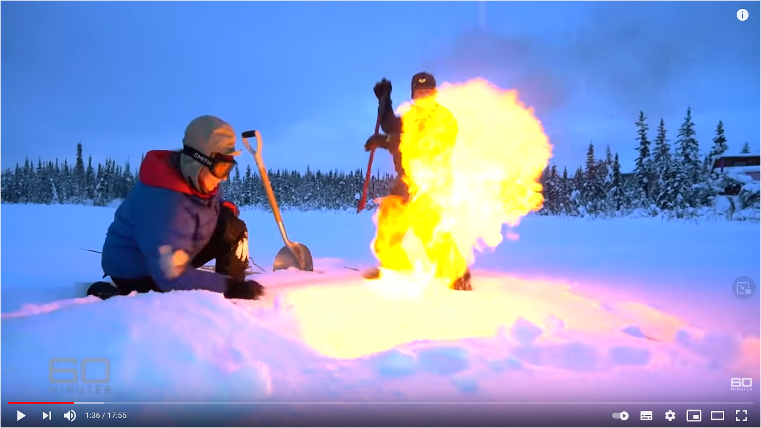
Notes:
Link to the video: https://youtu.be/zuiQtLAUi6U

Slide 29
Fill in the blanks
Notes:
If temperature increases, permafrost starts to thaw. As permafost contains organic matter, when it thaws, this matter starts to decompose and releases greenhouse gases. The more greenhouse gases are realesed to the atmosphere, the stronger is the effect of climate change and the temperature increases faster. It accelerates the process of thawing permafrost. Therefore, we call it a positive feedback loop.

Slide 30
Fill in the blanks
If temperature increases, permafrost starts to thaw. As permafost contains organic matter, when it thaws, this matter starts to decompose and releases greenhouse gases. The more greenhouse gases are realesed to the atmosphere, the stronger is the effect of climate change and the temperature increases faster. It accelerates the process of thawing permafrost. Therefore, we call it a positive feedback loop.

Slide 31
Release of methane and CO2 from permafrost
Scientists know that even with the rapid climate change the carbon deposit trapped in permafrost will not be revealed immediately. They use various models to estimate potential cumulative carbon release from thawing permafrost.
Scientists cannot estimate the carbon release with high accuracy, because they need to take into account various scenarios of temperature increase.

Slide 32
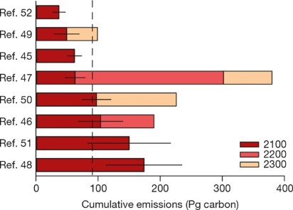
Release of methane and CO2 from permafrost
On the graph you may see potential carbon release by 2100, 2200, and 2300 for different scenarios of climate change.
Source: EAG Schuur et al. Nature 520, 1-9(2015) doi:10.1038/nature14338

Slide 33
Permafrost’s gases versus anthropogenic emission
Now, you will calculate the possible emissions of greenhouse gases from thawing permafrost and compare them to antropogenic (caused directly by humans) emissions.
Scenario | GT of carbon released by 2100 from permafrost | GT of CO₂ released by 2100 from permafrost | GT of CO₂ produced yearly by your country | GT of CO₂ estimate of production by your country 2100 | %
Ref. …
Notes:
First, choose one scenario and put the ref. number in the table. You may work in groups and each group will use different scenario.
In the second column write the number of gigatons (GT) of carbon, which will be relased by 2100 according to scientific models. Remember that 1 GT = 1 PG (petagram) = 1billion tonnes = 10^9 tonnes.
From 1 kg of carbon circa 3 kg of CO2 are produced. Calculate CO2, which will be produced from carbon released due to thawing permafrost and write the numbers in the 3. column.
In the fourth column write the number of GT of CO2 produced yearly by your country. In the next column write the number of GT of CO2 produced by your country from now till 2100 assuming that the emission stays at the same level as it was in 2019.
In the last column compare both types of emission and calculate percentage.

Slide 34
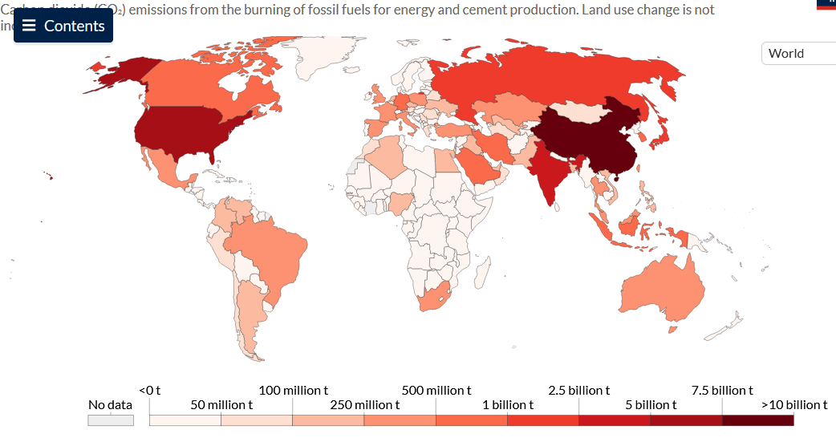
How much CO2 does your country produce?
Notes:
How much CO2 does the world emit? Which countries emit the most? Check how much your country emitts.
https://ourworldindata.org/grapher/annual-co2-emissions-per-country

Slide 35
Thank you for your attention!
More information:
http://polar-star.ea.gr/

