Slide 1
Exploring the POLAR STAR activities’ kit – Part 1
Agata Goździk

Slide 2
Notes:
The Northern Lights or Polar Lights are also known as "Aurora Borealis" and they appear in the North Hemisphere near the north magnetic pole. Watch a short movie with videos and photos taken next to the Polish Polar Station Hornsund on Svalbard - archipelago in the European part of the Arctic. Observe the colours and type of movement of the northern lights.

Slide 3
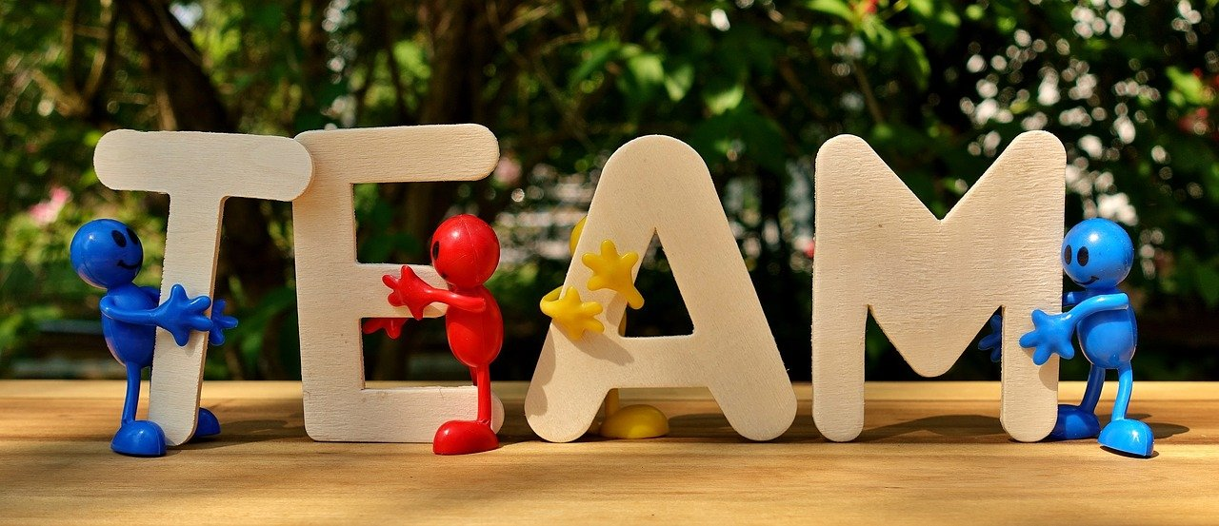
Tribe activity
Before scientists gave an explanation to this phenomenon, people of ancient times had various beliefs regarding the brilliant light shows occurring in the sky above them.
Let's put our creativity hats on!

Slide 4
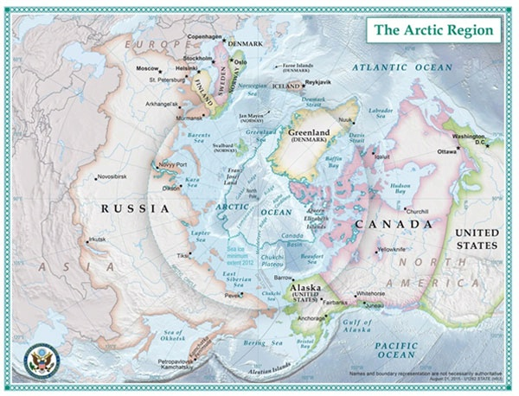
Imagine that you lived near the Arctic Circle thousands of years ago - long, long before scientists explained the Northern Lights phenomenon.
Where did your tribe live? - Choose one of the following locations: Northern Norway, Northern Sweden, Greenland, Iceland, Northern America.
This map of the Arctic was created by State Department geographers as part of the U.S. Chairmanship of the Arctic Council. Source: https://2009-2017.state.gov/e/oes/ocns/opa/arc/uschair/258202.htm

Slide 5
Tribe activity
*What is your tribe like? - Imagine and describe your tribe briefly (e.g. your traditions or characteristics). You may do a brief online search if you wish to retrieve information about these civilizations.
*Your tribe lives in an area where the Aurora is visible. How does your tribe 'explain' the aurora phenomenon based on its tradition and characteristics? - Make the folklore story of your tribe.

Slide 6
Notes:
After students created their tribe's story and shared with the peers, let them watch the video presenting the beliefs of people in ancient times on the northern lights.
Next, discuss, if their stories were similar or completely different?

Slide 7
Chasing auroras – group work
Group 1. What is solar wind/ solar flares? How fast it may be? How the Sun’s activity is changing and how it affects auroras?
Group 2. Auroras are also known as the Polar Lights. Why do auroras occur mainly in ovals centering the magnetic poles?
Group 3. What colors may aurora have? What determines the color of the aurora?
Group 4. Is the Earth unique with the auroras? Could they be observed at other planets of our Solar System?
Notes:
In the teachers’ guidelines the answer key is provided. If students don’t find the correct answers, teacher may provide information. If you work with a small group of students, you may skip some questions.

Slide 8
Notes:
After students made their own investigation on auroras and shared their findings with peers, let them watch a short summary lesson by Michael Molina. The Aurora Borealis and Aurora Australis occur when high-energy particles are flung from the Sun's corona toward the Earth and mingle with the neutral atoms in our atmosphere - ultimately emitting extraordinary light and color. Michael Molina explains every step of this dazzling phenomenon.

Slide 9
Let’s create an art work
You may use watercolor paints to create your artwork.
You may write a poem inspired by the epic battle between the Sun and the Earth.
You may play roles of a scientist and a interviewing journalist.
Just follow your artistic impulse!
Notes:
If you prefer other techniques or you are looking for other shapes of aurora, you may find inspiration in journals of various artists collected on Pinterest.
If you are looking for more inspiration with other techniques, have a look at website: http://funart4kids.blogspot.com/2011/01/aurora-borealis.html

Slide 10
Thank you for your attention!
More information:
http://polar-star.ea.gr/

