Slide 1
STEAM Education: From Science to STEAM using a seamless approach
Eleftheria Tsourlidaki
Ellinogermaniki Agogi

Slide 3
Bridging the Gap

Slide 4
The POLAR STAR methodology rationale
Overloaded curricula
Interdisciplinary: Integrating knowledge and methods from different disciplines, using a real synthesis of approaches
Multidisciplinary: people from different disciplines working together, each drawing on their disciplinary knowledge.
Content/curriculum
Transdisciplinary: creating a unity of intellectual frameworks beyond the disciplinary perspectives.
Science in action/learning and teaching methodologies
Activities that don’t provoke their interest

Slide 6
Let’s make a pizza!
Today is pizza day for you and your friends!
But not all your friends share the same eating preferences…
Make a pizza that suits your friends’ preferences best!
Strictly Vegan
Passionate meat eater
The “I love veggies” type
The “I eat everything” type

Slide 7
Let’s make a pizza!

Slide 8
Let’s make a pizza!
Now present to the group the pizza you made for your friends!
Did you make the exact same pizzas?
Did you make the exact same pizza to meet the same eating preferences?
What would happen if you distributed the pizza randomly and not according to preferences?
Strictly Vegan
Passionate meat eater
The “I love veggies” type
The “I eat everything” type

Slide 9
From eating preferences… …to learning preferences
What are the different learning styles of your students?
The hands-on type
The one all over the place
The ‘smarty-pants’
The quite but brilliant
The tech expert
The one all over the place
The ‘I don’t care’ one
The ‘leader’
The ‘follower’
The shy one
The ‘question everything’ type
The ‘researcher’
The artistic type
… and many more

Slide 10
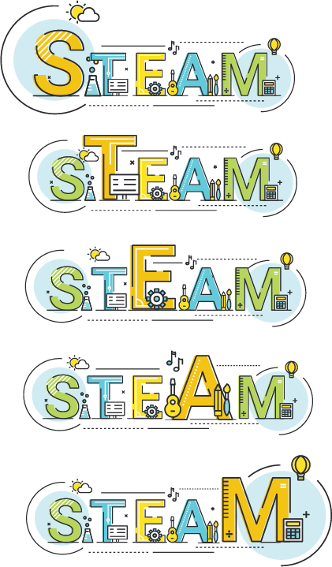
The many flavors of STEAM
Notes:
Why?

Slide 11
The challenges
In ideal scenarios, the teacher’s role is becoming that of a mentor, visiting with groups and individual learners during class to help guide them, while allowing them to have more of a say in their own learning.
NMC Horizon Report Europe: 2014 Schools Edition
Under the current circumstances, in which due to the pandemic not only has the ‘how’ of learning processes changed but also the ‘when’ and ‘where’, the role of the teachers is changing anew and becomes one in which they are activators of learning; practitioners who can differentiate task, time and space to meet student needs and include them as co-designers of that learning. The challenge is to integrate the best of what we have learned from this remote phase with the new skill set required for the future
Education Reimagined: The future of learning. Fullan, 2020

Slide 12
The challenges
How do I select the ideal type of activity?
How do I handle time?
How do I accommodate different learning styles?
Can I give different tasks to different students?

Slide 13
The many flavors of STEAM
Different types of activities, meet the needs of different students more effectively? – One size does not fit all
Choosing the type of activity depends on the subject, but variations need to be put in place to address different learning styles.
How can we build multidimensional activities tailored to multiple learning styles?

Slide 14
Notes:
https://www.youtube.com/watch?v=9RHMpi5diwg&t=14s

Slide 15
Time to snoop around!

Slide 16
STEAM approach
Station 1
STEAM approach
Station 2
STEAM approach
Station 3
You can spend 30 minutes per station

Slide 17
STEAM Education STEAM approach

Slide 18
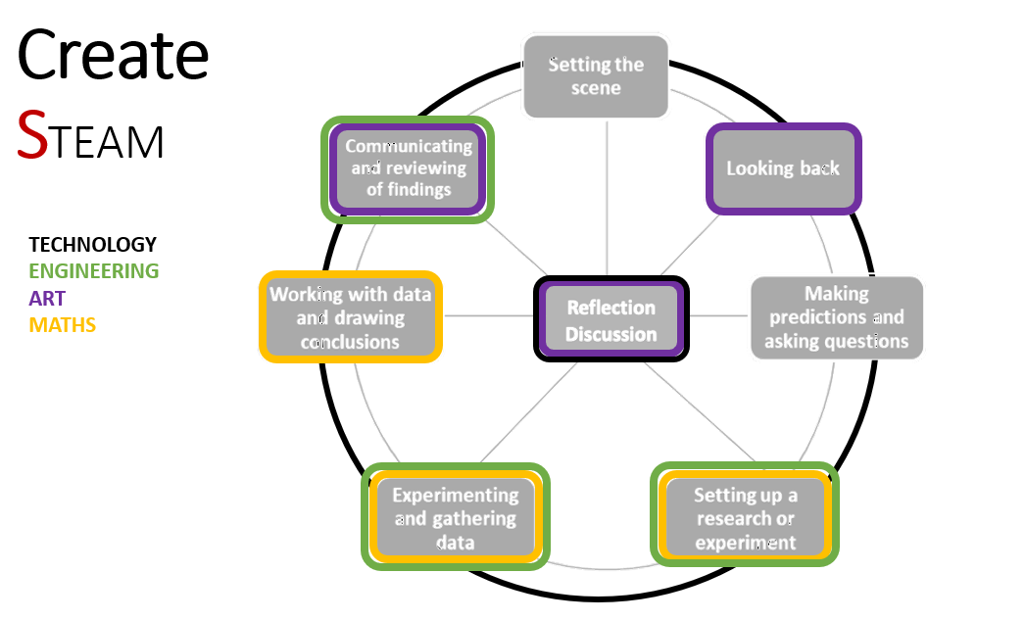
STEAM
Learn more:
http://polar-star.ea.gr/content/science-steam

Slide 19
STEAM Education STEAM approach

Slide 20
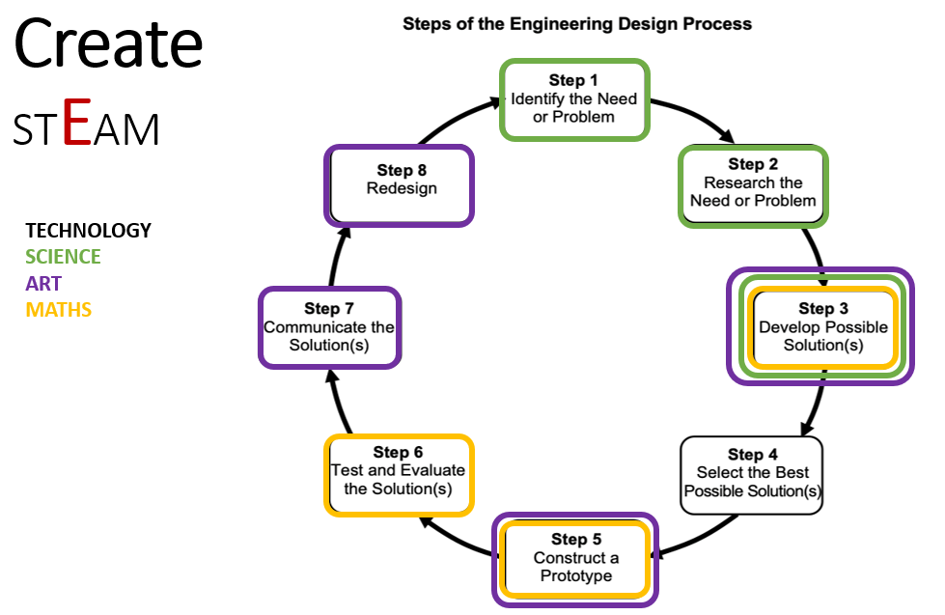
STEAM
Learn more:
http://polar-star.ea.gr/content/engineering-steam

Slide 21
STEAM Education STEAM approach

Slide 22
Art-based STEAM activities
Learn more:
http://polar-star.ea.gr/content/art-steam
STEAM
Drawing inspiration from STEM
Use Art to communicate science in an engaging way
Making Art following scientific research processes

Slide 23
Your guiding POLAR STAR…
How can I integrate the POLAR STAR approach in my teaching?

Slide 24
What can I do in my class?
Everyday Teaching
Links and cross-overs between classes on common subjects looked upon from different perspectives
Projects
Interdisciplinary projects organized by a team of collaborating teachers
The POLAR STAR Methodology tools
The POLAR STAR kit of activities and STEAM templates

Slide 25
The Design Thinking (DT) Guide for Teachers
FEEL
IMAGINE
CREATE
SHARE
It serves as a guide for teachers when preparing their lessons/ activities/projects/school year plan in interdisciplinary and transdisciplinary STEAM education.
Four phases: Feel – Imagine – Create – Share

Slide 26
DT Guide: phases
FEEL
IMAGINE
CREATE
SHARE
In each phase, you are prompted to reflect on certain questions that facilitate your instructional planning.
Icon explanation
Science WAND
STEAM education guide

Slide 27
DT Guide: Feel Phase
FEEL
What am I teaching? - Make an overview of the curriculum you plan to teach
What are the pre-requisite skills and knowledge that my students should have already developed?
Why is this topic important? - For each chapter/concept think about links you can make to other concepts/technology achievements/everyday life
Where should my focus be? - Is it best to focus more on Science, Engineering, Math or Arts?
How do I focus on that aspect of STEAM?

Slide 28
DT Guide: Imagine phase
FEEL
IMAGINE
Working alone - Where should my focus be?
When (which teaching phase) and how (demonstration, discussion, experiment) is it best to integrate concepts/technology achievements/everyday life links in your every-day teaching
Can I make the connections ‘tangible’ for my students and help them add their personal experience in the process?

Slide 29
DT Guide: Imagine phase
FEEL
IMAGINE
Working with your colleagues - Do a participatory workshop to find out:
What do my colleagues teach in their class?
Is there any common ground between what we teach?
How can we take advantage of overlapping and common concepts to make connections or to build an interdisciplinary project?
A dedicated POLAR STAR Design Thinking-based workshop is available, along with a guide to help you implement the methodology in your school!

Slide 30
DT Guide: Create phase
FEEL
IMAGINE
CREATE
Everyday Teaching
Links and cross-overs between classes on common subjects looked upon from different perspectives
Projects
Interdisciplinary projects organized by a team of collaborating teachers

Slide 31
DT Guide: Create phase
FEEL
IMAGINE
CREATE
 | Working Alone | Working with colleagues
Long-term projects | Choose the subject based on your answers in the two previous phases and based on which you feel are the most important/interesting subjects for your students | Choose the subject based on the outcome of the participatory workshop
 | Choose among our STEAM / STEAM / STEAM templates to structure your activities Design an interdisciplinary project for your students based on your answers in the previous questions
Everyday teaching | Make an timeline with the connections and links you want to mention for each subject you are teaching (Imagine phase) - Decide on the STEAM interventions you want to make | Based on the participatory workshop, make an outline of the cross-overs you want to have, focusing on the timeline of your classes.

Slide 32
DT Guide: Create phase
FEEL
IMAGINE
CREATE
SHARE
Implement the activity/project with your students as planned
Evaluate the process (in terms the degree of achieving your learning goals)
Share with others (e.g. peers, school, community) the problems you identified and results/solutions
Refine the instructional methodology and procedures followed for future use

Slide 33
Summing Up

Slide 34
Bridging the Gap

Slide 35
The POLAR STAR methodology rationale
Connection to
everyday life
(what and how)
The bigger picture behind individual science concepts
Connections between science concepts and phenomena
The science concepts taught in school
From Science
to STEAM
Science
as a whole
Basic Ideas
of Science

Slide 36
Summing Up
What are we trying to achieve?
Promote the teaching of Science disciplines within a uniform, seamless framework
Why do we want to do this?
Make sure core concepts stick with the students
Increase knowledge retention
Give meaning to what students learn at schools
How do we do this?
Providing a standard interdisciplinary backbone structure /reference system
Personalized learning,
Meaningful connections between concepts and phenomena
TEAM extensions to science concepts
When and where do we do this?
Everyday teaching at any opportune moment
Interdisciplinary long-term projects
As part of the reflection process (A year long plan)
With who do we do this?
Yourself
Other STE teachers
Math teachers
Art teachers

Slide 37
Thank you for your attention!
More information:
http://polar-star.ea.gr/

