Slide 1
Introduction to interdisciplinary learning: The Big Ideas of Science
Eleftheria Tsourlidaki
Ellinogermaniki Agogi

Slide 2
What’s a tangram?
Tangram means "seven boards of skill“. It is a dissection puzzle consisting of seven flat shapes, called tans, which are put together to form shapes. The objective of the puzzle is to form a specific shape using all seven pieces, which may not overlap.

Slide 3
Challenge 1
Can you make a square using all 6 tans?

Slide 4
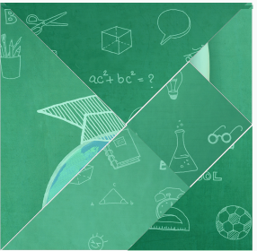
What are the common characteristics of the tangrams?
Uniform color
Same shape
Similar tans

Slide 5
Now look closer at the tans. Is there anything particular about them?

Slide 6
Challenge 2
The tans contain a hidden message.
Try to rearrange them to find out what it is.

Slide 7
Use the shape of the tangram as a guide to put the puzzle together.
Look at the back of each tan for further help!

Slide 8
What is the hidden message?

Slide 9
Reflecting on the activity
How did you work in order to make the tangrams?
How did you work in order to uncover the hidden message?
Is there a common scheme that helped build both the tangrams and the final puzzle?
Which is more appealing to you, the separate tangrams or the puzzle?

Slide 10
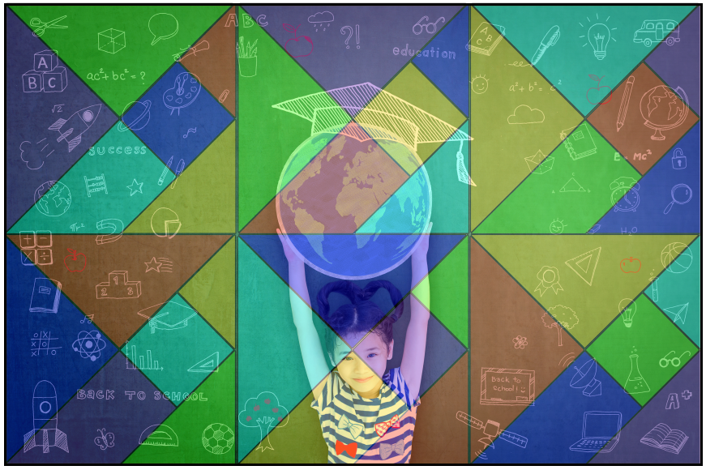
The analogy
Science Concepts
Core Interdisciplinary concepts
Science Disciplines
Science as a whole

Slide 11
COSMOS
CHEMISTRY
BIOLOGY
ENVIRONMENT
PHYSICS
CHEMISTRY
BIOLOGY
ENVIRONMENT
PHYSICS
concepts
concepts
concepts
concepts
concepts
concepts
concepts
concepts
concepts
concepts
concepts
concepts
concepts
concepts
concepts
concepts
concepts
concepts
concepts
concepts
concepts
concepts
concepts
concepts
concepts
concepts
concepts
concepts
concepts
concepts
concepts
concepts
concepts
concepts
concepts
concepts
concepts
concepts
concepts
concepts
concepts
concepts
concepts
concepts
concepts
concepts
concepts
concepts
concepts
concepts
concepts
concepts
concepts
concepts
concepts
concepts
concepts
concepts
concepts
concepts
concepts
concepts
concepts
concepts

Slide 12
The added value of Interdisciplinary learning
Providing common ground behind different natural phenomena.
Enable learners as individuals to understand aspects of the world around them.
Understand certain concepts and the connection between different principles and phenomena which at first sight might appear to be irrelevant.
Enable students to better understand how the world works
Can potentially increase knowledge retention.
Promotes collaboration and facilitates deeper learning processes.

Slide 13
How do we embed interdisciplinary learning in current teaching practices?
Providing common ground behind different natural phenomena.

Slide 14
What is needed?
Introduce an organization scheme that goes beyond the typical ones which helps teachers introduce to their classrooms activities as a progression from small, beginning ideas, followed by the bigger ones which can be developed to encompass a wider range of experiences, leading to the broad, more abstract ideas that enable understanding of objects, phenomena and relationships in the natural world.

Slide 15
Organization scheme
Basic concepts – curriculum content
Basic concepts – curriculum content
Basic concepts – curriculum content
Basic concepts – curriculum content
Core
Concepts
Core
Concepts
Core
Concepts
Core
Concepts

Slide 16
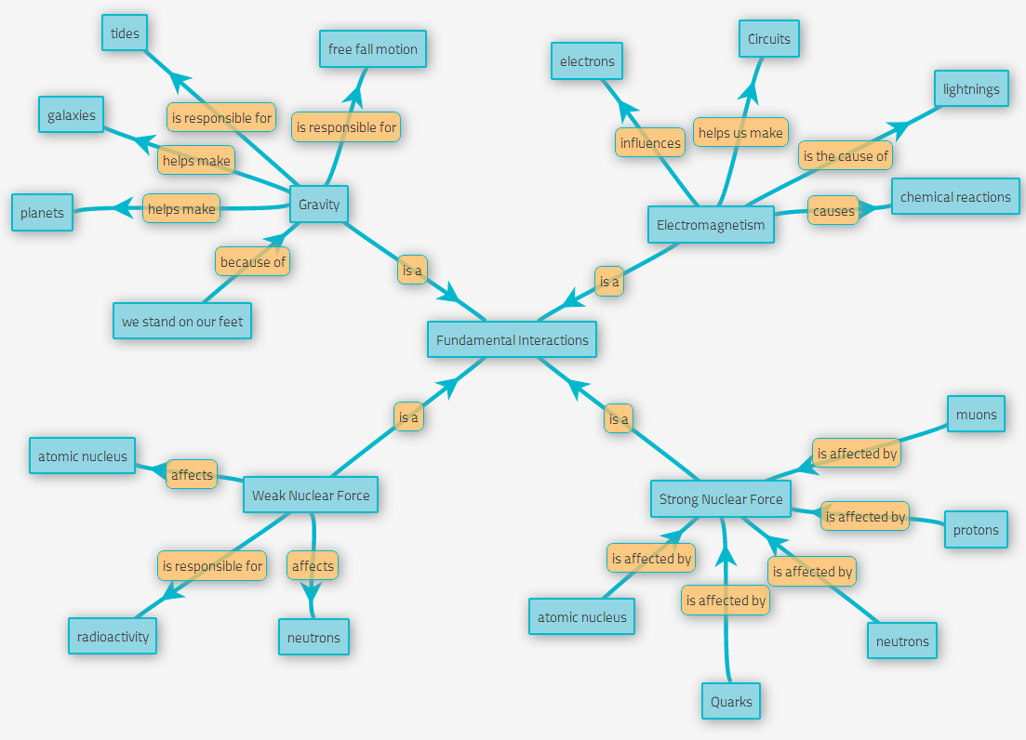
Core interdisciplinary concepts
A set of cross-cutting scientific concepts that describe the world around us and allow us to conceive the connection between different natural phenomena

Slide 17
Core interdisciplinary concepts
Cross-cutting scientific concepts
Fundamental concepts that to their total describe our world.

Slide 18
Which are the core concepts that could constitute a backbone organization scheme?
What is really important?

Slide 19
electricity
equations
forces
DNA
magnets
ph
friction
vectors
Life cycle
alkalis
molecules
photons
functions
gravity
kinematics
galaxies
Biosphere
Photosynthesis
Solubility
Mitosis
Ampere's law
Catalysts
Energy
Wind energy
Thermodynamics

Slide 20
Why do I have to learn this?

Slide 21
The why – why reflection tool
Why do students complain about having to learn what we teach them?
Too many things to learn
Too little time to work on each subject
They don’t want to study
They find no meaning in what we teach them
Why do they find no meaning in what we teach them?

Slide 22
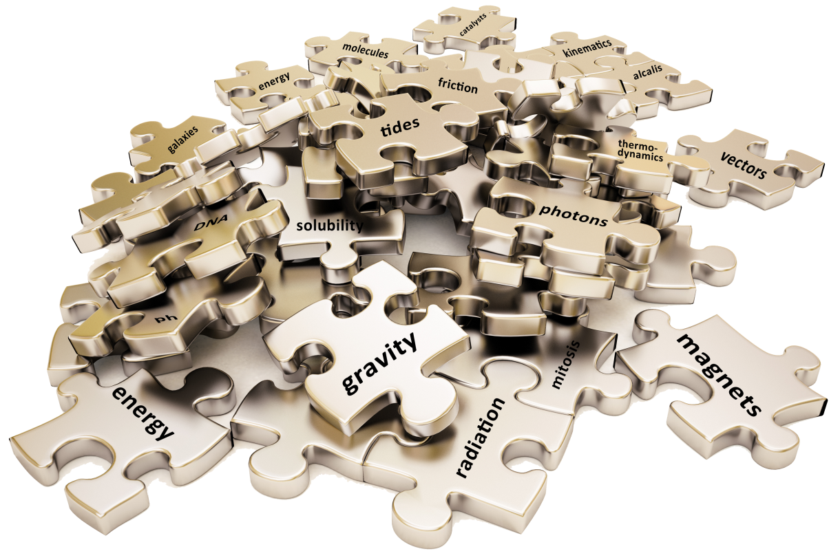

Slide 23
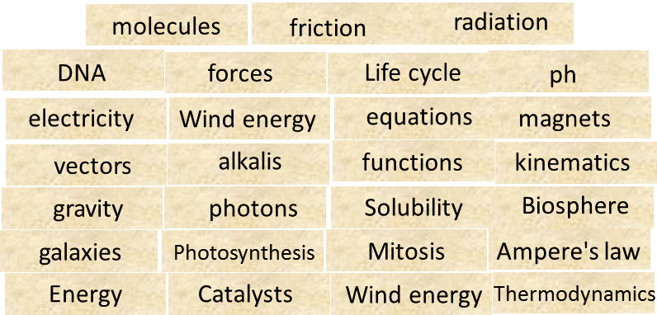
electricity
equations
forces
DNA
magnets
ph
friction
vectors
Life cycle
alkalis
molecules
photons
functions
gravity
kinematics
galaxies
Biosphere
Photosynthesis
Solubility
Mitosis
Ampere's law
Catalysts
Energy
Wind energy
Thermodynamics

Slide 25
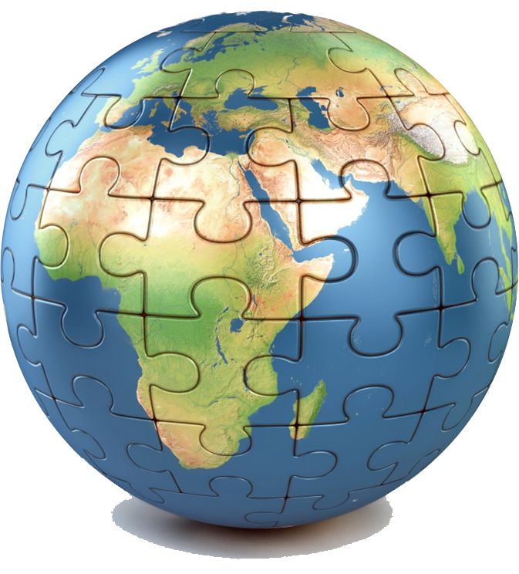
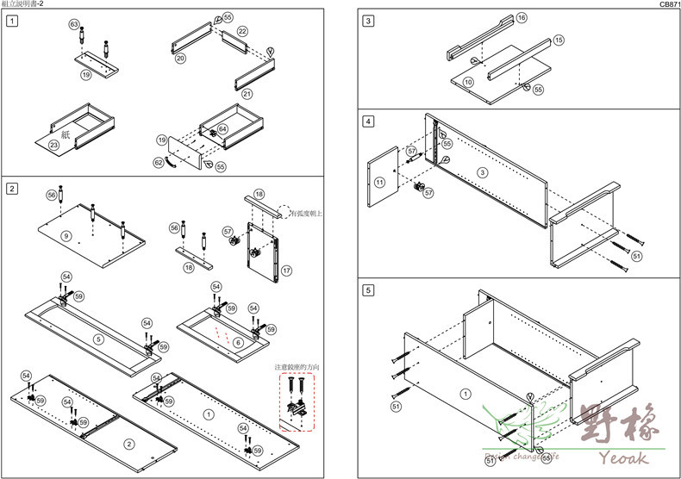
The Bigger picture
A guide and tools to place every piece of knowledge in the right place
An Interdisciplinary backbone structure
What is really important?

Slide 26
What is really important?
Students forget almost 90% of what they have learned only a couple of years after the finish school.
The 10% that remains is scattered pieces of knowledge unconnected to each other.
If we could choose that 10% of knowledge that sicks with them, what concepts would we choose?

Slide 27
What is really important?
Do all the concepts you teach have the same gravity?
How do you prioritize between core concepts and secondary concepts?

Slide 28
What is really important?
Among all the concepts students are taught over their school life, which are the core concepts that constitute the foundations of how the world works?
What so every educated person know about the laws and principles of nature to be considered science literate (to a basic level)?
Tip1: Don't focus on your discipline, think about all science disciplines.
Tip2: We are focusing on curriculum. So think about core concepts of science and not about science (like the added value of science in our life or the ethical extensions of science research)

Slide 29
What is really important?
Write each core concept you can think of to a post-it paper and stick it on the wall.
Write ONE CONCEPT PER POST-IT
Have a look at all the post-its on the wall and group them according to your understanding.
Take a group of post-its and write a phrase that summarizes the core concept behind them.

Slide 30
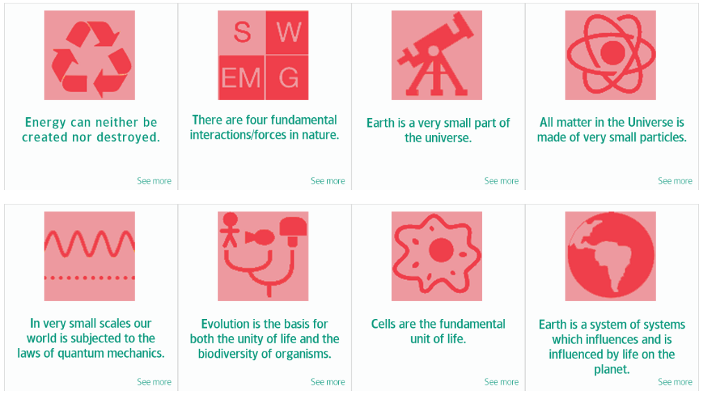
The Big Ideas of Science

Slide 31
Big Ideas of Science
1. Energy cannot be created or destroyed. | 5. In very small scales our world is subjected to the laws of quantum mechanics.
2. There are four fundamental interactions/ forces in nature. | 6. Evolution is the basis for both the unity of life and the biodiversity of organisms (living and extinct).
3. Earth is a very small part of the Universe. | 7. Organisms are organized on a cellular basis.
4. All matter in the Universe is made of very small particles. | 8. Earth is a system of systems which influences and is influenced by life on the planet.
It can only transform from one form to another. The transformation of energy can lead to a change of state or motion. Energy can also turn into mass and vice versa.
All matter and radiation exhibit both wave and particle properties. We cannot simultaneously know the position and the momentum of a particle.
Gravitation, electromagnetism, strong-nuclear and weak nuclear. All phenomena are due to the presence of one or more of these interactions. Forces act on objects and can act at a distance through a respective physical field causing a change in motion or in the state of matter.
Organisms pass on genetic information from one generation to another.
The Universe is comprised of billions of galaxies each of which contains billions of stars (suns) and other celestial objects. Earth is small part of a solar system with our Sun in its centre that in turn is a very small part of the Universe.
They require a supply of energy and materials. All life forms on our planet are based on this common key component.
They are in constant motion and the bonds between them are formed by interactions between them. Elementary particles as we know them so far form atoms and atoms form molecules. There is a finite number of types of atoms in the universe which are the elements of the periodic table.
The processes occurring within this system influence the evolution of our planet, shapes its climate and surface. The solar system also influences Earth and life on the planet.

Slide 32
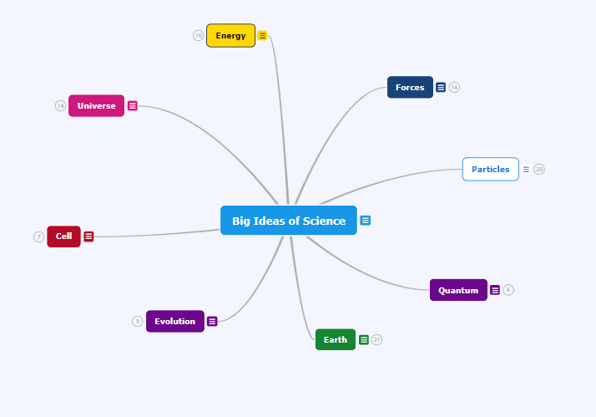
From small to the Big Ideas of Science

Slide 33
Thank you for your attention!

