Slide 1
Science as a whole: An interdisciplinary approach for Science Education
Eleftheria Tsourlidaki
Ellinogermaniki Agogi

Slide 2
Why do I have to learn this?
What is important?

Slide 3
The why – why reflection tool
Why do students complain about having to learn what we teach them?
Too many things to learn
Too little time to work on each subject
They don’t want to study
They find no meaning in what we teach them
Why do they find no meaning in what we teach them?

Slide 4
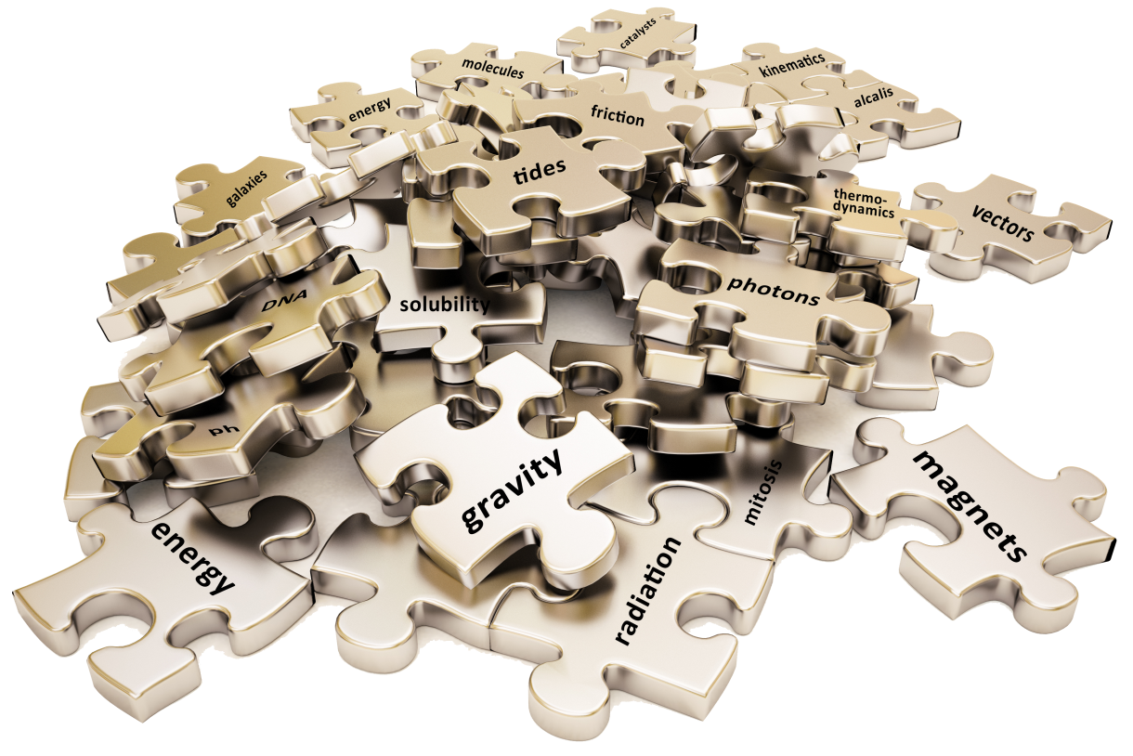

Slide 5
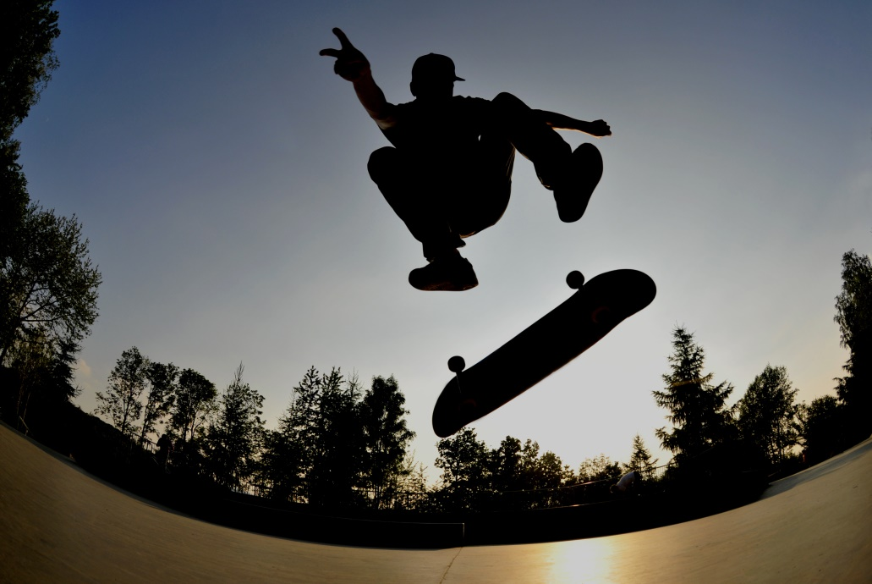
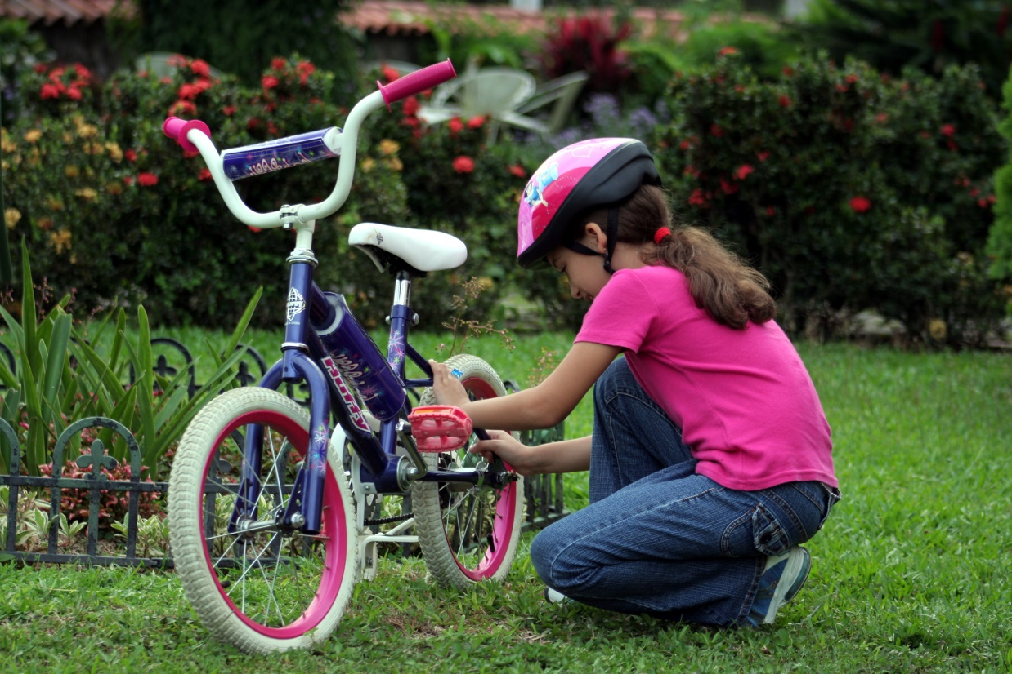
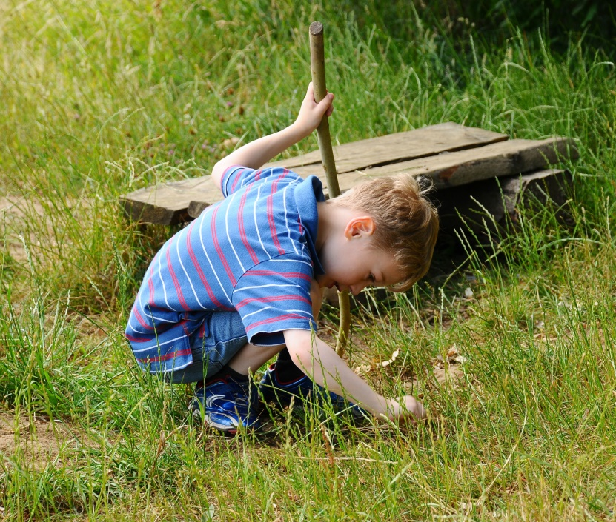
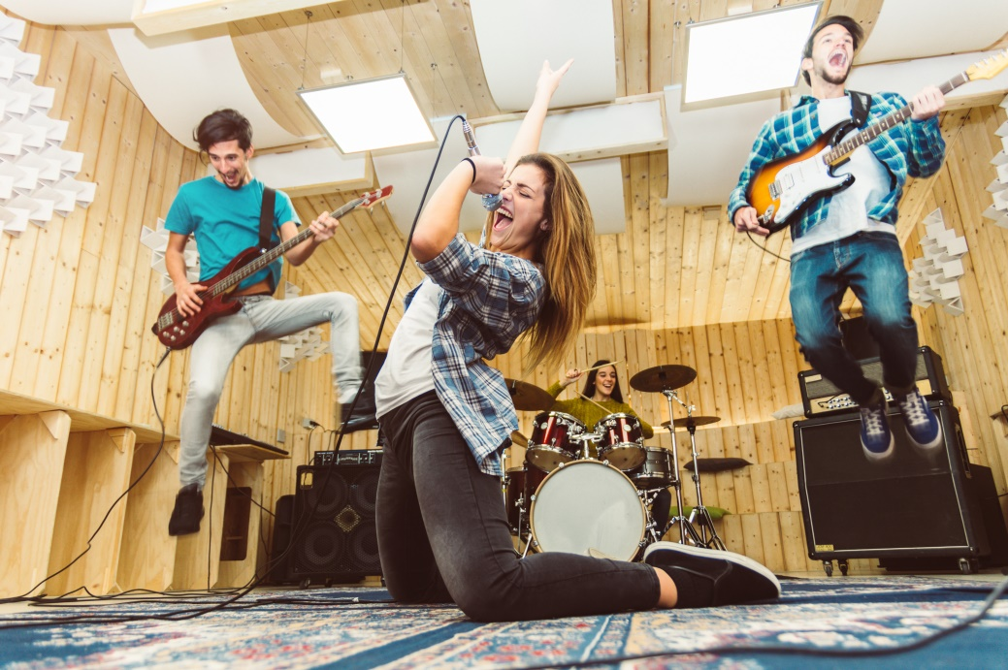
Everyday Life

Slide 6
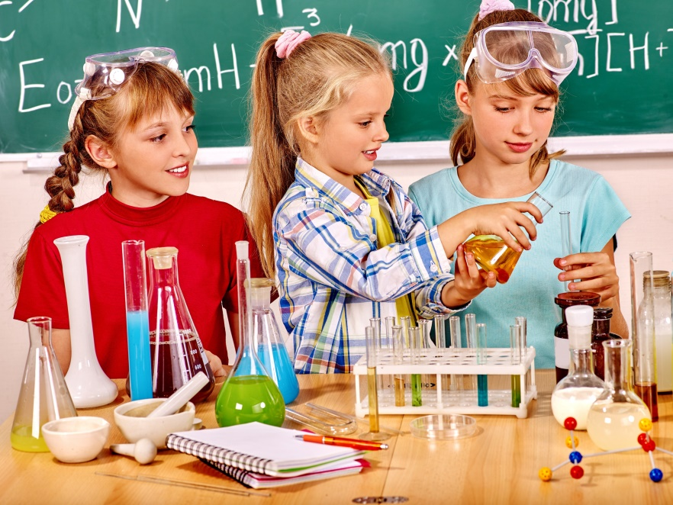
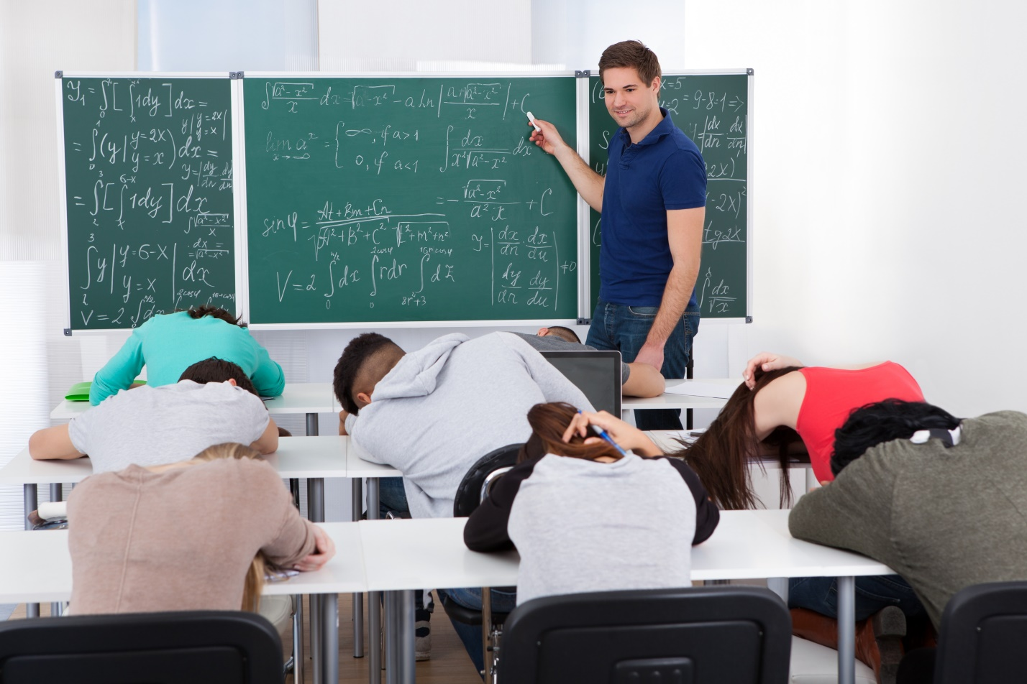
School
What happens in school stays in school…

Slide 7
?

Slide 8
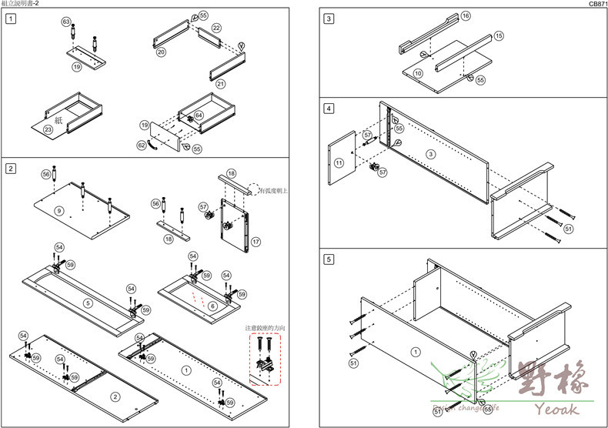
The Bigger picture
A guide and tools to place every piece of knowledge in the right place
An Interdisciplinary backbone structure
How do we give meaning to what students learn?

Slide 9
Bridging the Gap

Slide 10
Interdisciplinary: Integrating knowledge and methods from different disciplines, using a real synthesis of approaches
Multidisciplinary: people from different disciplines working together, each drawing on their disciplinary knowledge.
Content/curriculum
Transdisciplinary: creating a unity of intellectual frameworks beyond the disciplinary perspectives.
Science in action/learning and teaching methodologies

Slide 12
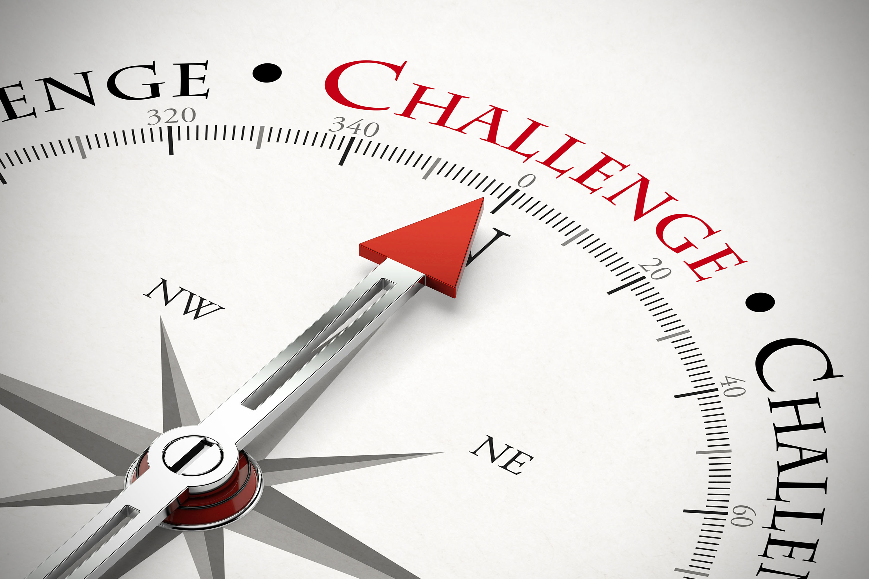
What is really important?
How do we increase knowledge retention?

Slide 13
How do we increase knowledge retention?
A guide and tools to place every piece of knowledge in the right place

Slide 14
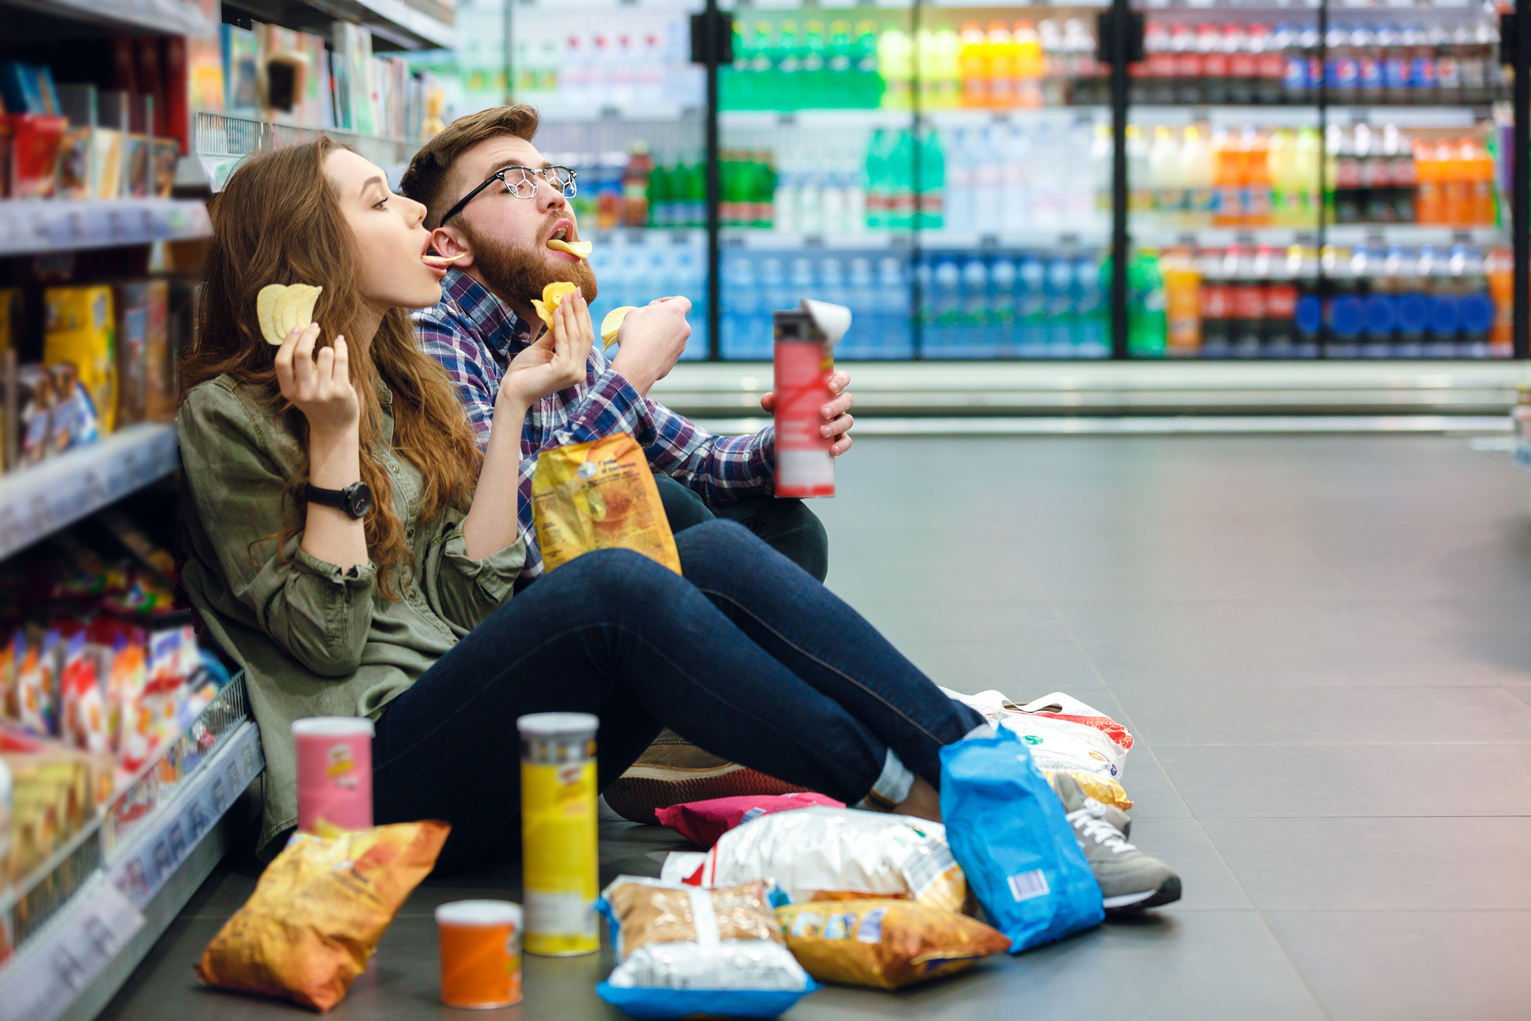
The shopping list challenge
How good are you at memorizing a grocery shopping list?
Let’s find out!

Slide 15
The shopping list challenge
You’ll be given a shopping list of 10 items
You’ll have 90 seconds to memorize them
Then… you’ll have to go shopping!
Those who complete the shopping list win!

Slide 16
The shopping list challenge
Milk
Cookies
Pasta
Garbage bags
Eggs
Sponges
Toilet paper
Ketchup
Bleach
Shampoo
1:30
0:30
0:20
0:50
0:40
1:10
1:20
0:00
0:10
1:00

Slide 17
The shopping list challenge
Time to go shopping!
Buy as many items from your list as you can remember!

Slide 18
The shopping list challenge
How many did you get?
What was your trick?
Milk
Cookies
Pasta
Garbage bags
Eggs
Sponges
Toilet paper
Ketchup
Bleach
Shampoo

Slide 19
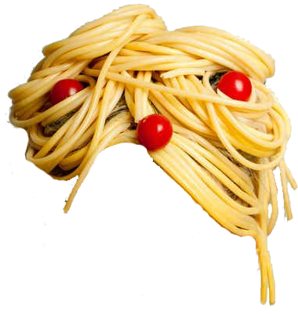
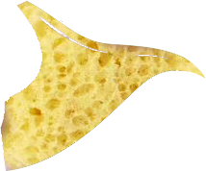
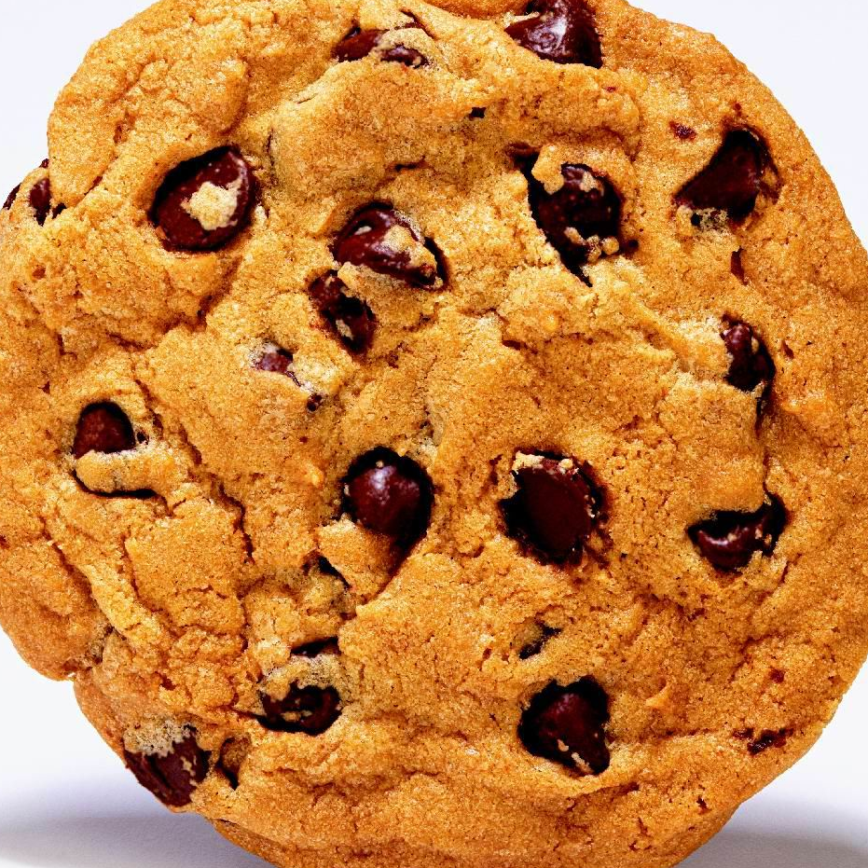
The shopping list challenge
Milk
Cookies
Pasta
Garbage bags
Eggs
Sponges
Toilet paper
Ketchup
Bleach
Shampoo

Slide 20
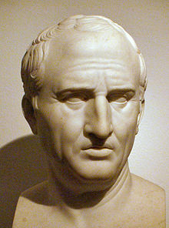
Tricks to strengthen your memory
Method of Loci (the Memory Palace) is a strategy of memory enhancement which uses visualizations of familiar spatial environments in order to enhance the recall of information.
How did people remember things back in the old days?
The Memory palace
Action
Emotion
Review
Cicero (106 – 43 BC)
and the Method of Loci

Slide 21
Tricks to strengthen your memory
Scene from a movie
The Memory palace
Action
Emotion
Review
Fried eggs (in Greek) are usually called Egg Eyes

Slide 22
Going in class
Can we use this method as a tool to increase students’ knowledge retention?
Moving from working memory to long-term memory
Selecting information based on importance
Deep processing → Connection to something meaningful
→ Related to one’s own personal emotional experience
Revisit and review

Slide 23
Increasing knowledge retention
The Memory palace – A Knowledge Palace
Action – Concepts in action, phenomena
Emotion – Memories, Experiences
Review – Revisiting concepts
The Memory palace
Action
Emotion
Review
Importance
Meaning
Experience
Revisit
Any Ideas?
Give meaning to what students learn

Slide 24
Importance – A Knowledge Palace
General method
A personal familiar entity (our house, our body)
Memories or things to remember, in a random or ordered way
Randomly or based on the order we need to remember
Our tailored method
A meaningful knowledge structure based on importance
Knowledge: Concepts taught in natural sciences
Through meaningful connections between the concepts and the parts of the knowledge palace
What is our Palace?
What do we store in the Palace?
How do we store them?

Slide 25
A meaningful knowledge structure based on importance
What is really important?
A guide and tools to place every piece of knowledge in the right place

Slide 26
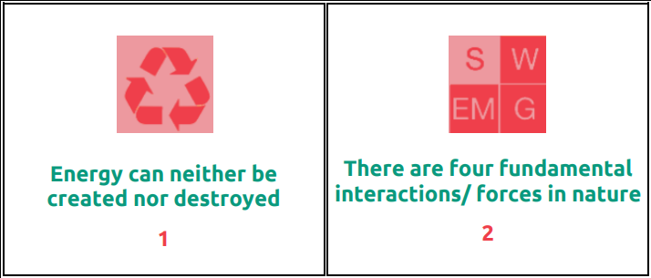
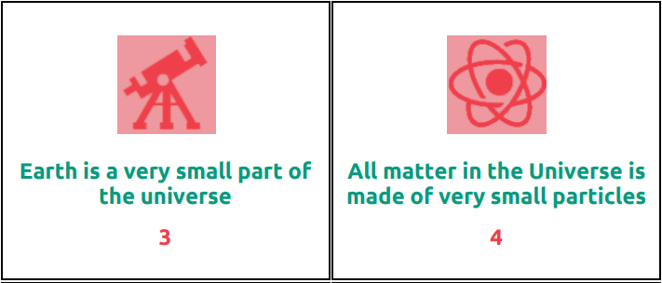
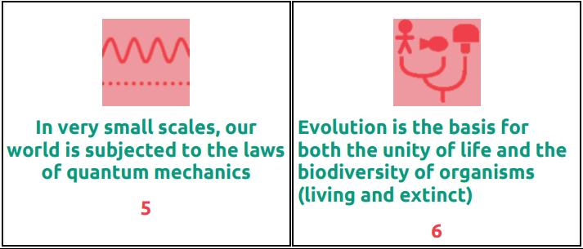
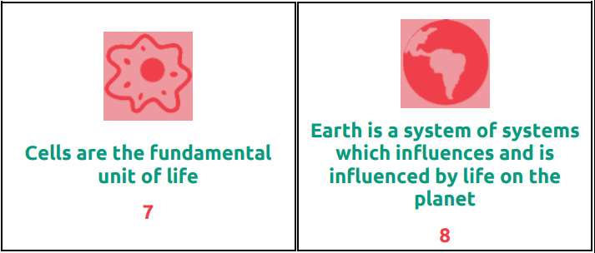
What is really important?
What is the Bigger Picture?
The Big Ideas of Science

Slide 27
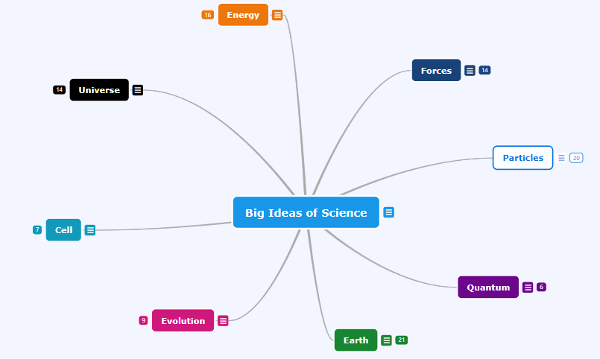
Importance – A Knowledge Palace
The more students use the Big Ideas of Science as their knowledge palace the more familiar they become with them.
When all other knowledge fades away, the Big Ideas of Science are more likely to stick around.

Slide 28
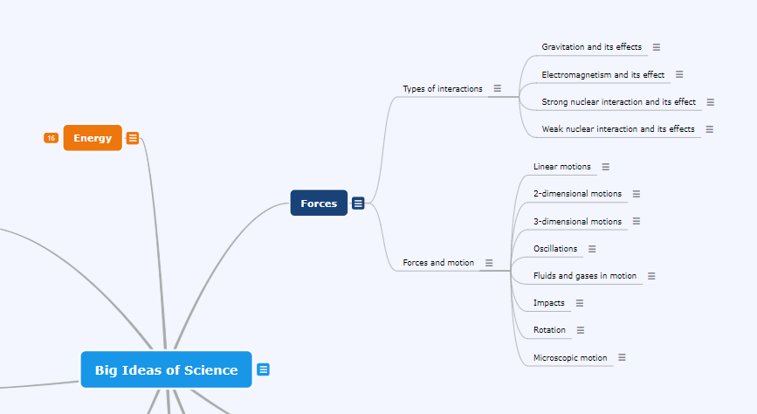
Pathways of concepts
Increasing knowledge retention by using a standard common backbone structure
https://www.mindomo.com/mindmap/big-ideas-of-science-f9d87e65372444b1a97b4b64db03519d

Slide 29
Importance – A Knowledge Palace
Our tailored method…
A meaningful knowledge structure based on importance
Knowledge: Concepts taught in natural sciences
Through meaningful connections between the concepts and the parts of the knowledge palace
… in action
The Big Ideas of Science
Basic Ideas of Science
The 3D Map of Interdisciplinary Science Ideas
What is our Palace?
What do we store in the Palace?
How do we store them?

Slide 30
Increasing knowledge retention
The Memory palace – A Knowledge Palace
Action – Concepts in action, phenomena
Emotion – Memories, Experiences
Review – Revisiting concepts
Importance
Meaning
Experience
Revisit
Give meaning to what students learn

Slide 31
Why?
“Once upon a time there was an acorn that fell of a tree and rolled on the ground, it kept rolling for about 1 kilometre and then it entered a hole where it found some other acorns. The end”.

Slide 32
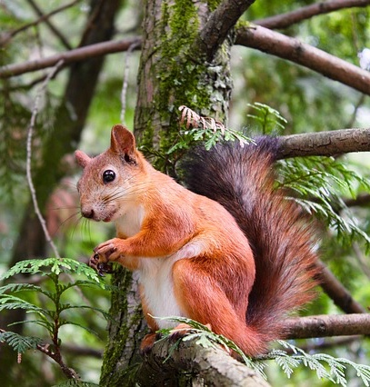
It’s all about how good the story is…
“Once upon a time there was a squirrel. This squirrel was very very hungry and could only think about eating a very good, caramel tasting acorn. Nham! It was his very favourite food in the world. He was resting in an oak when a little kid appeared and for no apparent reason decided to shake the tree. After he shook it a few times, many acorns started falling. The squirrel was a bit upset from the behavior of the little boy, but after the boy left, he noticed all the acorns that were left on the ground. He looked around, to see if it was safe to come down. When he felt safe, he went down and ate all the acorns he could eat. After he finished he was glad to see that one acorn was still there next to him. He thought he should save it for winter, so he kicked it and kicked it and kicked it until it rolled over the mountain and reached his acorn hiding spot. He dug his whole and put the acorn together with the other ones he had saved that month. You know, in winter the trees have no acorns to provide for this little squirrel and it can be very lonely, difficult and hungry. So, this squirrel hides all the acorns he can, to be safe and fed in winter. If things turn out ok for him, in winter he will remember this hiding spot and will be able to find it untouched by other animals.”

Slide 33
Action – Meaning: Concepts in action, phenomena
How does it connect to natural phenomena, T&E?
3-dimensional motions (Forces and motion)
Conservation of Angular momentum
S
Science concept
Gyroscope: inertial navigation systems, Steadicams, Heading indicators, Gyrocompasses, Accelerometers
T
Technological Achievements
Increasing knowledge retention through tangible results and real challenges
Navigation, Tracking motions
E
Engineering Problems
A
M
Science in action

Slide 34
Increasing knowledge retention
The Memory palace – A Knowledge Palace
Action – Concepts in action, phenomena
Emotion – Memories, Experiences
Review – Revisiting concepts
Importance
Meaning
Experience
Revisit
Give meaning to what students learn

Slide 35
Emotion – Experiences: Memories
How does it connect to personal experiences?
Link concepts to past experience and memories
Recall concepts during future endeavors and when building of new memories (with in-class projects too!).
Deploying concepts to correctly explain new phenomena.
Misconceptions are often built on the wrong interpretation of our own experiences. Discussing students’ experiences can help not only link the concept taught to the students own life, it can also help teachers identify possible misconceptions and tackle them
Increasing knowledge retention through experience

Slide 36
Increasing knowledge retention
The Memory palace – A Knowledge Palace
Action – Concepts in action, phenomena
Emotion – Memories, Experiences
Review – Revisiting concepts
Importance
Meaning
Experience
Revisit
Give meaning to what students learn

Slide 37
Review – Revisit: Revisiting concepts
Pick 5 to 8 tiles at random
Place them together based on the connections between them
Can you group them together into one project activity?
Have a look at the shapes others made
What projects did they come up with?

Slide 38
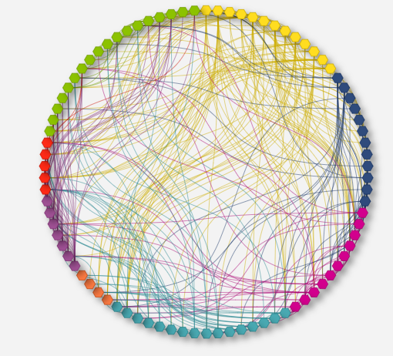
Review – Revisit: Revisiting concepts
How does it connect to other concepts I’ve learned?
Increasing knowledge retention by revisiting concepts within multiple context

Slide 39
Revisit: Linking pieces of knowledge
Recall related concepts when learning something new
Review not only the definitions and equations but also meaningful information about each concept
Deploying concepts repeatedly in different activities.
Keep information available through an effective organization scheme.
Increasing knowledge retention by revisiting concepts in different contexts

Slide 40
What is really important?
Students assess for themselves what feels more important to them judging based on meaningful criteria:
Role in explaining natural phenomena
Use in T&E and everyday life
Personal experience

Slide 41
Keeping the Bigger Picture in mind
Present each concept in action
Personalized learning
Present each concept within different contexts
Memory Palace
Action
Emotion
Review
The Big Ideas of Science
Connections to natural phenomena, T&E
Students’ memories, stories and experiences
Connections to other concepts

Slide 42
Your guiding POLAR STAR…
The Science WAND
Wondering
Along
Natures
Dimensions

Slide 43
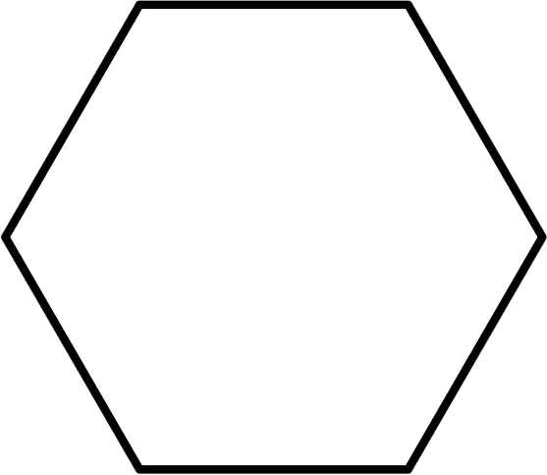
The Science WAND tools
At the end of each chapter:
Invite your students to fill in a knowledge hive
Ask your students to make their own knowledge maps
Give you students an empty tile according to the color of the parent Big Idea
Ask them to add the name of the concept learned and place it in their map
Invite your students to tell stories around the concepts they have grouped together

Slide 44
The Knowledge Hive
Brief Description
Are there in other concepts related to it?
What’s the Bigger picture?
Concept learned
Any personal stories or experiences?
Do you know any phenomena related to the concepts?
Where do you find
this concept in everyday life?

Slide 45
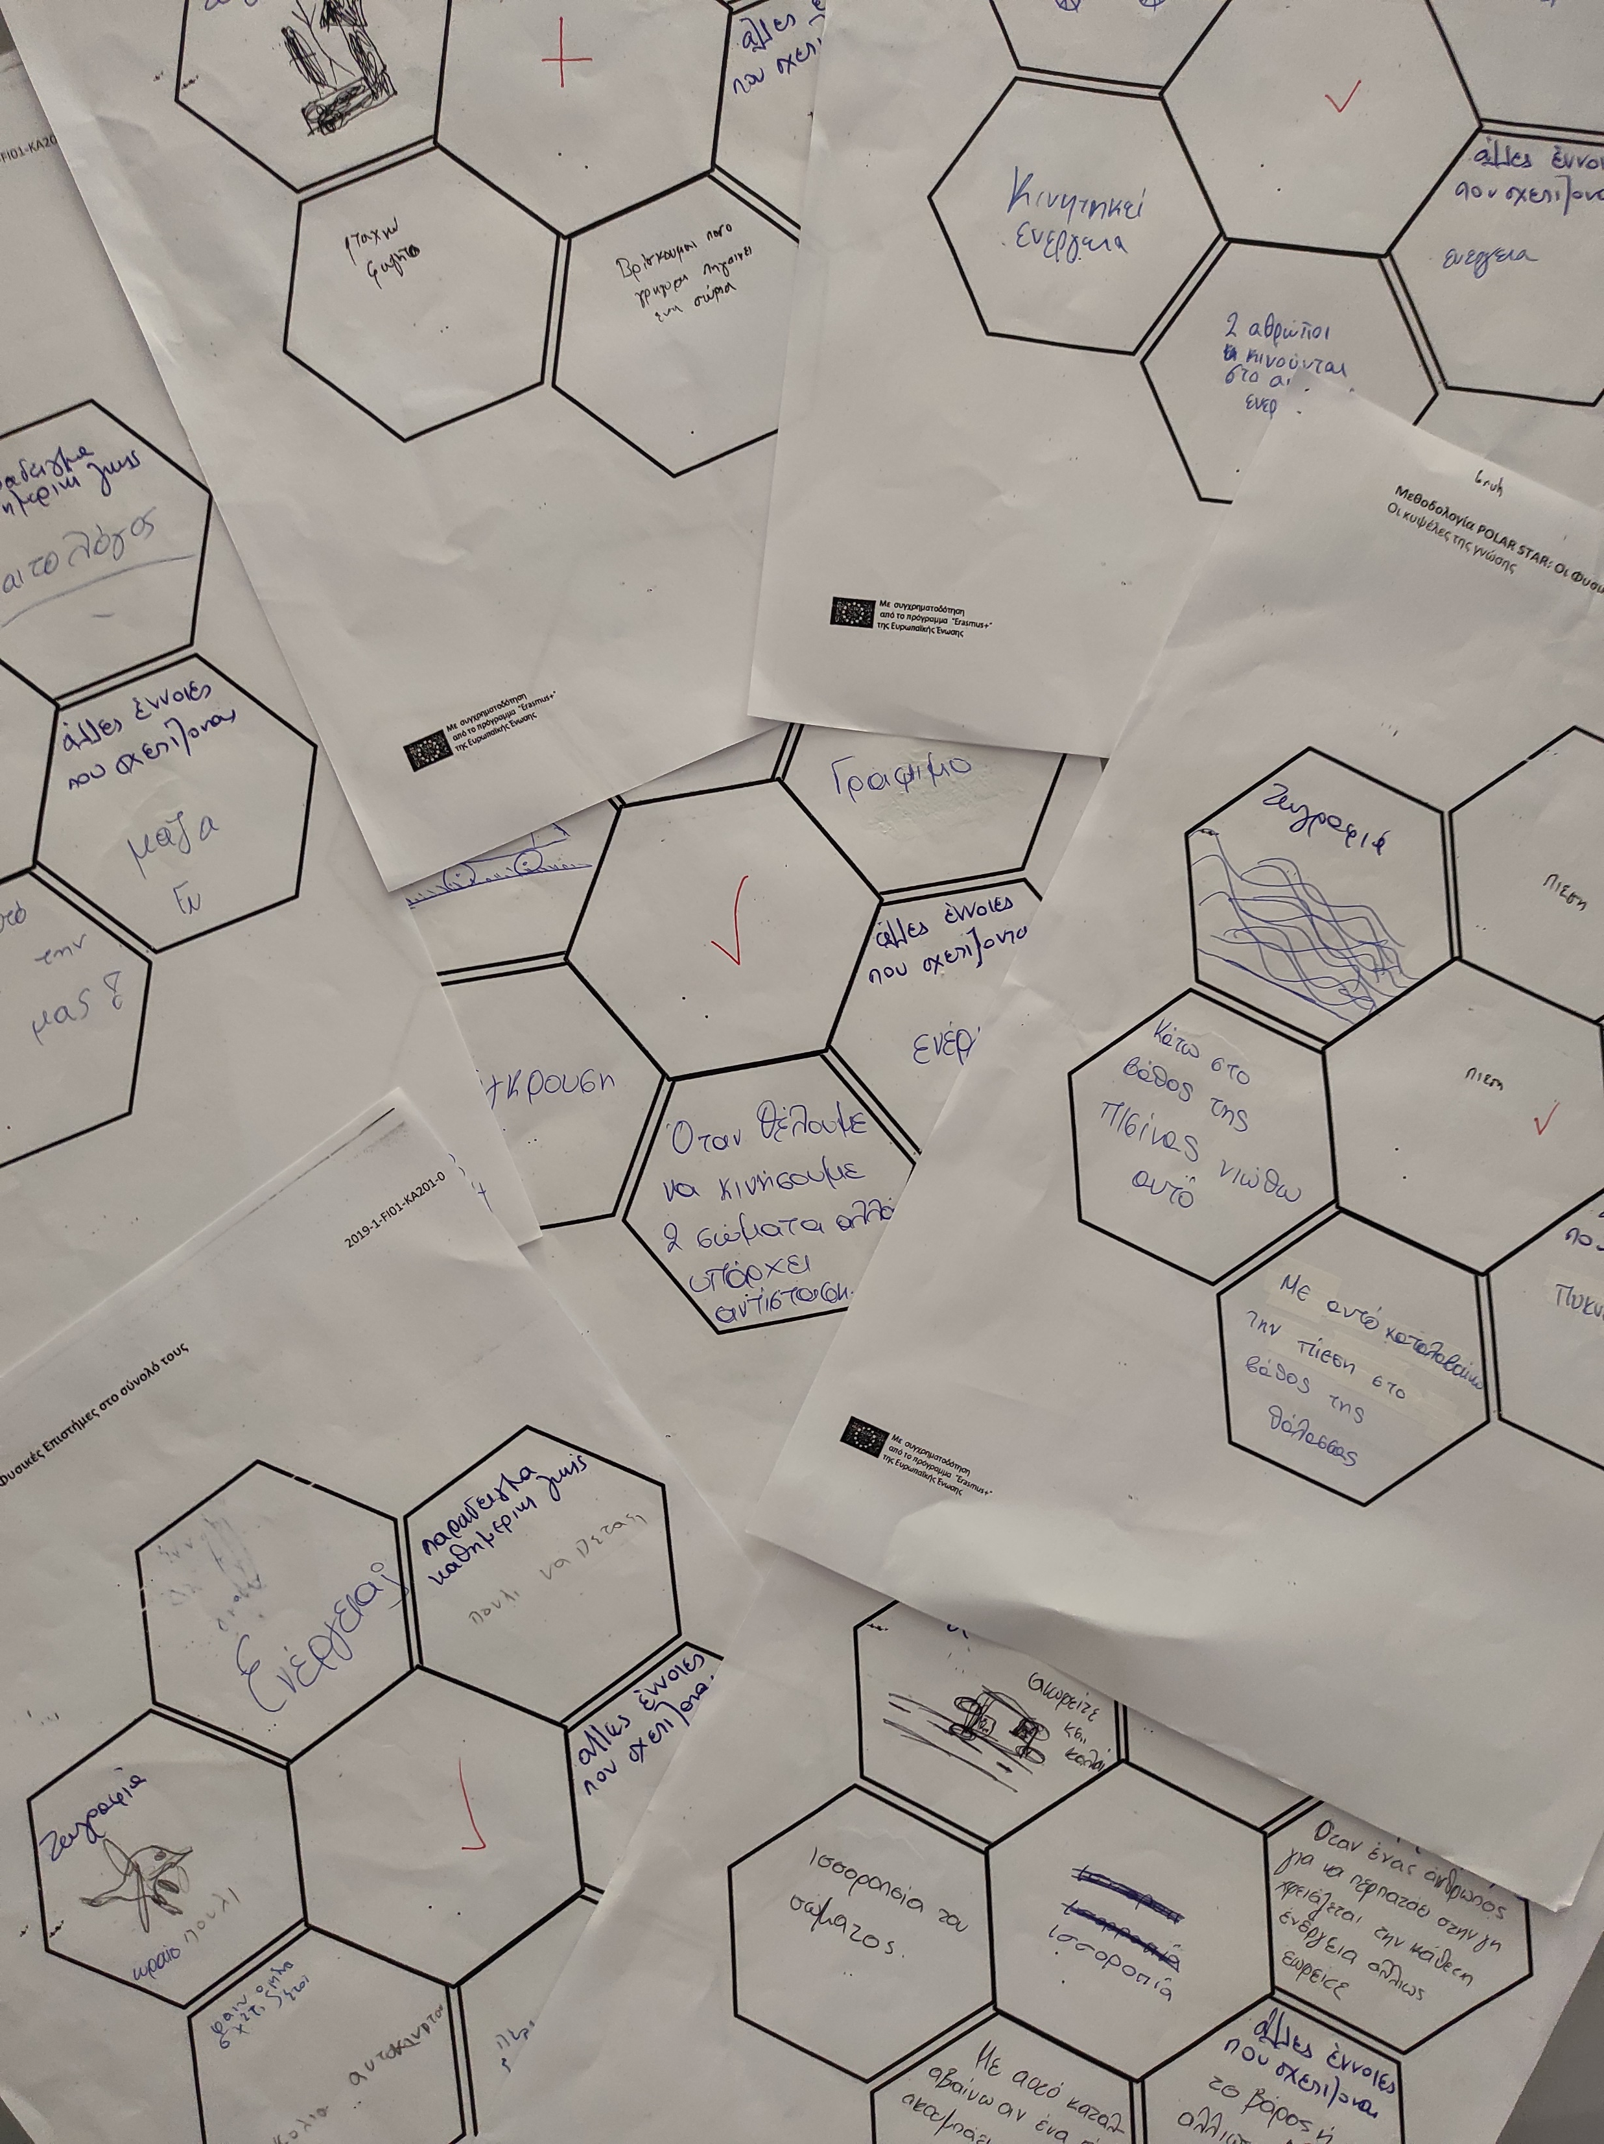
The Science WAND tools – Knowledge hive

Slide 46
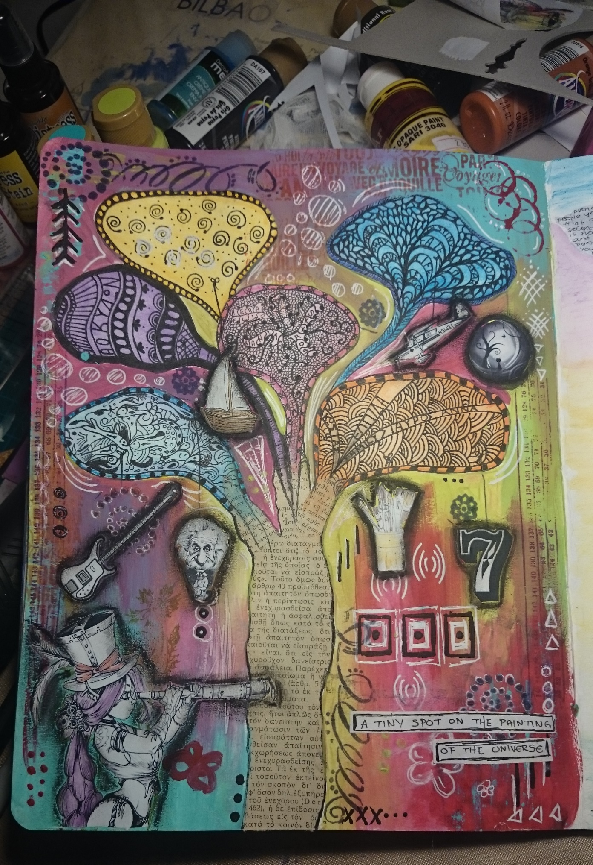
The Knowledge Map
Personal Geography
Story telling
Personalized learning

Slide 47
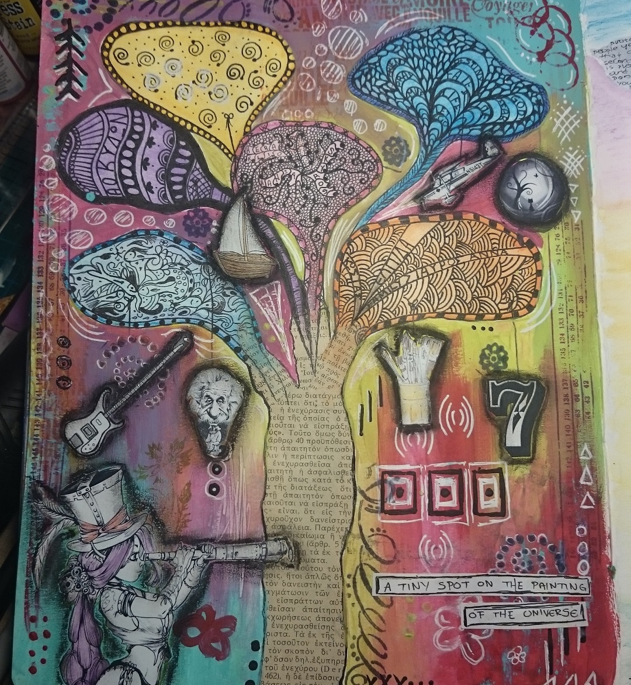
Personal Geography
Helps students to discover the value of what they learn through an artistic expression while it promotes a self-reflection and a deeper realization of the impact of each learning experience.

Slide 48
Story telling
Children have an innate love of stories. Stories create magic and a sense of wonder at the world. They teach us about life, about ourselves and about others. Stories:
Promote a feeling of well-being and relaxation
Increase children's willingness to communicate thoughts and feelings
Encourage active participation
Increase verbal proficiency
Encourage use of imagination and creativity
Encourage cooperation between students
Enhance listening skills
https://www.teachingenglish.org.uk/article/storytelling-benefits-tips

Slide 49
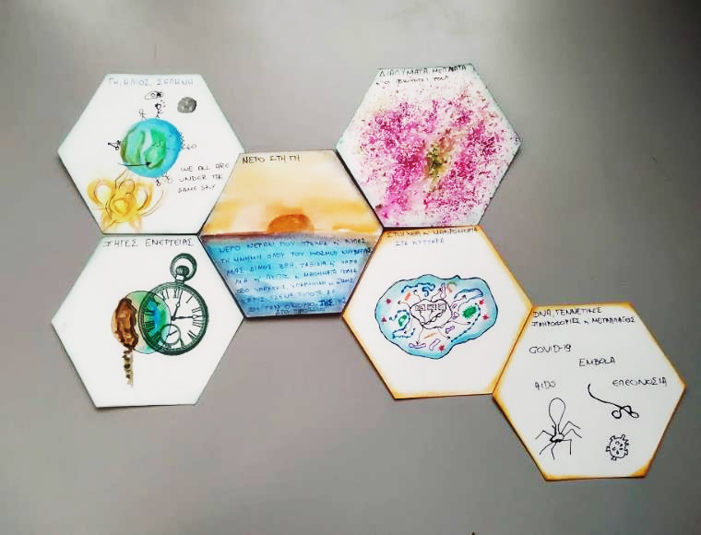
Personal Geography
“I’ve placed ‘Water on Earth’ in the heart of my map as it is the source of all life. It is everywhere in nature and plays a pivotal role in countless processes on Earth, from Tides to the function of organisms.
Tides and moving water can be a source of clean energy to help us counter the exploitation of fossils.
Water rich in elements is in our cells and the key ingredient of life. At the same time however, more than 884 million people do not access to clean water to drink which makes them suffer from multiple diseases.”
Story telling
“I’d like tell a story about a water droplet. The droplet makes a journey around the planet. The journey begins when the droplet falls from the sky in the form of rain, it travels around the world through streams and ocean currents, going through hydraulic power plans and then moving on become part of solution in a lab that becomes a malaria vaccine. The droplet is inserted through the vaccine to a human and travels in the cells where it observes the wonders of cell functions. The journey ends back where it started with the droplet travelling back to the clouds only to set off to a new journey.”

Slide 50
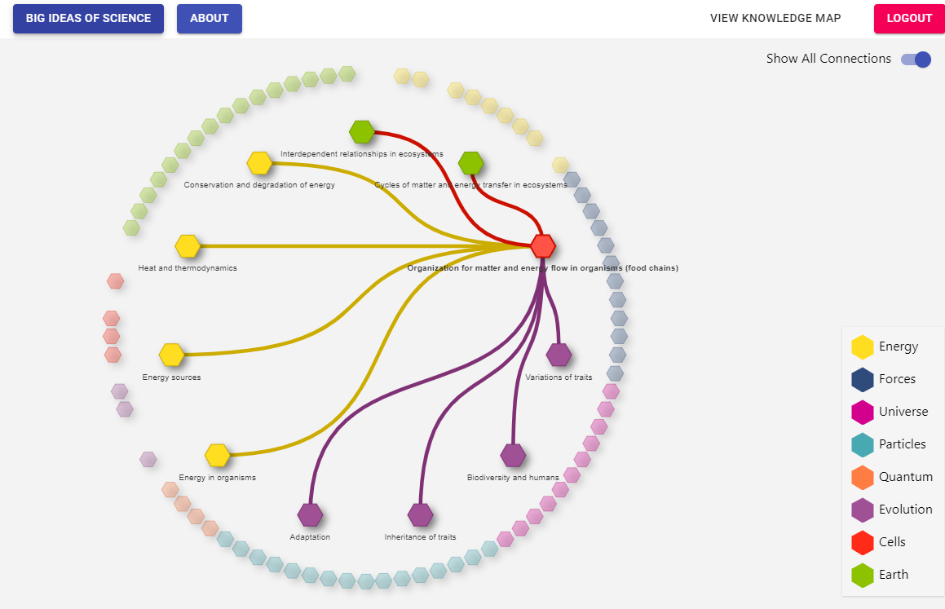
The Science WAND tools – Digital or tangible

Slide 51
The Science WAND tools – Digital or tangible

Slide 52
Summing Up
Give meaning to what students learn
How do we increase knowledge retention?
The bigger picture – the Memory Palace
Concepts presence in natural phenomena, T&E- Action
Connection to everyday life, students’ memories and experiences – Emotion
Concepts within different contexts and connections to other concepts - Review
The Big Ideas of Science
Connections to natural phenomena, T&E
Students’ memories, stories and experiences
Connections to other concepts

Slide 53
The POLAR STAR methodology rationale
Connection to everyday life
(what and how)
The bigger picture behind individual science concepts
Connections between science concepts and phenomena
The science concepts taught in school
From Science
to STEAM
Science
as a whole
Basic Ideas
of Science

Slide 54
Summing Up
What are we trying to achieve?
Promote the teaching of Science disciplines within a uniform, seamless framework
Why do we want to do this?
Make sure core concepts stick with the students
Increase knowledge retention
Give meaning to what students learn at schools
How do we do this?
Providing a standard interdisciplinary backbone structure /reference system
Personalized learning,
Meaningful connections between concepts and phenomena
TEAM extensions to science concepts
When and where do we do this?
Everyday teaching at any opportune moment
Interdisciplinary long-term projects
As part of the reflection process (A year long plan)
With who do we do this?
Yourself
Other STE teachers
Math teachers
Art teachers

Slide 55
Thank you for your attention!

