Slide 1
Educational video game about detecting gravitational waves
Albiona
Anđela
Monica
Nolan
Tobias

Slide 2
General information
Type of activity: Video/Card-Game
Theme: Gravitational Wave detection
Age of players: 15 - ∞
Short description: The player will need to locate a villain harvesting the power of two orbiting black holes, by using a gravitational wave detector. To do this, the player will need to classify glitches in order to get points and buy components for their detector.
Goals: The players will learn about gravitational waves and their detection, as well as about challenges scientists face while doing GW detection through gamified classification of glitches and pieces of information incorporated into the game. You fill find here a blueprint on how to play the game.

Slide 3
Description of the game
Game materials: Internet connection, a PC or a laptop, mobile phone
Set-up:
Three levels based on recognition of glitches.
Each tile is a glitch to identify.
Buy components of the interferometer with gained points
Level 1 up to three basic types of glitches
Level 2 up to 6 types
Level 3 all possible glitches; plus the mystery card

Slide 4
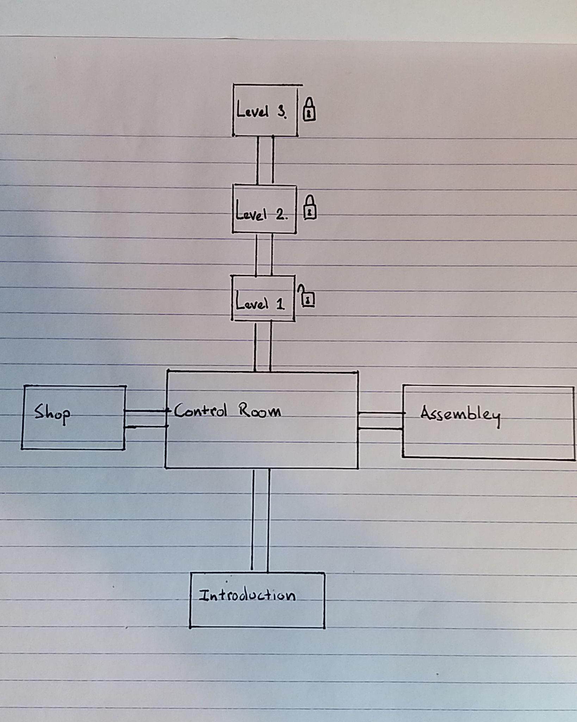
The flow of the game
Introduction room – the player gets basic information about the game what is it about, how to play it, what GW, an interferometer and glitches are etc.
Control room shows the visualisation of the progress, leaderboard, option to move to other rooms.
Assembly room – you assembly the parts into an interferometre, visual representation of the players interferometers.

Slide 5
How to play
User gets presented a glitch-card and needs to classify it by dragging an identification-card onto it. If the classification was correct the player will get points depending on the rarity of the glitch. If the answer was wrong, players will not get any points.
For points, players can buy components for the interferometer in the shop and build it in the factory.
Player can press button in factory to try to find the villain. If successful, game ends

Slide 6
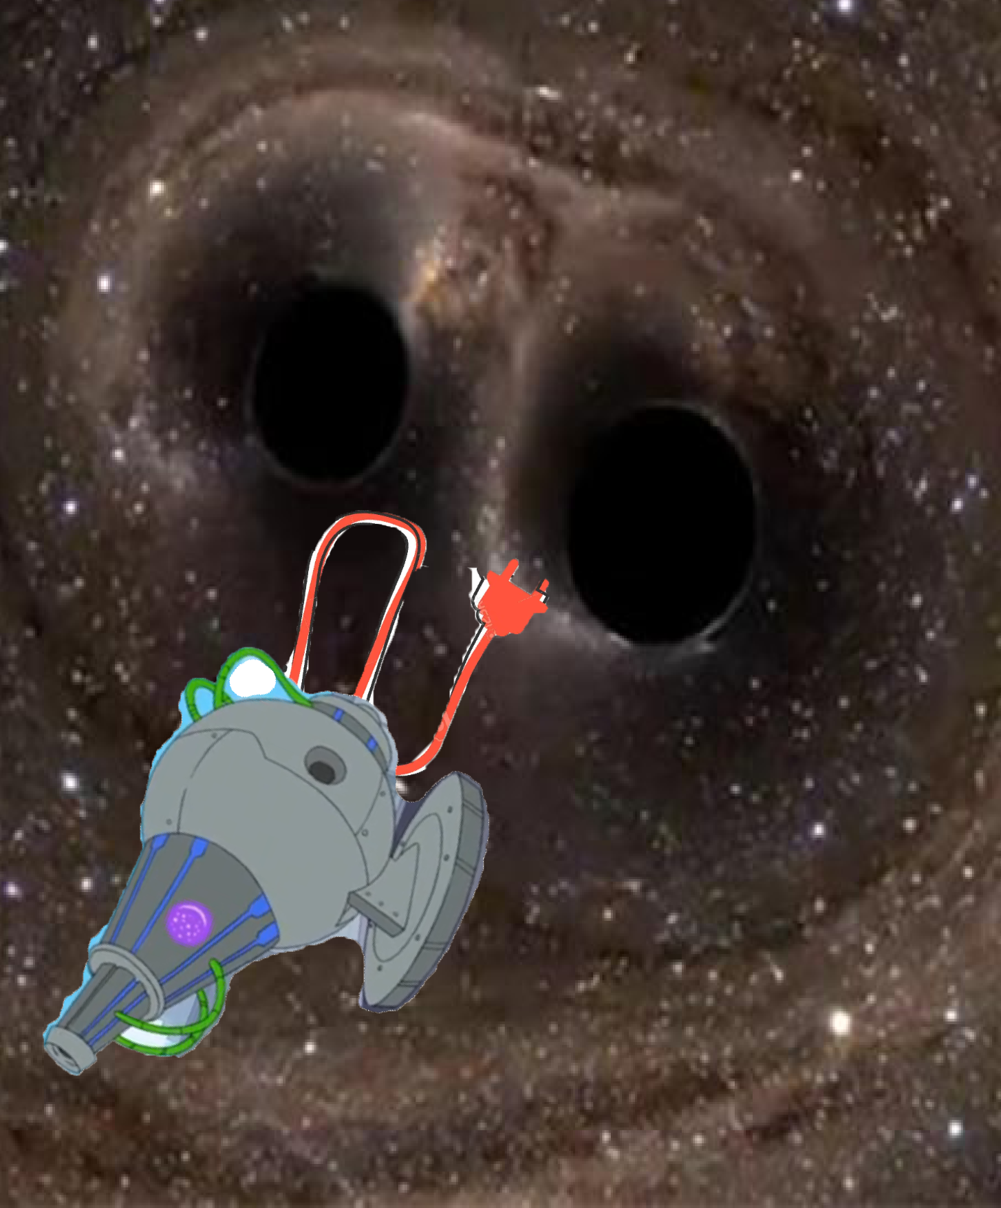
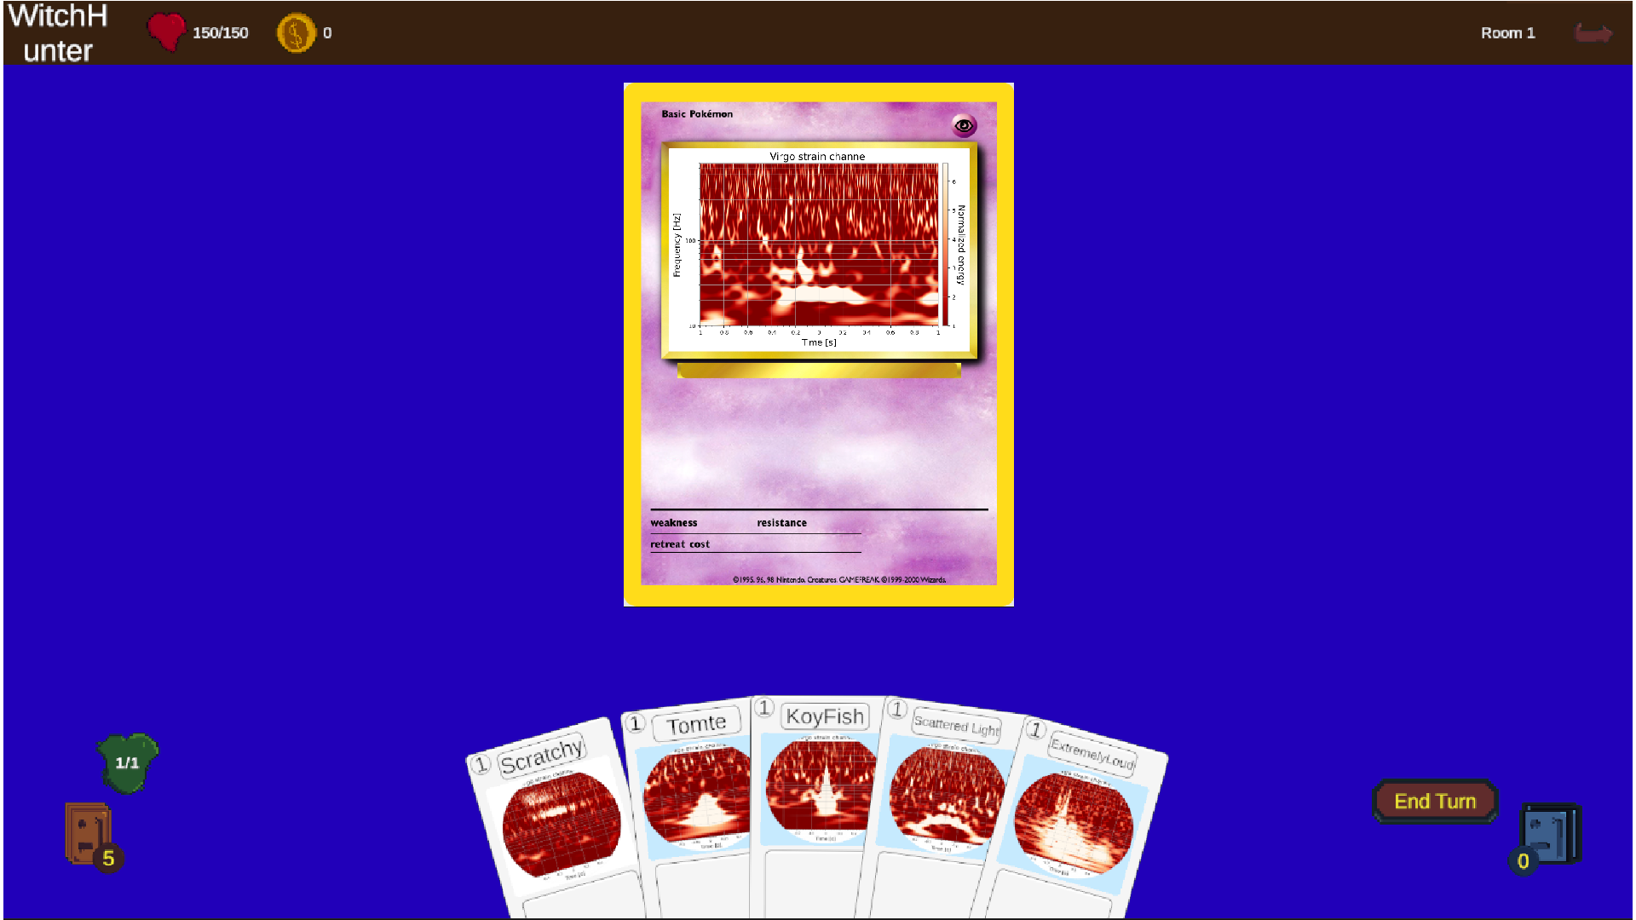
Visuals

Slide 7
Additional ideas for the development the game
the Google Document with the whole introduction story: https://docs.google.com/document/d/17FI4YX9lQ3840hrmlqYKzV-zPlMGFJDKdRbaX9fsQg0/edit
Road Map/Mind Map https://drive.google.com/file/d/1X3IgxGdblCxaGGro8GZ15dBOO6f147wK/view?usp=sharing

