Slide 1
Particle Fun Park
Georgia Dragoutsou
Thanassis Spanias
Georgia Tsirigoti
Miltos Vavoulidis

Slide 2
Kind of activity: Fun Park
Theme: New Particles in Cern, Muons Tomography
Age of visitors: General Public
Short description: An interactive Fun Park with particles and cosmic Muons
Goals: Engaging public in scientific research – citizen science

Slide 4
Introduction to particles in Standard Model
https://home.cern/science/physics/standard-model
https://youtu.be/4o91Jnnh0NI

Slide 5
Bumper cars
different colors – different flavors
Matter – antimatter
Collisions between a matter and an antimatter car give rewarding points

Slide 7
New Particle Search at CERN

Slide 8
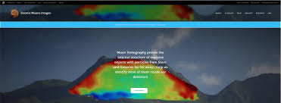
Muons escape room
MDS(Muon Detector Simulator)
MHG( Muon Hunter Game)
Muon Tomography Zooniverse project

Slide 9
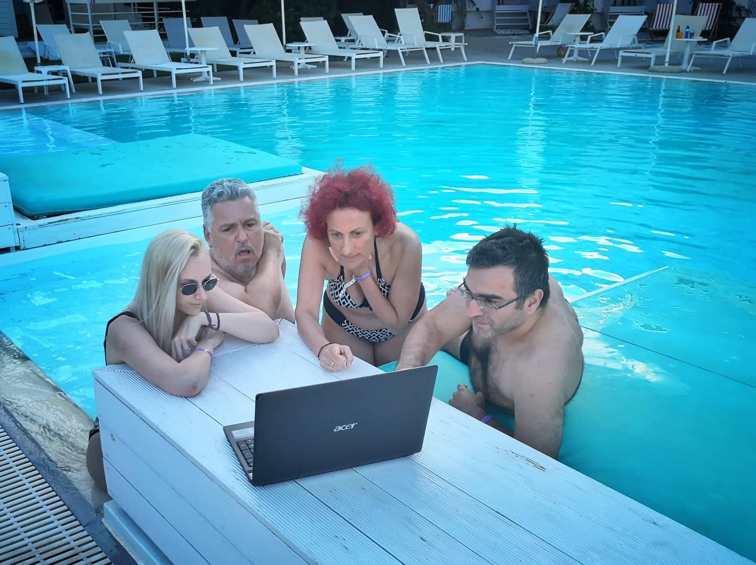
It’s time to Reinforce your summer!

