Slide 1
Summer school challenge
M. Panagopoulou Research and Development Department, Ellinogermaniki Agogi

Slide 2
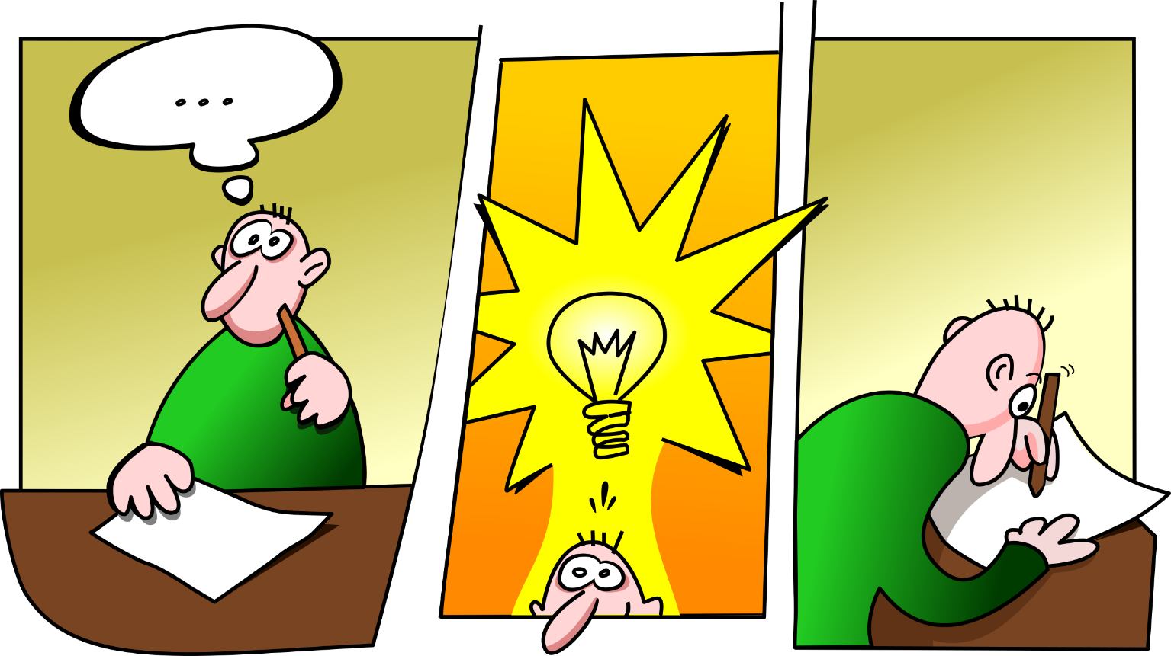
The challenge: create your own activity
Notes:
Including at least one of REINFORCE projects, engaging the public or a group of people

Slide 3
Presentation of all activities
Each team will present the activity on Friday
Given template uploaded on the indico page
Duration of presentation: 5 minutes

Slide 4
What kind of activity could you create?

Slide 5
Non-formal and Informal education
Learning/Education
Formal
Non-formal
Informal

Slide 6
Let’s see a few examples
Αυτή η φωτογραφία από Άγνωστος συντάκτης με άδεια χρήσης CC BY-SA

Slide 7
Escape Room
HEPSCAPE: THE HIGH ENERGY PHYSICS ESCAPE ROOM
https://library.iated.org/view/SOFFI2022HEP
https://indico.cern.ch/event/949705/contributions/4555987/
Escape Games in Particle Physics Education & Outreach
https://indico.cern.ch/event/577856/contributions/3419454/attachments/1878765/3094766/20190711_AJ_JW_EPSHEPtalk.pdf

Slide 8
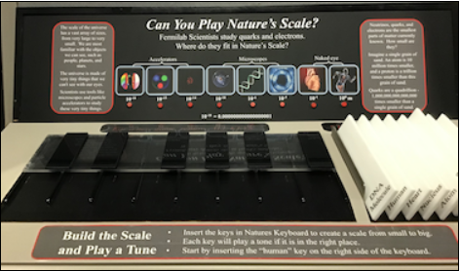
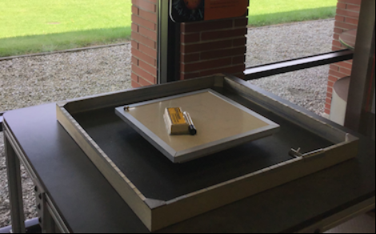
Lederman Science Center
https://visit.cern/lhc-interactive-tunnel
Particles and forces - What is a Particle Family
https://eddev.fnal.gov/lsc_exhibits/list.html
The Scale of the Universe - Can You Play Nature's Scale?
Can You Guess the Hidden Shape?

Slide 9
LHC Interactive tunnel
https://visit.cern/lhc-interactive-tunnel

Slide 10
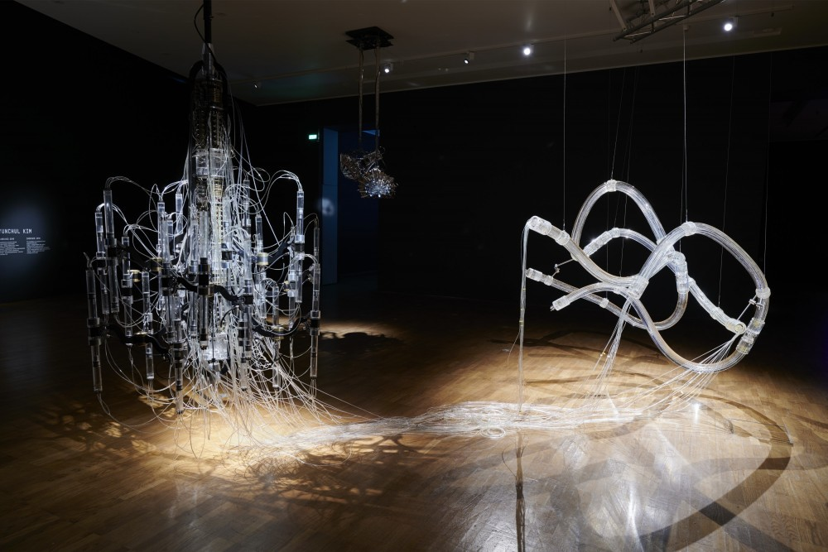
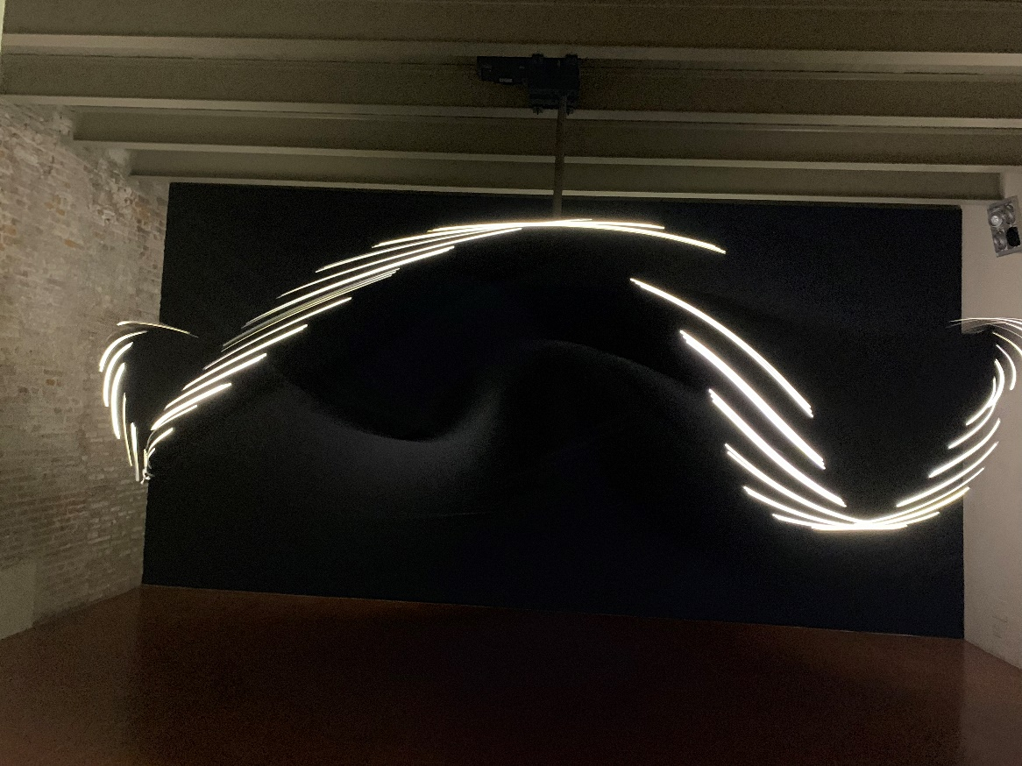
Art exhibit
Cascade, Yunchul Kim, 2018
Gravity’s dance, Liliane Lijn, 2019

Slide 11
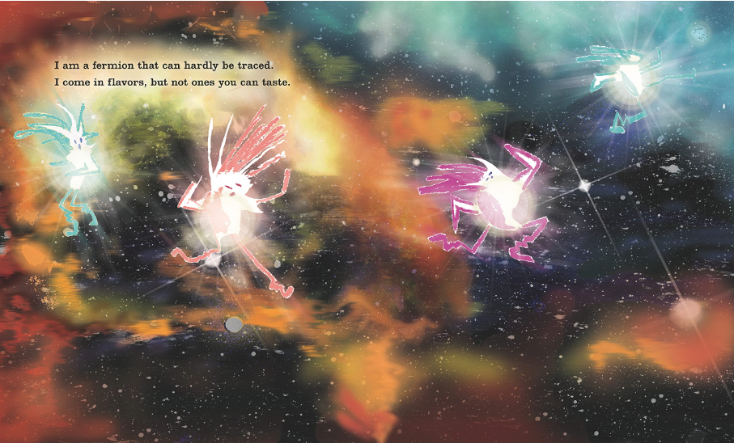
Storytelling
Notes:
The Little Particle That Could is the story of a happy little graviton, who spends her days spinning on her axis and pulling jumping children, flying baseballs, and falling cats back down to earth. One day the graviton notices a photon flying by, and she desperately wants to meet him. So she chases the photon away from earth and through the far reaches of space, never quite catching up to him (neither can travel faster than the speed of light). She eventually follows him into a black hole, which is filled with other gravitons pulling photons toward them. There she finally gets to properly meet the photon, and they begin their friendship.

Slide 12
Video
Quantum SHAPE-SHIFTING: Neutrino Oscillations
https://www.youtube.com/watch?v=7fgKBJDMO54
Impossible Muons
https://www.youtube.com/watch?v=rVzDP8SMhPo
Gravitational Waves Explained
https://www.youtube.com/watch?v=4GbWfNHtHRg
Gravitational Waves Explained Using Stick Figures
https://www.youtube.com/watch?v=YHS9g72npqA
Neutrinos in 60 seconds | Even Bananas 02
https://www.youtube.com/watch?v=zL5p3CqXxbw&list=PLCfRa7MXBEsp1cvIsZ4shi6MrHb-tnAqT&index=2

Slide 13
Song
The Molecular Shape of You (Ed Sheeran Parody) | A Capella Science
https://www.youtube.com/watch?v=f8FAJXPBdOg
LIGO Feel That Space (The Weeknd Parody) | A Capella Science
https://www.youtube.com/watch?v=degD69wnZcY
Started From A Bottom Quark (LHC Rap) | A Capella Science at CERN!
https://www.youtube.com/watch?v=txq6ChEMqio
Strange Charm: A Song about Quarks
https://www.youtube.com/watch?v=U0kXkWXSXRA
Great Waves (The LIGO Gravitational Wave Song)
https://www.youtube.com/watch?v=k1lwJWQhPxA
The Particle Physics Song
https://www.youtube.com/watch?v=28X9czEROPs

Slide 14
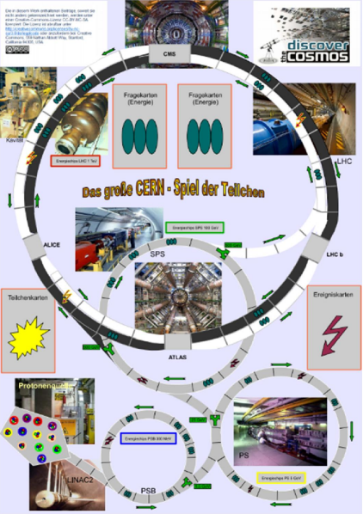
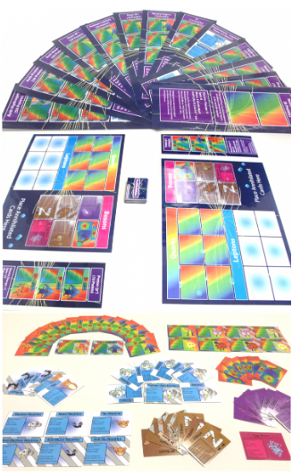
Game
The Great CERN-Game of Particles
Particle Physics Board Game
http://portal.discoverthecosmos.eu/el/node/196165
https://scoollab.web.cern.ch/particle-physics-games

Slide 15
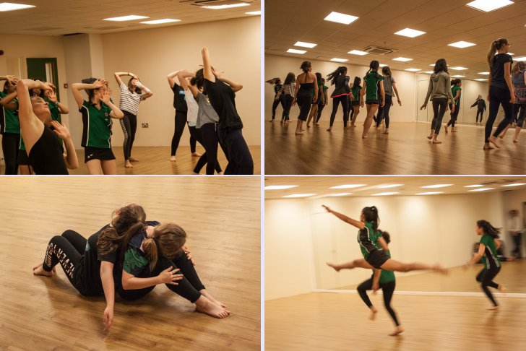
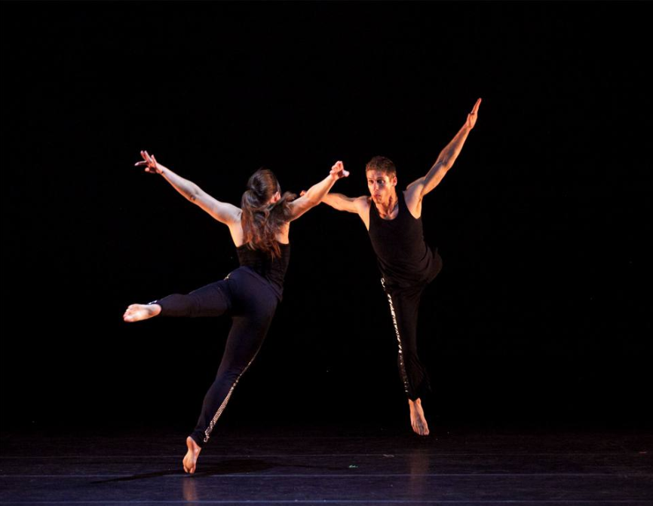
Theater-based activity
Introducing Students to Particle Physics: Fine Arts and Dance
Particle Physics Demonstrated Through Dance at Saddleback

Slide 16
Voting for the best activity
Everyone will vote on Friday after the presentations.
You cannot vote the activity of your team.
The team with the most votes wins.

Slide 17
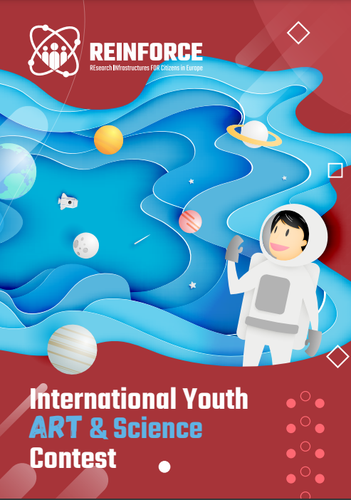
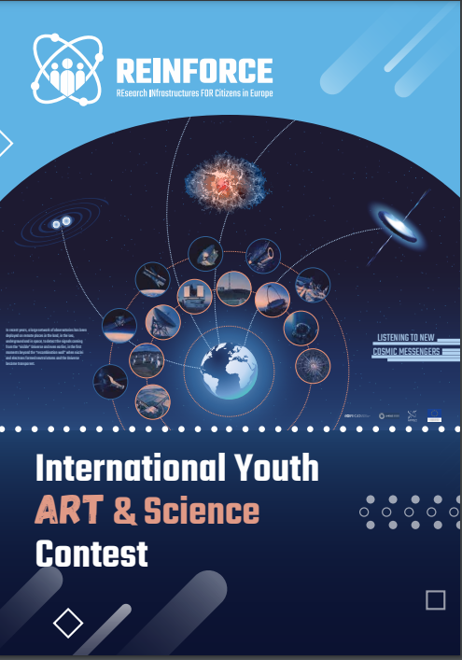
International Youth ART & Science Contest
https://reinforceeu.eu/platform-for-artistic-intervention/international-youth-art-science-contest

