Slide 1
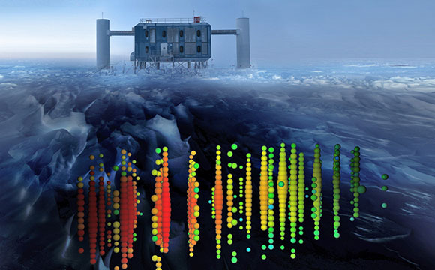
Introducing Neutrino Astronomy
E. Chaniotakis,
Research and Development Department
Ellinogermaniki Agogi

Slide 2
What is the neutrino?
Almost massless elementary particle
Lepton (no internal structure –so far)
Interacts very weakly with matter through weak interactions
Is produced in elementary processes where the weak interaction is at play: Supernova explosions, cataclysmic cosmic events, nuclear reactors, particle accelerators..

Slide 3
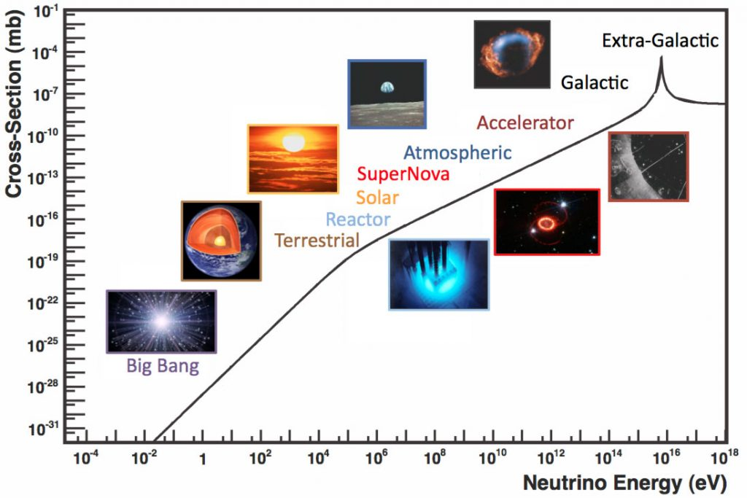
Sources of neutrinos

Slide 4
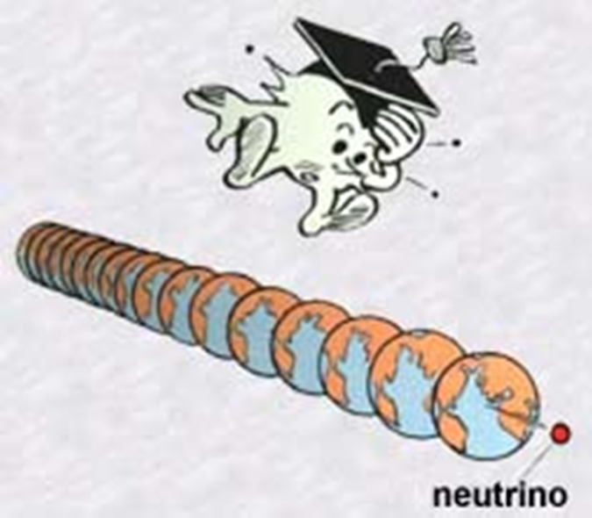
Did you know that… about 65 million neutrinos from the sun pass through our fingernail every second?
Interaction probability with matter: Infinitessimal! A 1 MeV neutrino may travel for a distance of 50 light years in water before it interacts!

Slide 5
As the neutrino energy increases, its interaction probability increases.
The more “targets” we have in our disposal, the more probable it is to detect a neutrino

Slide 6
Why should an astronomer care?

Slide 7
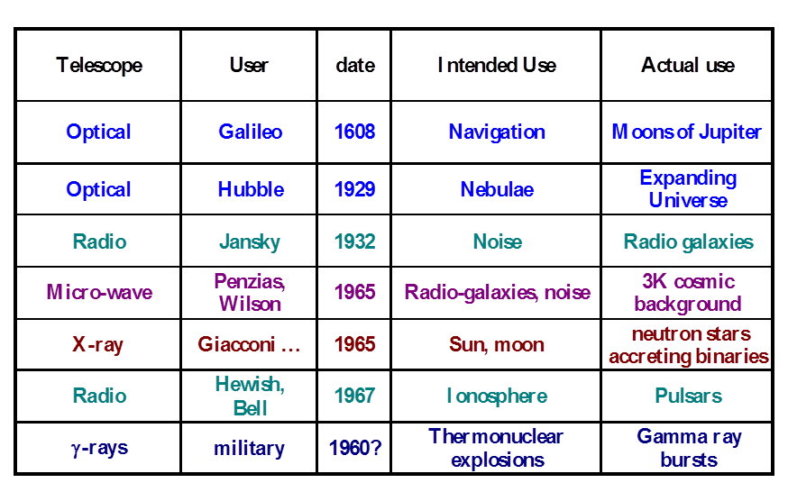
Astrophysics is the science of unexpected discoveries

Slide 8
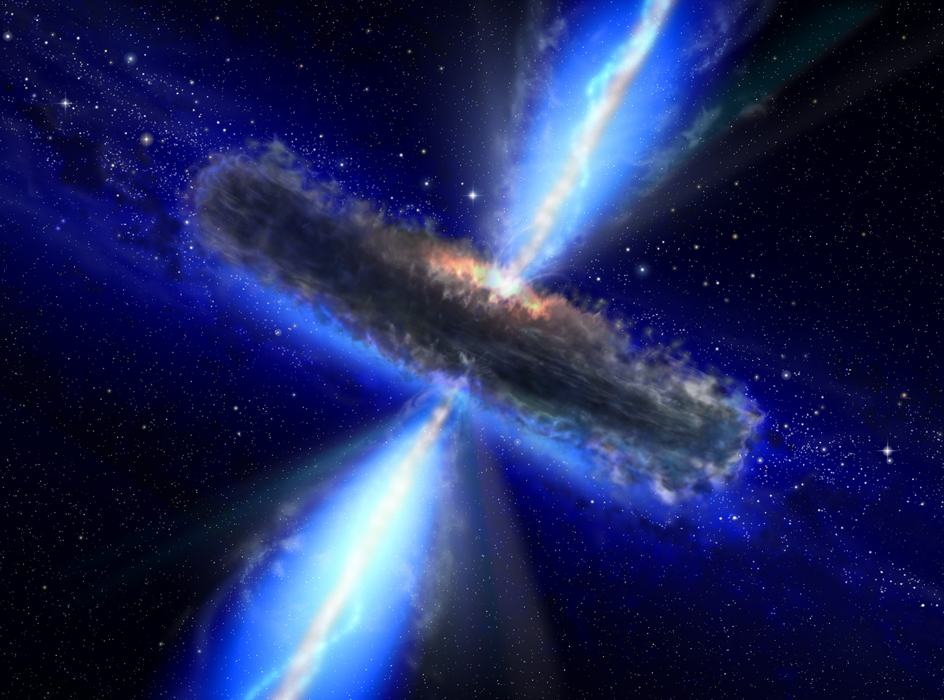
What about neutrinos?
All stars produce neutrinos in the hadronic interactions taking place in their cores.
Violent, cataclysmic events in the Universe such as Supernova explosions (SN1987 A) produce neutrinos!
Cataclysmic cosmic events are expected to produce neutrinos of high energy (AGNs, Blazars – confirmed)
Dark matter annihilations, interactions of exotic particles existing since the infancy of the Universe etc could produce neutrinos!
If we can use neutrinos to do astronomy, we can open a new window to the Universe! And when we do that, we expect.. The unexpected.

Slide 9
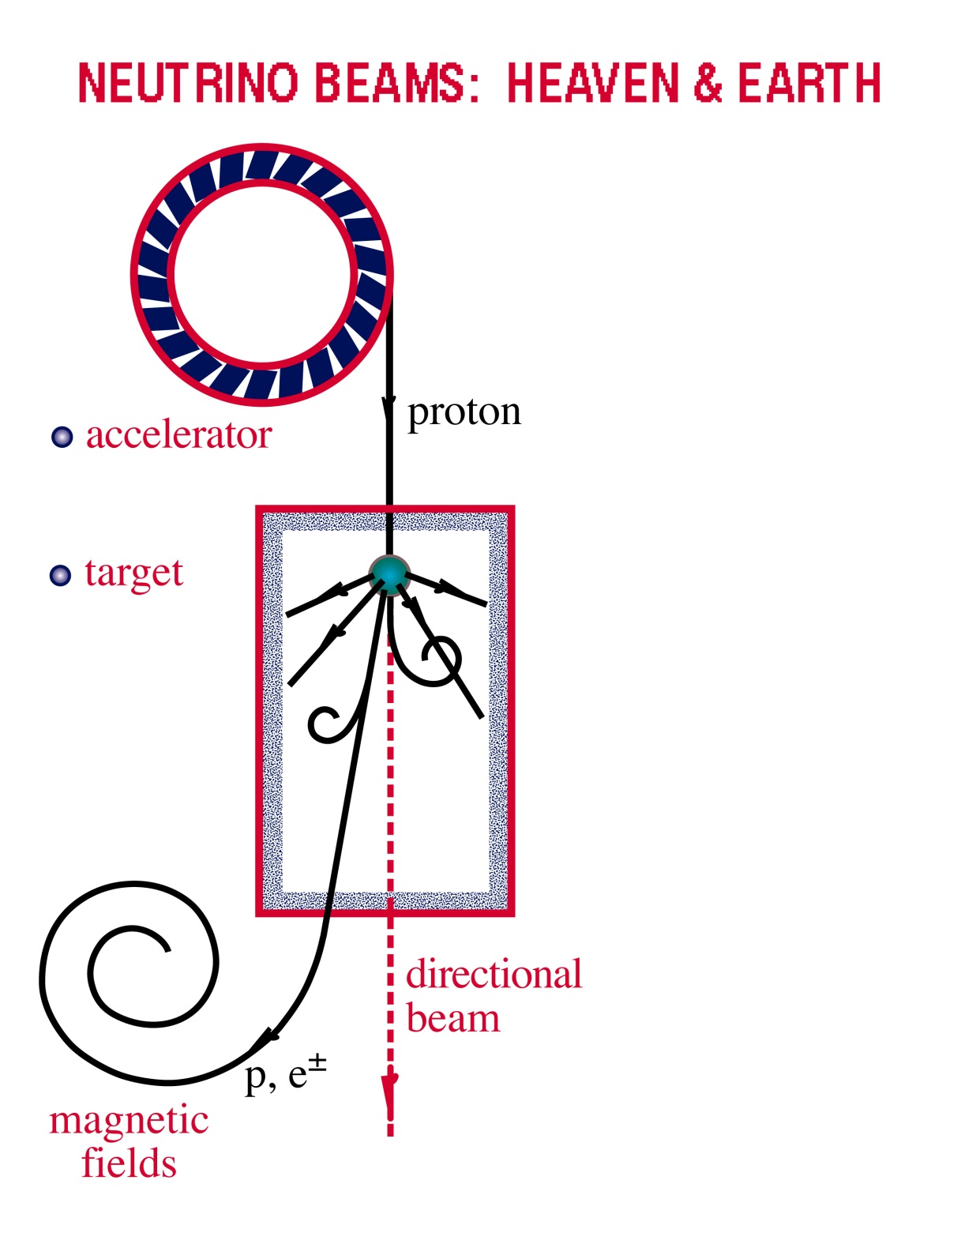

Cataclysmic cosmic phenomena
Neutrino Beams: Heaven & Earth
Cosmic Accelerators
NEUTRINO BEAMS: HEAVEN & EARTH
AGNs, Blazars
Interstellar dust and matter
p + γ → n + π⁺
^{~ cosmic ray + neutrino}
→ p + π⁰
^{~ cosmic ray + gamma}

Slide 10
Neutrino: The cosmic messenger
Zero electric charge. Their trajectories are not curved by galactic magnetic fields → we can use them to point back to their sources
They don’t decay
They rarely interact with matter → we can use them to point back to their sources and probe the innards of astrophysical objects otherwise inaccessible to us.

Slide 11
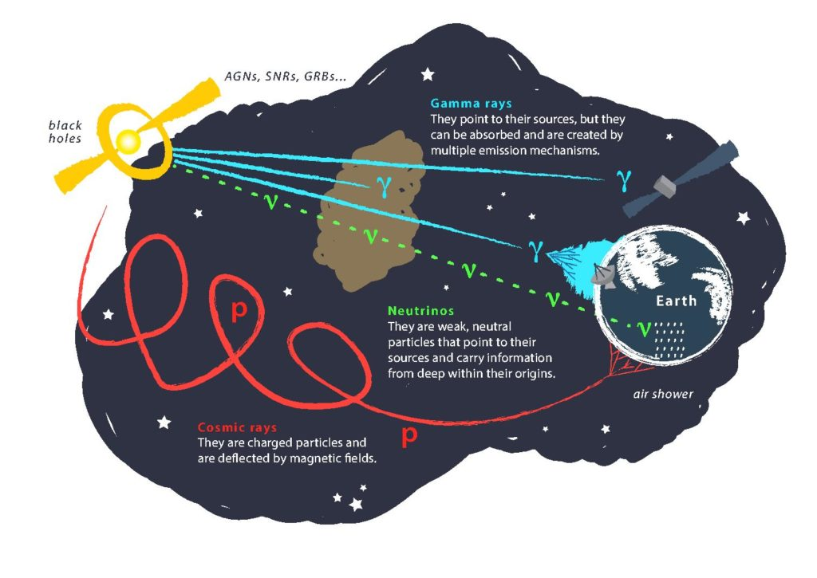
6/49

Slide 12
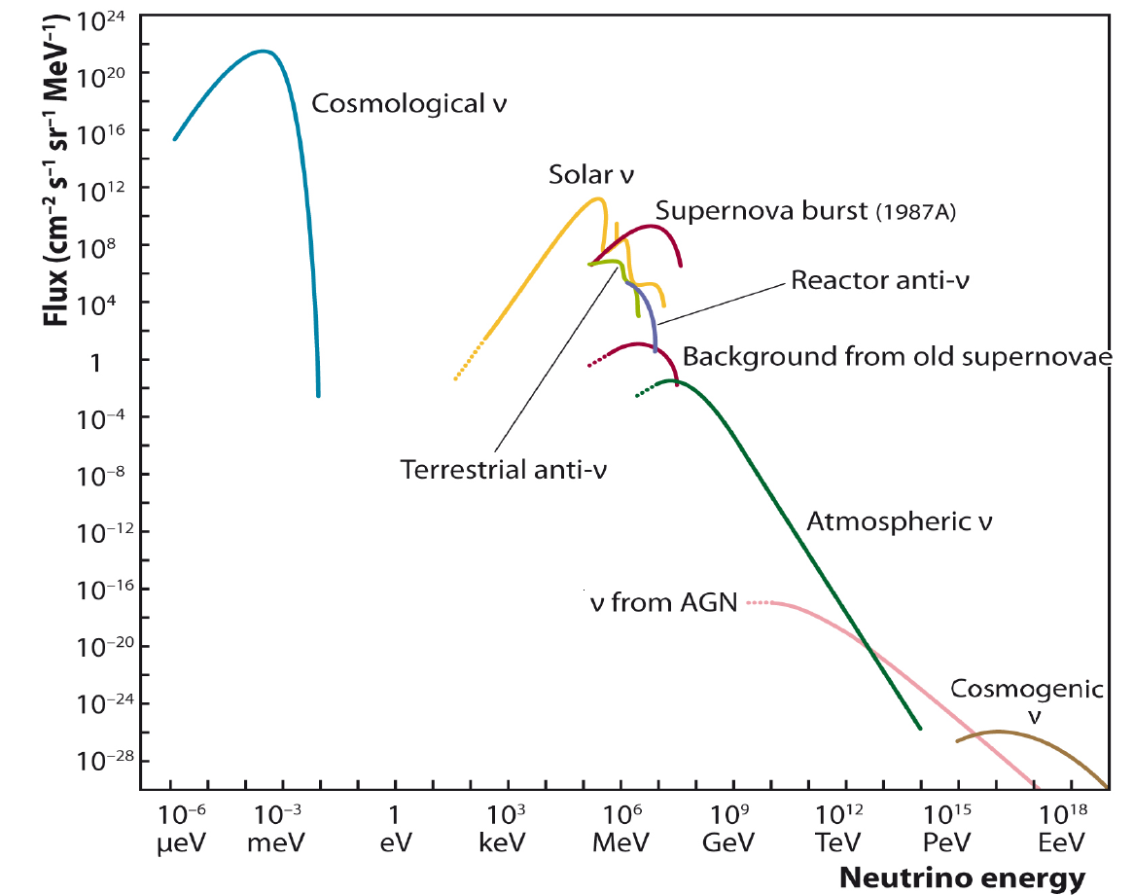
Problem: too few neutrinos
Area of interest

Slide 13
Neutrinos are ideal cosmic messengers, but their detection is a challenge.
Their property to interact very rarely with matter makes it very difficult to “catch” the few high energy neutrinos that Astrophysical Events may produce.
A very big detector, with many “targets” for the interaction of neutrinos may see only a few dozen neutrinos per year.
We need a huge detector!

Slide 14
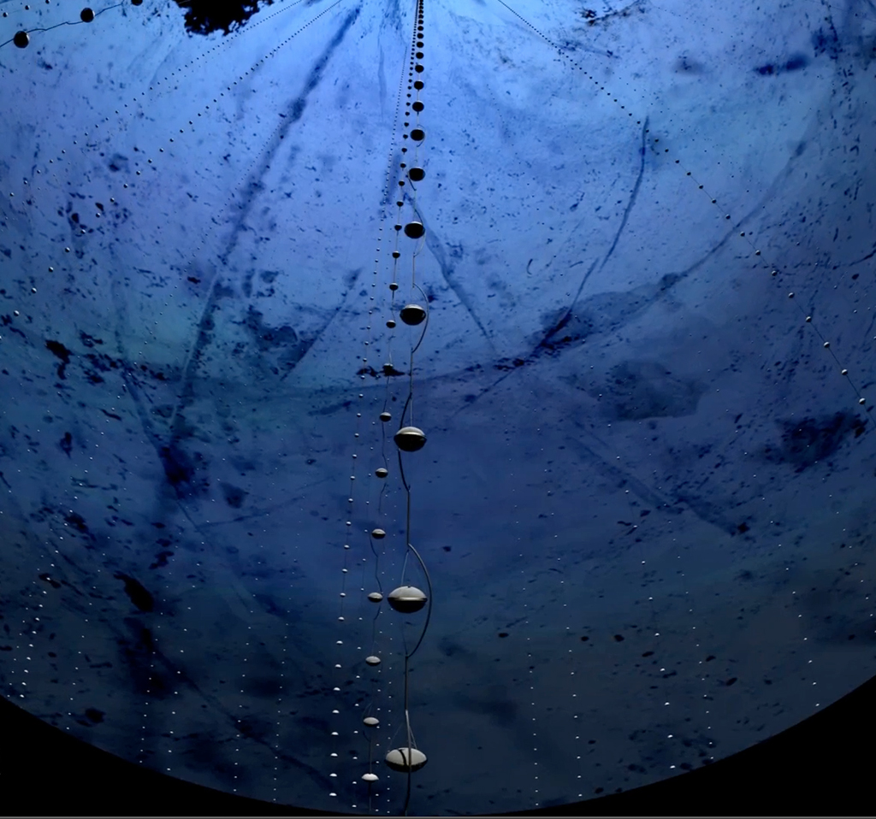
High energy neutrino telescopes
Volume of at least 1 cubic kilometer
High costs, take a lot of space
We need to submerge them in deep sea or ice that allow us to install detectors of such volume!

Slide 15
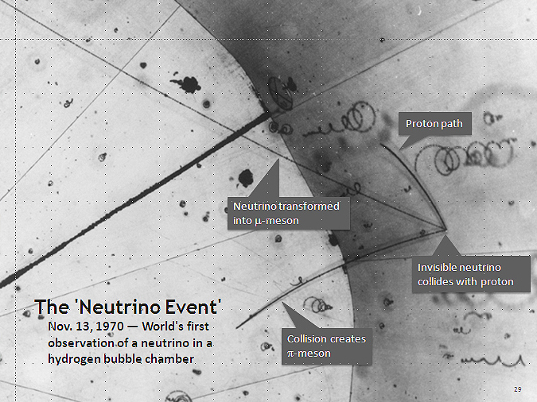
How do neutrinos interact?
We cannot observe neutrinos themselves: only the products of their interactions!

Slide 16

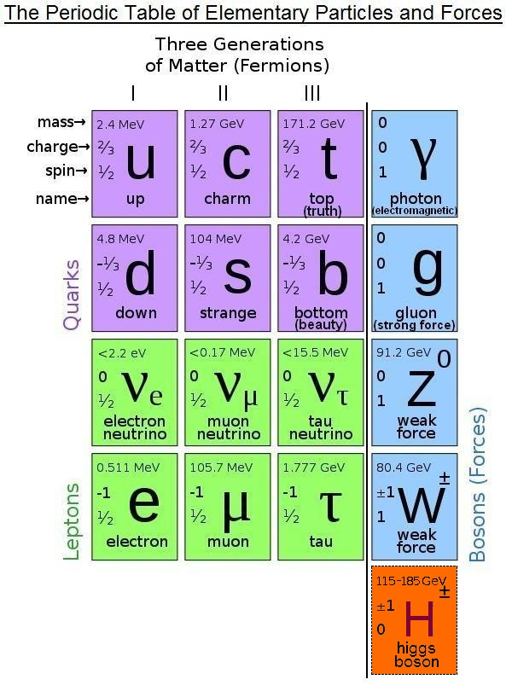
Neutrinos appear in 3 different flavors

Slide 17
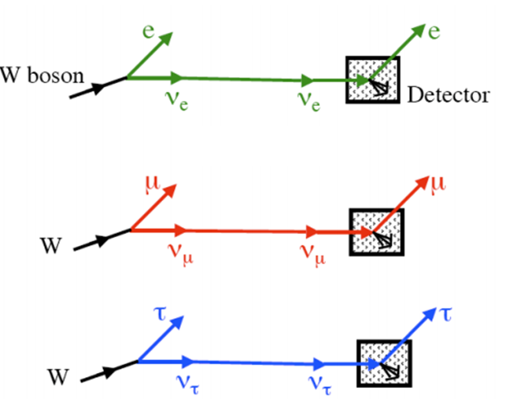
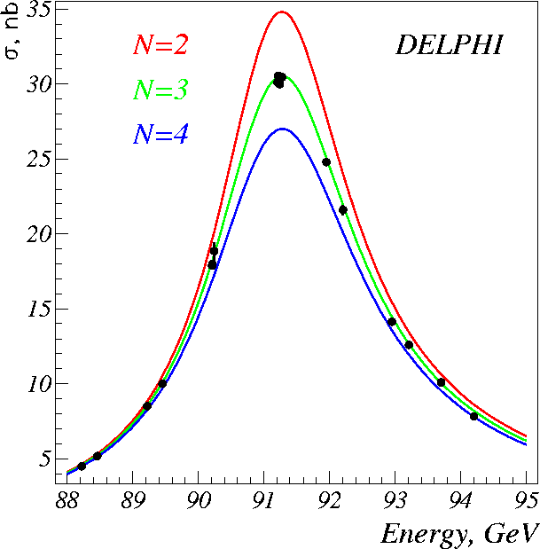
The three different types of neutrinos

Slide 18
Now we know that..
Neutrinos can be detected through the detection of the products of their interactions.
There are three “flavours” of neutrinos”: το ντ, νμ, νe with different experimental signatures in our detectors: when they interact, they produce charged leptons (e,μ,τ).
Therefore, to detect cosmic neutrinos we need to measure the product charged leptons!
How?

Slide 19
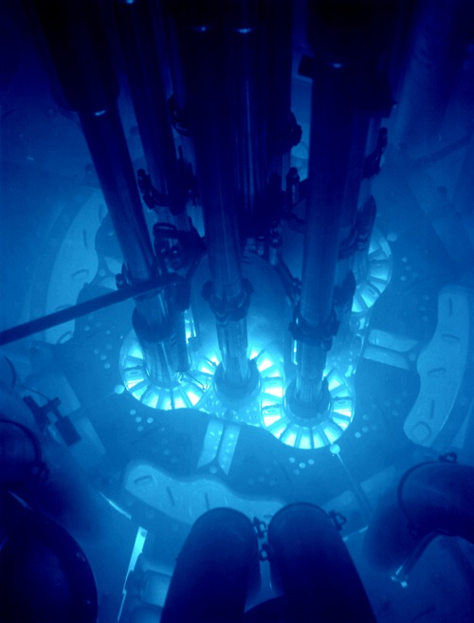
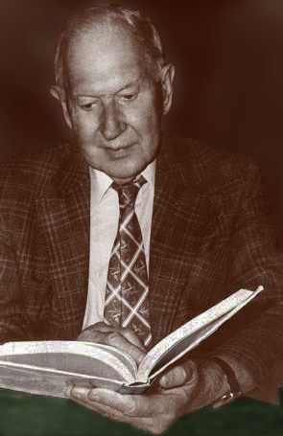
Charged leptons produced in neutrino interactions from neutrinos of astrophysical origin can travel faster than light in water! (cwater ~ 0.75 c)
When charged particles travel faster than the speed of light in water (or any medium), a characteristic bluish light is produced: Cherenkov radiation. By measuring this radiation we can reconstruct the track of the secondary particles as well as estimate their energy (with logarithmic sensitivity). This way we can understand where the neutrinos came from and how energetic they are!
High velocity charged particles in a nuclear reactor produce the
characteristic blue light of the Cherenkov radiation.
Moissey Markov

Slide 20
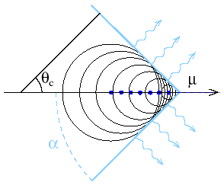
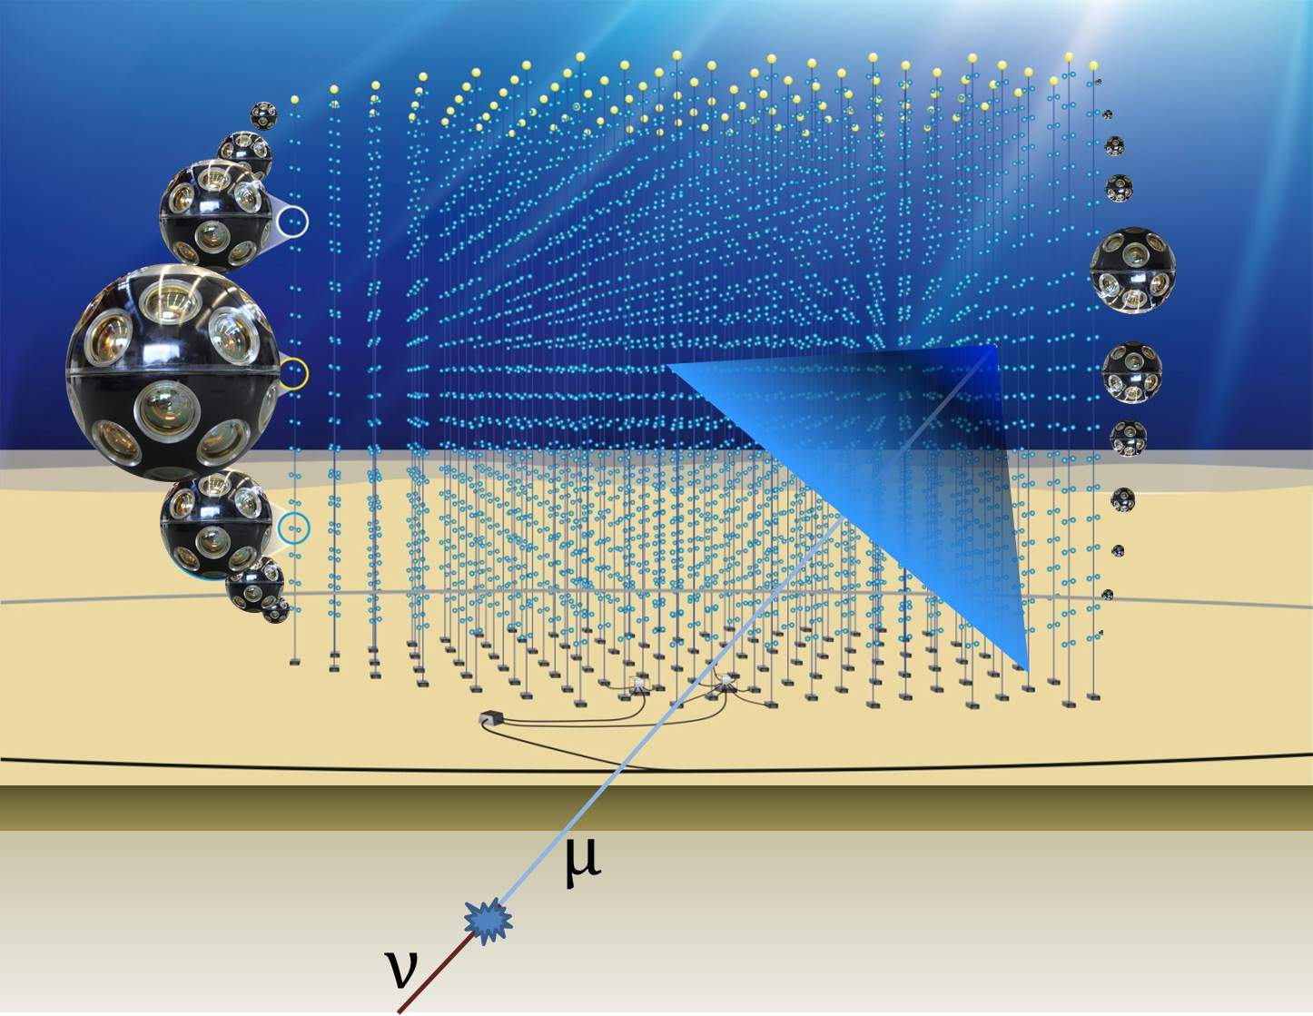
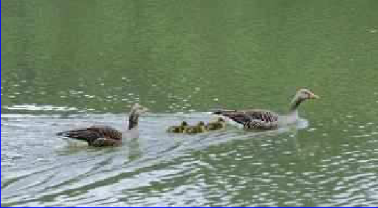
Cherenkov Radiation

Slide 21
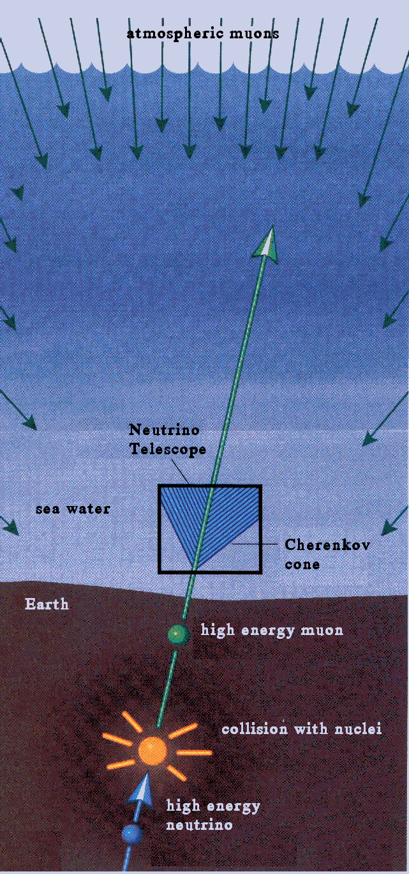

Slide 22
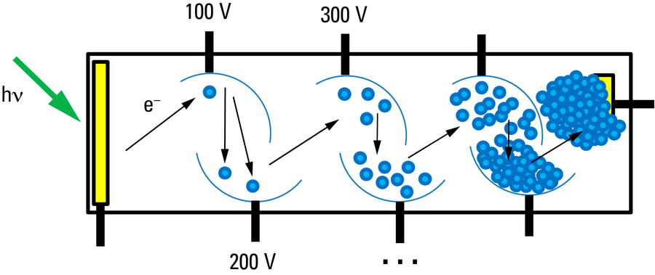
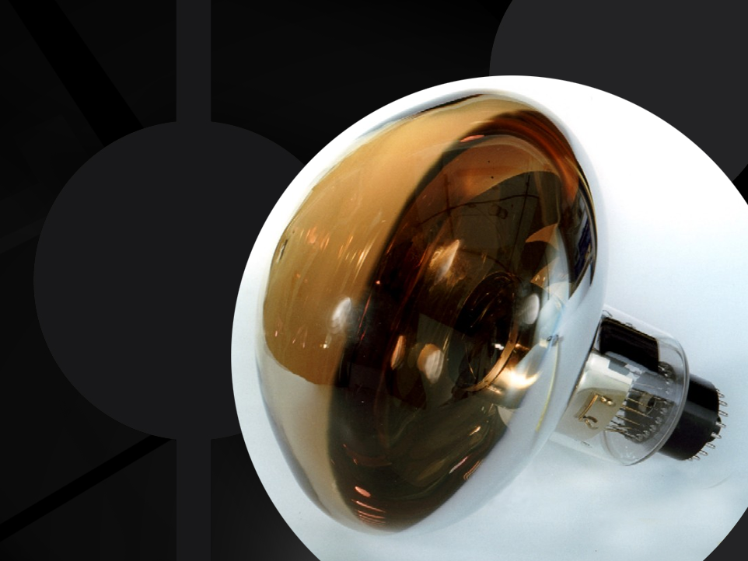
How do we detect cherenkov radiation?
We use photosensitive devices called “photomultipliers” (PMTs) that can detect
even single photons through the photoelectric effect:
When a photon of specific frequency interacts
with their photosensitive surface an electron
is produced. The electron is accelerated
through a high voltage and is “multiplied”
in a system of dynodes. As a result we have
a measurable electric pulse in the anode.
PMTs transform light into electric
current. Like inverse lamps!
http://quarknet.fnal.gov/projects/pmt/student/dynodes.shtml

Slide 23
High energy neutrino telescopes
Big volume(~1 km3)
Optical modules (eyes) consisting of photomultipliers submerged in the very deep sea or ice to reduce the “noise” of cosmic rays (muons) that come from the atmosphere (more about this in J. Marteau and T. Avgitas’s presentation).
They require an optical medium with long transmission length (water/ice), low levels of contamination and optical backgrounds.
They measure neutrinos coming from the other side of the Earth!
Notes:
EY

Slide 24
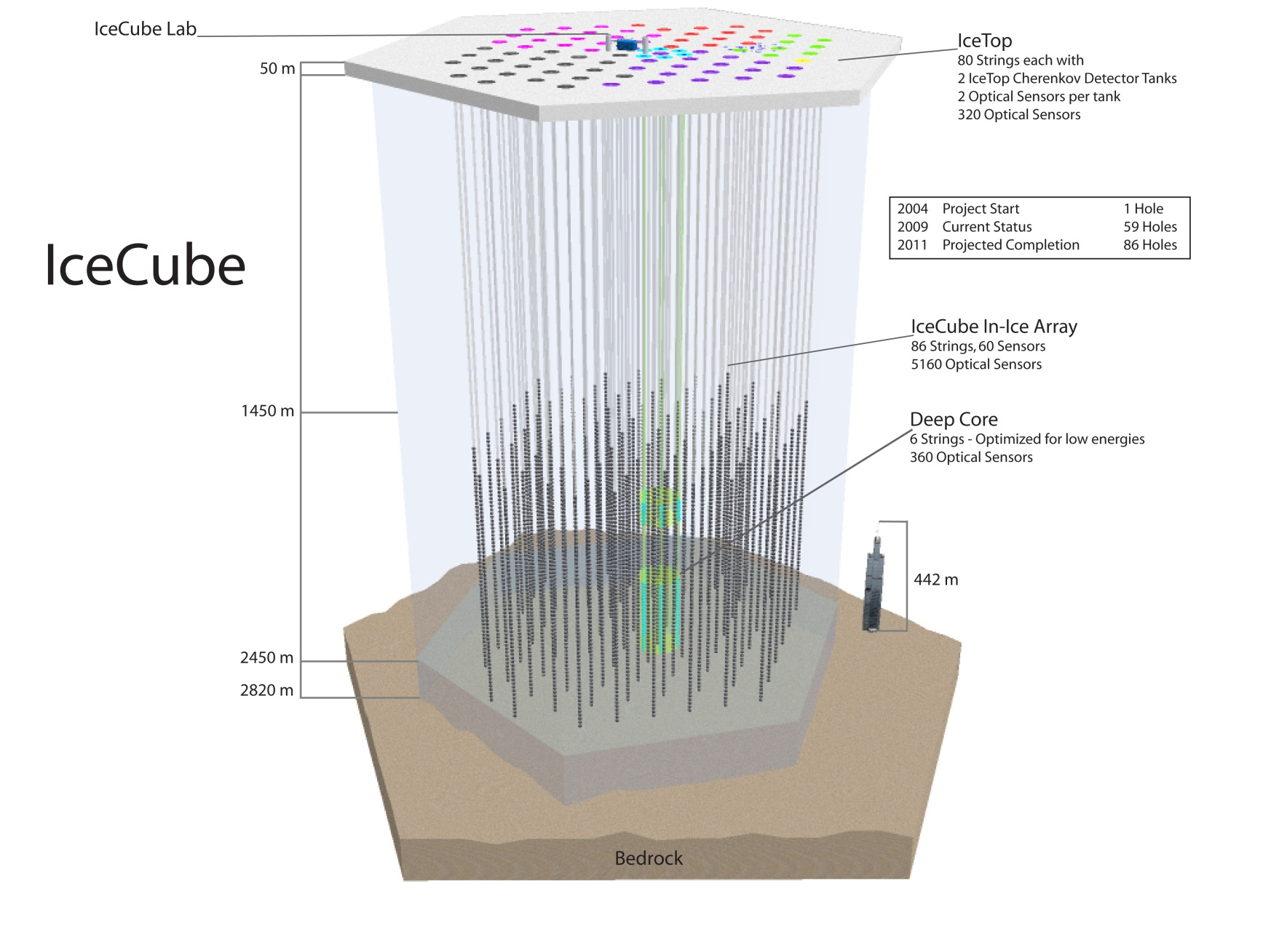
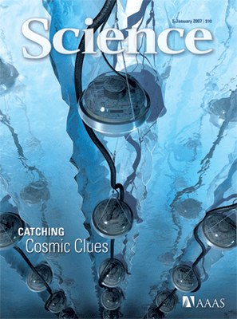
The IceCube experiment

Slide 25
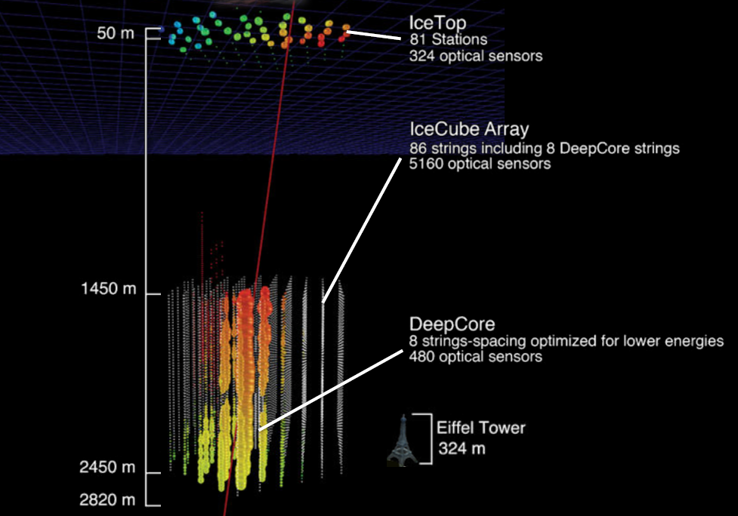
The IceCube Experiment
5160 φωτοπολλαπλασιαστέςσε 1 km³

Slide 26
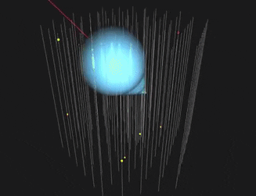
Detecting neutrinos (ANTARES experiment)

Slide 27
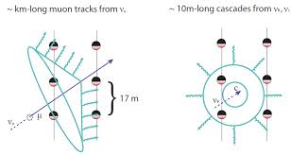
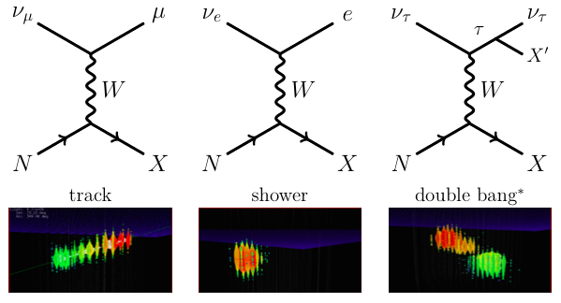
Experimental signatures

Slide 28
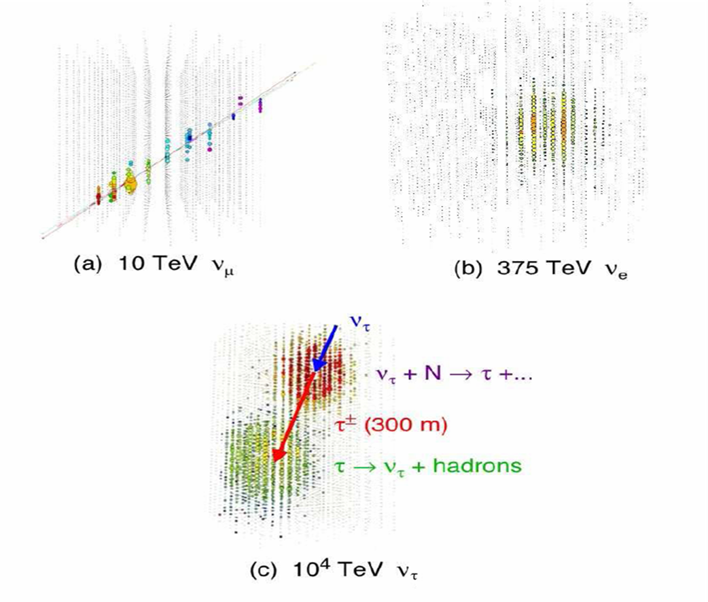

Slide 29
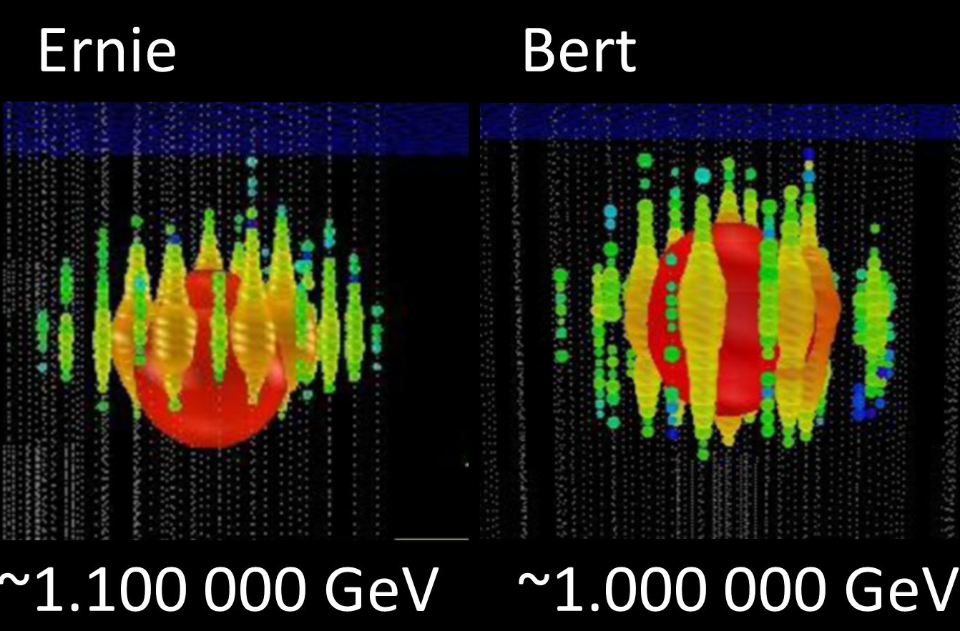
The first detections of High Energy Astrophysical Neutrinos (IceCube)

Slide 30
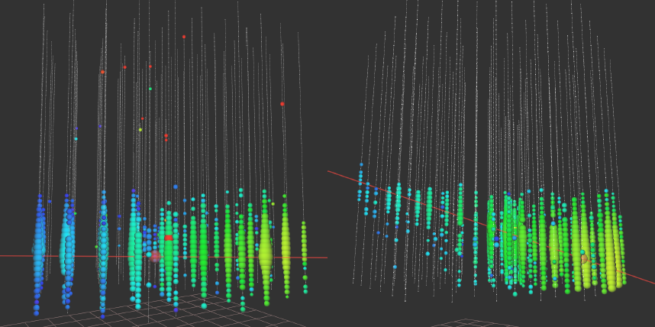
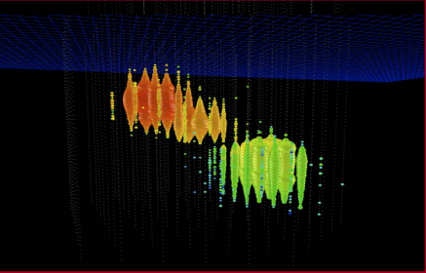
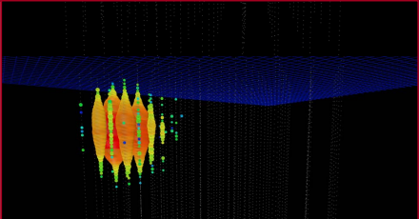
560 TeV muon in IceCube (compare with LHC energies) !!
Simulated tau
Simulated electron
20/49

Slide 31
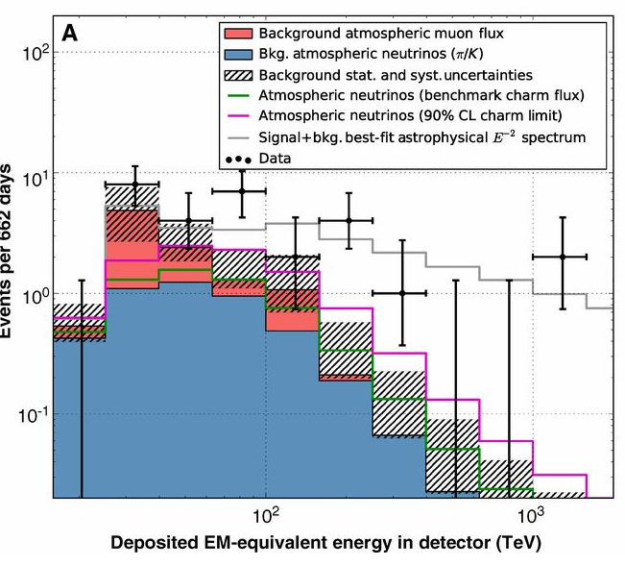

Slide 32
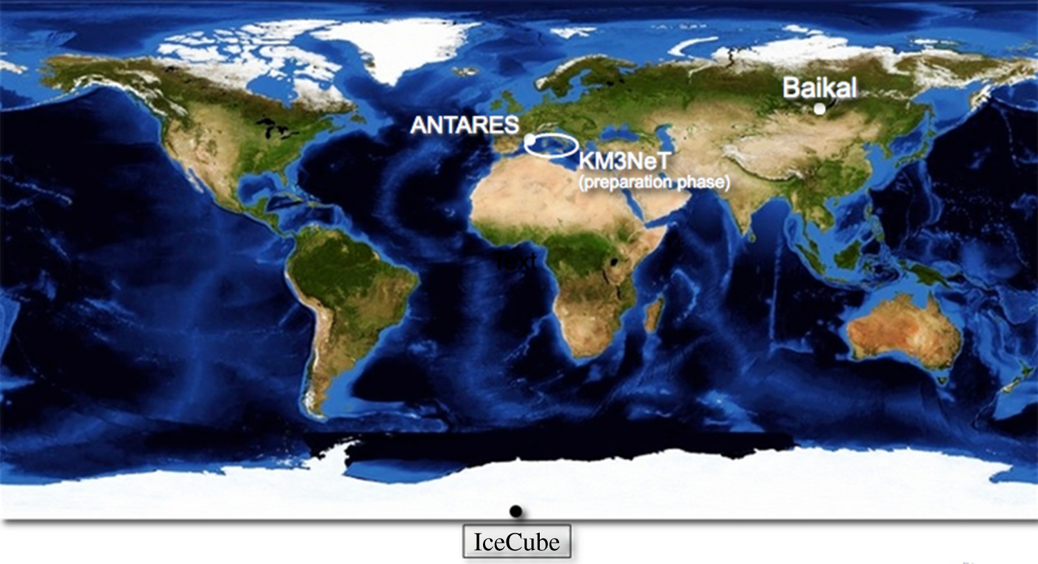
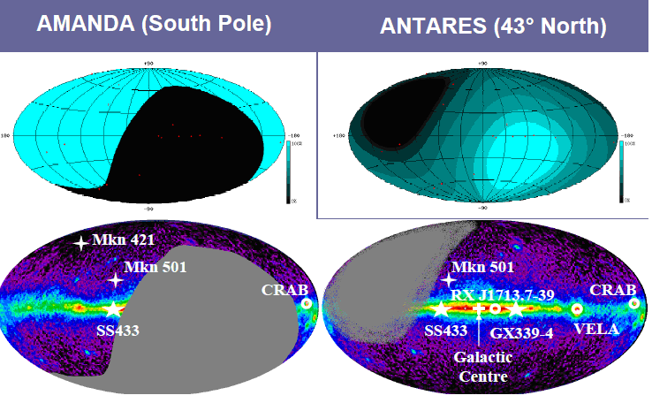
HOW MANY NEUTRINO TELESCOPES DO WE NEED?
WE NEED FULL SKY COVERAGE. AT LEAST 1 TELESCOPE IN THE SOUTH POLE AND ONE IN THE MEDITERANNEAN

Slide 33
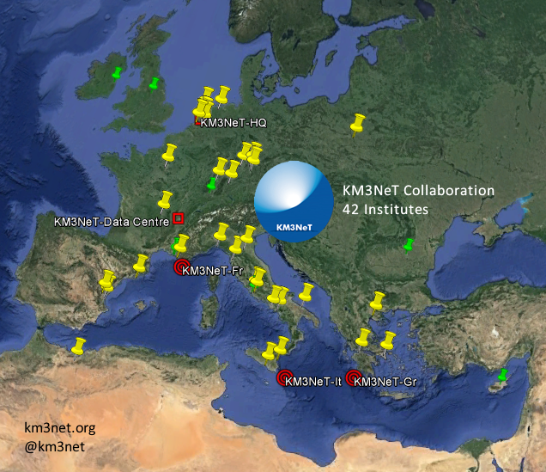
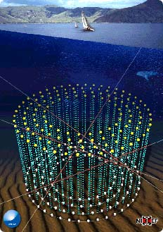

THE KM3NET EXPERIMENT
Collaboration of institutions in Europe to build a >1km3 experiment in the
Mediterannean. Based on the work done in the pilot projects NESTOR
(Pylos, Greece),ANTARES (Toulon, France),
NEMO (Catania, Italy)

Slide 34
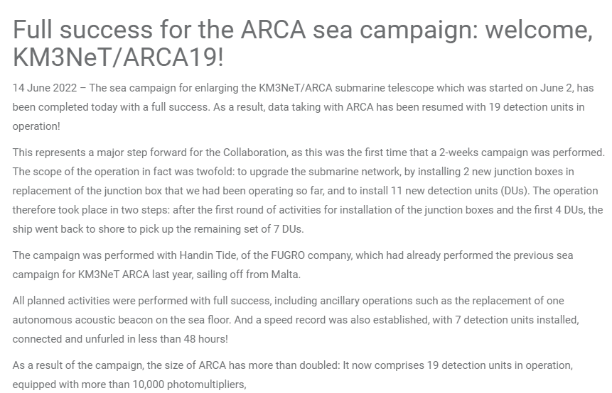
https://www.youtube.com/watch?v=iVx_WKXtgt4

Slide 35
EPILOGUE
The neutrino is the “ghost” of particle Physics: very hard to detect.
Its properties allow it to be an ideal cosmic messenger allowing us to observe the universe in new “eyes”.
Their detection requires very large volume detectors (>1km3) in sea or ice to detect the Cherenkov radiation from their byproducts.
So far we have managed to detect the first neutrinos of cosmic origin (IceCube), the first neutrino point source (Blazars) as well as measure the atmospheric neutrino flux in high energies.

