Slide 1
Notes:
Large Scientific Infrastructures enriching online and digital Learning (LaSciL) is an Erasmus+ project to support high quality science teaching.
Enhancing teachers’ digital preparedness and competences; and
Supporting high quality science teaching in situ and from a distance.
LaSciL envisions to empower and support teachers to become literate and fluent with the use of high quality digital tools. They will able to:
Create their own open educational resources for use of their students in open and distance learning;
Manage large numbers of students in an online environment, keeping them motivated to participate, maintaining or enhancing their science motivation; and
Personalise their teaching practices based on the needs of their students.
To achieve that, LaSciL will:
Demonstrate innovative ways to involve teachers and students in eScience by sharing and exploiting the collective power of high quality digital resources (research facilities, scientific instruments, advanced ICT tools, simulation and visualisation applications and scientific databases;
Provide teachers cutting edge, curriculum-tailored educational scenarios that can be used, reused and adapted to their needs as well as act as a source of inspiration for the design of their own open educational content;
Carefully monitor and assess the teacher training and implementation with students;
Select a series of good practices and construct a roadmap both for supporting science teachers and a for proposing a new organizational framework for the collaboration between schools and research infrastructures; and
Demonstrate effective ways for involving a broader set of actors in the use of research infrastructures by developing a framework of actions that will attract young people to science and pool talent to scientific careers.
Source: https://lascil.eu/index.php/about-lascil/

Slide 2
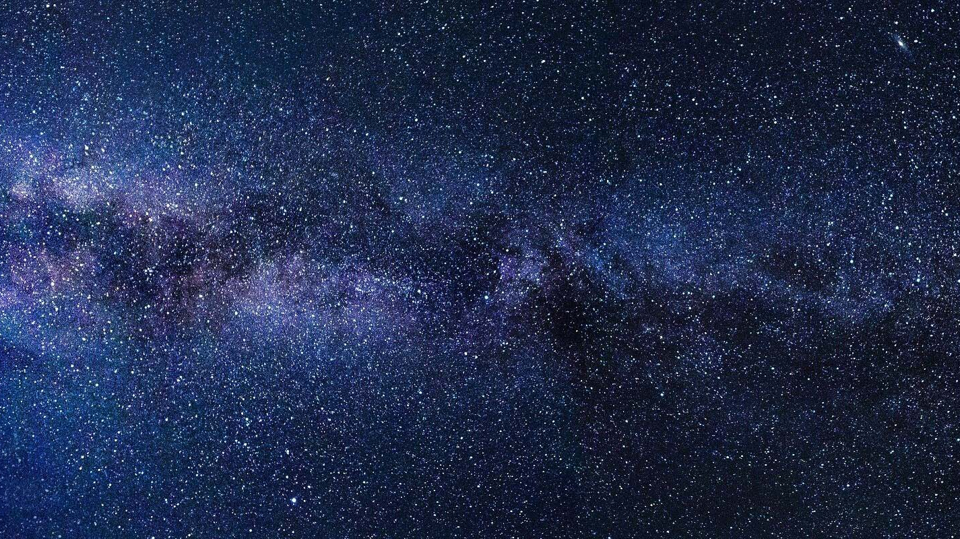
S P E C T R A L T Y P E S
How do astronomers make sense of the millions of stars they see?
NOIRLab / NSF / AURA
Notes:
About
Name: Paul Prouse, Teacher of Physics at Bromsgrove School
School: Worcester Road, Bromsgrove, Worcestershire, B61 7DU, United Kingdom
Telephone: +44 (0)1527 579679 / Email: pprouse@bromsgrove-school.co.uk
General information
Title: Spectral Types – How do astronomers make sense of the millions of stars they see?
Description: This project teaches students about how astronomers classify stars and the link between absorption lines and temperature. Students warm up by looking for similarities and differences in stellar spectra. Then, they classify stars using two different methods: by the strength of the Hα line (as the astronomers of the late 1800s did) and by temperature. Then, questions help students bridge the gap between line formation and temperature to understand the science that came from classifying stars.
Keywords: Electromagnetic spectrum, spectroscopy, Wien’s Law
Context
Age: 13-19 years
Prerequisites: Students should have a basic understanding of the nature of light before undertaking this project. They should know that light is a wave and that different wavelengths correspond to different colours. Students also need to be able of read and understand graphs of spectra. The only mathematical calculation is relatively simple – finding the temperature of a star from its thermal radiation curve.
Duration: 3 x 60 minutes
Objectives
To understand that each star has a unique spectrum, with a series of absorption and emission lines
To understand that stars emit thermal radiation with a peak wavelength that depends on the star's temperature
To explain that stellar absorption lines are caused by electrons in the outer layers of a star's atmosphere absorbing photons from the star
To know that the pattern of absorption lines depends on the temperature of the star
To classify the spectrum of a star from its absorption lines
To find the temperature of a star from its thermal radiation curve if the peak is visible
To identify which types of stars are most common, and understand that some types of stars are too faint observe, even with large telescopes
Cognitive: Remembering, understanding, applying, analysing, evaluating and creating
Affective: Receiving, responding, valuing, organising and characterising
Psychomotor: Perception, set, guided response, mechanism, complex overt response, adaptation and origination
Curriculum
Pearson Edexcel Level 1 / Level 2 GCSE (9-1) in Astronomy (1AS0):
13.4 Understand what information can be obtained from a stellar spectrum, including chemical composition, temperature and radial velocity;
13.5 Understand how stars can be classified according to spectral type;
13.6 Understand how a star’s colour and spectral type are related to its surface temperature; and
13.21 Understand how astronomers obtain and study the patterns of spectral lines in the light from astronomical objects.
Source: https://qualifications.pearson.com/en/qualifications/edexcel-gcses/astronomy-2017.html

Slide 3
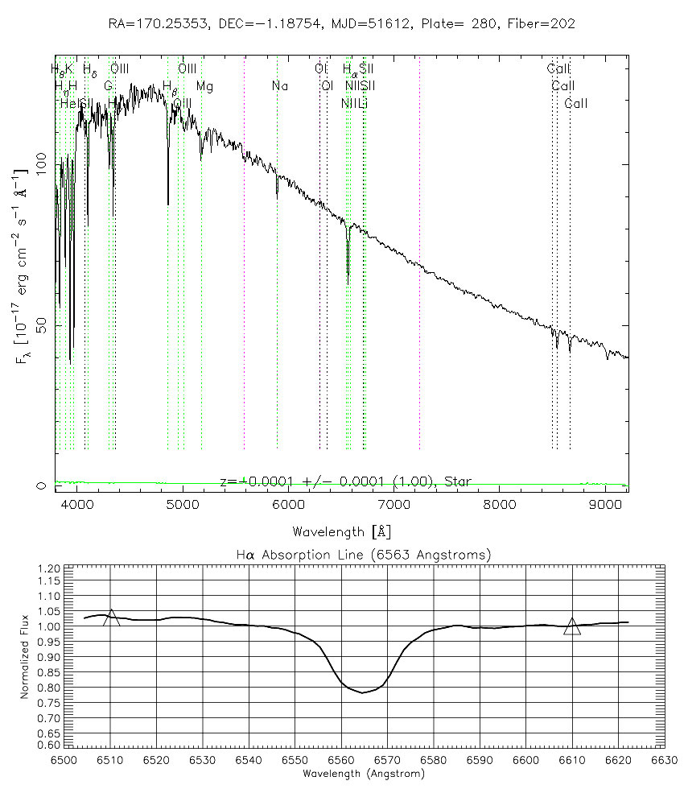
J. K. Adelman-McCarthy, M. A. Agüeros, S. S. Allam et al., The Sixth Data Release of the Sloan Digital Sky Survey, Astrophysical Journal Supplement 175 (2008) 297-313.
Notes:
Classifying by Line Strength
Try classifying stars based on the "strength" of their hydrogen absorption lines, specifically the Hα line. The spectrum above has been zoomed in to show the spectrum's Hα line shown below it.
Notice that the Hα absorption line dips down vertically, but it is not a straight drop; the line has some width. The two triangles in the zoom-in mark two spots on the continuum spectrum. If you drew a line between the two triangles, you would see approximately how much light would have been emitted by the star if it had no hydrogen.
If you coloured in the area between that line and the actual spectrum, you would see the amount of hydrogen "missing" from the spectrum due to hydrogen absorption. This amount is referred to as the strength of the absorption line. The strength of an absorption line depends not only on the depth of the valley, but also on its width.
Look at the spectra of these seven stars:
1. SDSS J155028.73+003801.1 (http://cas.sdss.org/dr6/en/tools/quicklook/quickobj.asp?id=587722953841377411)
2. SDSS J153437.70-004719.4 (http://cas.sdss.org/dr6/en/tools/quicklook/quickobj.asp?id=587722982300450865)
3. SDSS J112100.84-011115.1 (http://cas.sdss.org/dr6/en/tools/quicklook/quickobj.asp?id=587722981735792686)
4. SDSS J114635.23+001233.5 (http://cas.sdss.org/dr6/en/tools/quicklook/quickobj.asp?id=587722983349223466)
5. SDSS J115643.84-010837.8 (http://cas.sdss.org/dr6/en/tools/quicklook/quickobj.asp?id=587722981739724873)
6. SDSS J154841.72-000003.5 (http://cas.sdss.org/dr6/en/tools/quicklook/quickobj.asp?id=587722952767438985)
7. SDSS J133008.54+000921.9 (http://cas.sdss.org/dr6/en/tools/quicklook/quickobj.asp?id=587722983360561187)
Using their spectra, rank the seven stars according to the strength of their Hα absorption lines.
If you have a hard time judging by eye, colour in the area between the line connecting the triangles and the spectrum, then count the number of grid boxes to measure the line strength. Rank the stars by writing each star number in the appropriate place in the second column of the table below.
Line Strength Star Number Spectral Type
Strongest line (largest area)
↓
↓
↓
↓
↓
Weakest line (smallest area)
Originally, astronomers classified those stars with the strongest hydrogen lines as 'A' stars, stars with the next strongest lines as 'B' stars, the next strongest 'C' and so on. Eventually, they realised that some letters were unnecessary, and dropped them from the classification system. The letter assigned to a star is called its spectral class. The spectral classes that remain are: A,B,F,G,K,M and O.
In the third column of the table, write the spectral class of each star. There is only one star of each type in this data.
Source: https://cas.sdss.org/dr6/en/proj/basic/spectraltypes/lines.asp

Slide 4
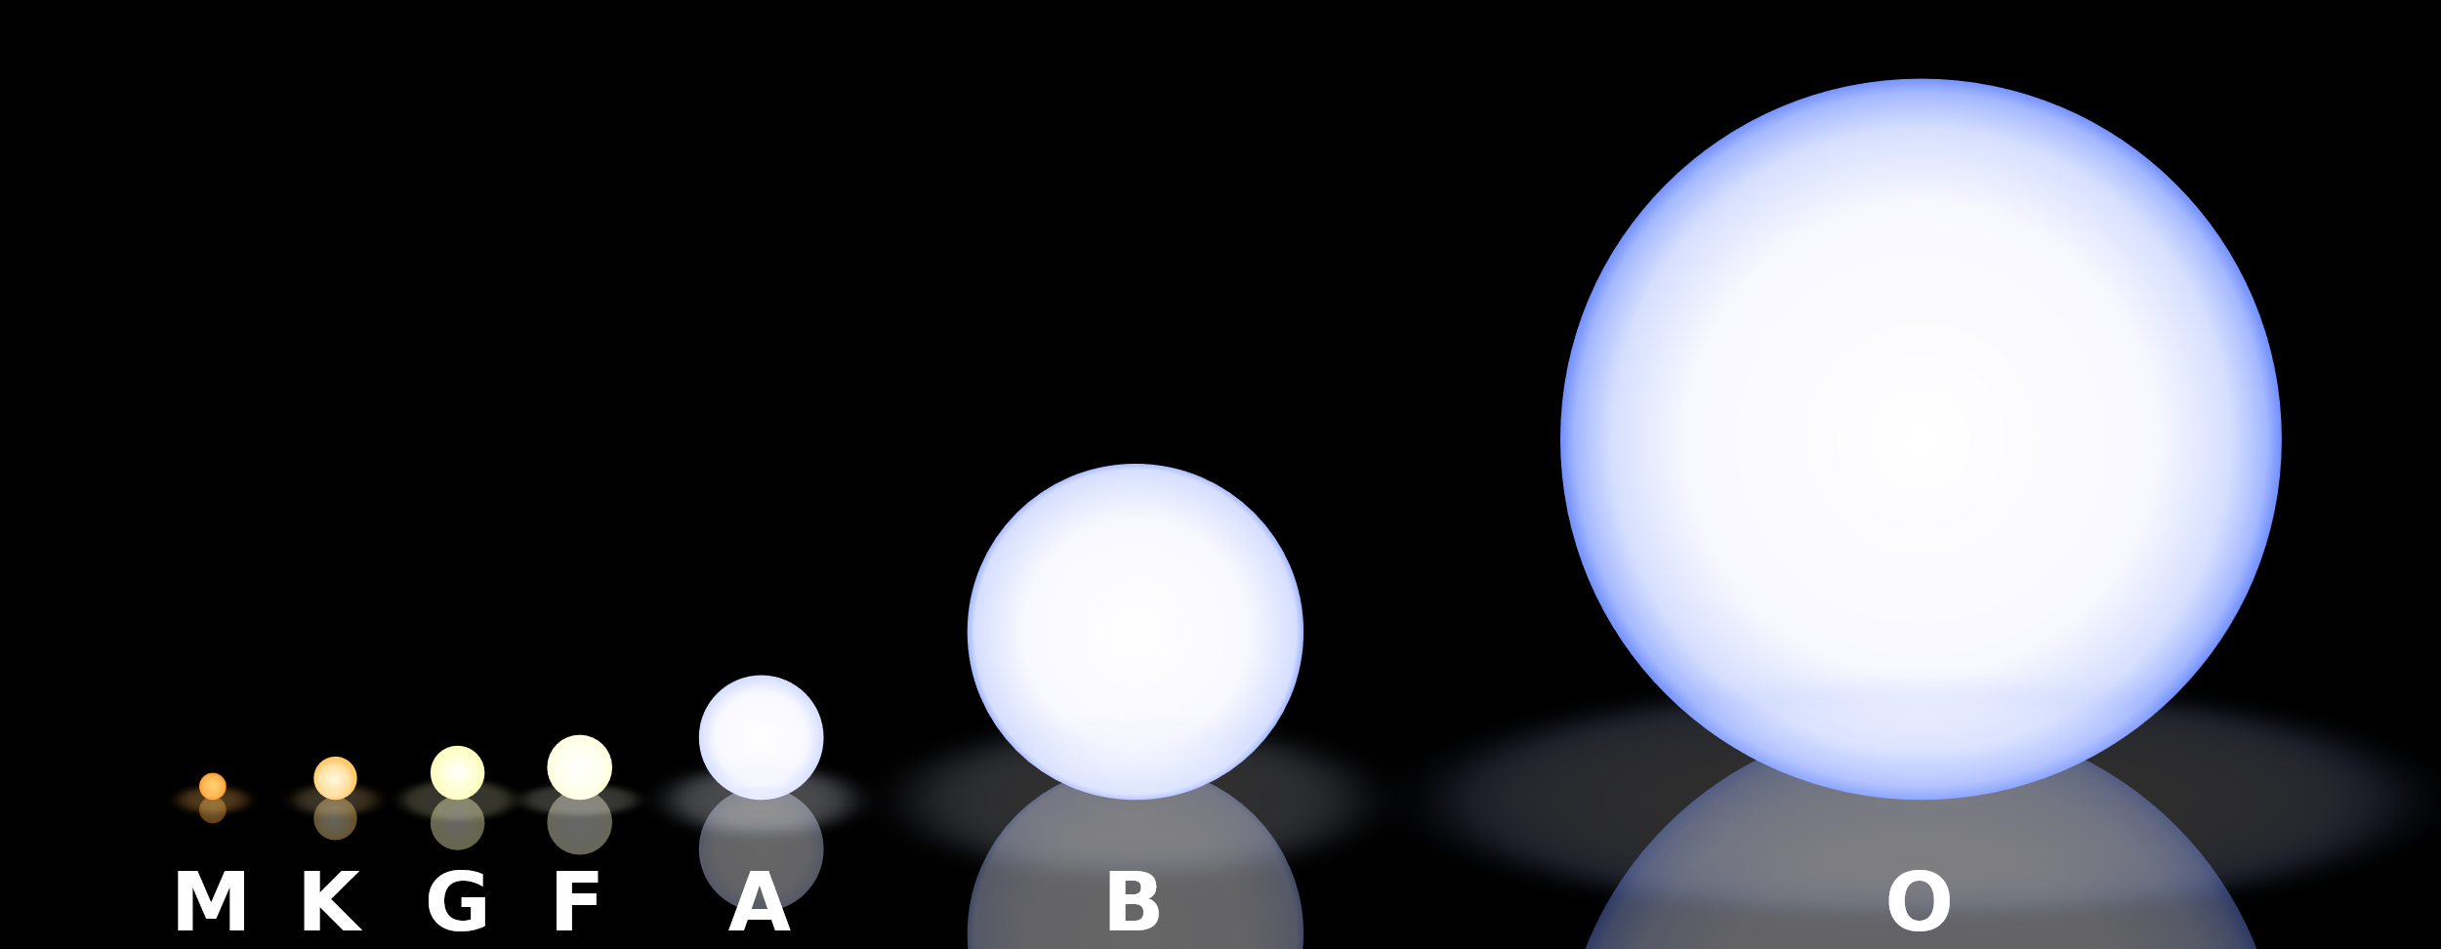
Rursus, CC BY-SA 3.0, via Wikimedia Commons
Notes:
Stellar Classification
Astronomers began to categorise stars, based on their mass and temperature, hundreds of years ago. As scientists have learned more about stars, this classification scheme has had to evolve.
Stars are grouped into seven main categories (also called, classes). These were created by astronomer Annie Jump Cannon. The classes are called O, B, A, F, G, K and M. Stars in the 'O' class are the most massive and hottest, with temperatures above 30,000 °C. Stars in the 'M' class are the smallest and coolest, with temperatures below 3,000 °C.
If you look closely at stars in the sky, you notice they are not all the same colour. Some appear redder and some appear bluer. The colour of light a star gives off, is controlled by its temperature. Hotter 'O' stars glow bluer, and cooler 'M' stars glow redder. This is similar to what happens when you heat up metal to very high temperatures. As the metal heats up, it will start to glow red. As it gets hotter, that red becomes more yellow, and then white. Eventually, the metal will be hot enough to glow a bright blue colour.
Our closest star, the Sun, shines with a yellow light. The Sun is classed as 'G' star, with a temperature of about 5,500 °C.
We can be even more accurate when we categorise stars by splitting each class into ten smaller sub-classes. These sub-classes are numbered 0 - 9, with 0 being hotter than 1. For example, the Sun is actually a G2 star. This is hotter than a G7 star, but cooler than a G0 star. Similarly, a B9 star is cooler than a B4 star.
The table below lists the average temperatures and colours for each class of star.
Class Temperature (°C) Colour
O > 30,000 Blue
B 20,000 Blue-White
A 10,000 White
F 7,000 Yellow-White
G 6,000 Yellow
K 5,000 Orange
M 3,000 Red
Source: https://www.schoolsobservatory.org/learn/astro/stars/class

Slide 5
Notes:
Bromsgrove Astronomical Society (BASOC) caters for astronomers of all ages and experience in the local area.
BASOC has many members, ranging from experienced amateurs to relative newcomers to astronomy. We meet on the first and third Mondays of each month at Bromsgrove Rugby Football Club (https://goo.gl/maps/6TgPtVqTe1p22LXh7). It is a fantastic venue, offering dark skies with a good southern view. Doors open around 7:30 p.m.
Over seventy visitors attended our inaugural event, making us one of the largest astronomical societies in the United Kingdom.
Since 2008, we have enjoyed a wide range of talks from visiting speakers and from Society members (https://broms-astro.org.uk/previous-society-events/). Also, we have hosted inter-society quizzes and organised Society outings. We hope to continue attracting new interest, and welcome anyone with an interest in astronomy.
Source: https://www.broms-astro.org.uk/about-us/
Faulkes Telescope Project – Bringing the Universe to your classroom
The Faulkes Telescope Project (FTP) is an education partner of Las Cumbres Observatory (LCO). Our aim is to provide free access to robotic telescopes and a fully supported education programme to encourage teachers and students to engage in research-based science education. Access to our resources and those of our partners is provided at no charge to teachers and students.
Robotic Telescopes
LCO operates a network of research-class robotic telescopes. Currently, they have twenty-one telescopes across the world, including two 2 metre telescopes (the Faulkes Telescopes – one in Hawaii and the other in Australia), and a number of 1 metre and 0.4 metre telescopes. For more up-to-date information on their location, visit the LCO website (https://lco.global/observatory/sites/). The LCO telescopes are available to UK and EU teachers to use through the FTP as part of their curricular or extra-curricular activities and are fully supported by a range of educational materials, a team of educators and professional astronomers.
Source: http://www.faulkes-telescope.com/information/about-us/

