Slide 1
Hertzsprung-RUSSEL DIAGRAM OF PLEIADES
Light and the 7 sisters
George Klimis
Pagkrition School

Slide 2
Project Outline
The Goal : Students should be able to predict the evolution of several stars of Pleiades open cluster
Ages : 16-17-18
Project Duration : Several weeks
Method of Implementation : Inquiry-Based Learning
Subjects Involved : 1. Light and its properties. Emission & Absorption spectra
2. Basic stages of stellar creation & evolution 3. H-R diagram and stellar classification 4. Basics on optics & telescopes 5. Data acquisition & Analysis
Estimated Level of Difficulty : Medium to High , but it is the journey that matters, not the destination…

Slide 3
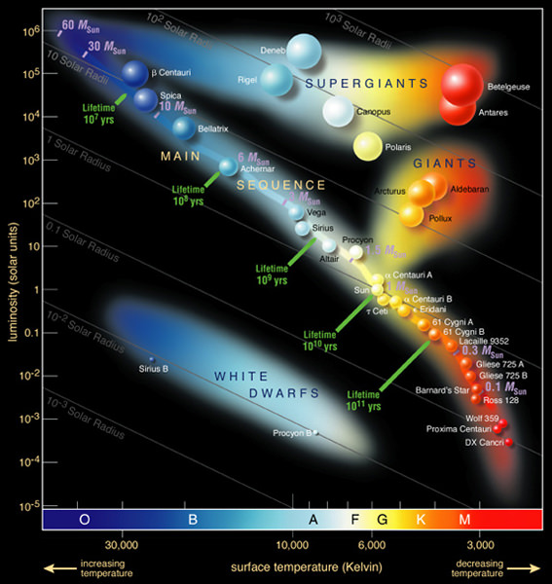
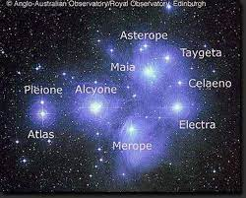
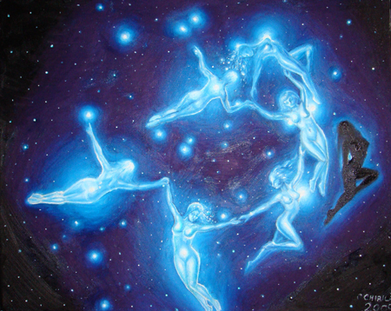
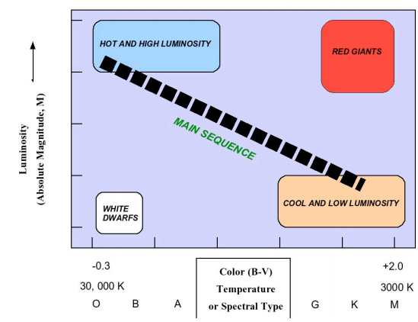

Slide 4
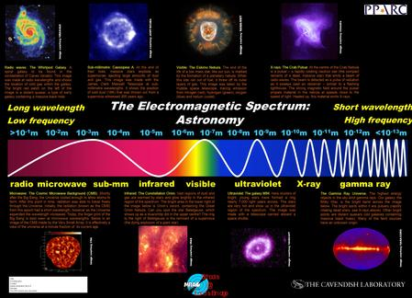
Educational Purposes
Evolution
Stellar
Importance of Light
Data Acquisition
& Analysis
In Astronomy
Born in Space when there was no space
Born at a time when there was no Time

