Slide 1


APOSPERITIS OR AUGERINOS(MORNING STAR)
CHRISTODOULAKIS NIKOS
PAGKRITION JUNIOR HIGH SCHOOL

Slide 2

Look through Greek literature and poetry and find as many tales as possible that have something to do with Aphrodite(VENUS).
Listen to the following tale related to Aposperitis and Augerinos.https://www.openbook.gr/o-aposperitis-kai-o-aygerinos/

Slide 3


Slide 4
2. If you know that the angle that Venus forms with the horizon is 45° when it is at its zenith, then make a prediction about the possible distance between Venus and the Sun.
https://solarsystem.nasa.gov/planets/venus/in-depth/

Slide 5
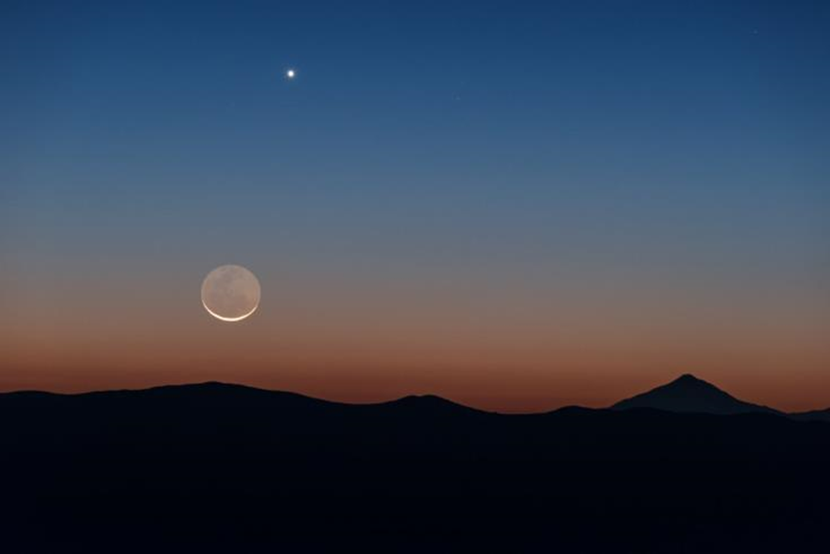

Slide 6
3. What are the phases of Venus?
https://www.youtube.com/watch?v=n_46Zp9UHgs

Slide 7
