Slide 1
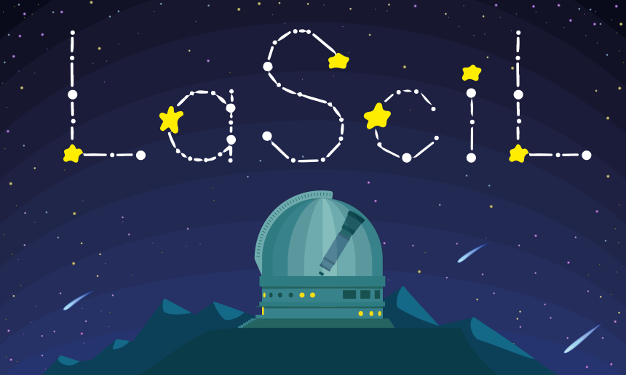

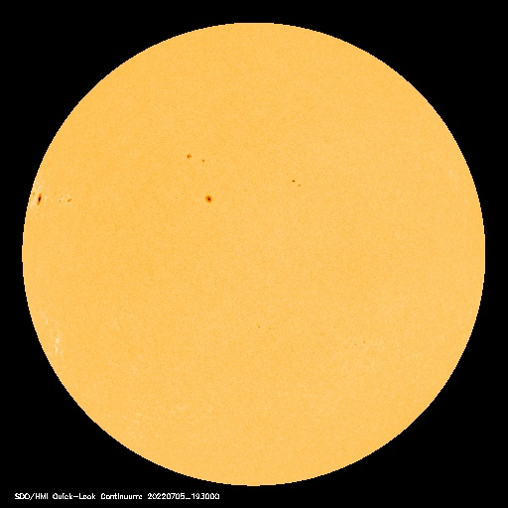
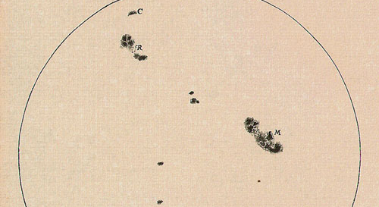
Safe Solar Observation and Sketching Sunspots
Kleio Milioni
Ellinogermaniki Agogi

Slide 2


Short description
Educational Goals
Describe the positive and negative aspects of the Sun
Establish that there are ways to safely observe the Sun.
Realize that there are many factors involved in planning and implementing an observation.
construct a device for indirect and safe observation of the Sun
Observe the sunspots and their displacement and establish that this is due to the rotation of the Sun
6th Grade Primary students
Module Sun (Physics Lesson)
3 didactic hours

Slide 3

Short description
need to study solar activity by scientists
methods of safe observation of our Sun
observation of the Sun from a solar telescope and also through the construction of a solar projector,
draw the spots of the Sun.
compare images of the Sun from different dates (data from SOHO)
change in positions of the spots.

Slide 4

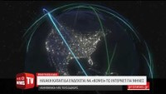
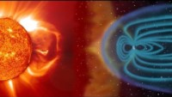
Engagement-Orientation
Is the sun important to Earth?
Are there any dangers from the sun?
(Class discussion and recording of positive and negative effects on humans)
Solar Storm in News
Space Weather

Slide 5
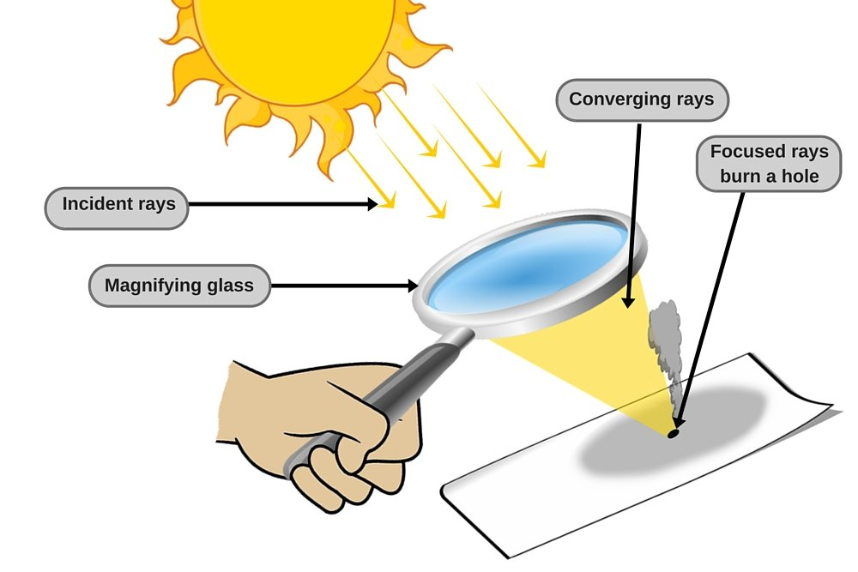
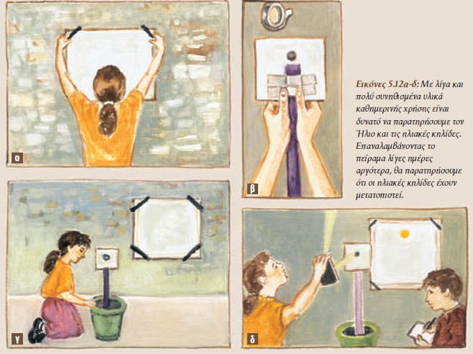
How could a scientist study the sun? Are there any risks with observing it?

Slide 6
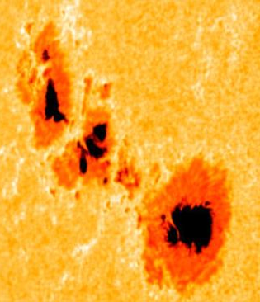

How can we see the sun more accurately? What do we observe with the telescope?
They record the observing conditions and draw the shape of the Sun on a suitable worksheet. Observe and draw the sunspots (new knowledge)

Slide 7
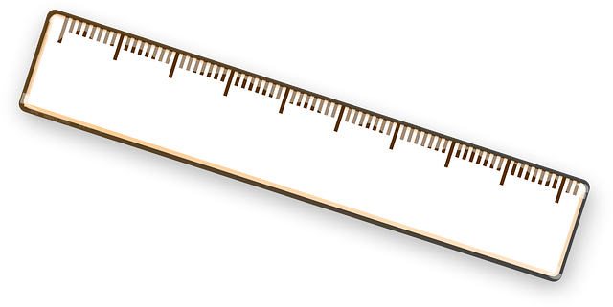
How many times does the earth fit in one spot?
SOHO pictures : Spot measurement with a ruler (pixelruler)
Suns diameter 1.392.700 km
Earths diameter 12.742 km

Slide 8
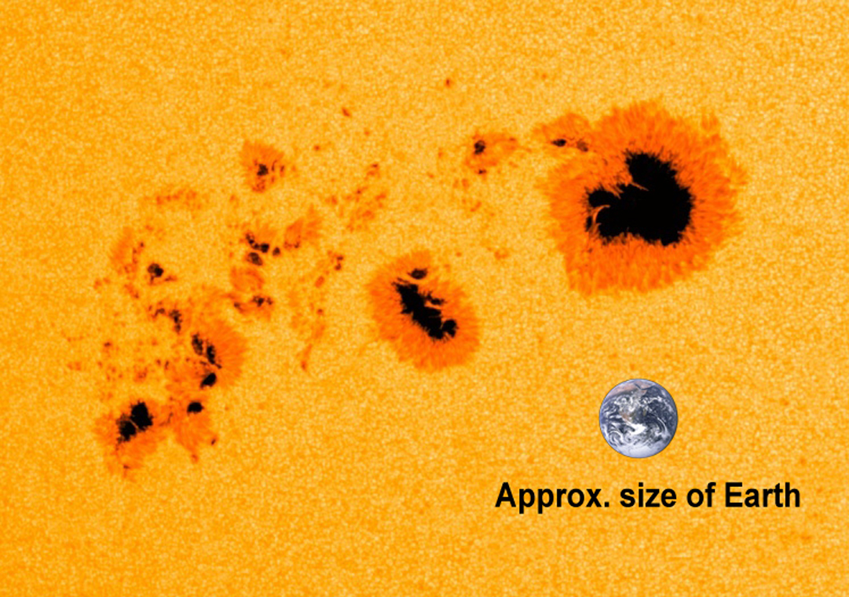

Slide 9
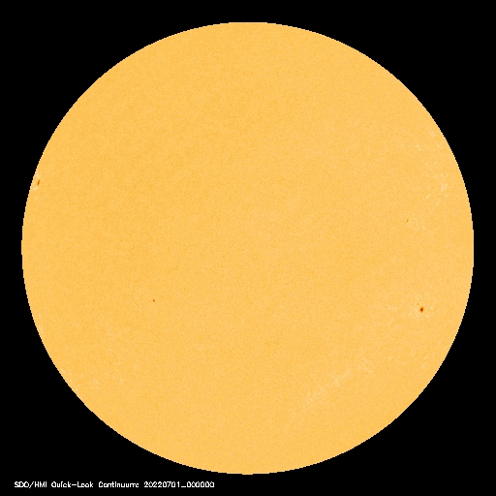
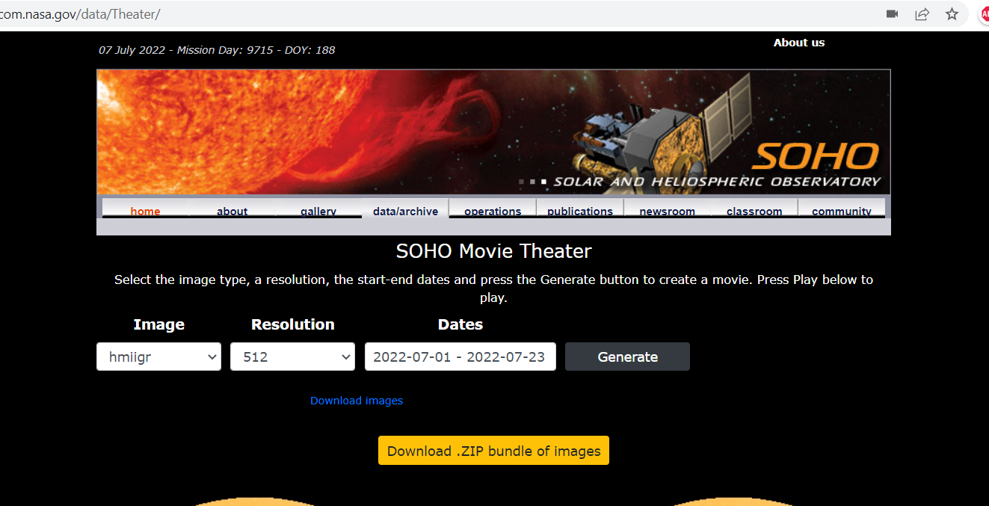
Does the Sun has a rotation?
Make a gif from SOHO Movie Theater

Slide 10
Thank you!
Kleio Milioni
kleiom@ea.gr

