Slide 1
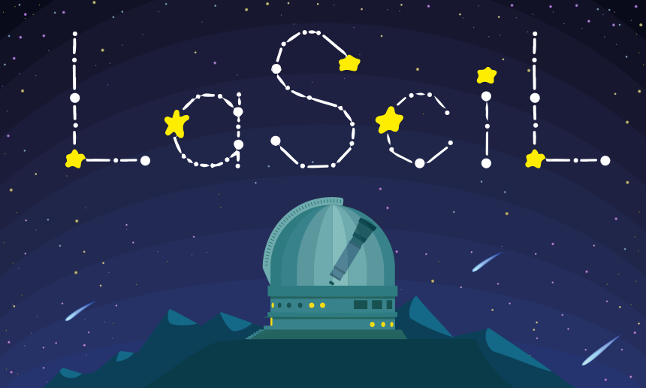


My Constellation
Rosa Doran
NUCLIO
Gustavo Rojas
NUCLIO
LaSciL Summer School, July 3-8 2022

Slide 2
Background
Thousands of years ago, our ancestors had little leisure options during the dark hours of the night. When they stared at the starry night sky, they imagined figures and patterns connecting the stars, and associated legends and stories to these figures, thus giving birth to what we know as constellations.
Constellations are cultural artifacts that reflect beliefs and realities of a given people, place and time.

Slide 3
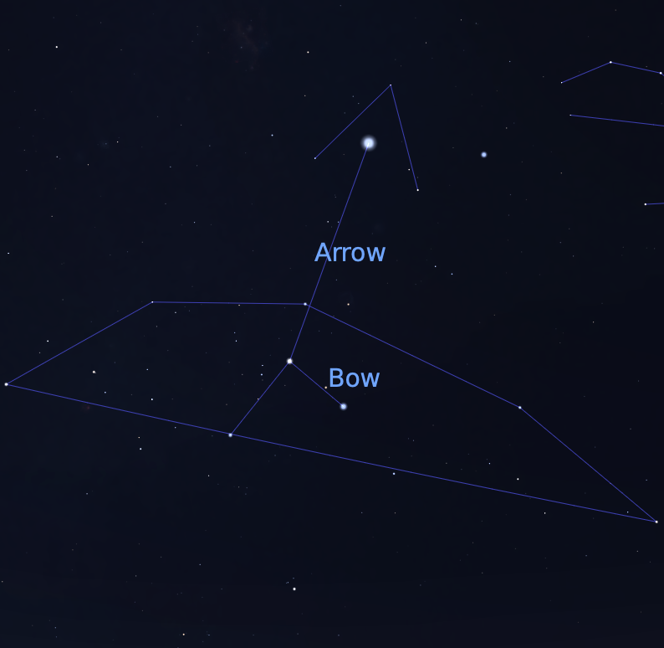
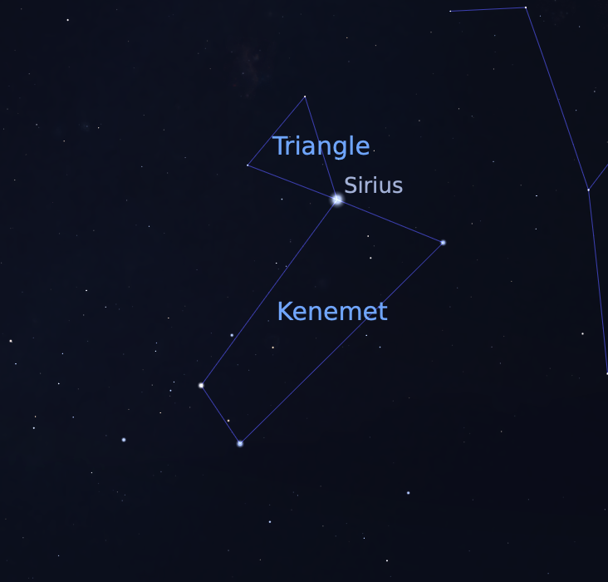
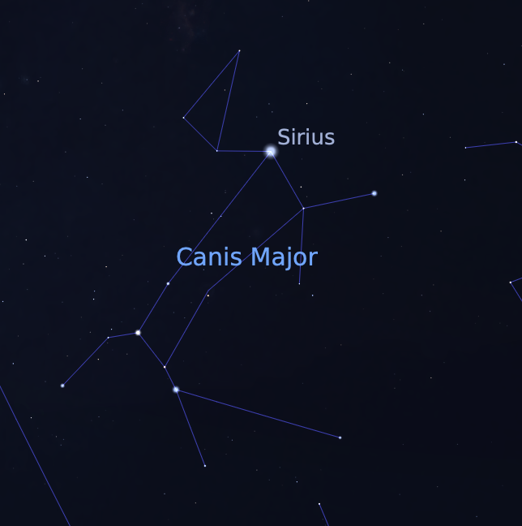
Canis Major in 3 different Cultures
Babylon
Egypt
Greece

Slide 4
Modern representation of Canis Major constellation

Slide 5
Orienting Questions
To start this activity, we suggest that you have an open conversation with the students to gauge their initial knowledge on this subject.
What are constellations?
Do you know any constellation names?
Do you know any legends about constellations?
Can you identify constellations in the sky?

Slide 6
Activity Steps
Use Stellarium to display the night sky
Ask the children to imagine figures
Show the traditional western constellations
Then show other cultures’ representations

Slide 7
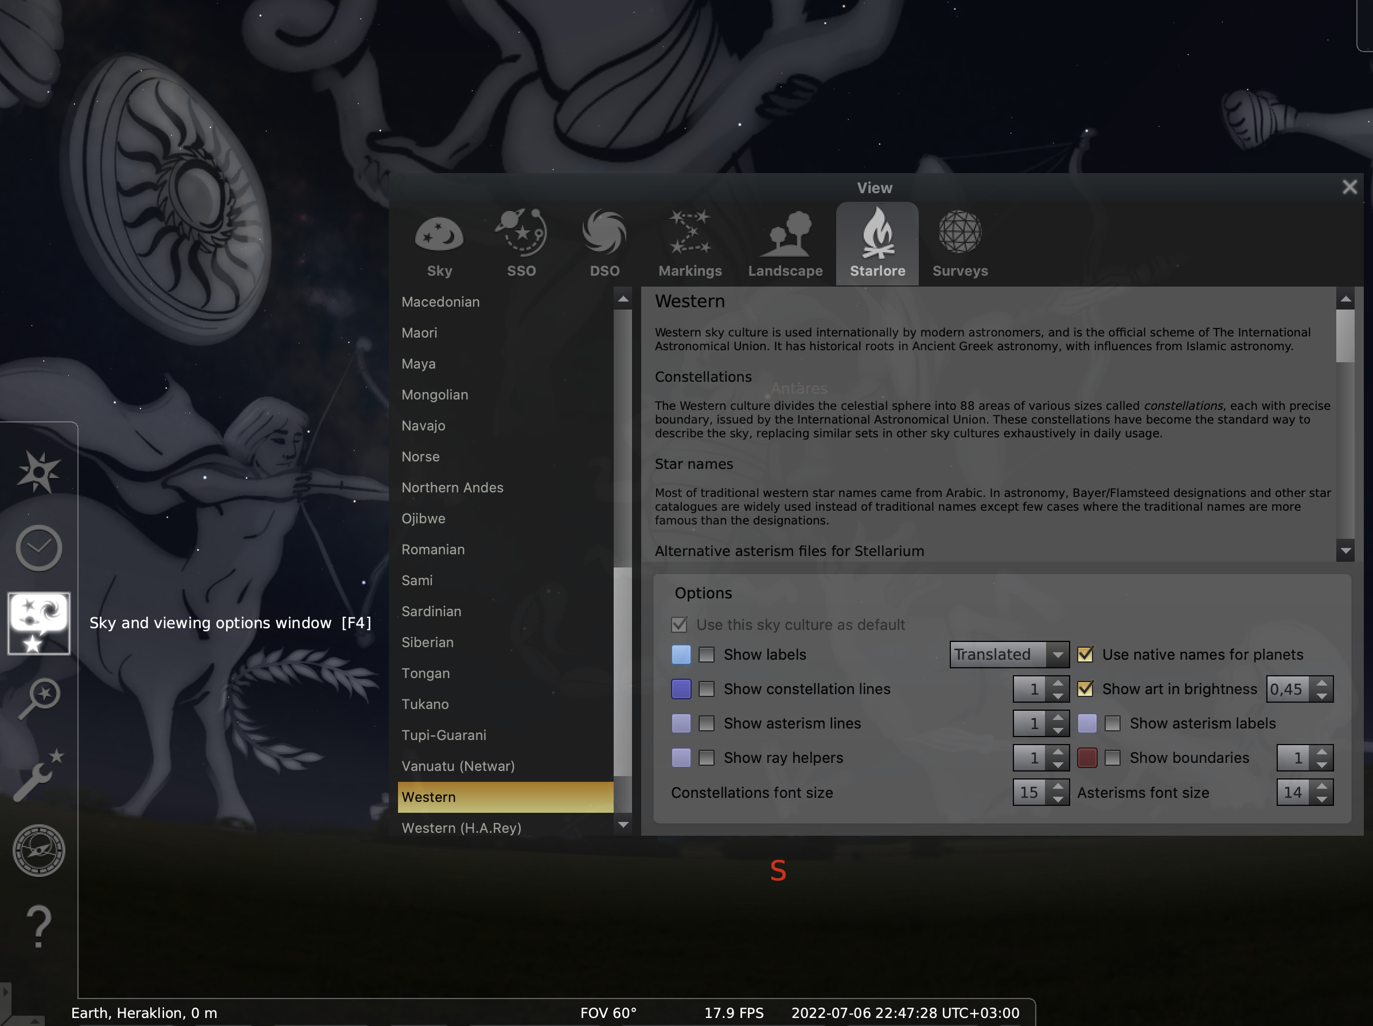

Slide 8
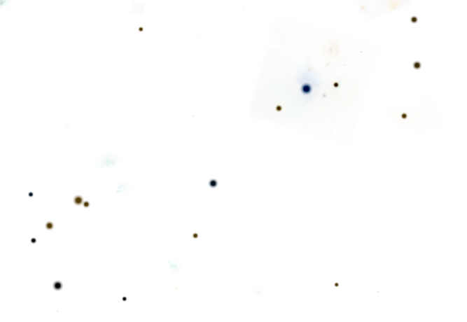
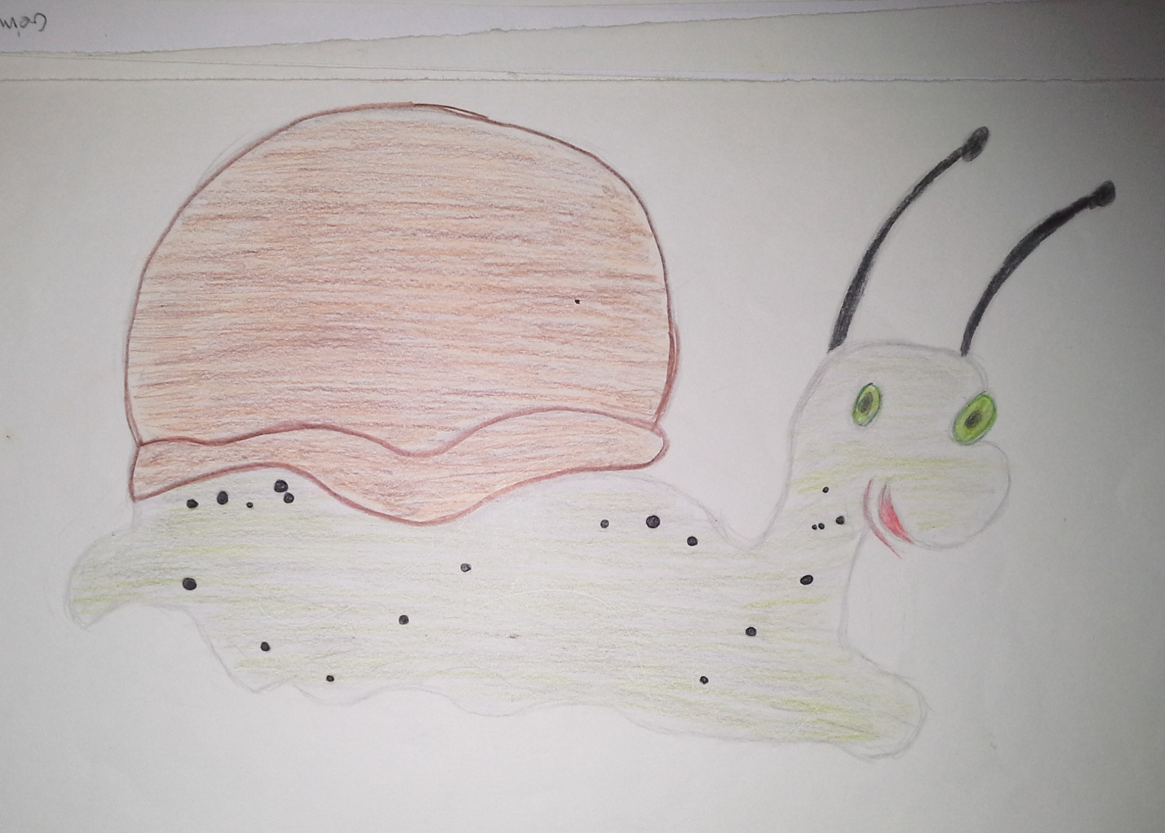
Building a 3D model
Give the constellation blanks to the children and ask them to draw a representation

Slide 9
Building a 3D model
Ask them if stars are at the same distance of us, and if that would affect the star pattern.
Build a table for the brightest star distances and scale them for string lengths up to 30cm

Slide 10
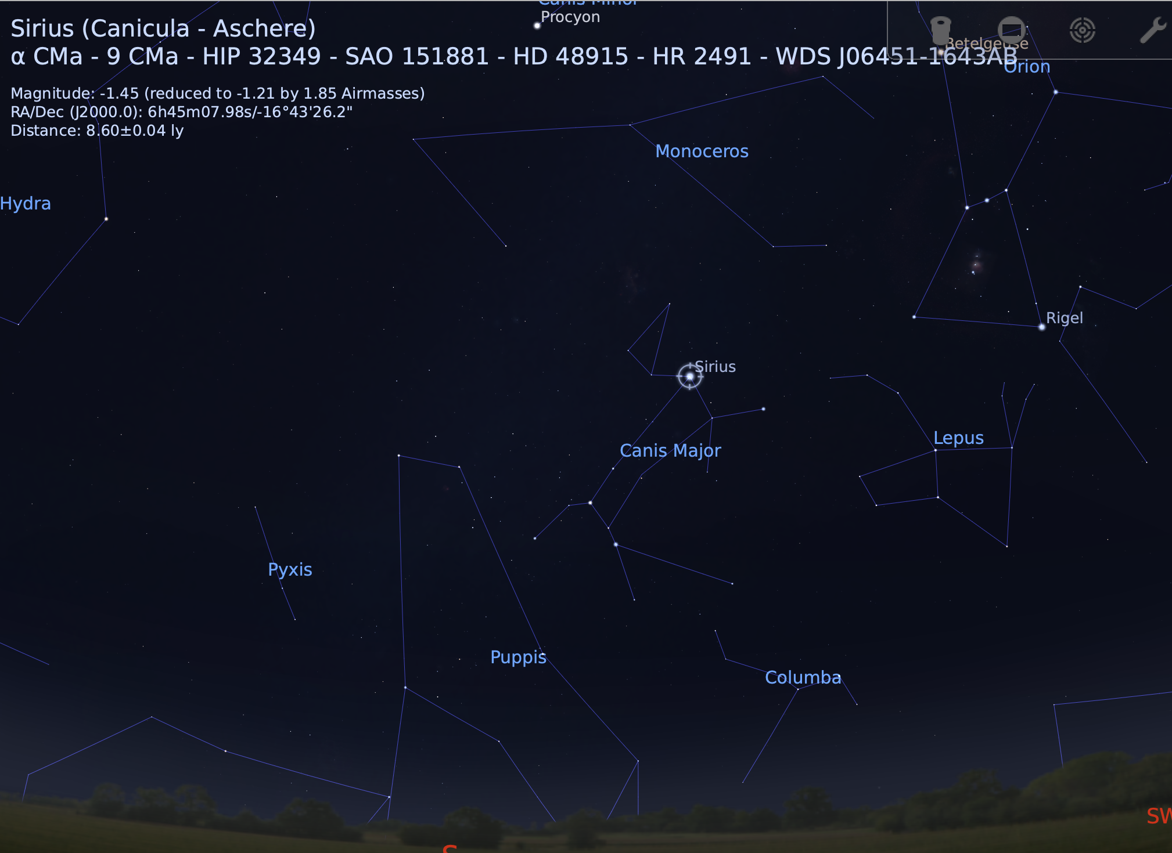
Clicking on a star on Stellarium will display information about it, including its distance in light-years (top left).

Slide 11
Star | Distance (light-years) | String Length (cm)
Acrux (Alpha Crucis) | 320 | 27,8
Mimosa (Beta Crucis) | 278 | 24,2
Rubidea (Gamma Crucis) | 88 | 7,6
Palida (Delta Crucis) | 345 | 30
Intrometida (Epsilon Crucis) | 229 | 19,9
Distance to the brightest stars in the southern cross and corresponding string lengths.

Slide 12
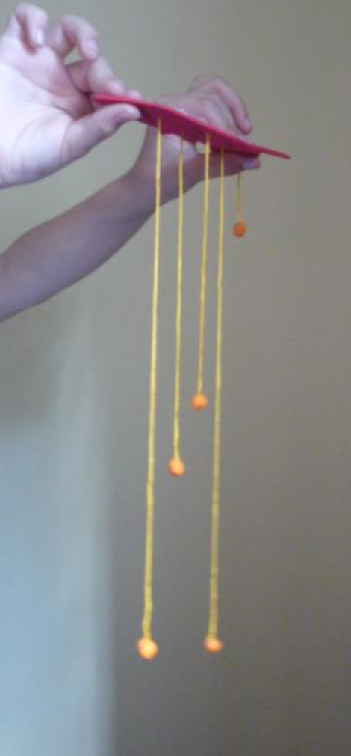
Cut the strings in the corresponding distances, and attach a putty clay ball (or any other object representing a star) in one tip of the string. Tie the other end of the string with a knot in the corresponding star in the constellation blank.
Fix the arrangement at the ceiling of the classroom and look at it from the side. Now, look at the representation from below.
Sketch watch you see from both perspectives and compare it with the original constellation blank.

Slide 13
Thank you for your attention!
  For further details :
  www.lascil.eu
  @lascil.project
  lascil@nuclio.org

