Slide 1
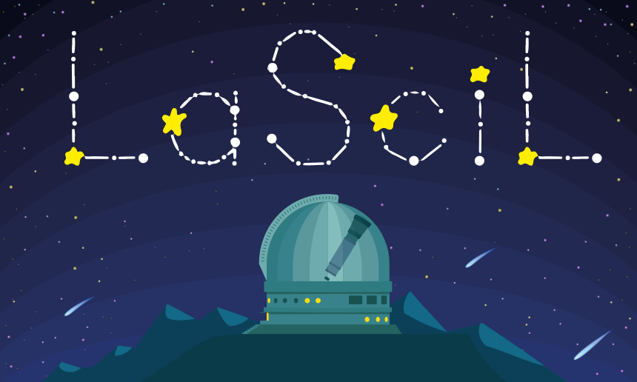
How far is the Moon?
Use of high school geometry in calculating astronomical distances
The project was supported by the Hellenic Foundation for Research and Innovation (H.F.R.I.) under the “3rd Call for Action “Science and Society” “Research, Innovation and Dissemination Hubs”” (Project Number: 02181).

Slide 2
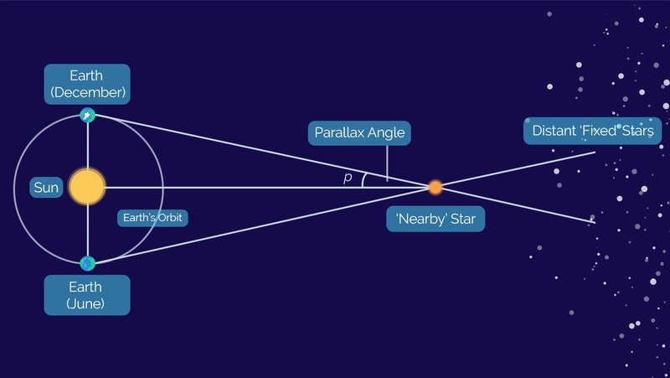
Stellar parallax
https://youtu.be/iwlMmJs1f5o
Notes:
Have you ever tried to see a small object alternately with one eye or the other? It seems to be moving, when in fact it is stable. This phenomenon is called parallax. Now think that you have a head the size of the Earth, so the one eye is at the northern hemisphere and the other eye is at the southern hemisphere and both of them are located at the same meridian. So if you observe the Moon alternately with the one eye or the other, you’ll realize that the position of the Moon is changing. This is the key to measure the distance to the Moon geometrically and we use the digital tool of Stellarium for that.
Our goal is to understand the very limited accuracy we have and to estimate that with only a few geometrical things, we can calculate astronomical distances in a very satisfactory level which seems, at the eyes of our students, that the scientific way of thinking is really working.

Slide 3
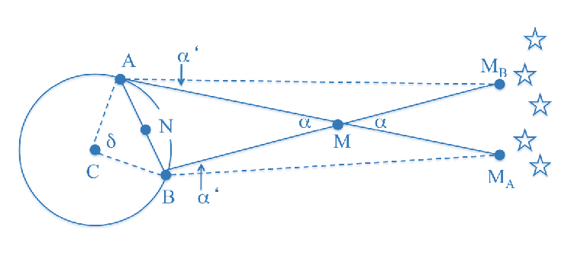
Reaching the Moon with parallax method
Selected location | Geog. Latitude (°) | Geog. Longitude (°)
Stockholm | 59.3294 N | 18.0687 E
Cape Town | 33.9249 S | 18.4241 E
Notes:
We’ ll set two locations: Cape town at the southern hemisphere and Stockholm at the northern hemisphere. These two locations are approximately at the same meridian. This fact is crucial, because through Stellarium we will measure the angular distance between the two positions from which the Moon is seen for the two selected locations, simultaneously.

Slide 4
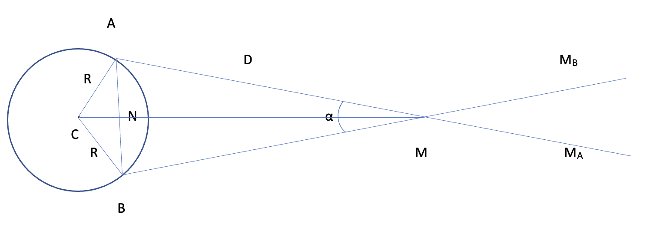
Assumptions
We can assume that the ABM triangle is isosceles because the distance between the two locations and the Moon are approximately the same. With this assumption, we have to take into account the figure nearby for our calculations.
An assumption is that the Earth is completely round with a radius of 6,371 km.
Because the two locations are approximately at the same meridian, we also assume that the points A, B, C, N and M are at the same plane.
MM_{A} // BM_{A}

Slide 5
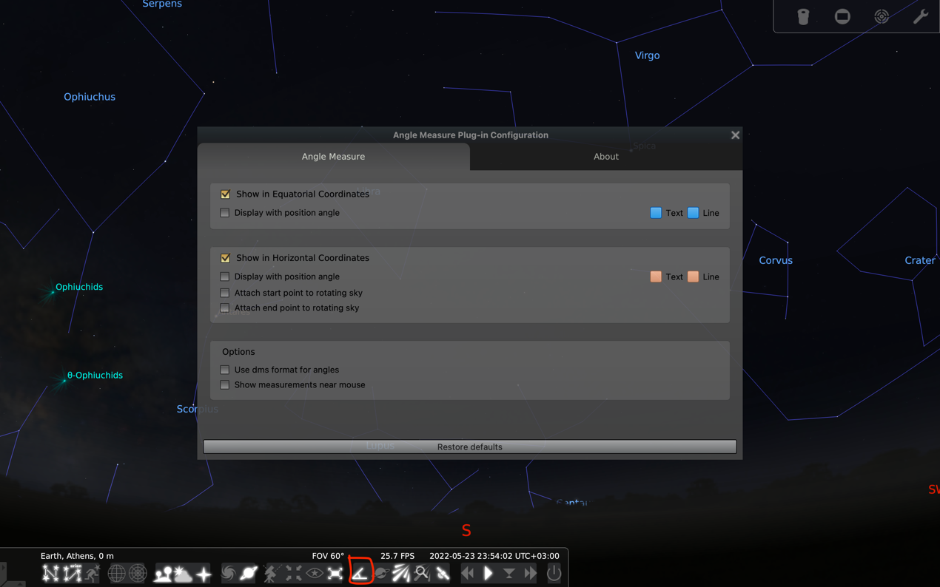
Angle measure tool of Stellarium

Slide 6
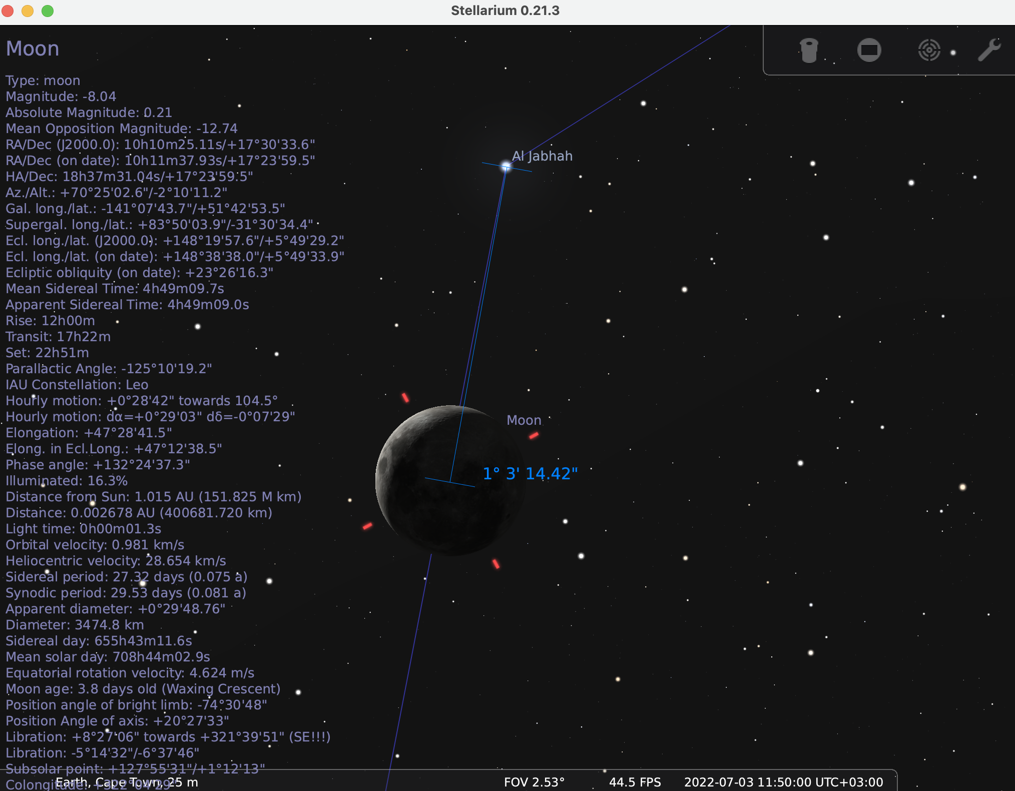
Notes:
Firstly, we measure the angular distance between the centre of the lunar disc and a close star to it, for the first location. Secondly, we take advantage of that Stellarium keeps the previous measurement and we set the right click of the mouse to drag for the measurement of the angular distance between the centres of lunar discs as observed through the two locations.
So α angle is measured as 1° 16’ 58.20’’ or 1.283°. The time that we have selected for the calculation is showed on the figures. For the conversion and the calculation of sine, we use wolfram alpha https://www.wolframalpha.com/ which is a very easy and direct online tool for a huge range of calculations.
So, from our calculations D is calculated with a relative uncertainty of 20 % which is quite satisfactory based on the assumptions that we’ve taken into account. 3/7/22 11:50 UTC

Slide 7
