Slide 1
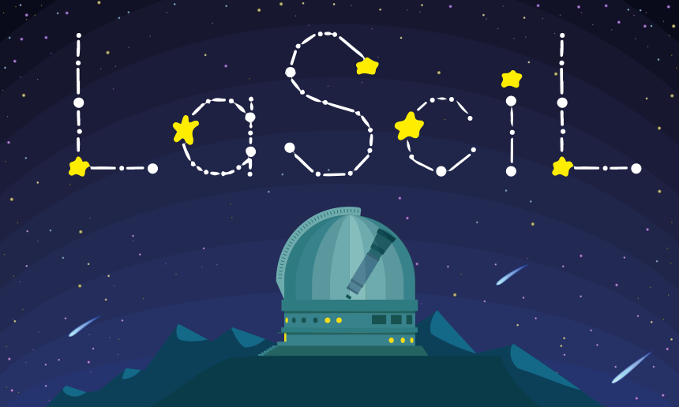


Observing Experience Part 1
Plan Your Observation
Rosa Doran
NUCLIO
Gustavo Rojas
NUCLIO
LaSciL Summer School, July 3-8 2022

Slide 2
Planning Steps
Set up location
Search object
Check FOV
Estimate exposure time
Determine best epoch
Other factors

Slide 3
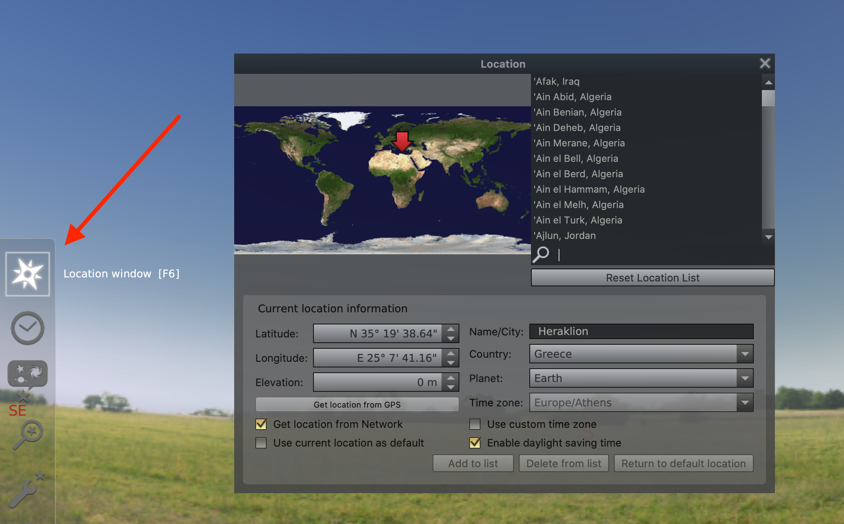
Set up Location

Slide 4
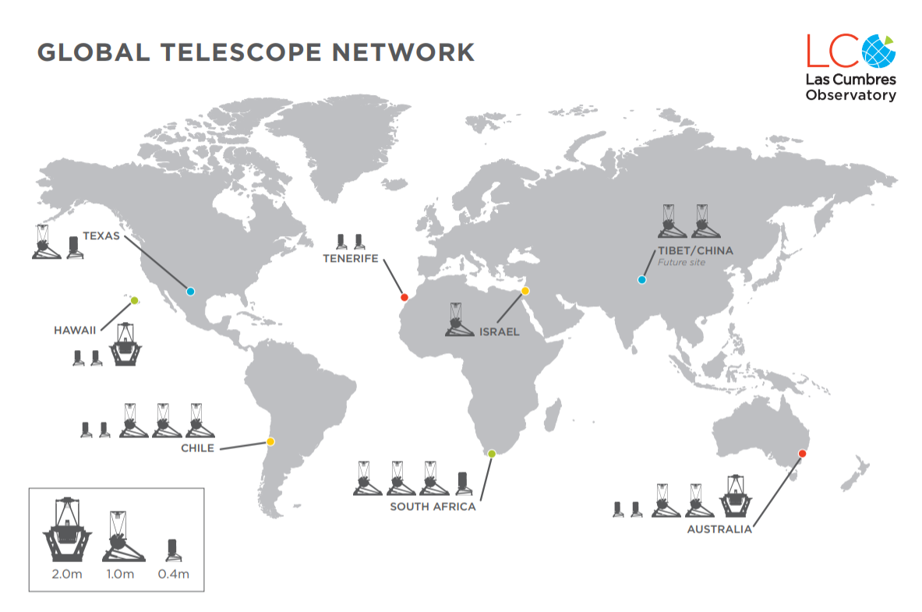
Set up Location
McDonald
Teide
Wise
Haleakala
Cerro Tololo
SAAO Sutherland
Siding Spring

Slide 5
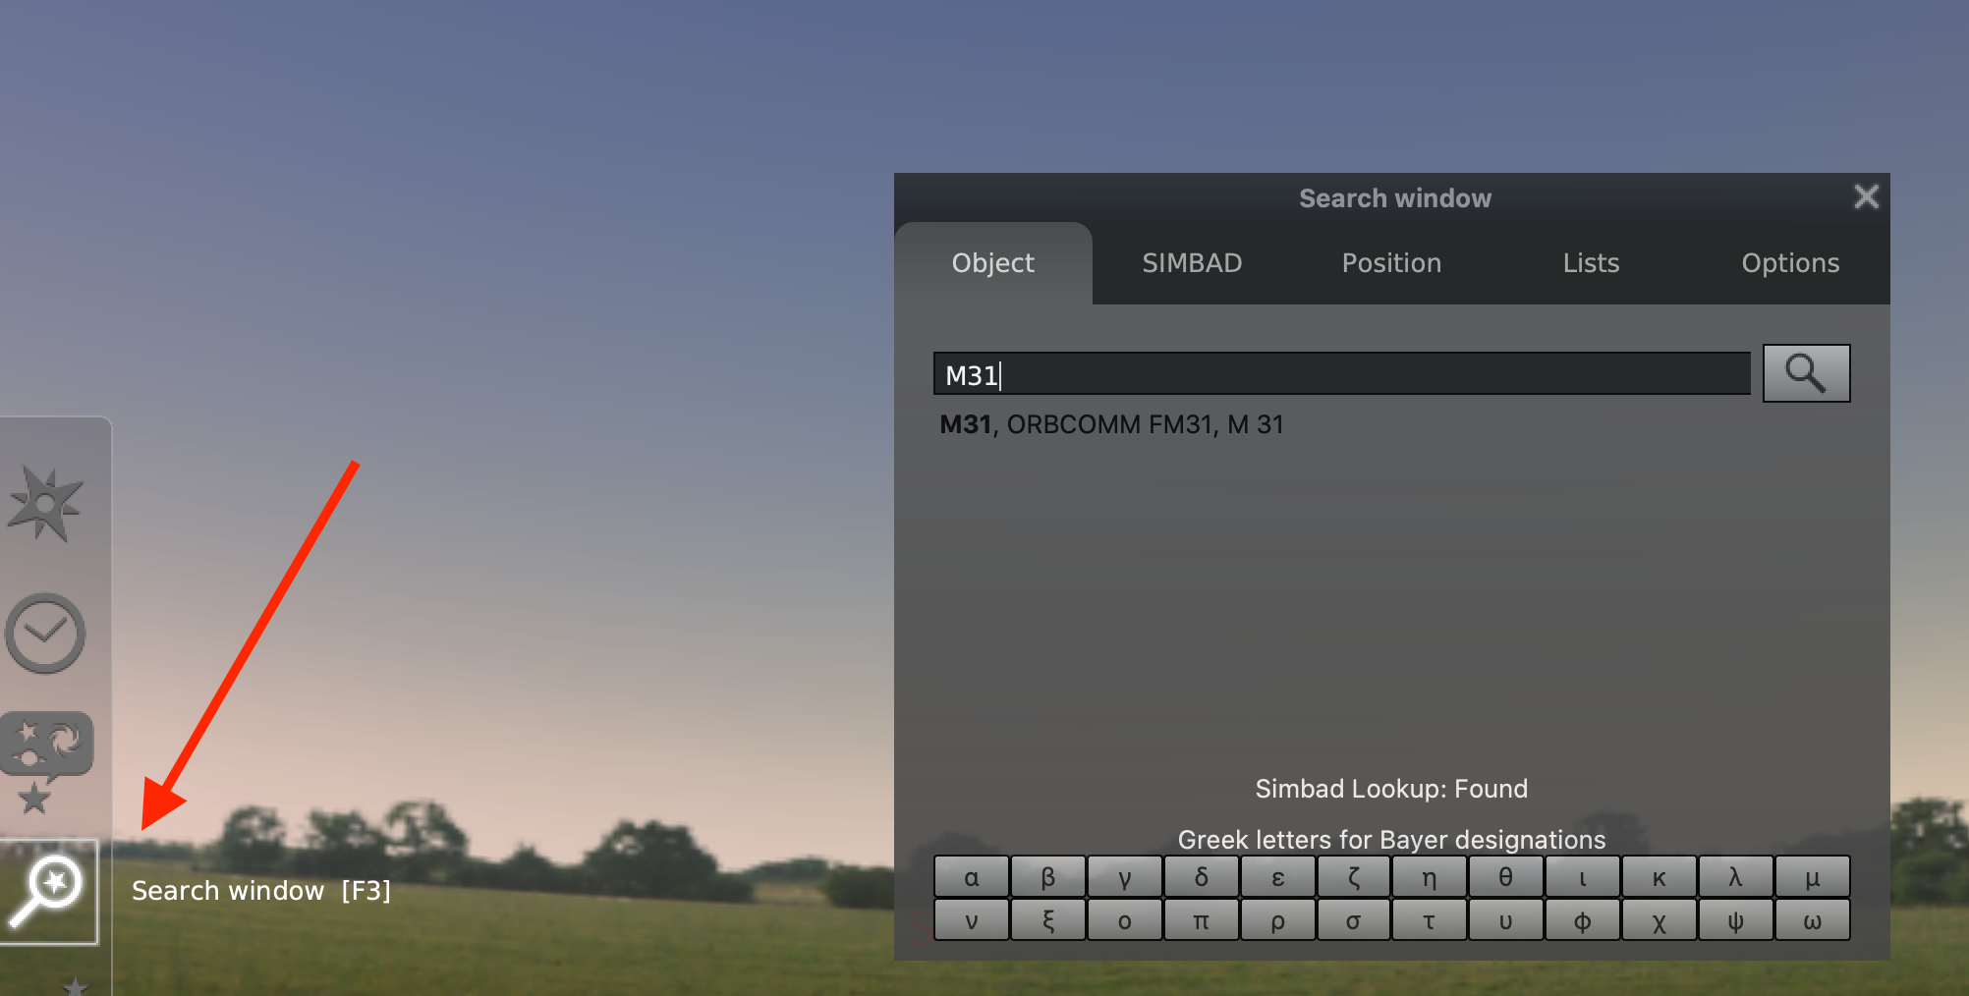
Search Object

Slide 6
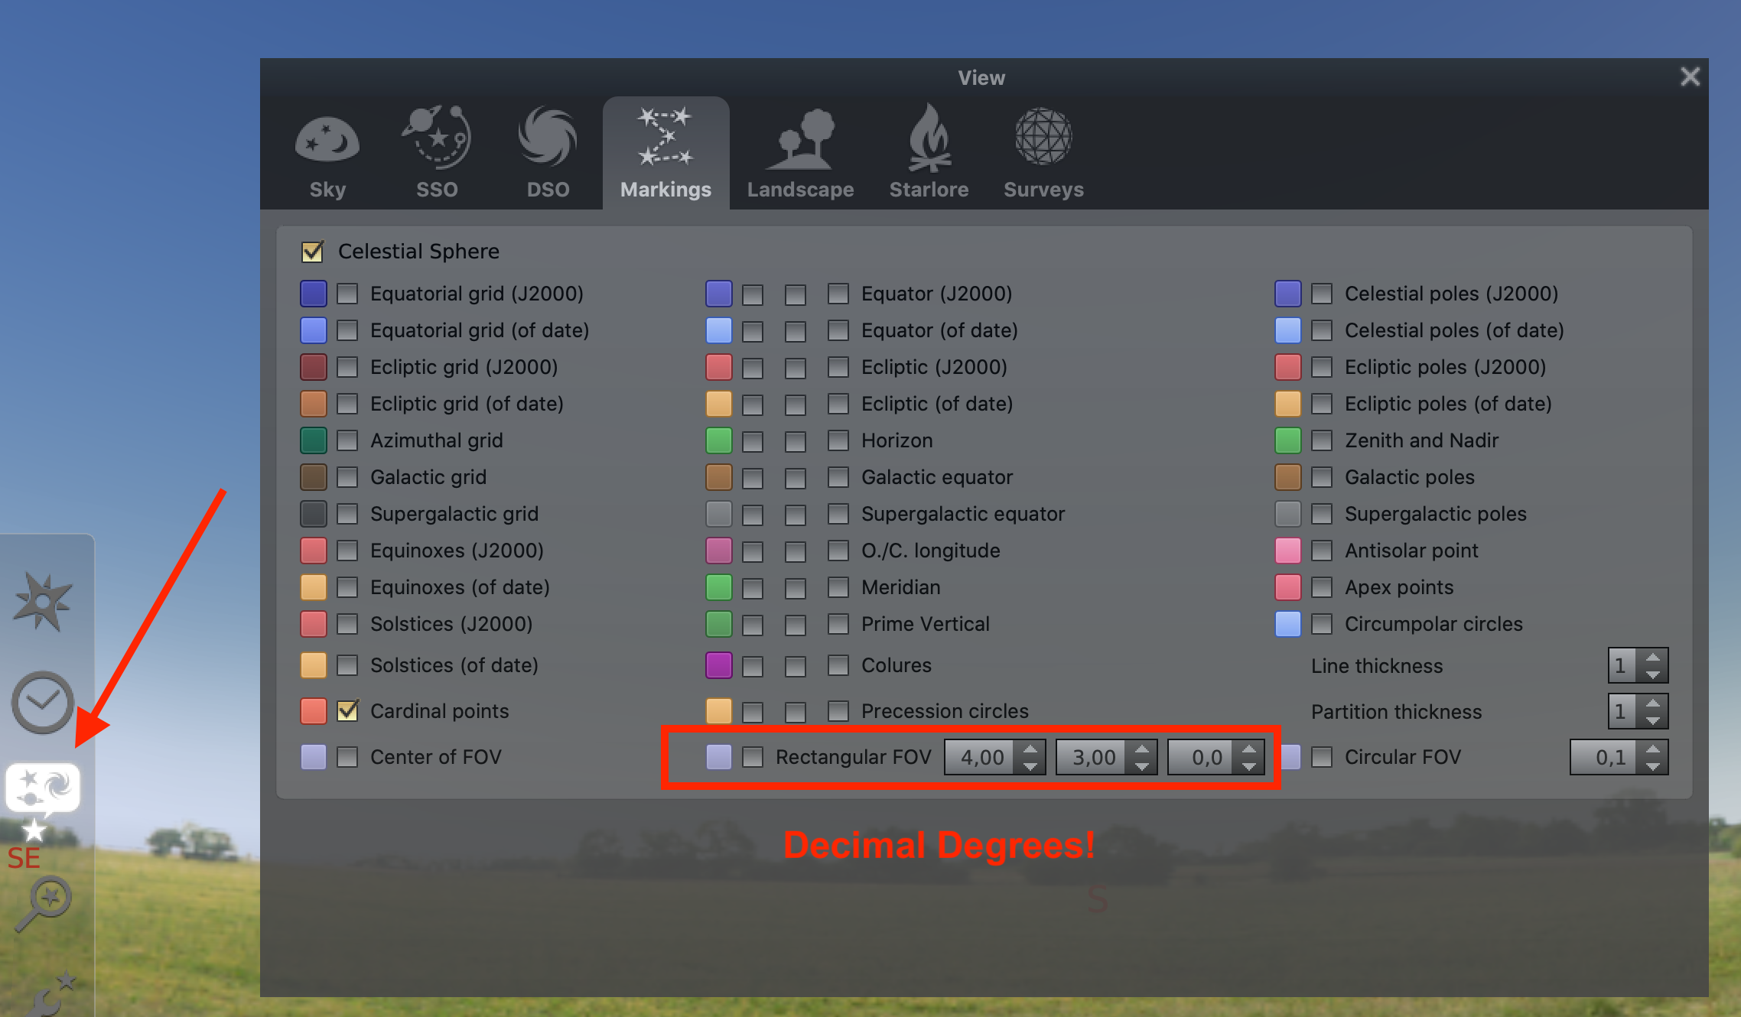
Check FOV

Slide 7
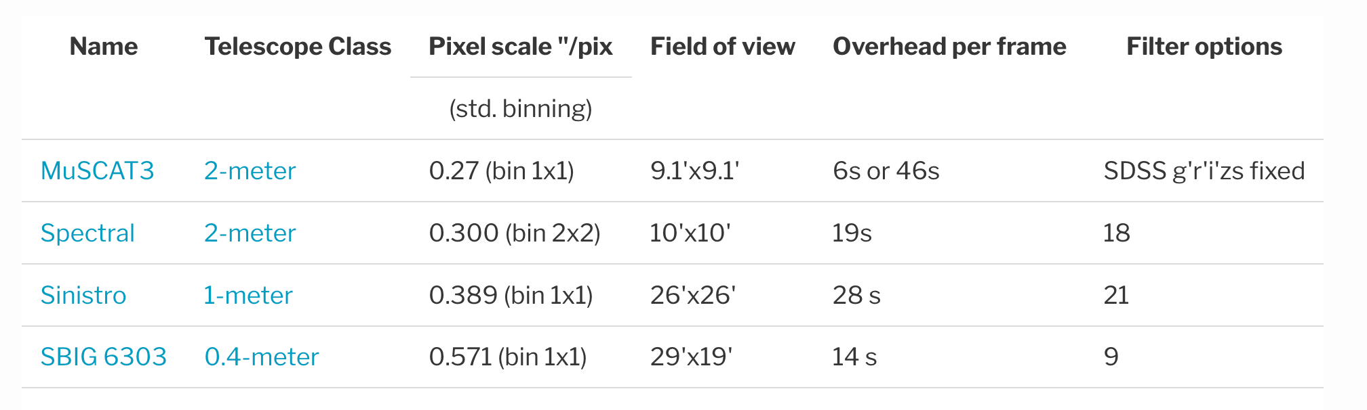
FOV

Slide 8
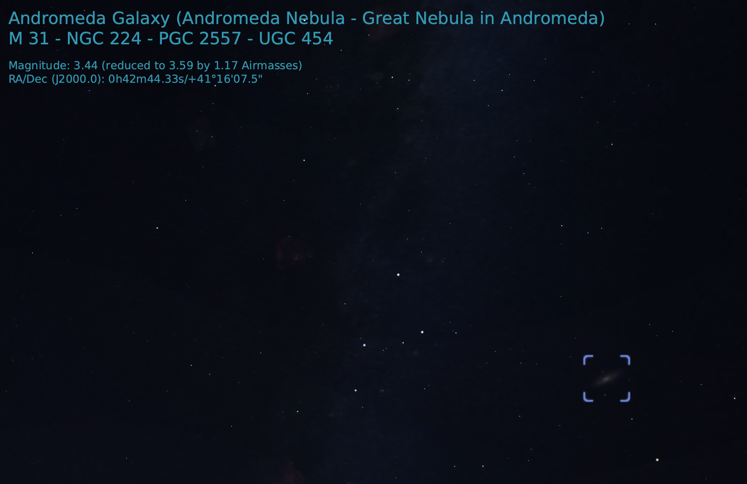
Estimate Exposure Time
  Check magnitude!

Slide 9
Estimate Exposure Time
  Estimates for 2-m exposure times
Mag | Exposure time (s)
10 | 5
11 | 15
12 | 40
13 | 100
14 | 240
15 | 600
  1 magnitude = 250% more exposure time

Slide 10
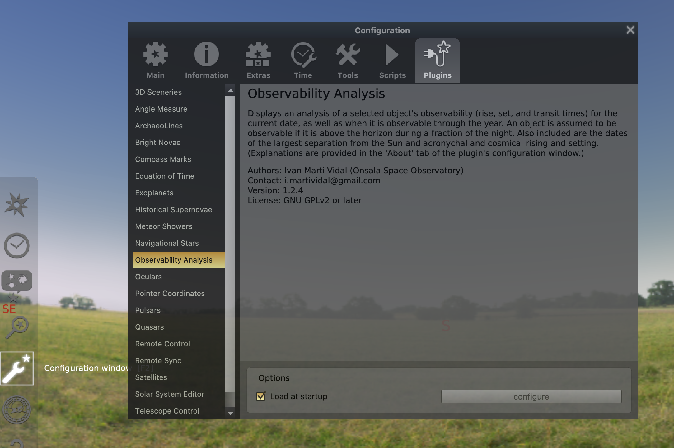
Determine best epoch

Slide 11
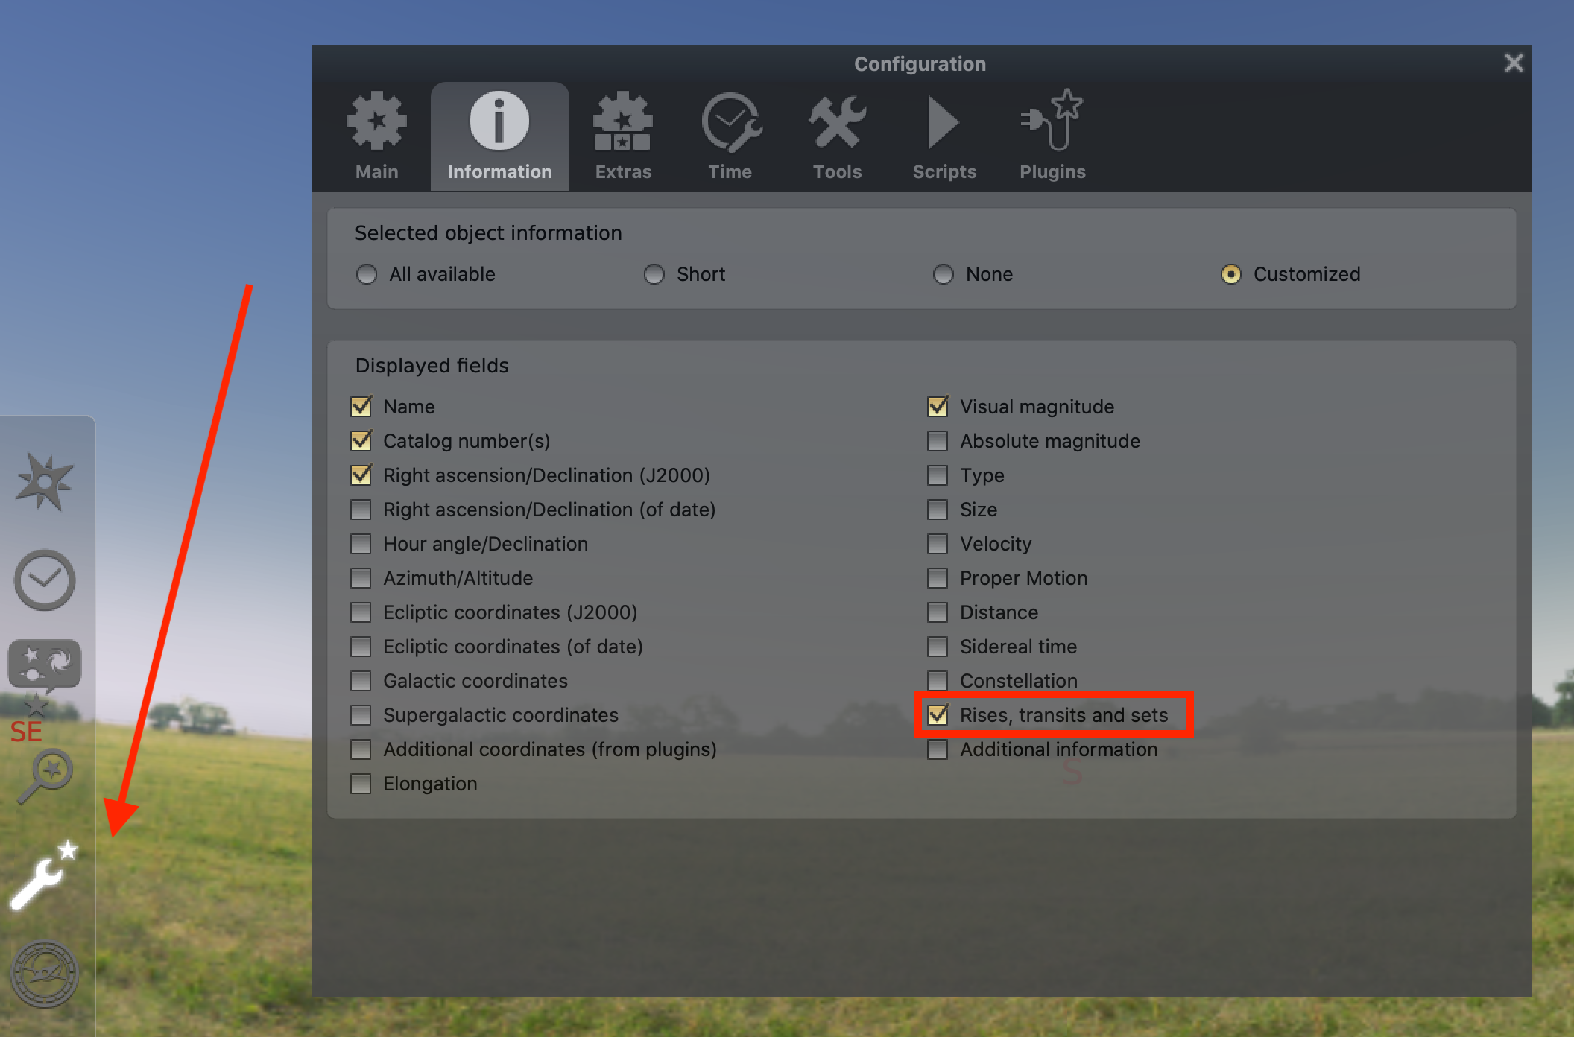
Turn on transit time

Slide 12
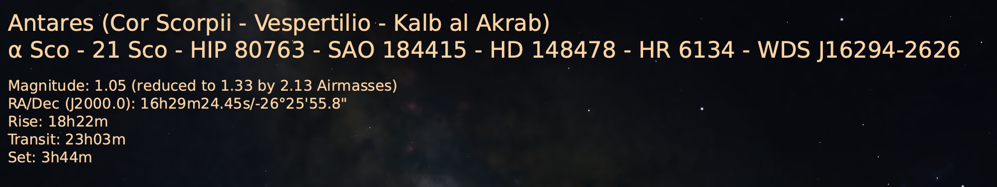
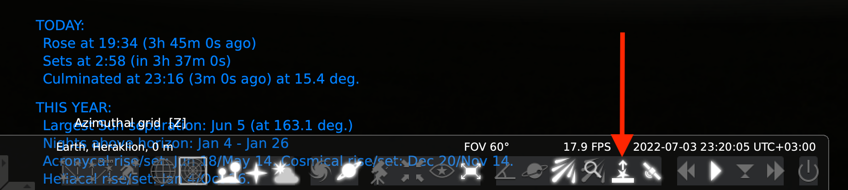
Choose time near transit

Slide 13
Other factors
Airmass
Moon
Satellites
Weather
Technical issues

Slide 14
Thank you for your attention!
  For further details :
  www.lascil.eu
  @lascil.project
  lascil@nuclio.org

