Slide 1

Innovation and Inclusion in Education
Summer School - July 3rd – 8th 2022 – Crete
Rosa Doran – rosa.doran@nuclio.org

Slide 2
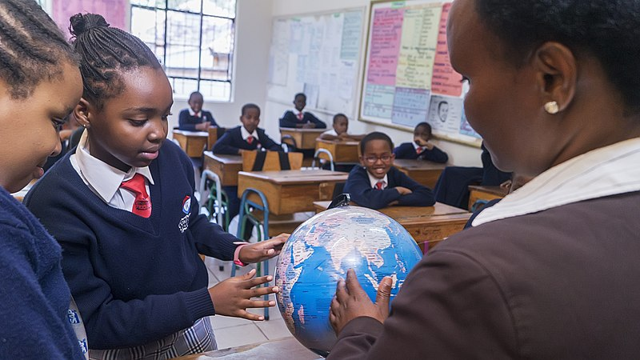
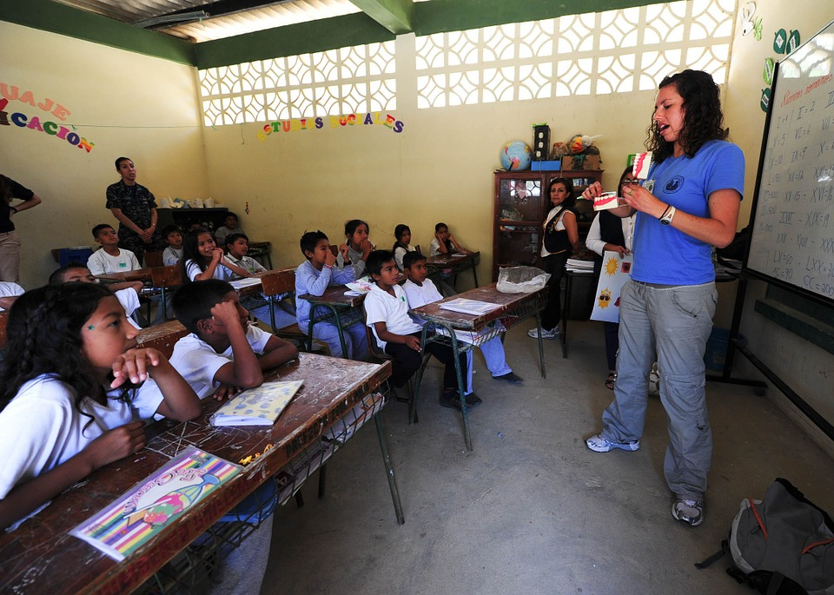
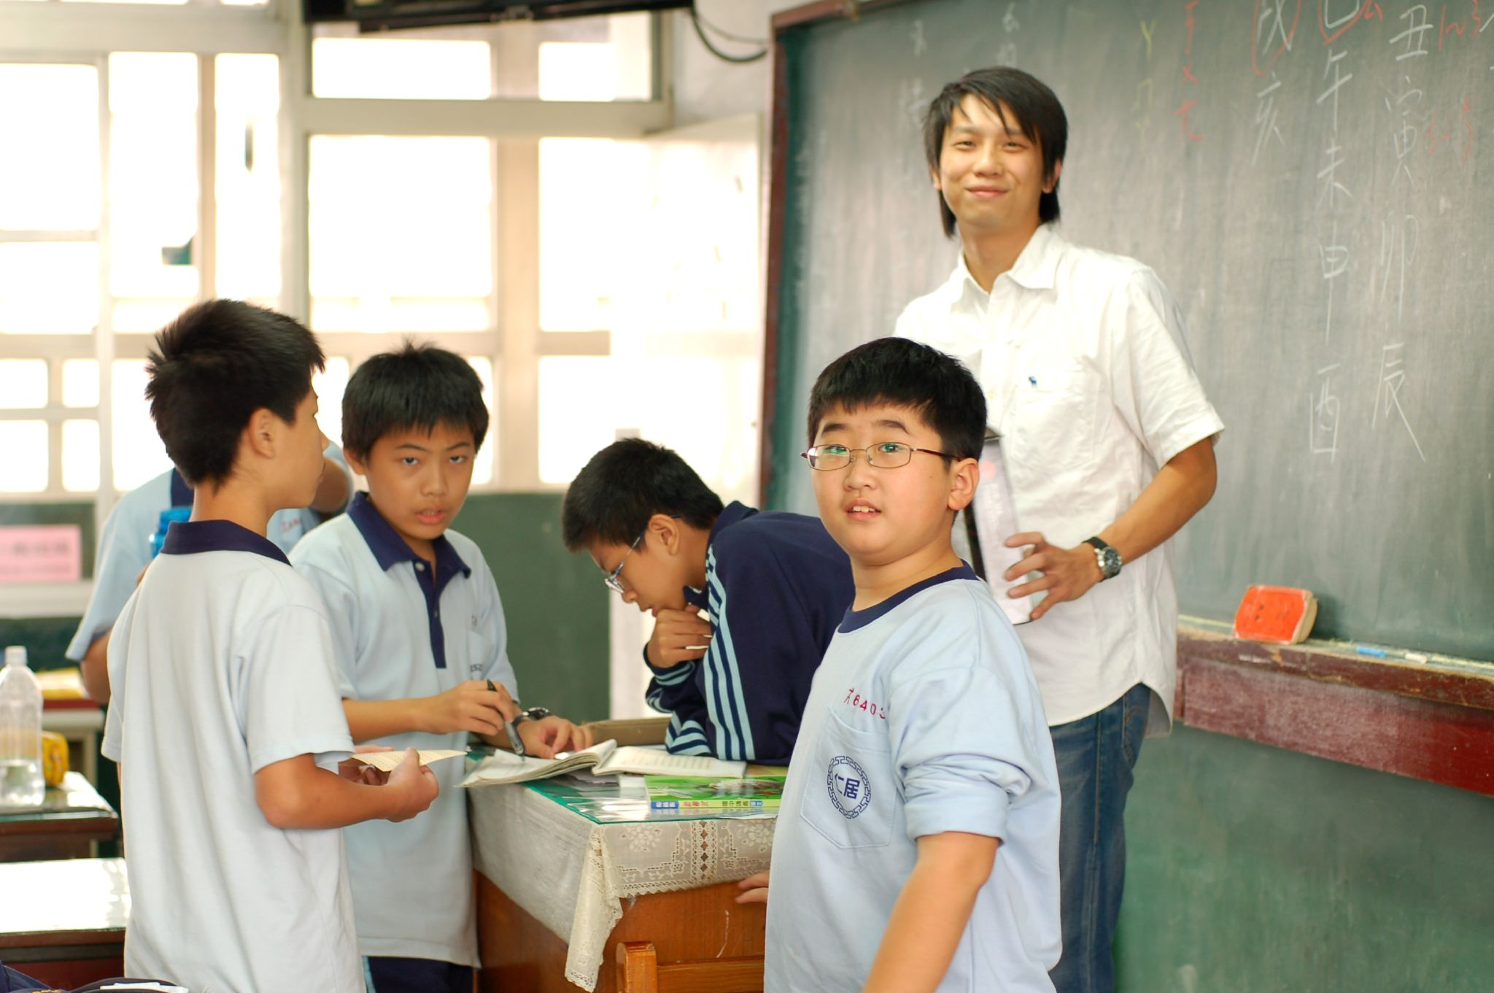
Let’s revisit one year in the life of a Teacher
I really love teaching. Just wish I could always find the best way to empower my students....
Wikimedia commons CC BY 2.0

Slide 3










Technology can makes teacher’s life easier right??
© VHargyono (WMF

Slide 4

Does it have copyright?
It has to be free
Does it have good quality?
Did anyone use this before ?
Does it require software?
Is there any support?
Does it fit the curricula?
Can I repurpose existing one?

Slide 5

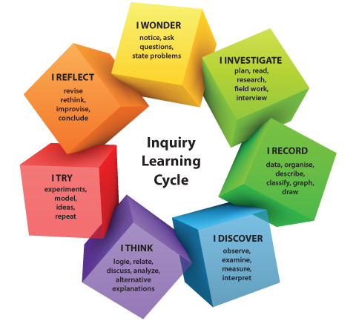

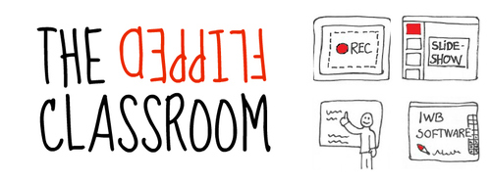


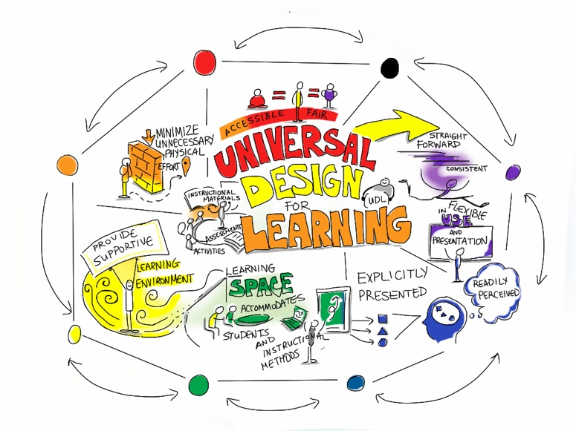


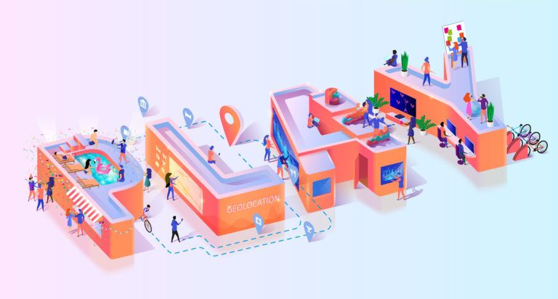
Integrating new methodologies is an excellent idea. I think this can completely change the environment in the classroom
Design Thinking

Slide 6

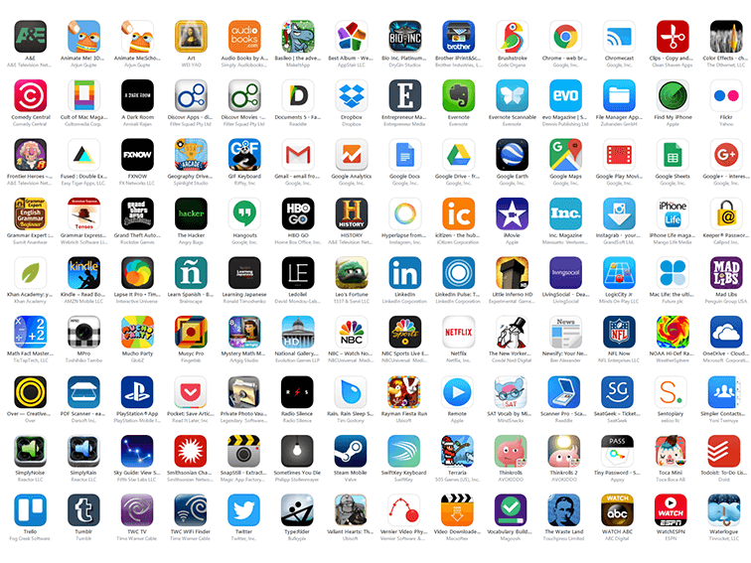
I just need to choose the best apps!!

Slide 7
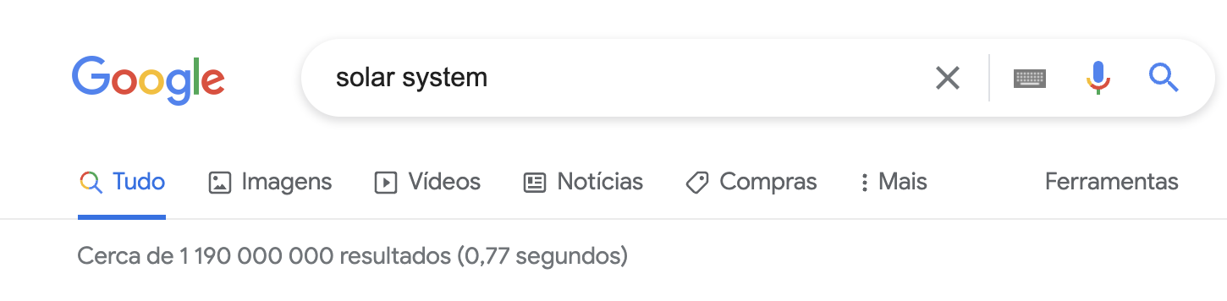

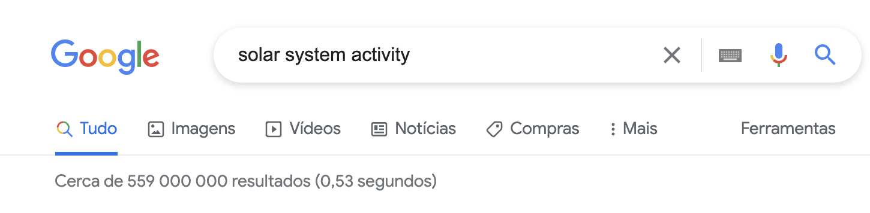
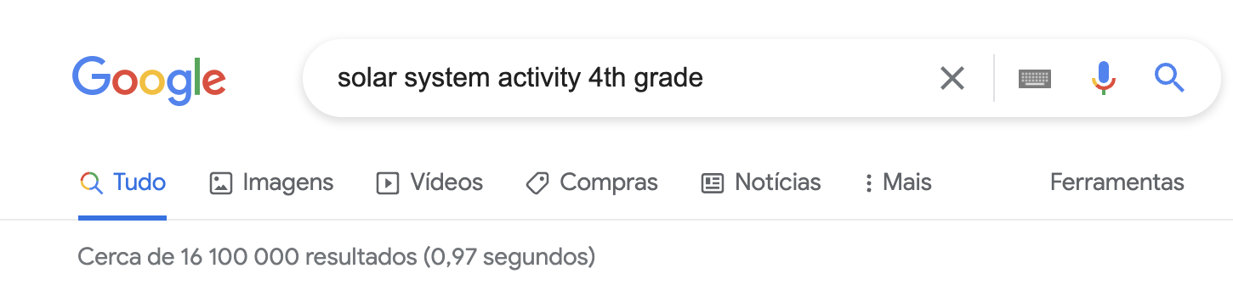
I just need to find the resources. I learned in that conference that they are for free. I just need to find them….
CC BY-SA 2.0

Slide 8

Zillions of resources

Slide 9
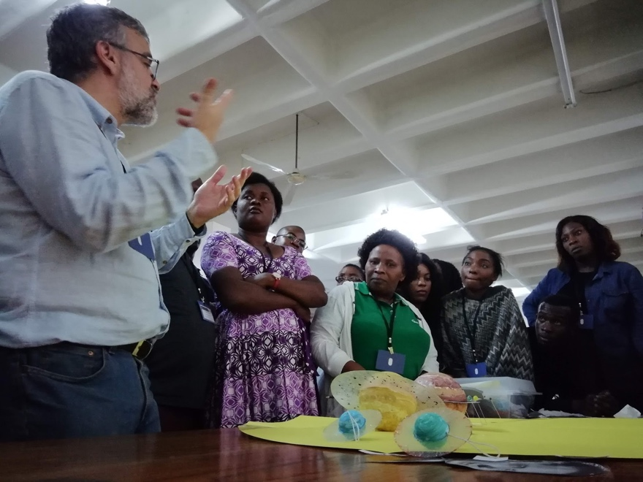
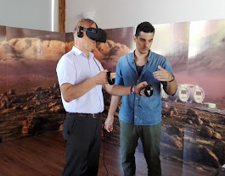
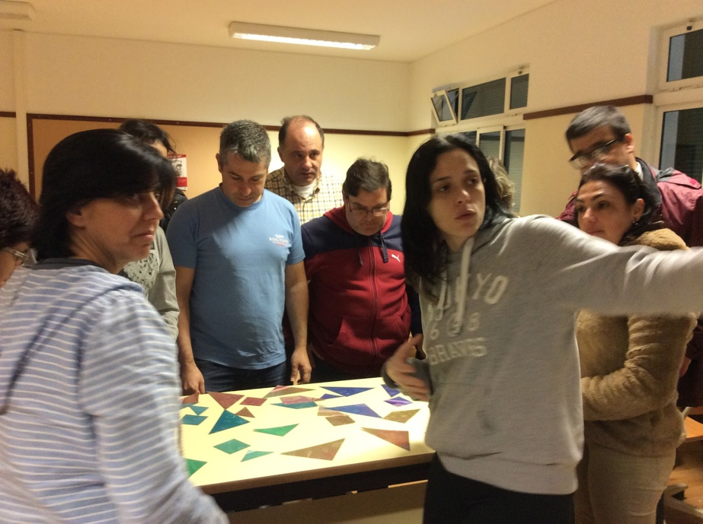
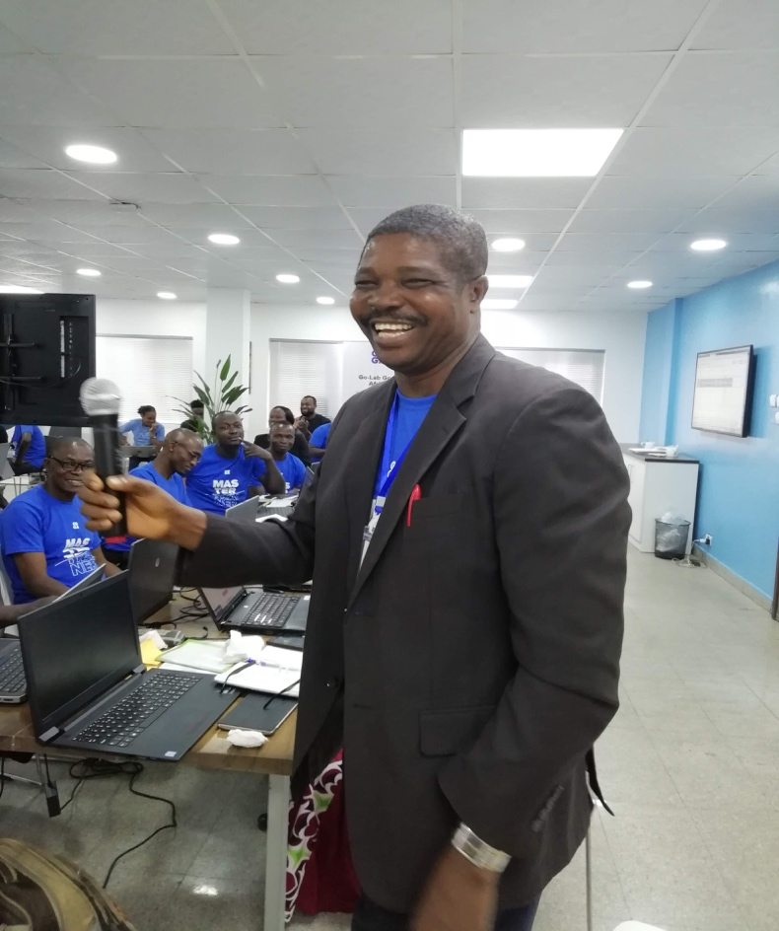

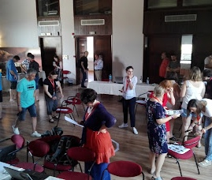
I definitively need to participate in more training events !!

Slide 10

I will think about it tomorrow ...

Slide 11

And suddenly life changes ....

Slide 12


Simple ... Just replicate what is done in the classroom ....

Slide 13

Oh wait .... Not working... Need to change something

Slide 14
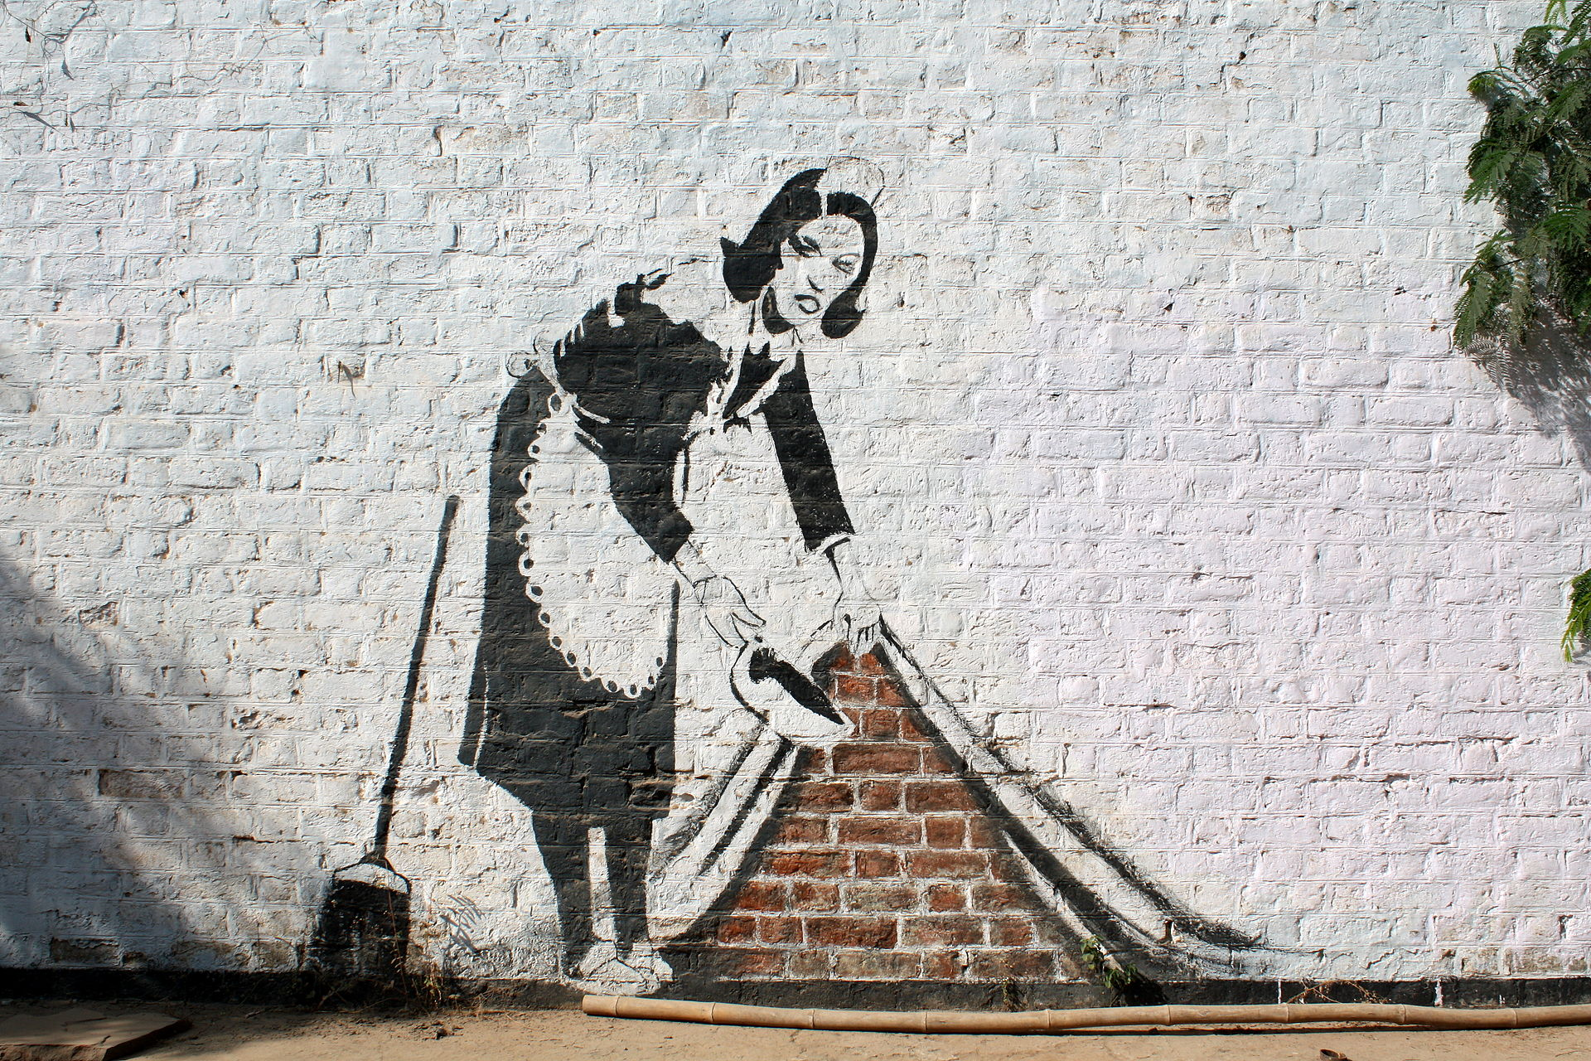
© Trompe l'oeil graffiti at CEPT university -- inspired by Banksy's Sweep It Under The Carpet

Slide 15

Innovation in Science Education
© rawpixel.(Freepik)

Slide 16

For sure technology will help me with this objective
© VHargyono (WMF)

Slide 17

It has to be free
Does it have copyright?
Does it have good quality?
Did anyone use this before ?
Does it require software?
Is there any support?
Does it fit the curricula?
Can I repurpose existing one?

Slide 18



Integrating new methodologies is an excellent idea. I think this can completely change the environment in the classroom
Design Thinking

Slide 19
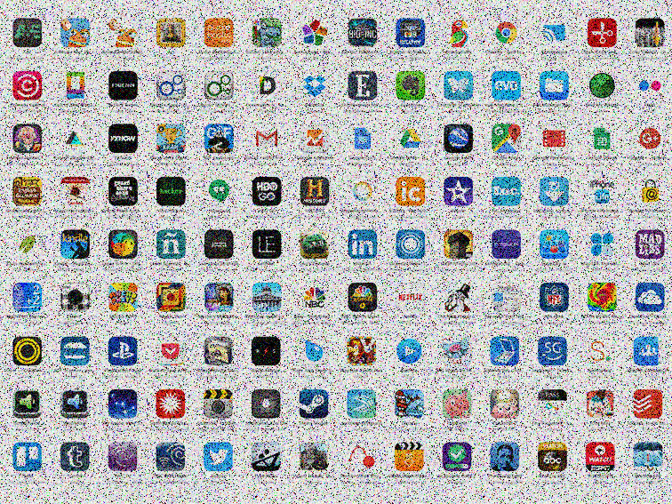

I just need to choose the best apps!!

Slide 20
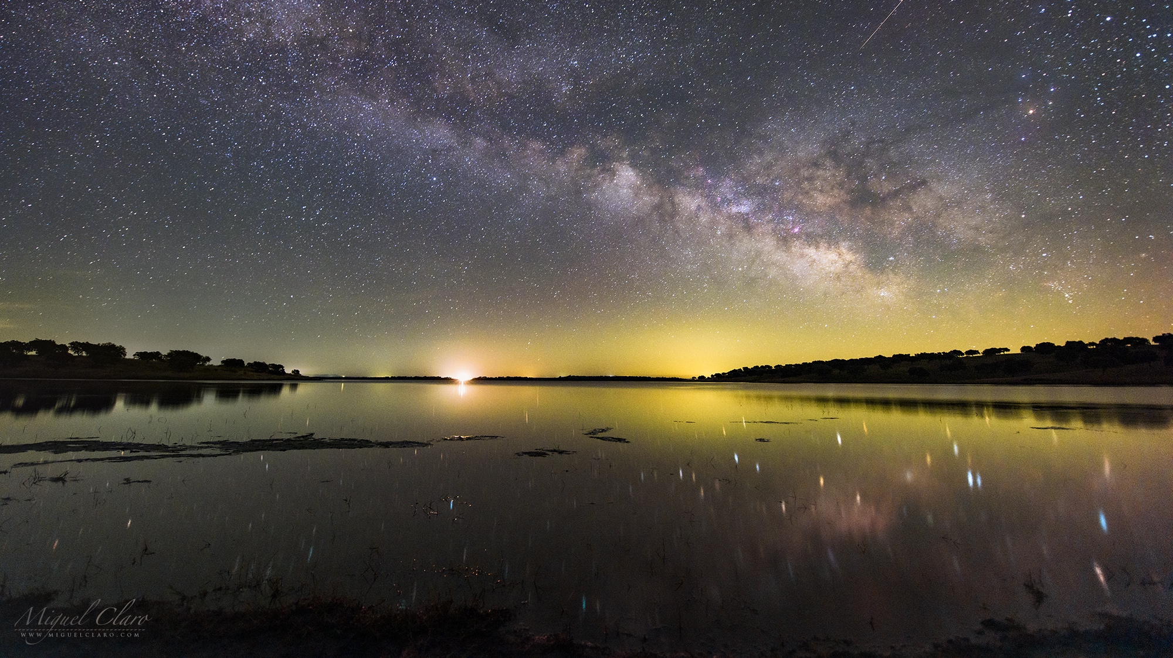
Why is astronomy important?
How prepared are educators to promote astronomy learning?
How innovative is the presentation of astronomy topics in schools?
©Miguel Claro

Slide 21

Astronomy and Space Exploration in the Curriculum
Interdisciplinary (STEAM)
Inquiry Based Learning
©Gerd Altmann - Pixabay

Slide 22

SOME STRENGHTS
ASTRONOMY INTERDISCIPLINARY NATURE
INTRIGUING POWER
ACCESSIBLE TO EVERYONE
USUALLY, A NON-PROFIT ENTREPRISE

Slide 23

INEQUALITIES (WEAKENESSES)
NOT A SUBJECT IN MOST COUNTRIES (ALTHOUGH PART OF THE CURRICULUM)
NOT INCLUDED IN PRE-SERVICE TRAINING OF EDUCATORS
NOT ENOUGH OUTREACH AND EDUCATION INITIATIVES
PERCEIVED AS SUBJECT OF MARGINAL IMPORTANCE FOR MANY
LACK OF SUPPORT NETWORKS IN MANY COUNTRIES

Slide 24

OPPORTUNITIES
ASTRONOMY IN STEAM
PATHWAY TO NUMEROUS PROFESSIONS
ASTRONOMY RESEARCH AS PART OF CURRICULUM OPPORTUNITES
AVAILABILITY OF THE SCIENCE COMMUNITY
ADVANCE OF IMAGERY/VIDEOS/ANIMATIONS/SIMULATIONS
ACCESSBILITY OF DATA

Slide 25

CHALLENGES (THREATS)
MISCONCEPTIONS
FUNDING
TEACHERS PREPAREDENESS
LACK OF AWARENESS (IMPORTANCE OF ASTRONOMY, RELEVANCE, INTERDESCIPLINARY NATURE, etc.
FEAR OF FAILURE
STEREOTYPES

Slide 26

Enthusiasm: Students

Slide 27


But not all students feel connected to the art and magic of Science
Nah!!! Science is not really for me .....
©Miguel Claro

Slide 28
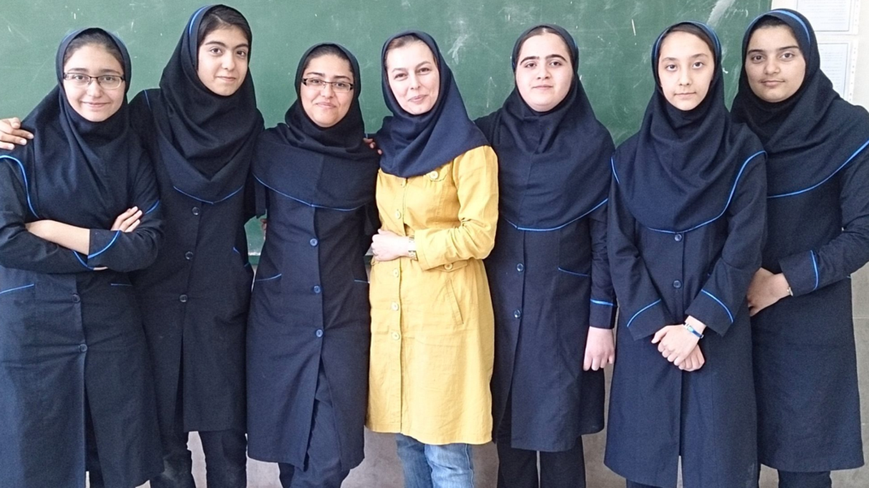
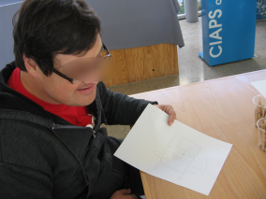

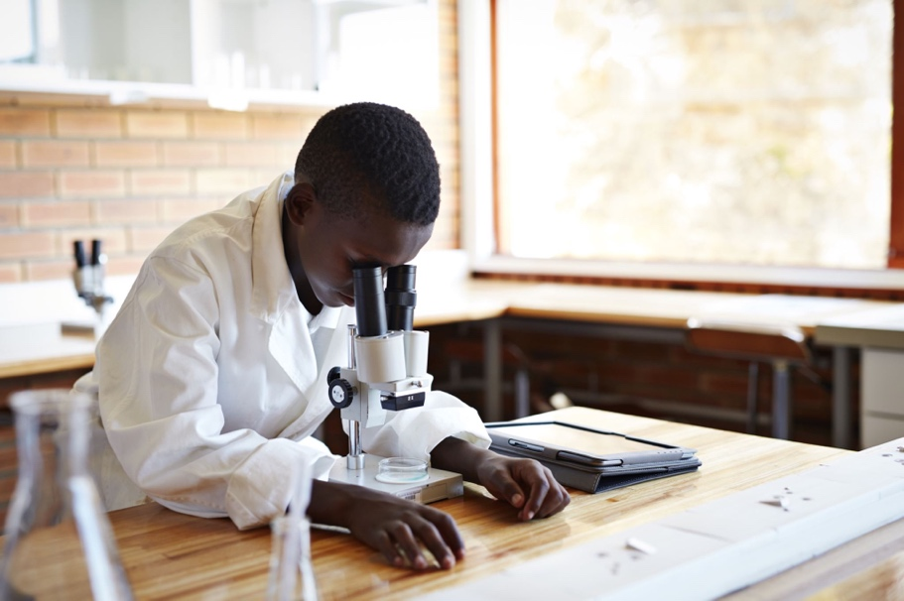
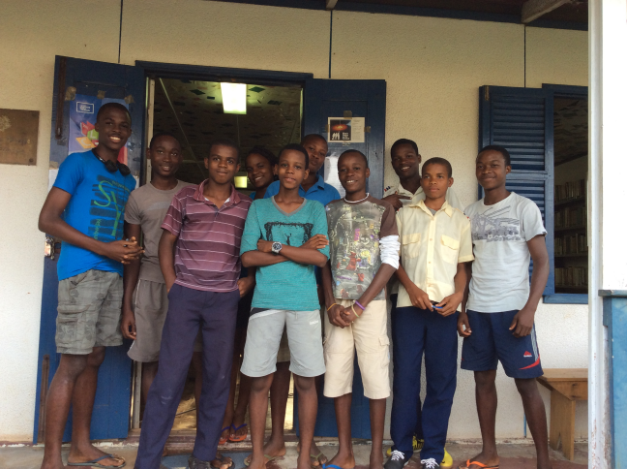
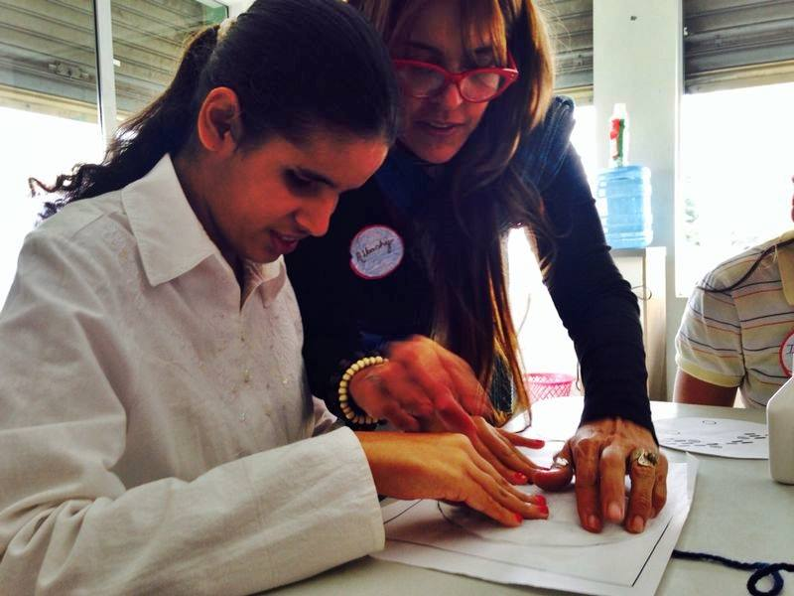
Where does life come from?
I do have some very smart students that might thrive in the world of Science!!
© NGC602 - HST
Notes:
That galaxies are filled with gas and dust resulting from the life cycle of stars

Slide 29


It is Quantum Mechanics, but girls are not really into that !!!

Slide 30
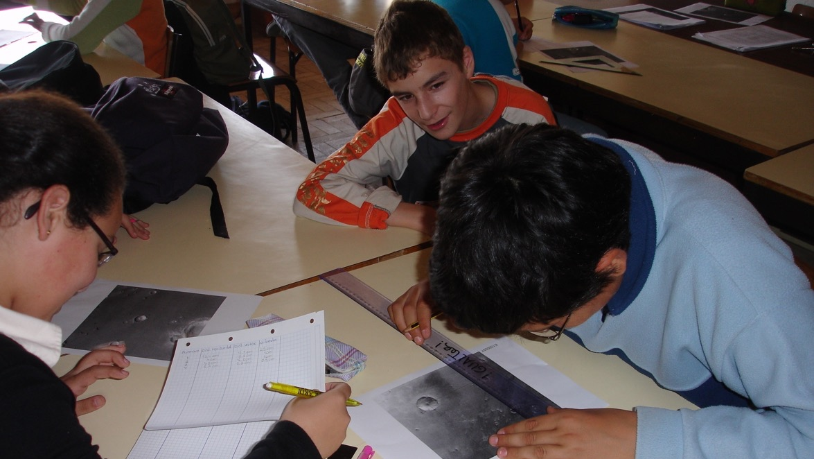
With your hands in scientific research

Slide 31
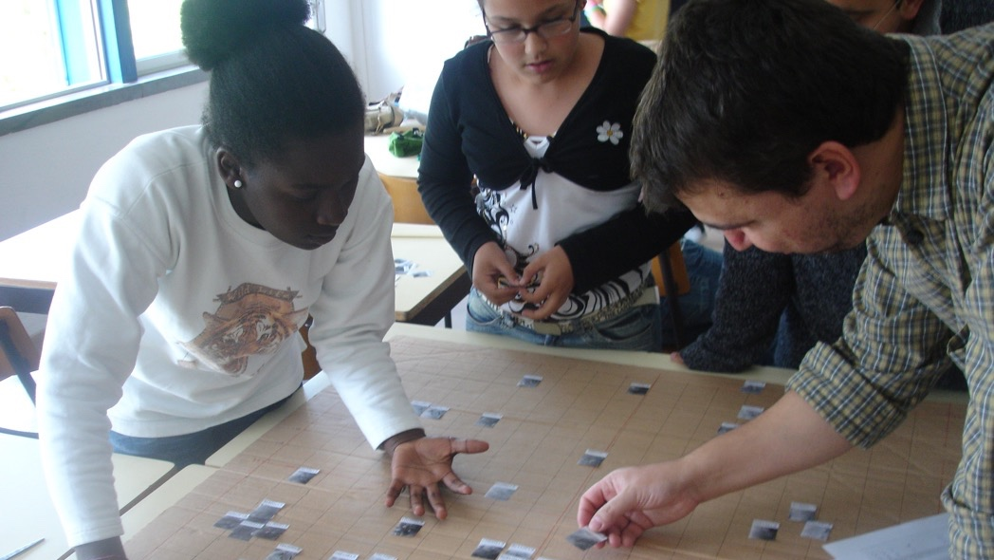
Working with Scientists

Slide 32
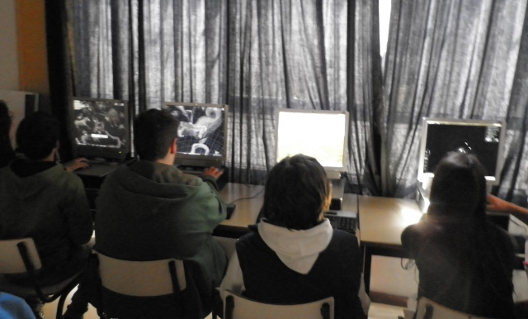
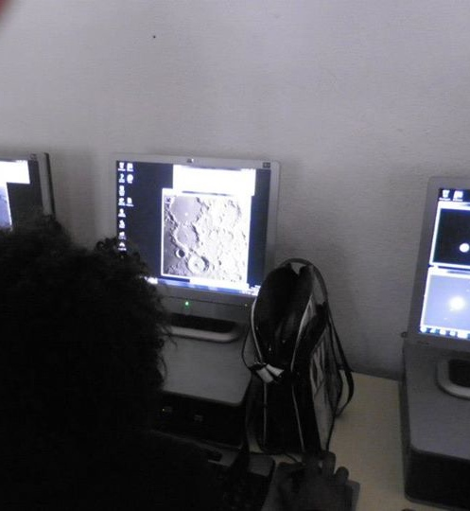
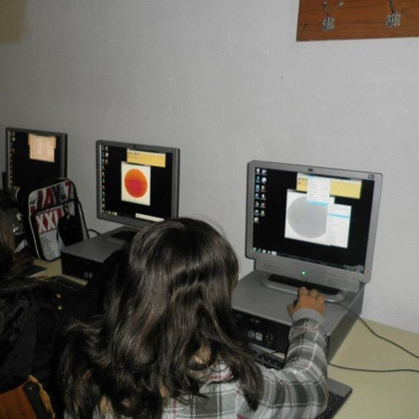
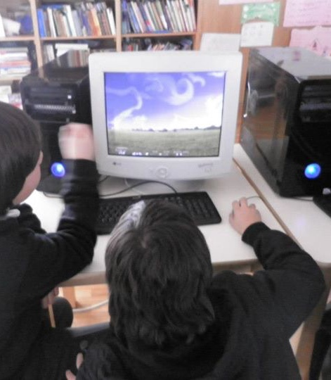
Research in Action

Slide 33

Empower Educators

Slide 34
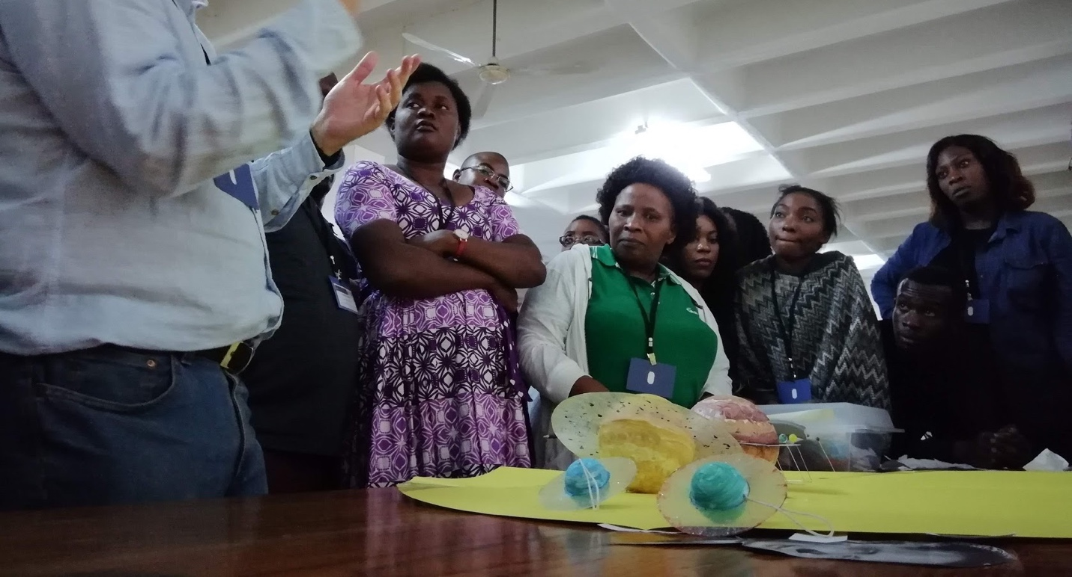
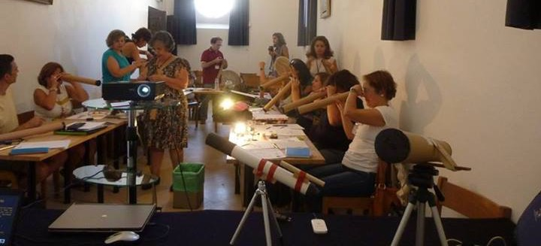
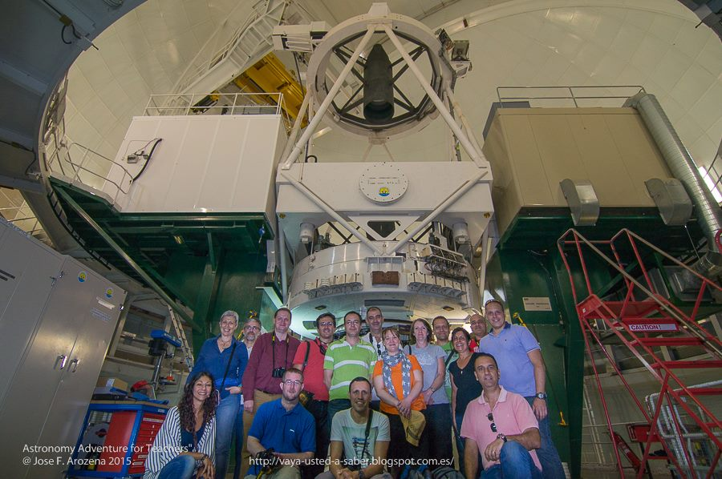
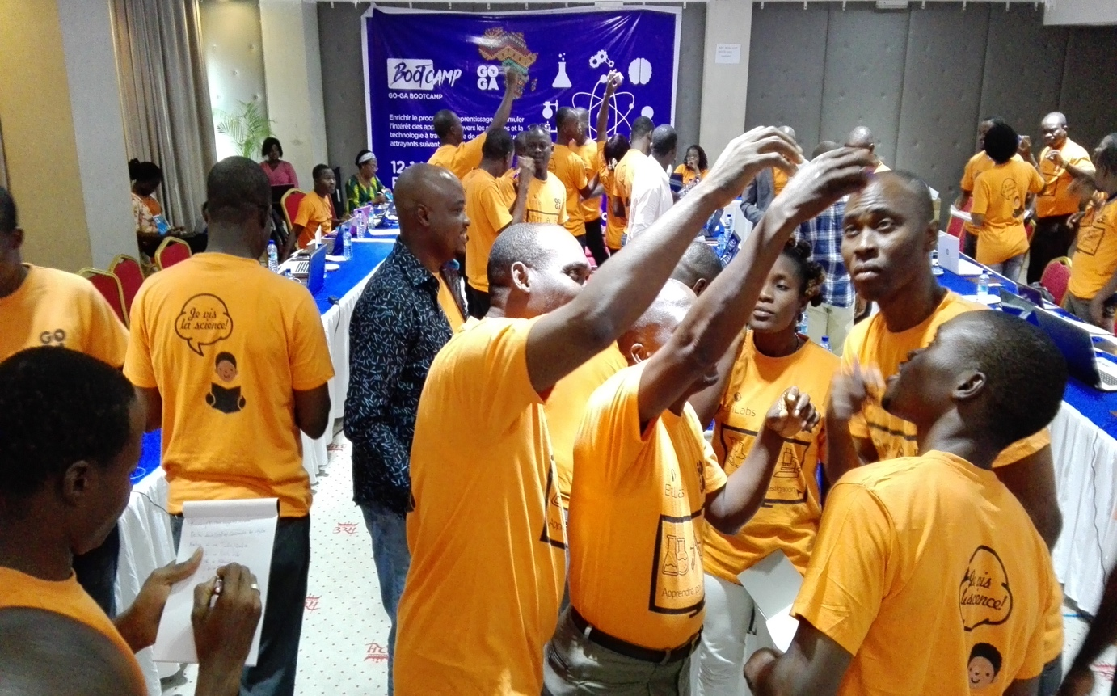
Adapted and Localized Professional development Opportunities

Slide 35
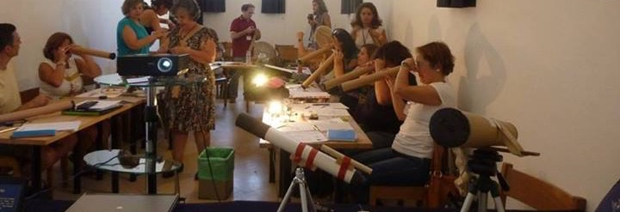
Accredited Teacher Training Courses
Synchronous and Asynchronous

Slide 36

Change Educational Systems

Slide 37

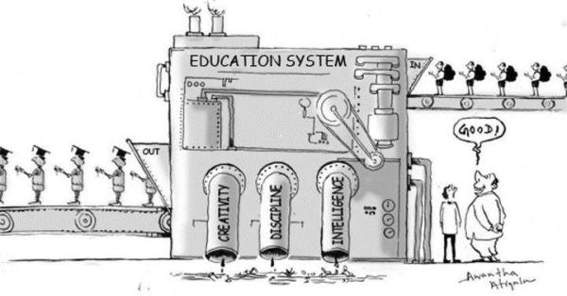
Stop managing educational systems in an excel spreadsheet

Slide 38
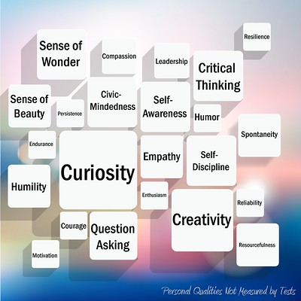

Slide 39
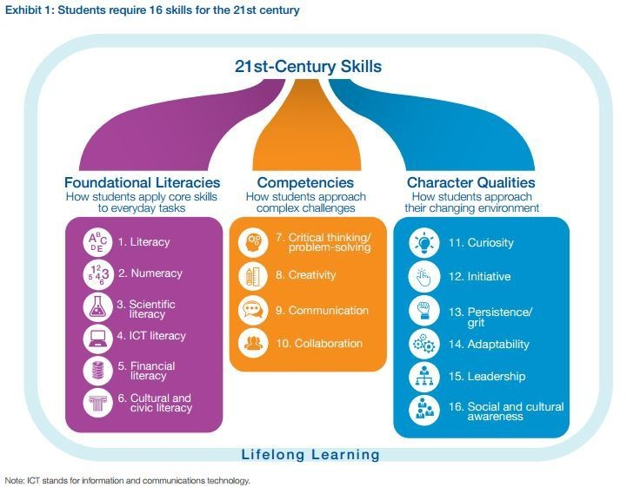

What is the teachers' mission?
FUNDAMENTAL LITERACIES
literacy
numbering
ICT literacy
Scientific Literacy
Financial Literacy
Cultural and Civic Literacy
CHARACTER QUALITIES
curiosity
initiative
persistence
adaptability
leadership
Social and
Cultural Awareness
COMPETENCIES
Critical Thinking
Problem Solving
criativity
communication
collaboration

Slide 40

What is expected of all of us !!!

Slide 41
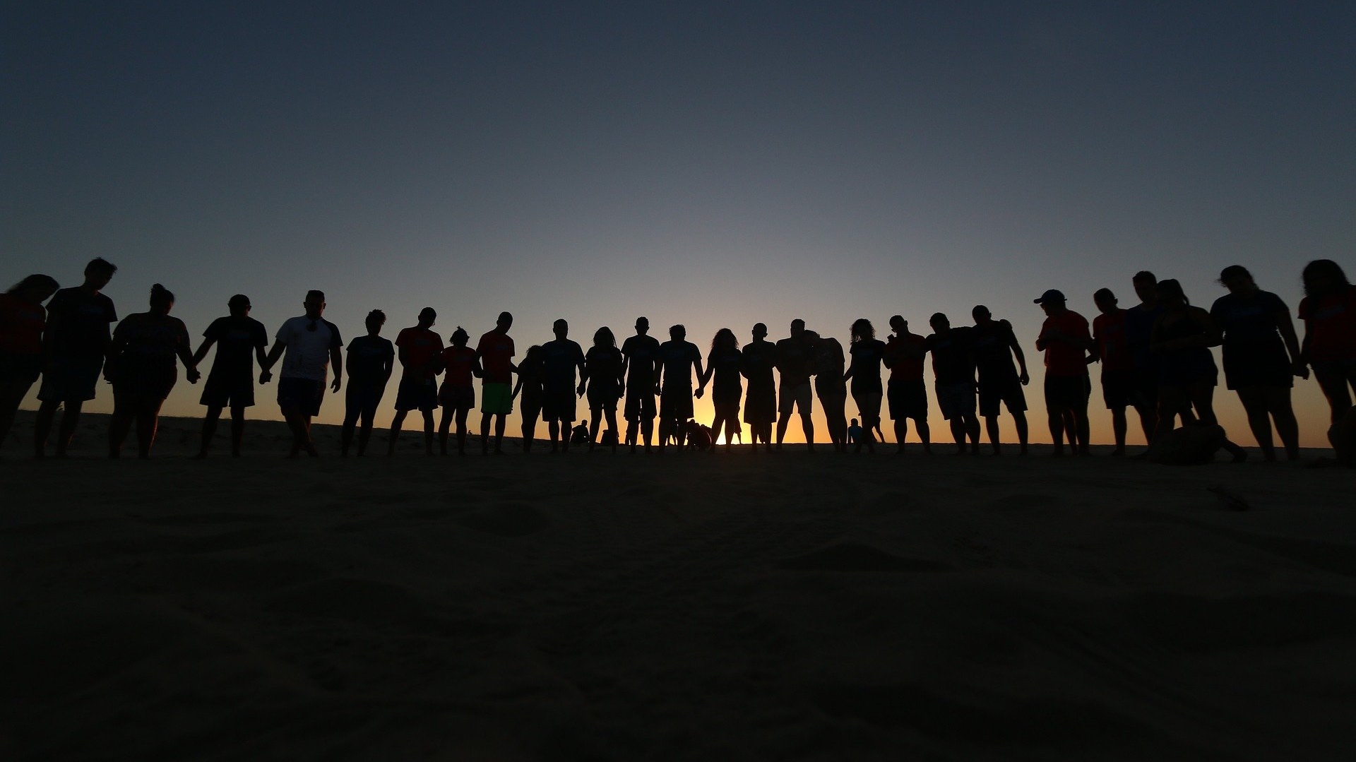
Students taking ownership of their learning → A shortcut for their future

Slide 42













ONLINE LEARNING SYNCHRONOUS AND ASYNCHRONOUS
STEAM LEARNING
ASSESSMENT
OER AND AUTHORING TOOLS
INCLUSION AND ACCESSIBILITY
STUDENT-CENTRED METHODOLOGIES

Slide 43
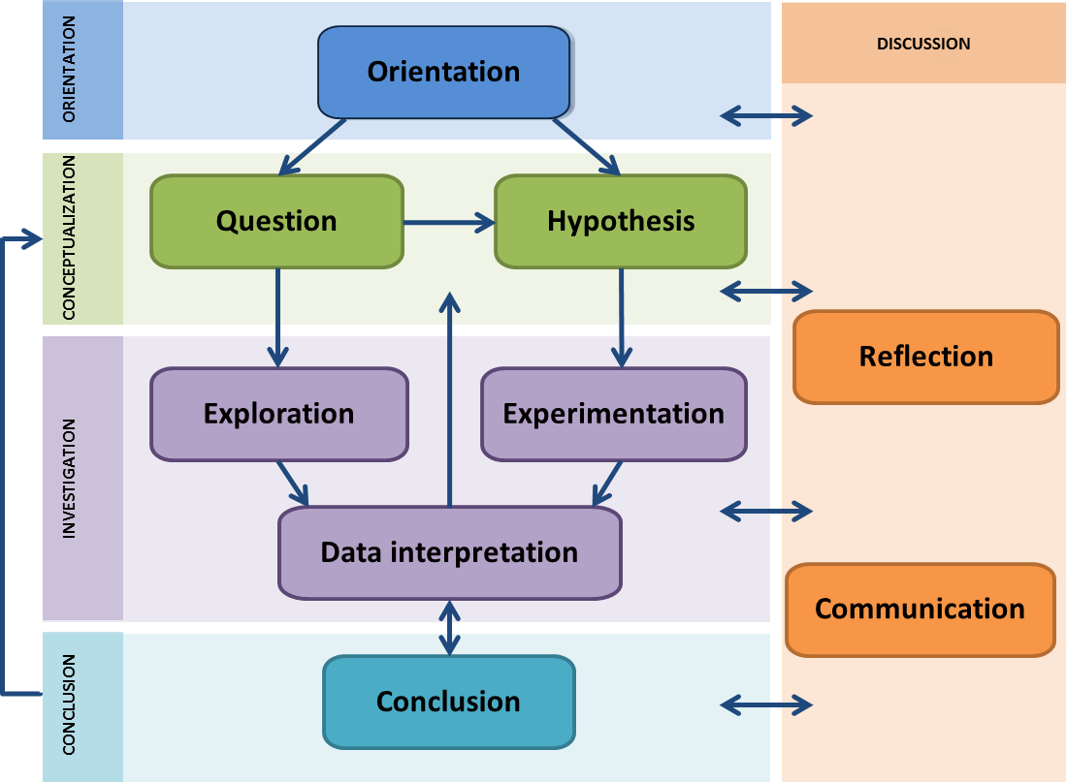

Inquiry Based Learning

Slide 44










Slide 45
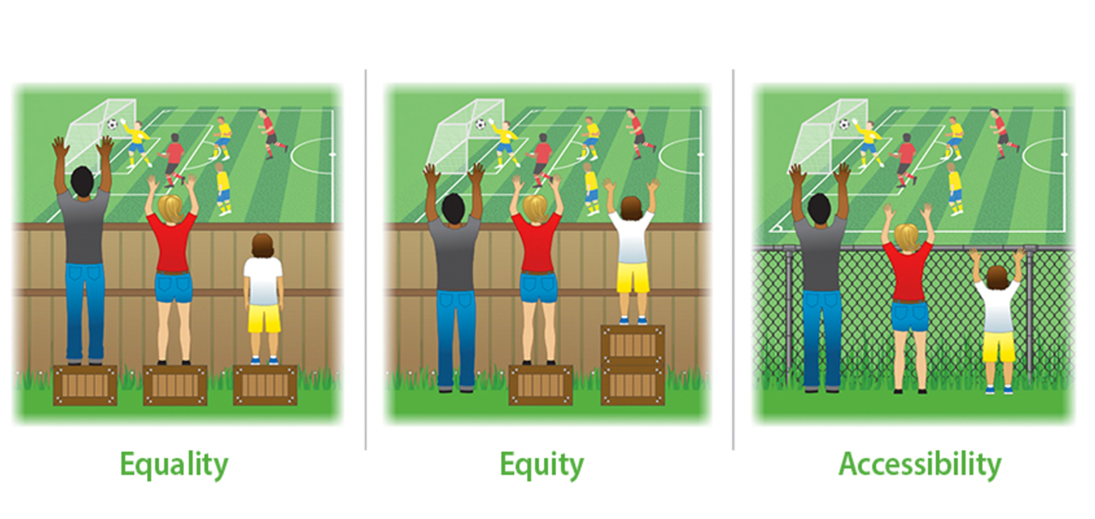

Slide 46




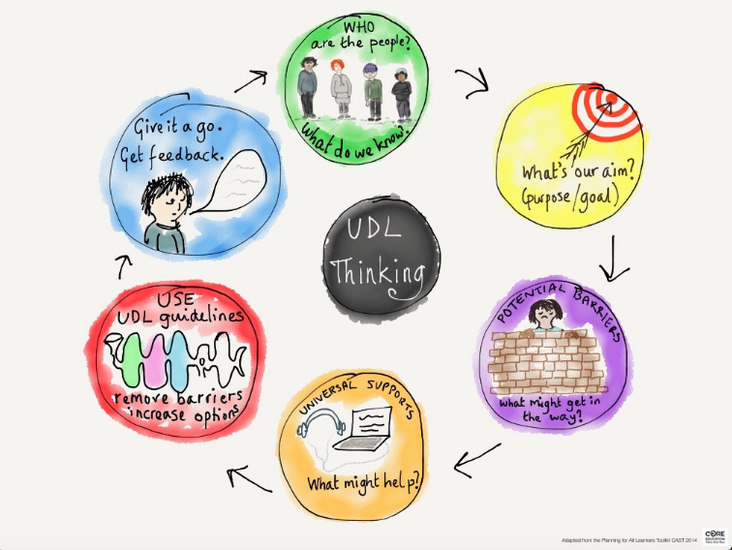

UNIVERSAL DESIGN FOR LEARNING

Slide 47

Do you really think all this is necessary !?!?!?
yes!!!!
I never said being a teacher is an easy task.

Slide 48

The most important profession in the world !!!!!

Slide 49

Empowering with hands-on data

Slide 50

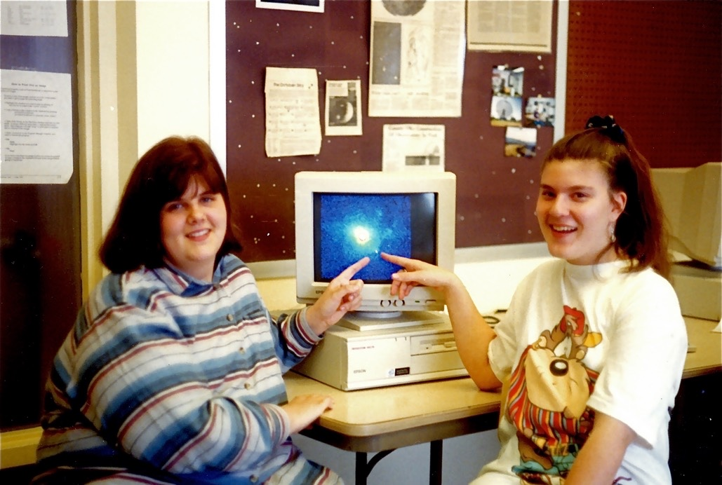
Hands-on Universe – developing 21st century skills for over 30 years
Supernova
Asteroids
Jupiter Moons
Solar Activity
Black hole in the Center of our galaxy
Cepheids
Exoplanets

Slide 51

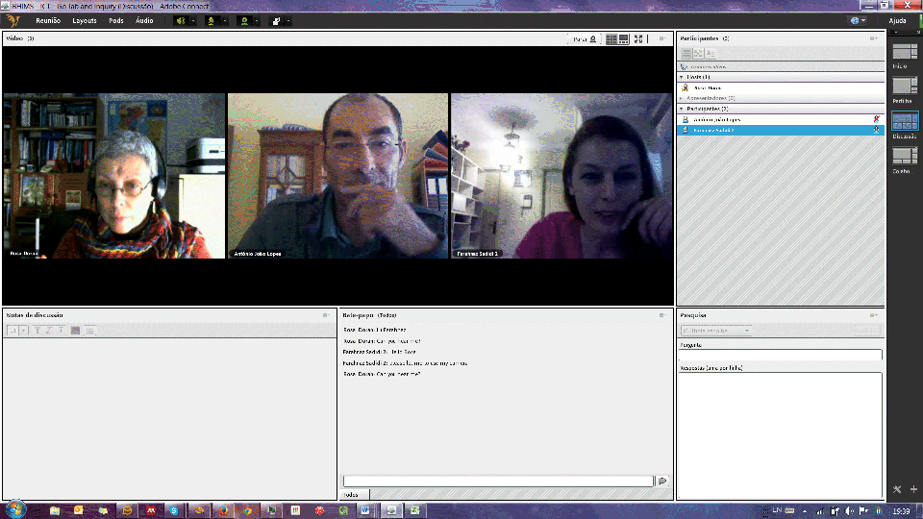

BHIMS

Slide 52
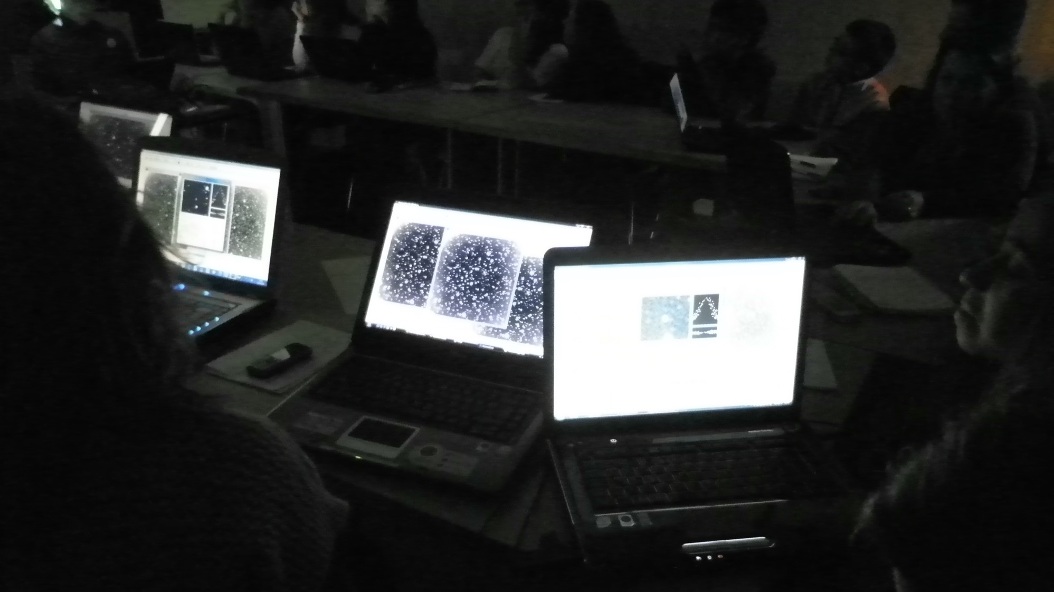
IASC
International Astronomical Search Collaboration

Slide 53
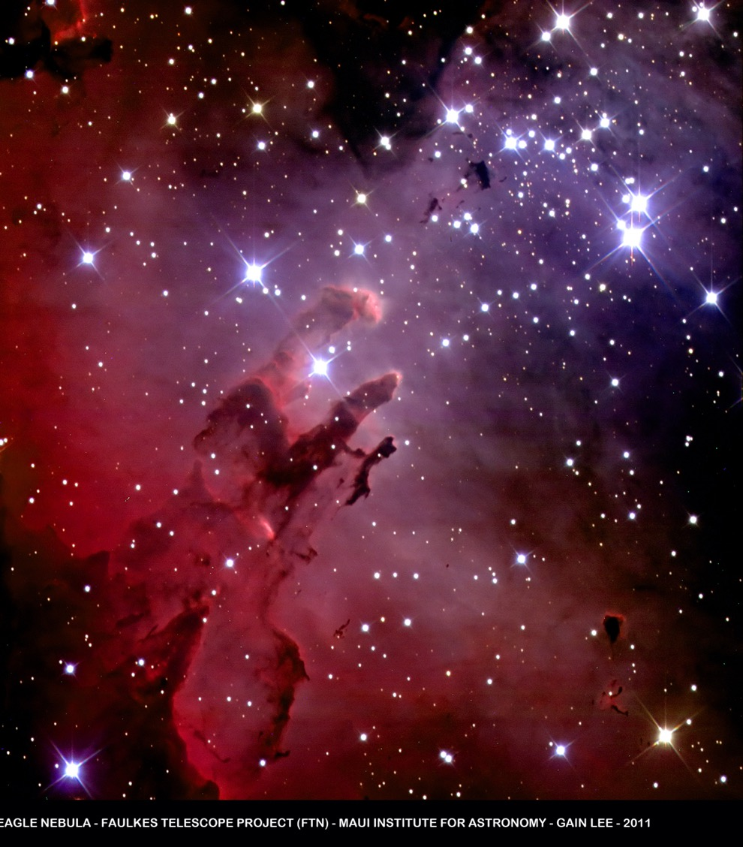


Large Scientific Infrastructures enriching online and digital
Learning
Inspiring and Learning with Robotic Telescopes

Slide 54
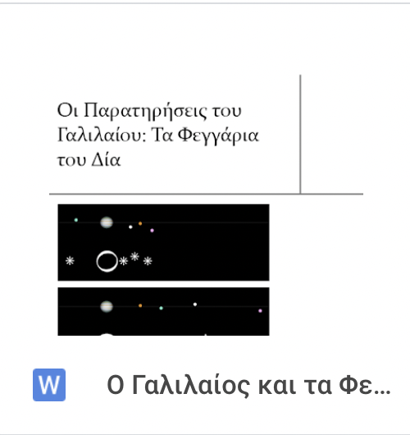
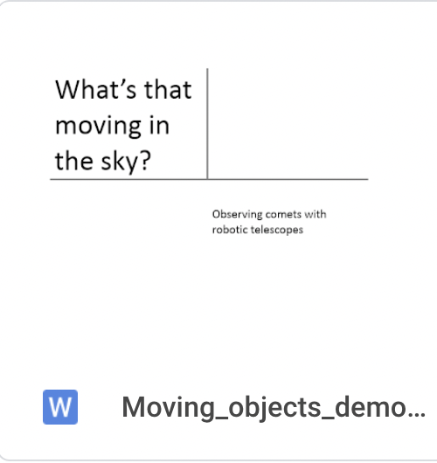
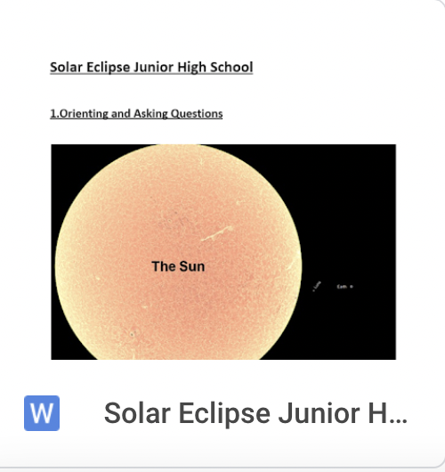
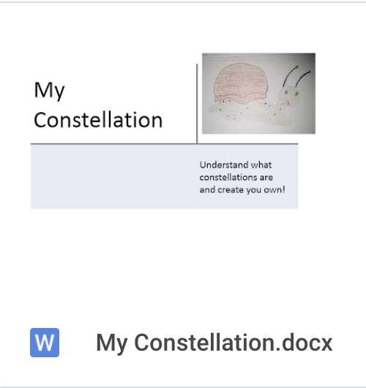
















LasCiL Demonstrators

Slide 55
LaSciL Tools

Slide 56

Science literate individuals capable to make wise decisions and understand our place in the cosmos

Slide 57



© Astrobiology Magazine

Slide 58

We are all made out of star dust…

Slide 59

Inhabitants of a magical place…

Slide 60
















One World… One People… One Sky…

