Slide 1
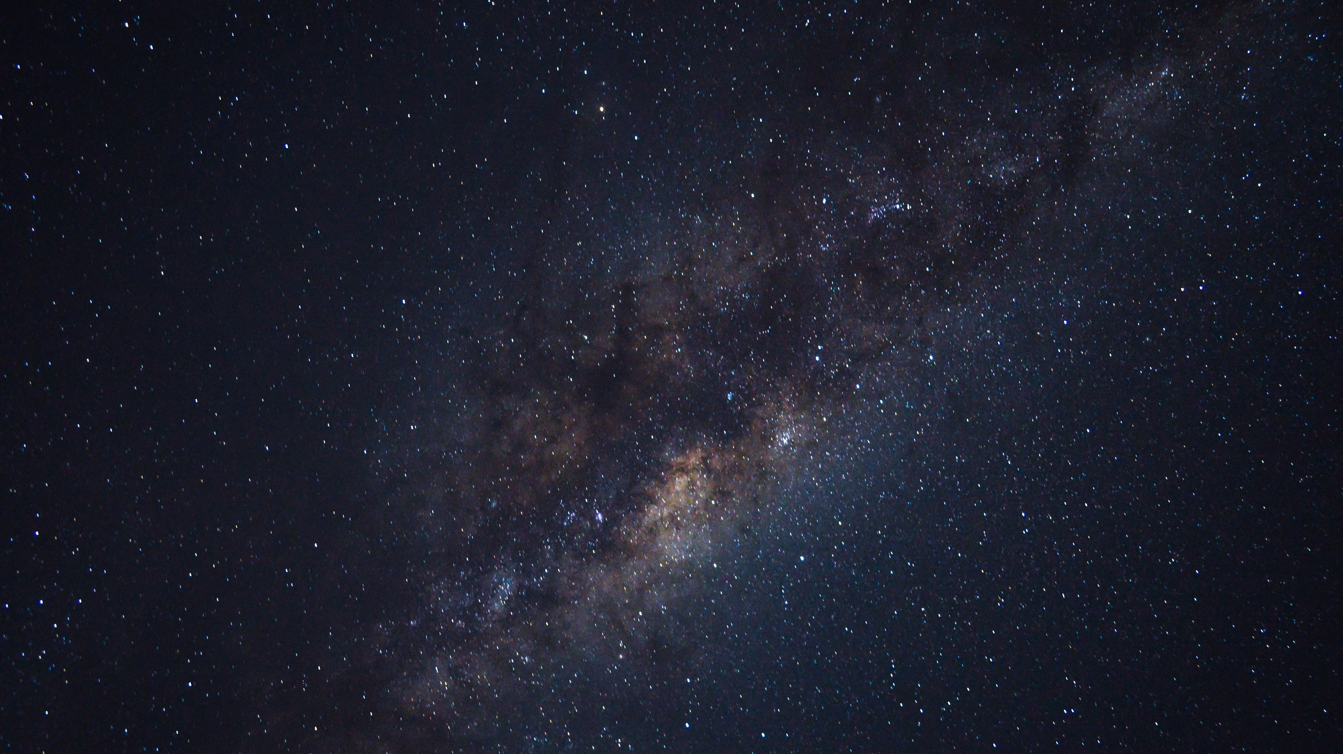






School as a hub for Astronomy
Maria Panagopoulou, Physicist
Research and Development Department, Ellinogermaniki Agogi
Panagiotis Evaggelopoulos, Physicist
Public Outreach, Institute of Astrophysics FORTH
The LaSciL project has been co-funded with support from the Erasmus+ funding scheme of the European Commission with grant agreement: 2020-1-UK01-KA226-SCH-094579
The project was supported by the Hellenic Foundation for Research and Innovation (H.F.R.I.) under the “3rd Call for Action “Science and Society” “Research, Innovation and Dissemination Hubs”” (Project Number: 02181).

Slide 2
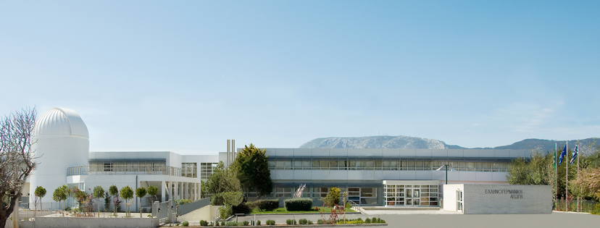
Astronomy projects for students

Slide 3
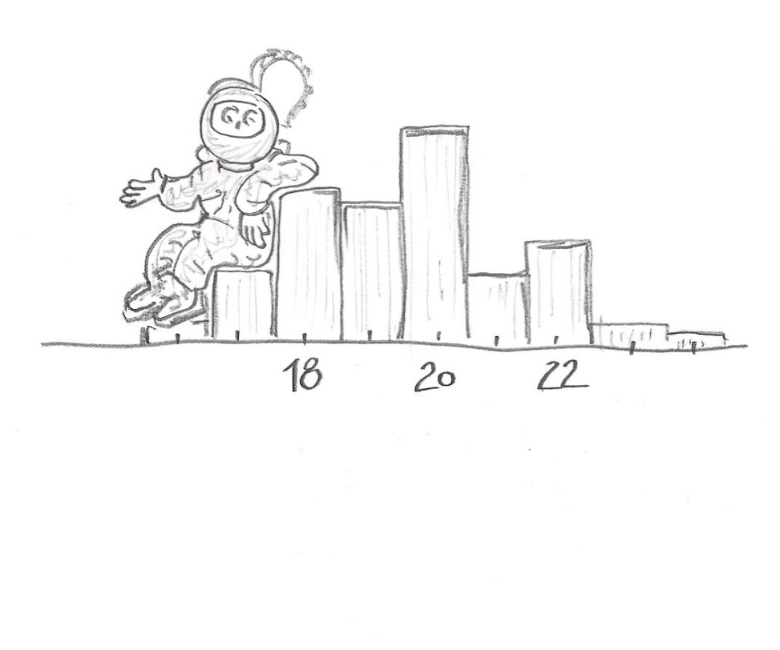
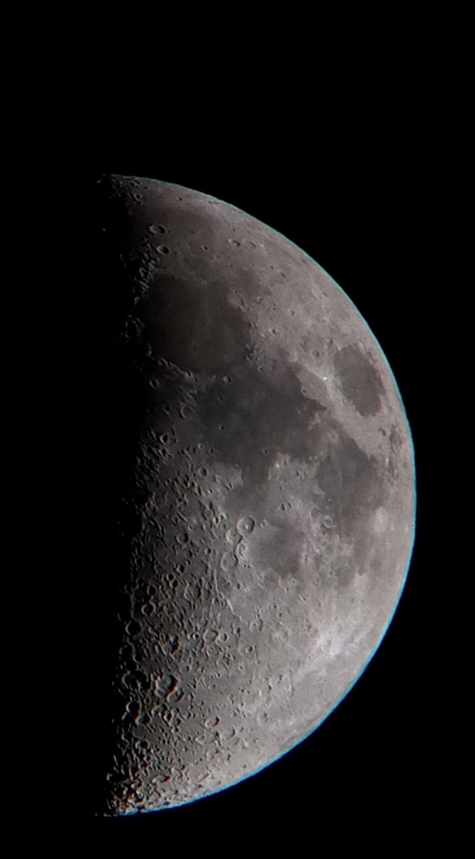
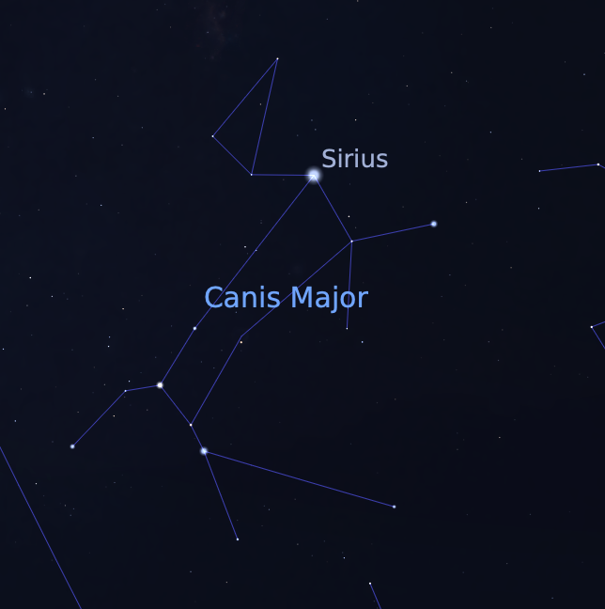
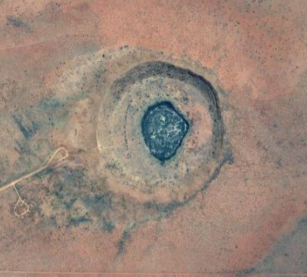
Introducing Astronomy to the Curriculum

Slide 4
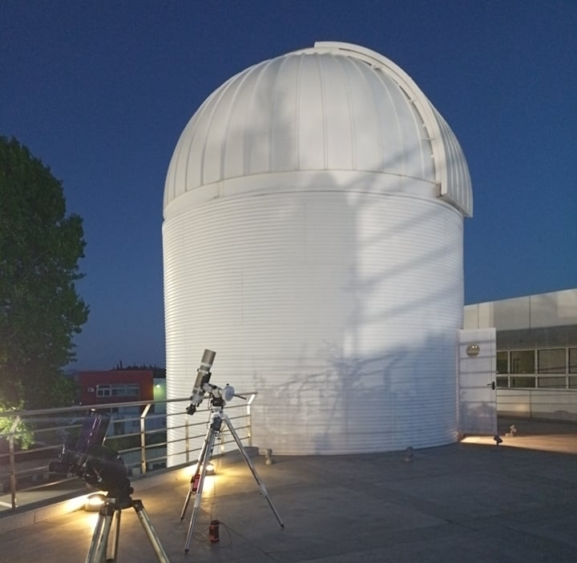
Extracurricular activities for students

Slide 5
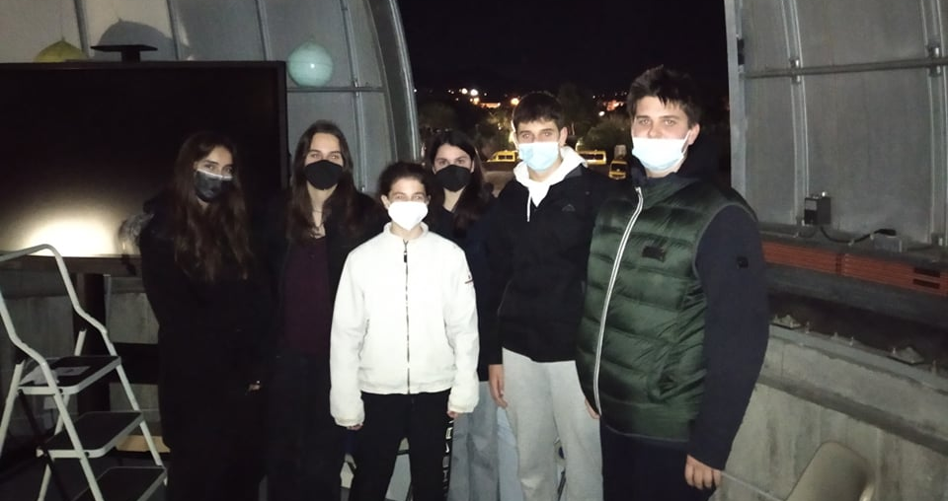
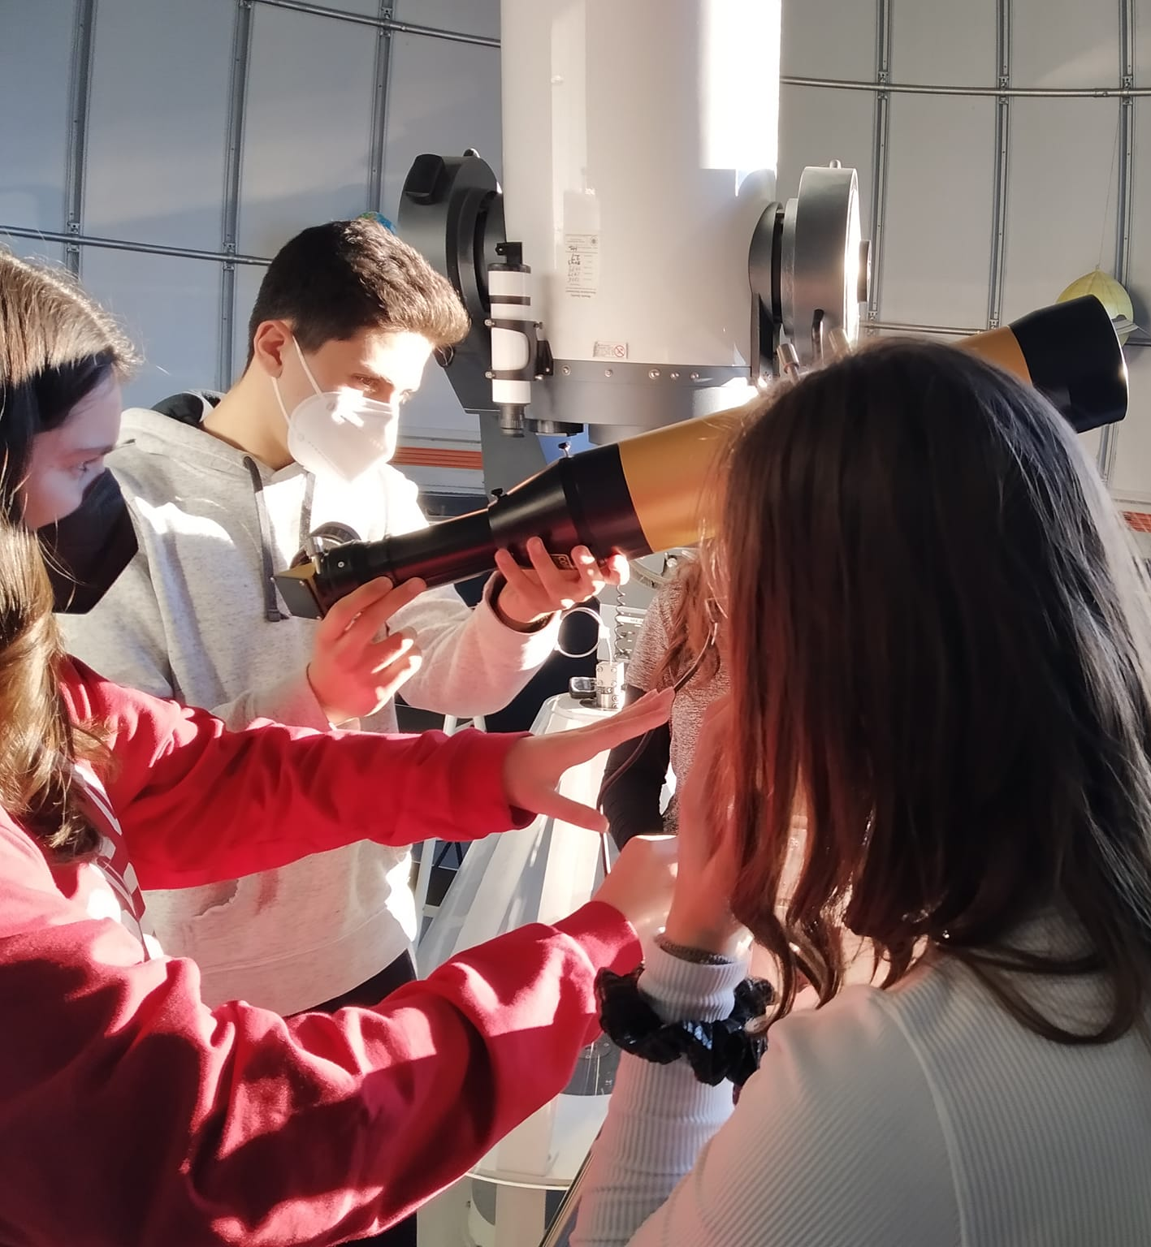
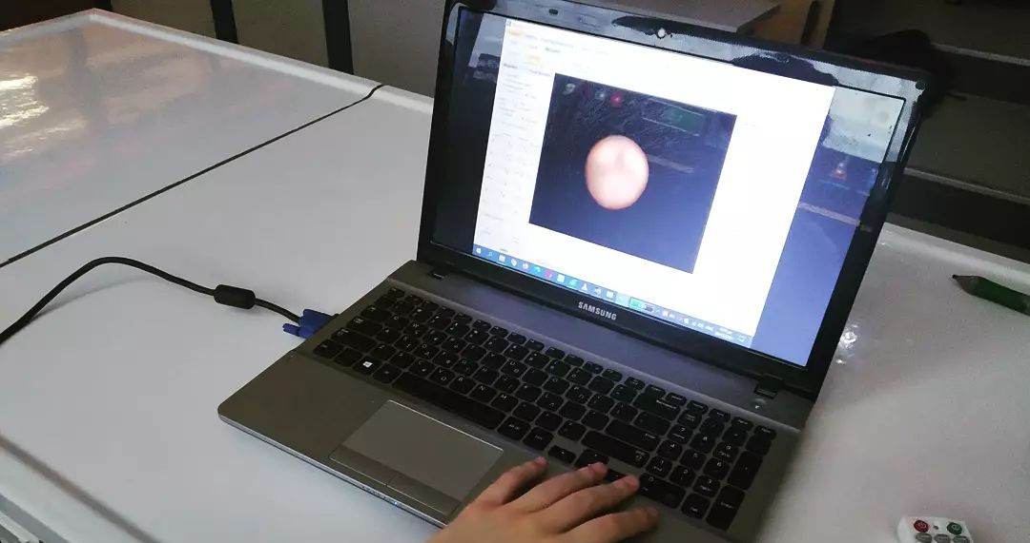
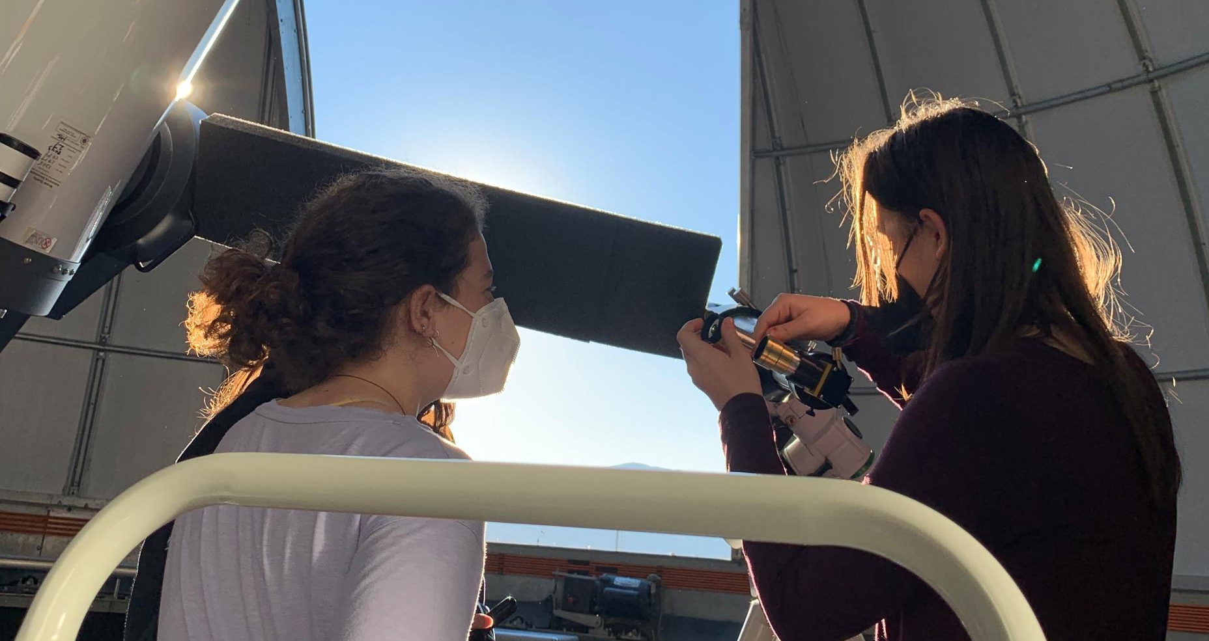
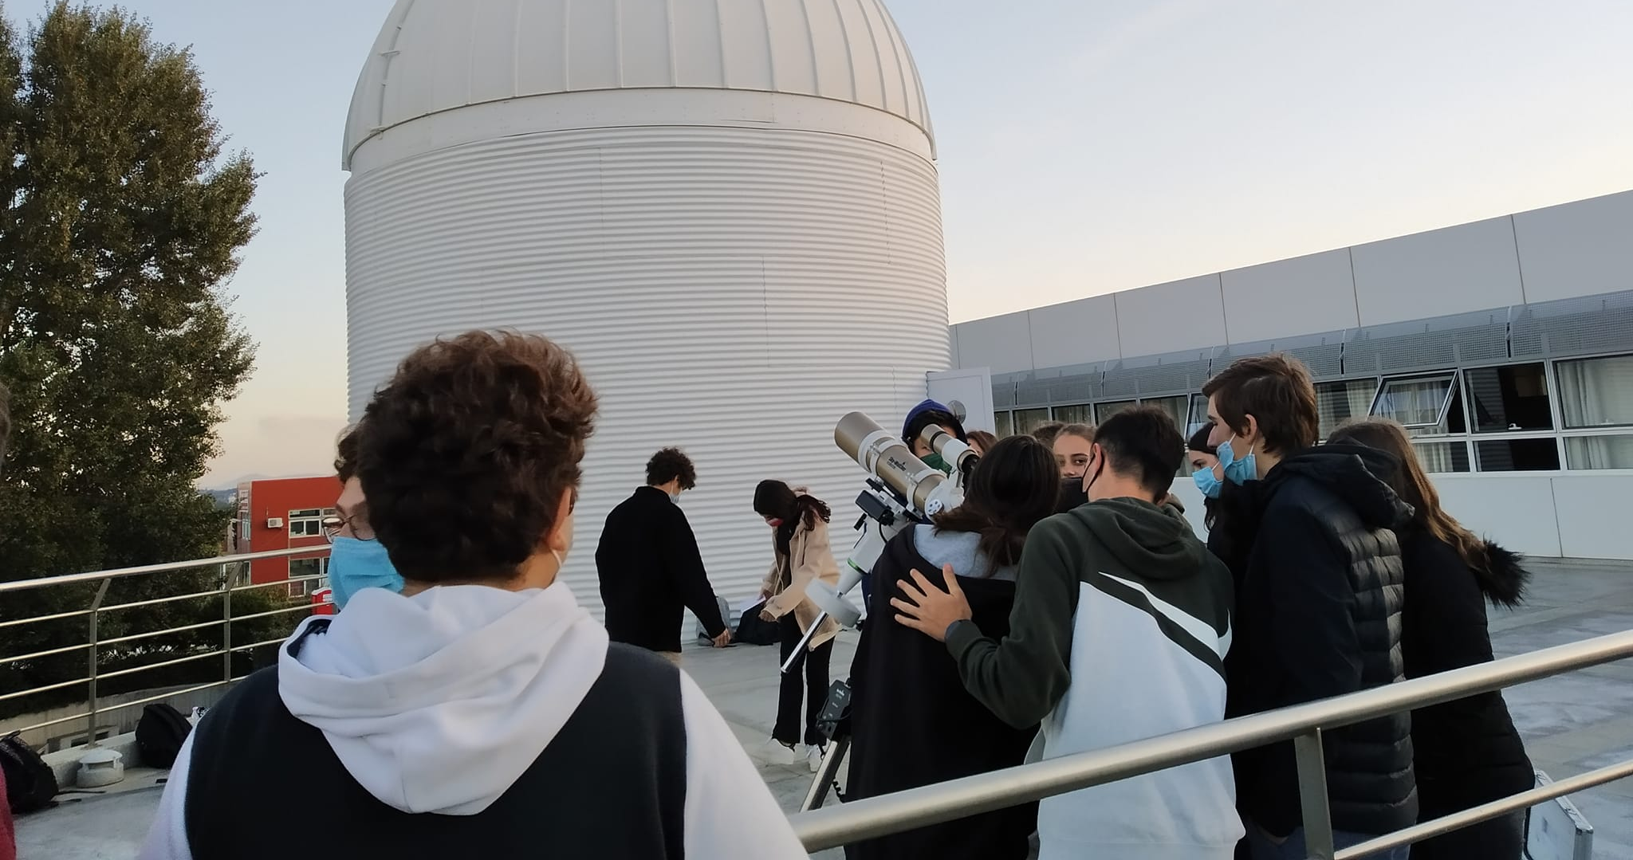
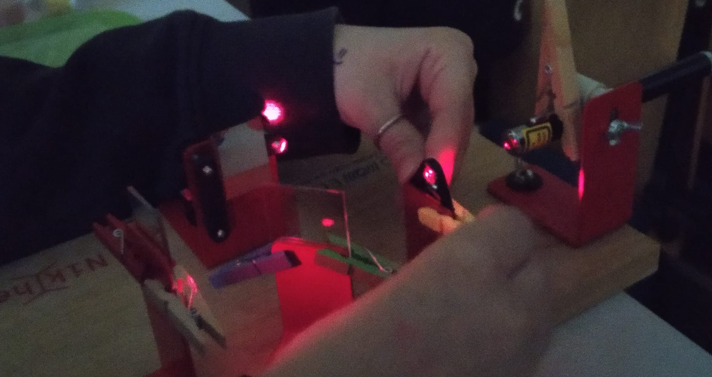
Astronomy club 2021-2022

Slide 6
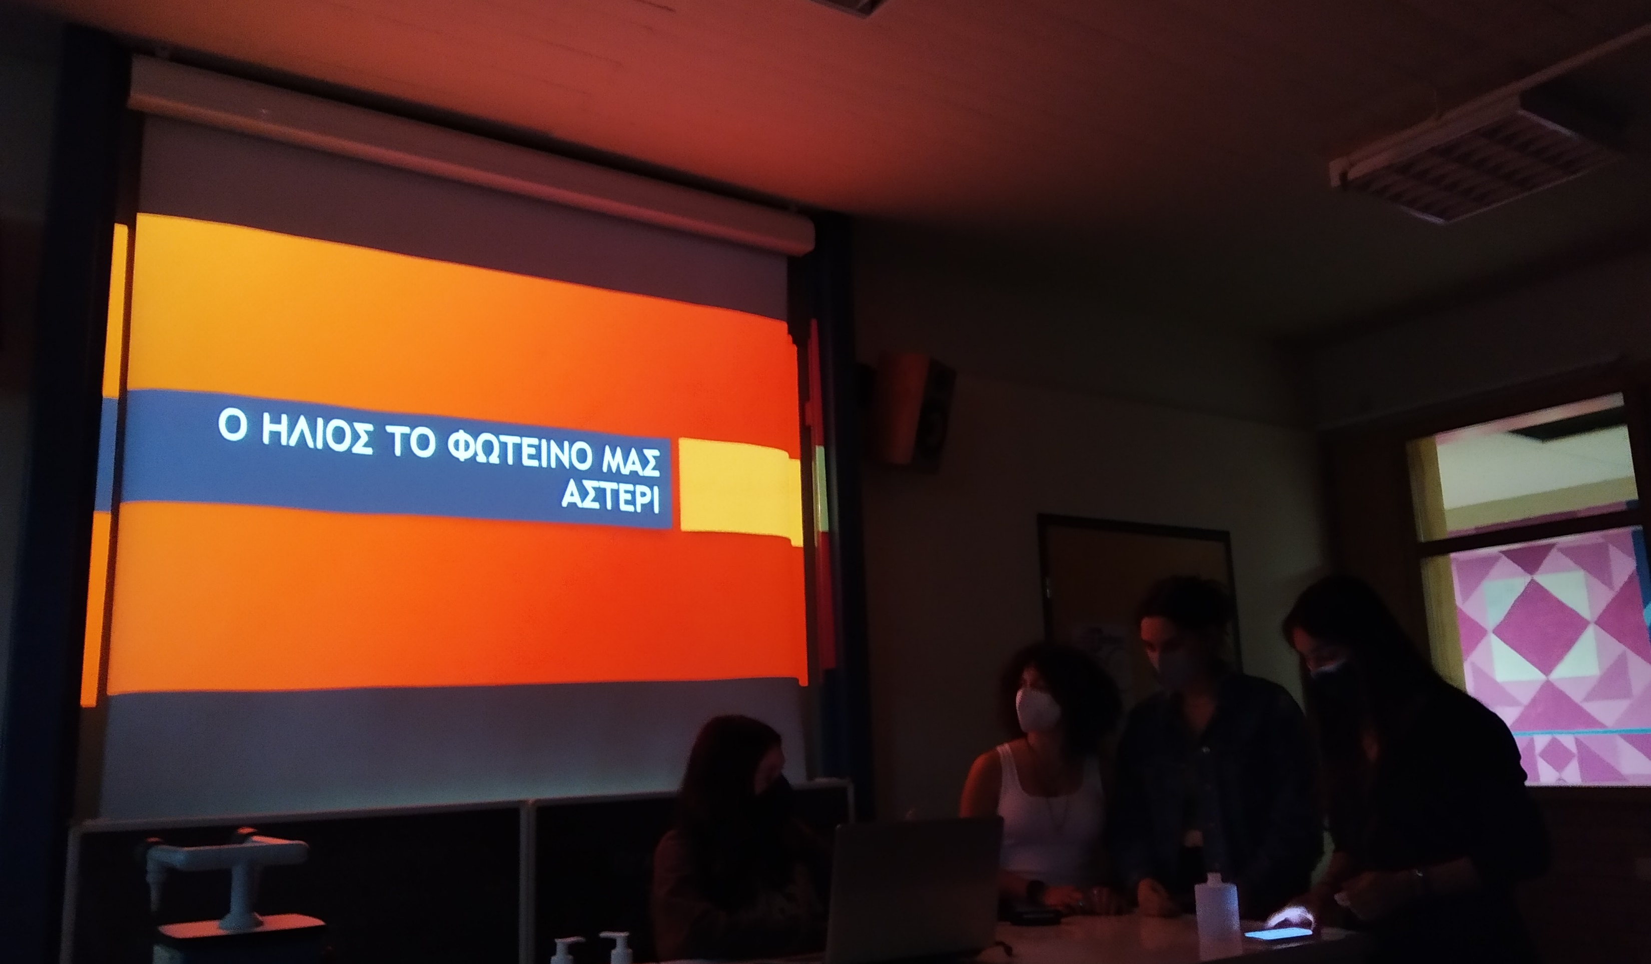
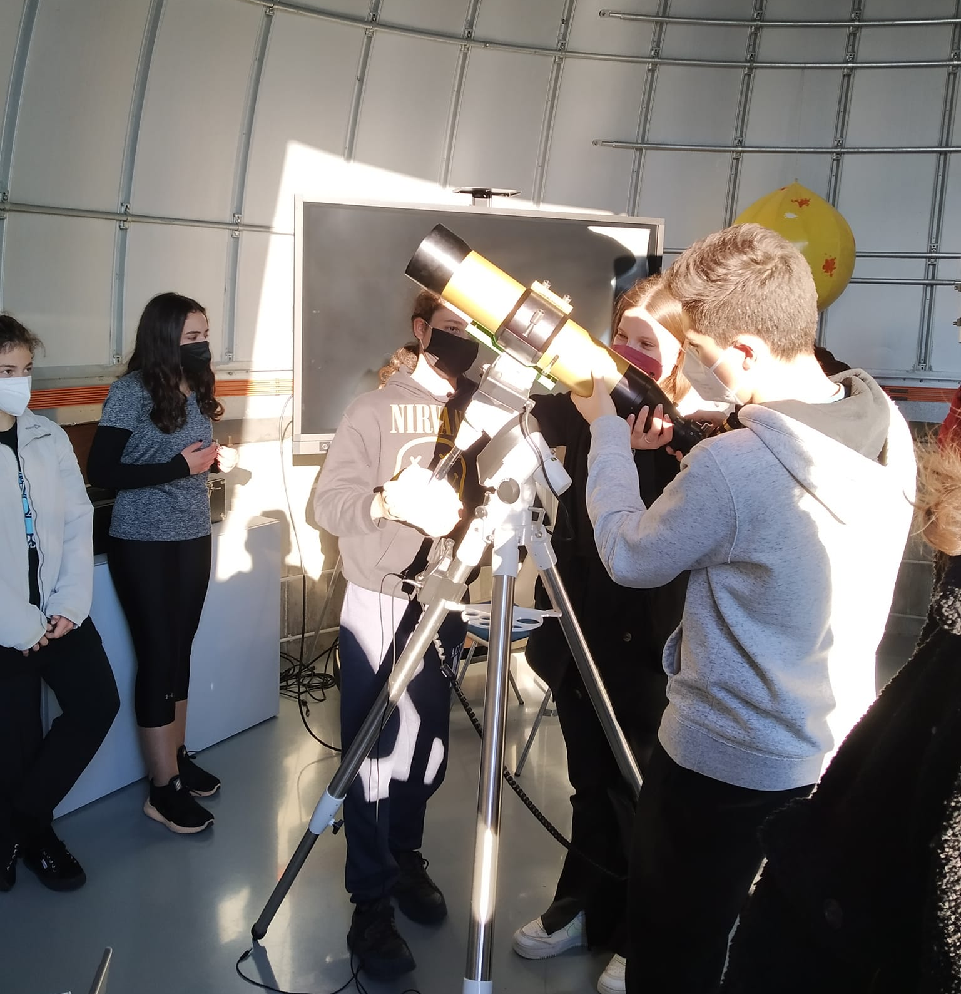
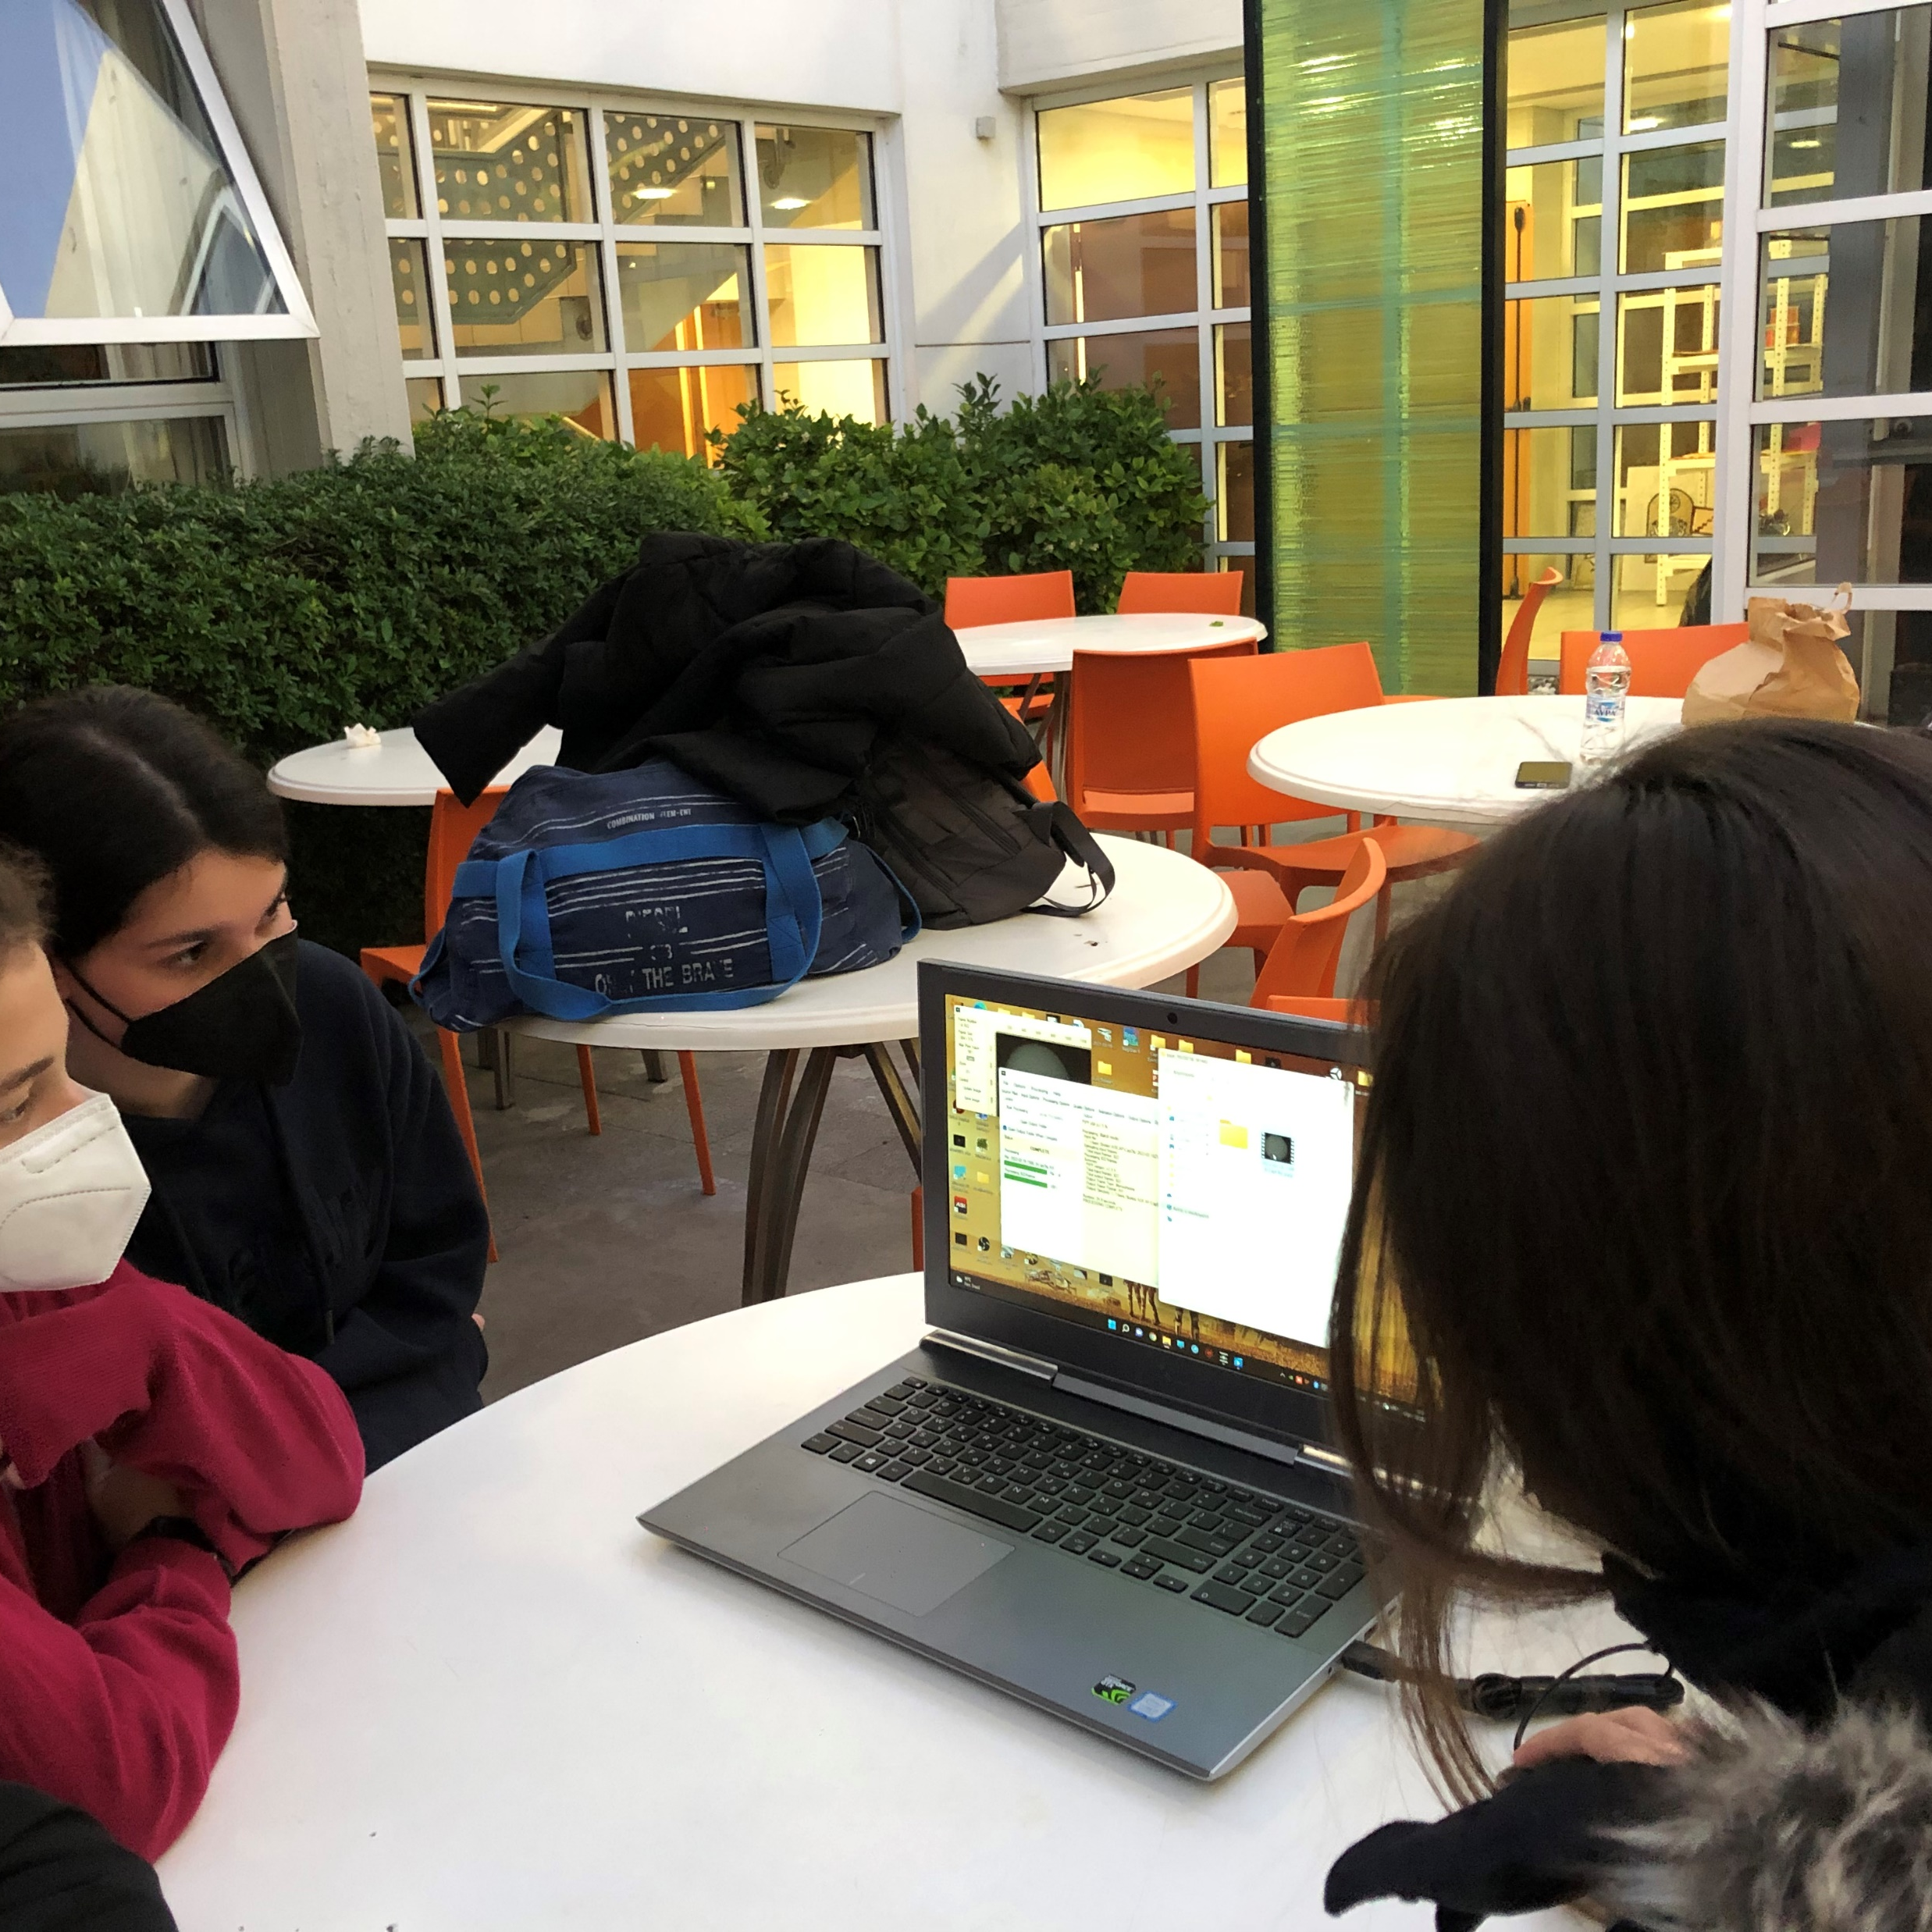
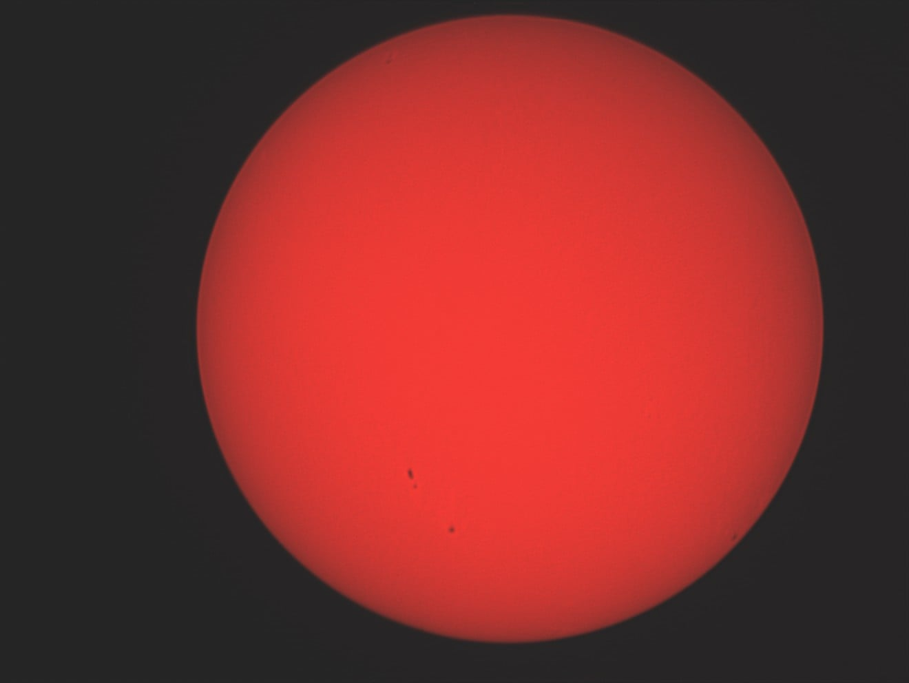
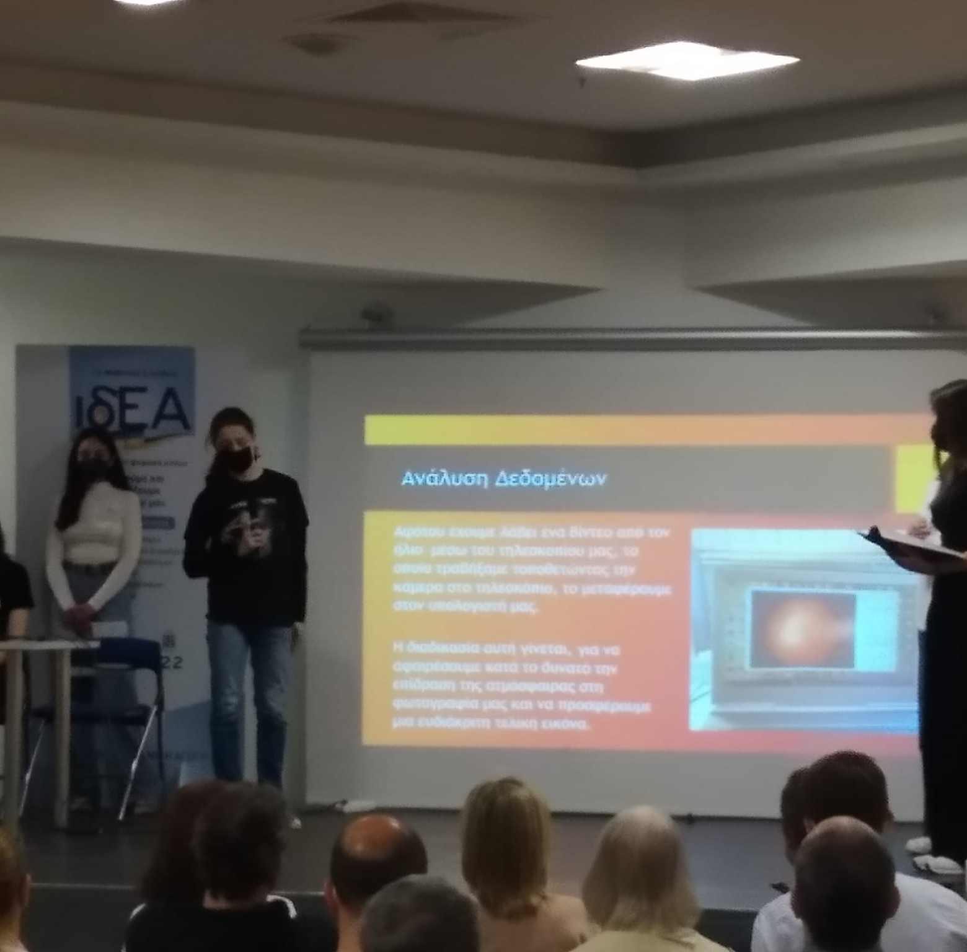
Astronomy club 2021-2022

Slide 7
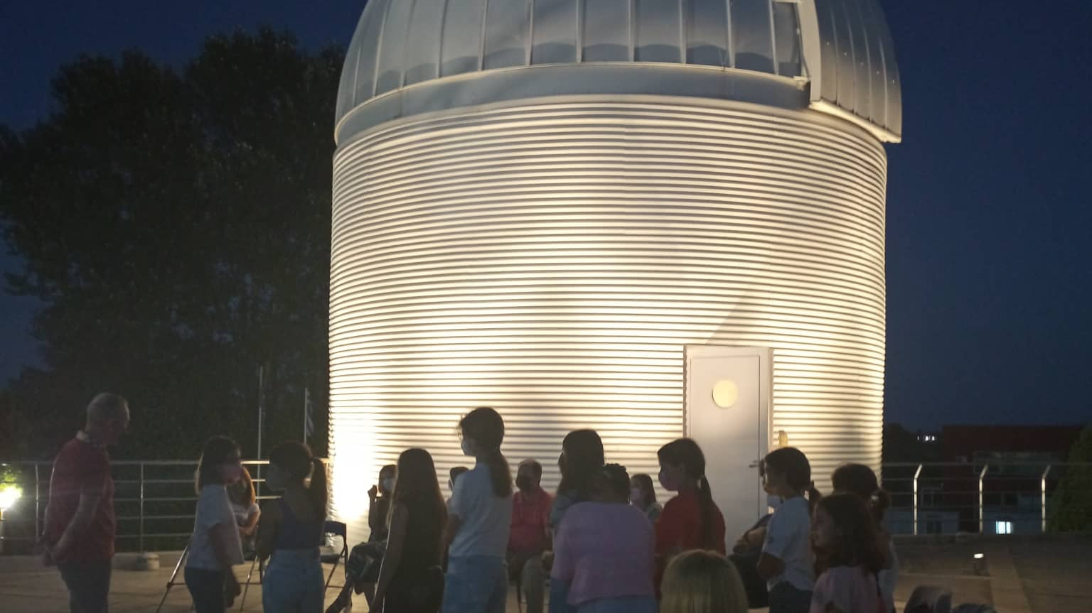
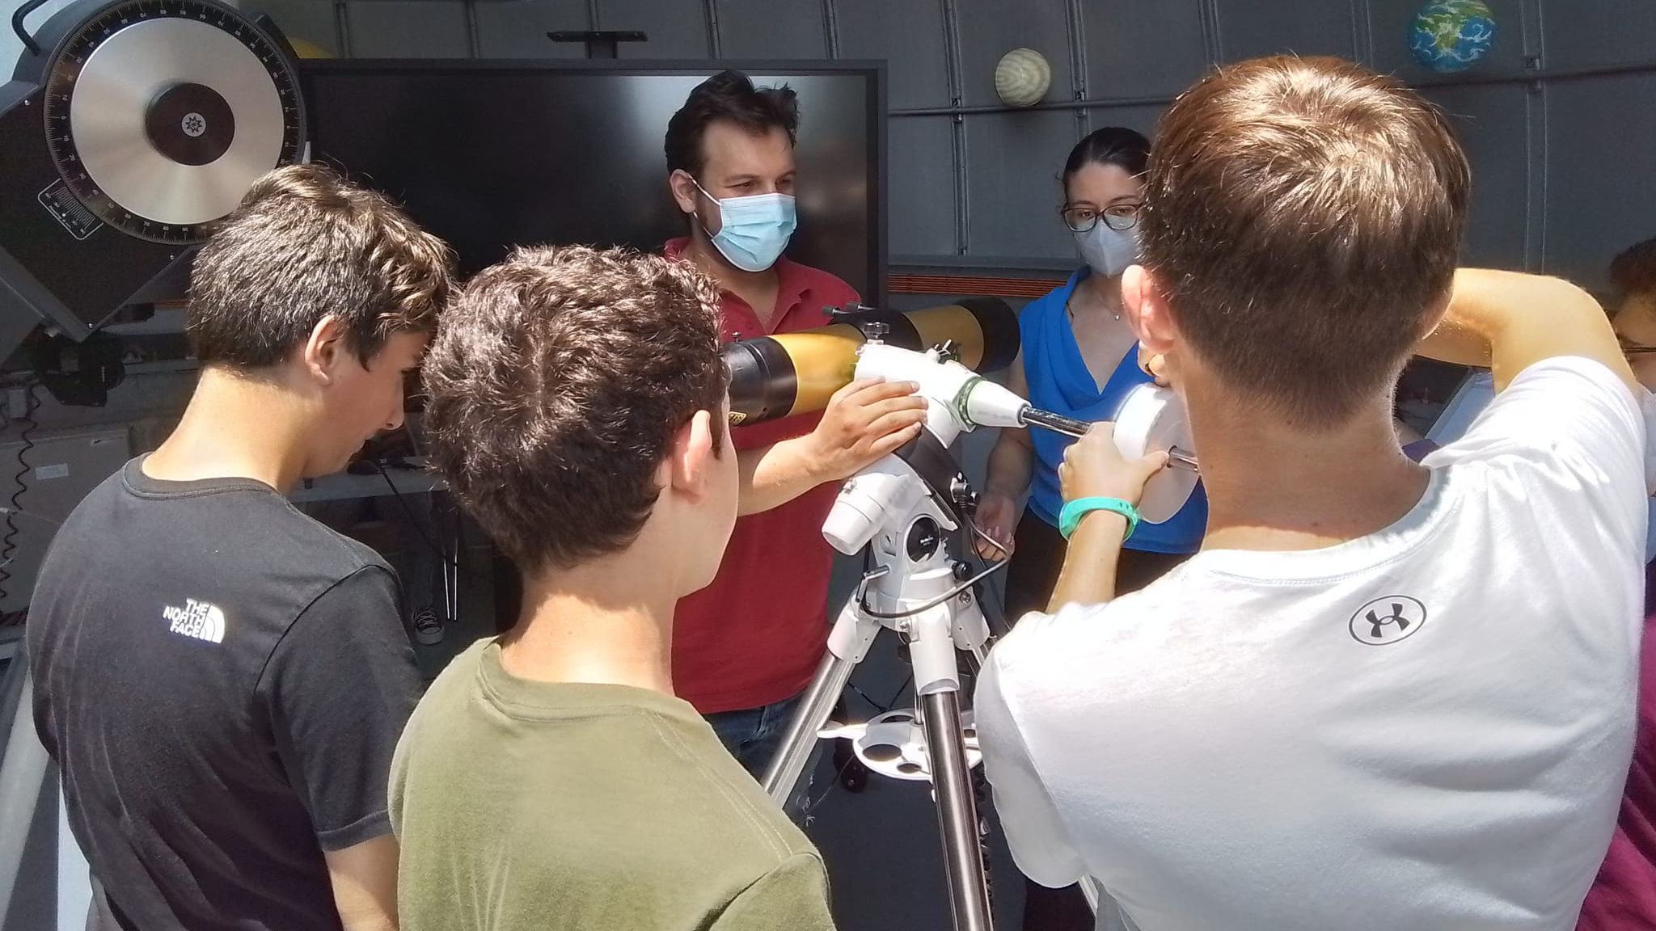
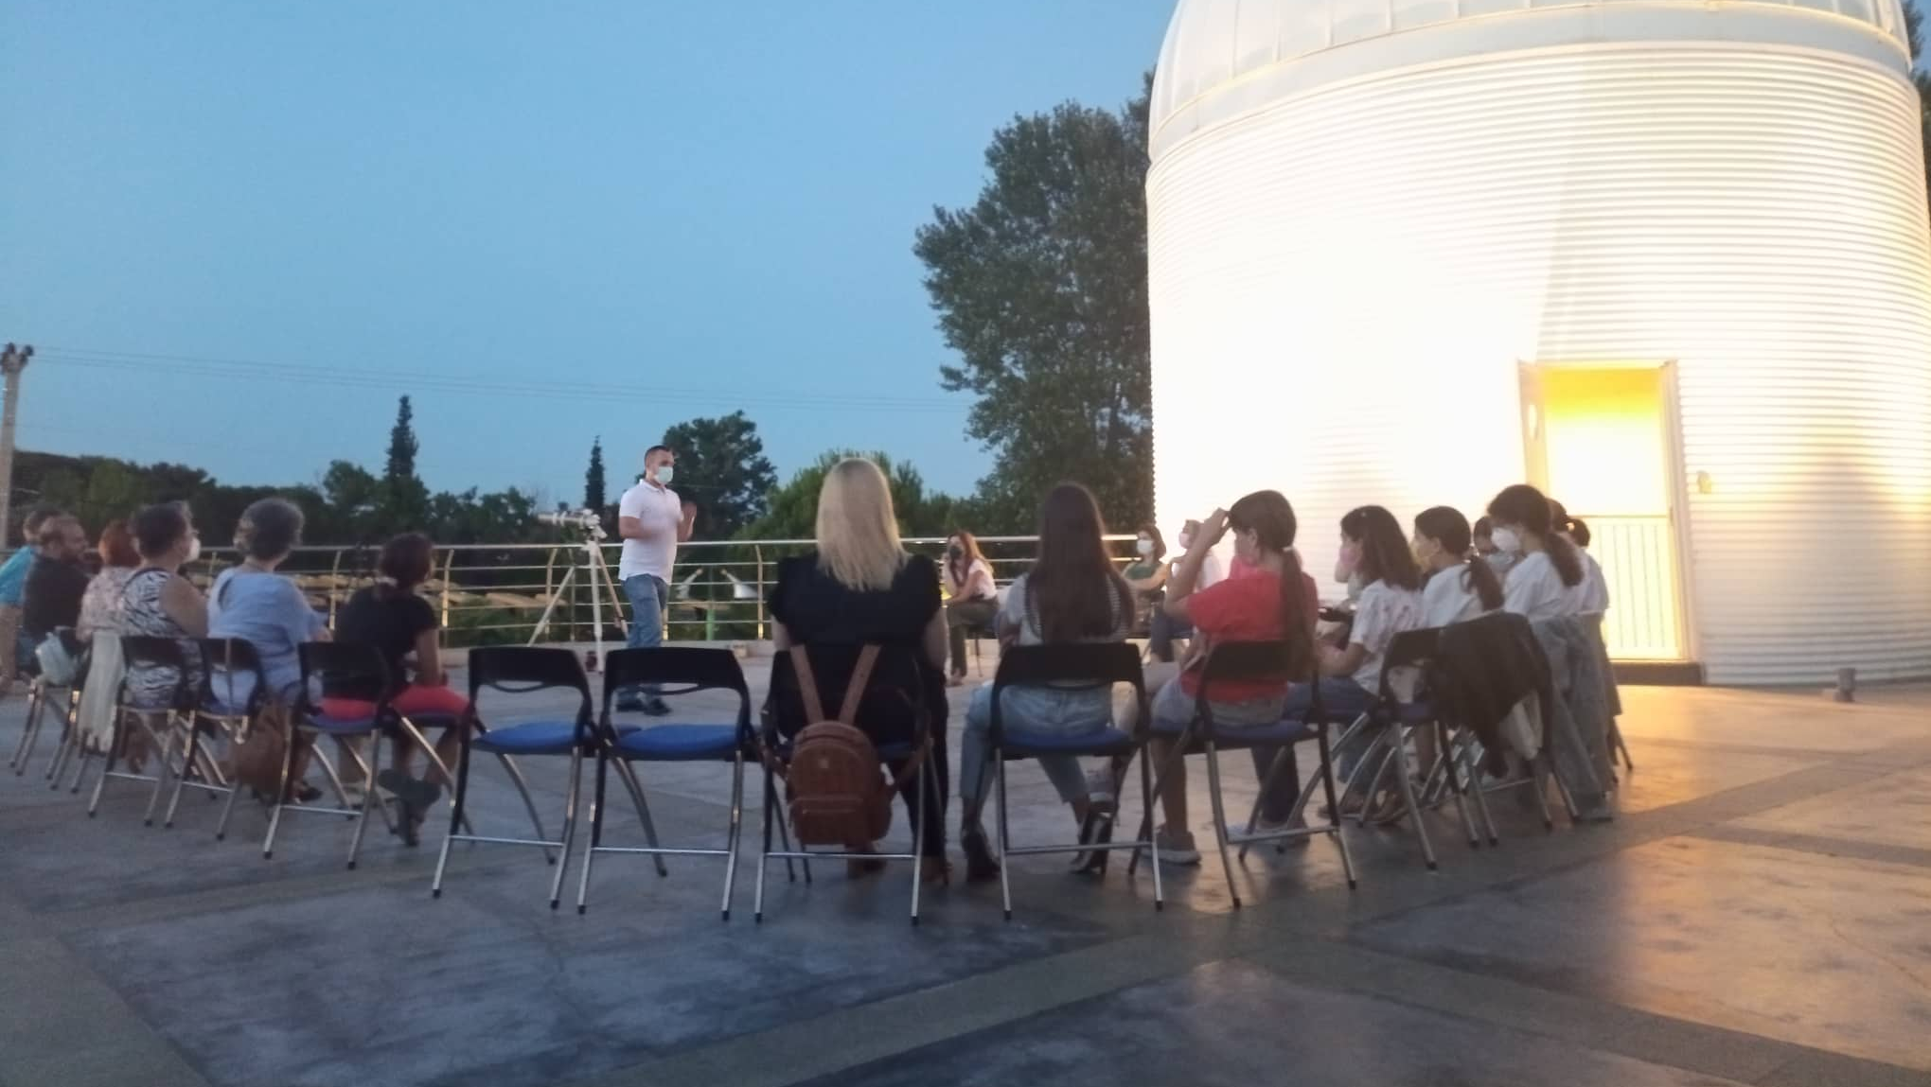
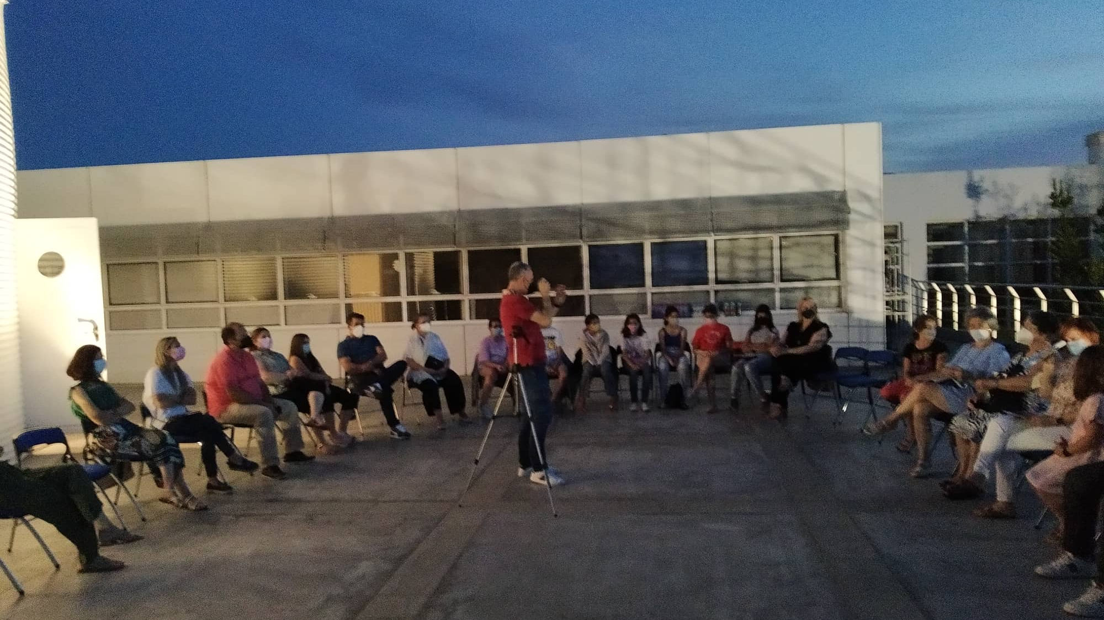
Summer camps 2022

Slide 8
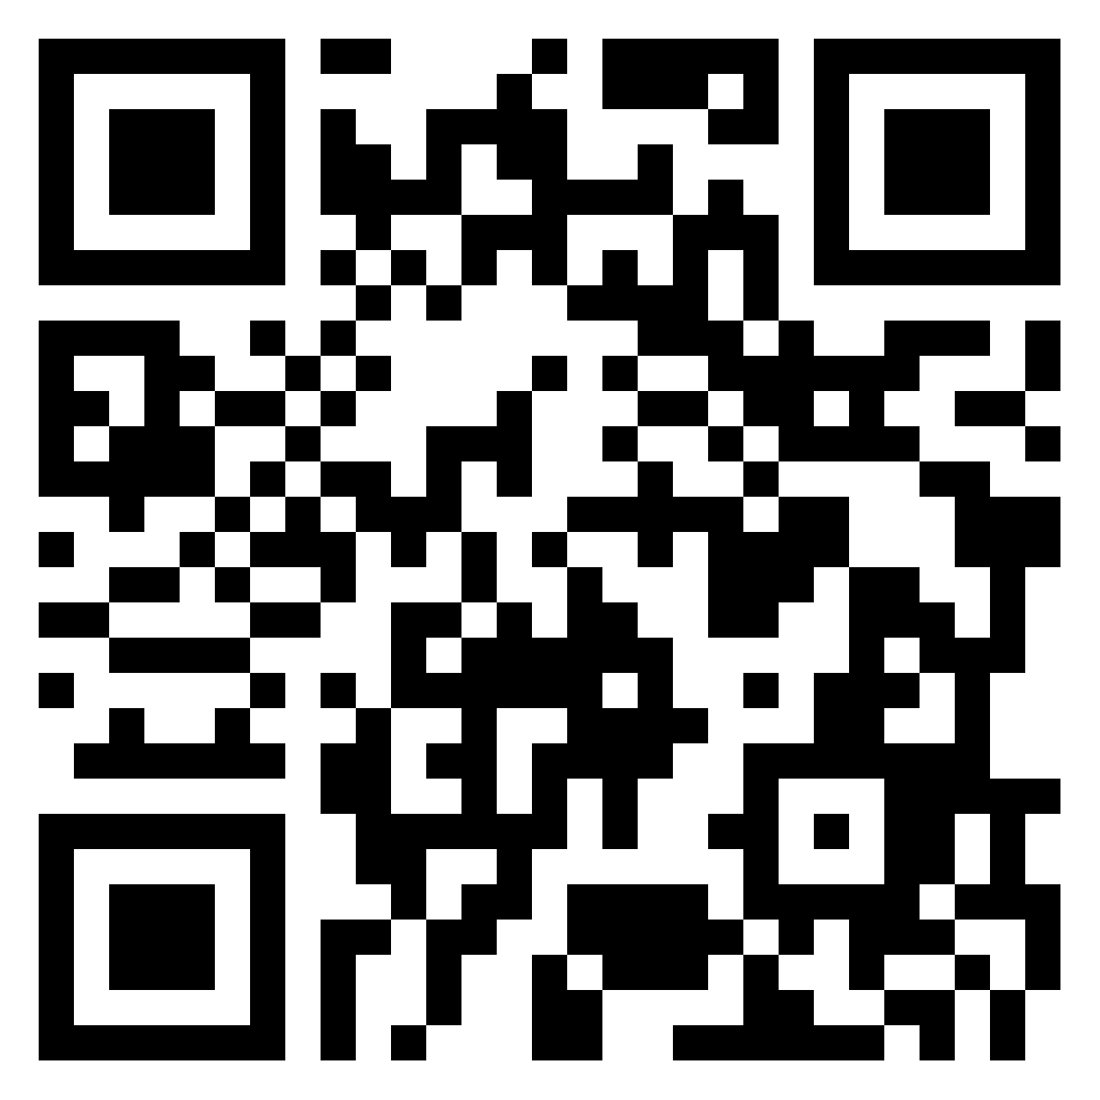
What extracurricular activities would you design for your school?
https://padlet.com/mariapanago/27hun9hwmwe66wr7

Slide 9
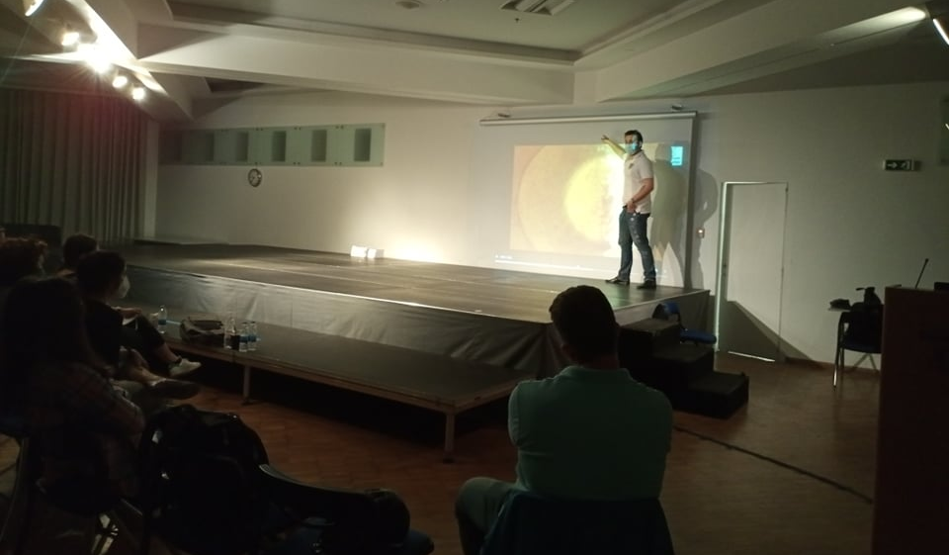
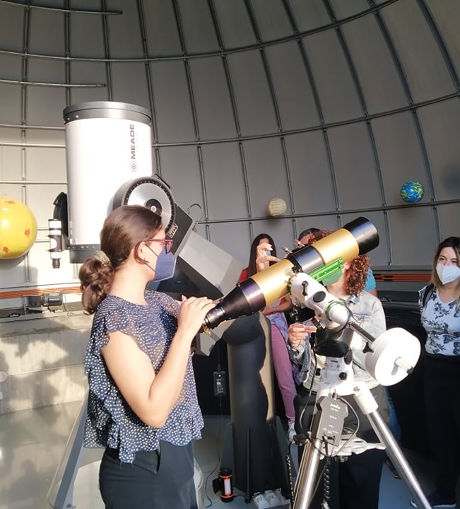
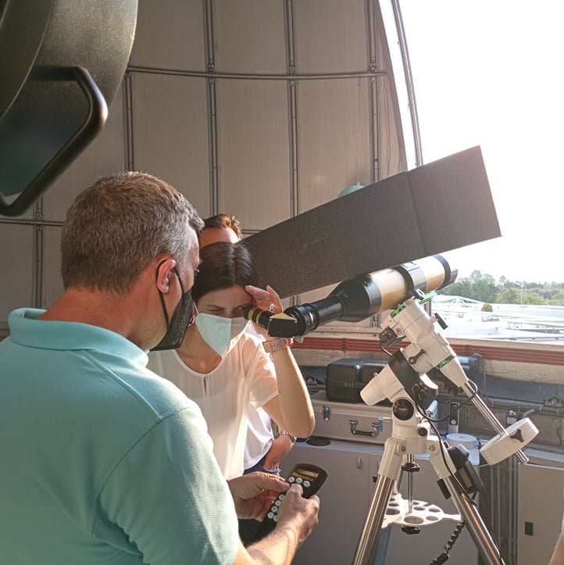
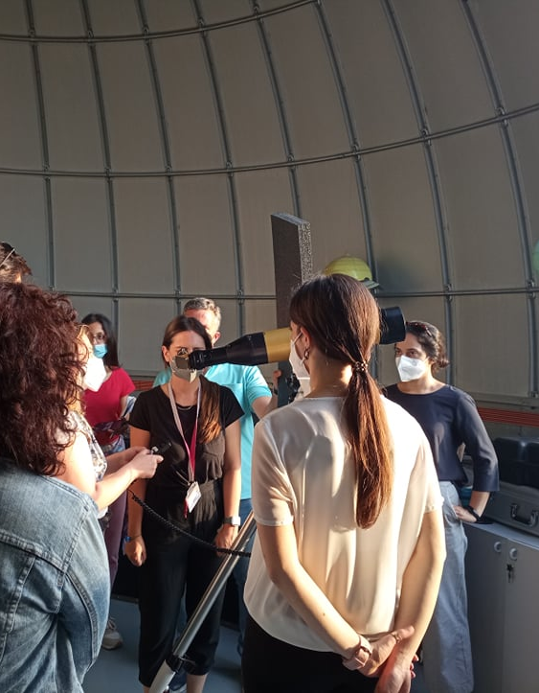
Seminars for teachers

Slide 10
What would you include at an event devoted to teachers?
https://padlet.com/mariapanago/27hun9hwmwe66wr7

Slide 11
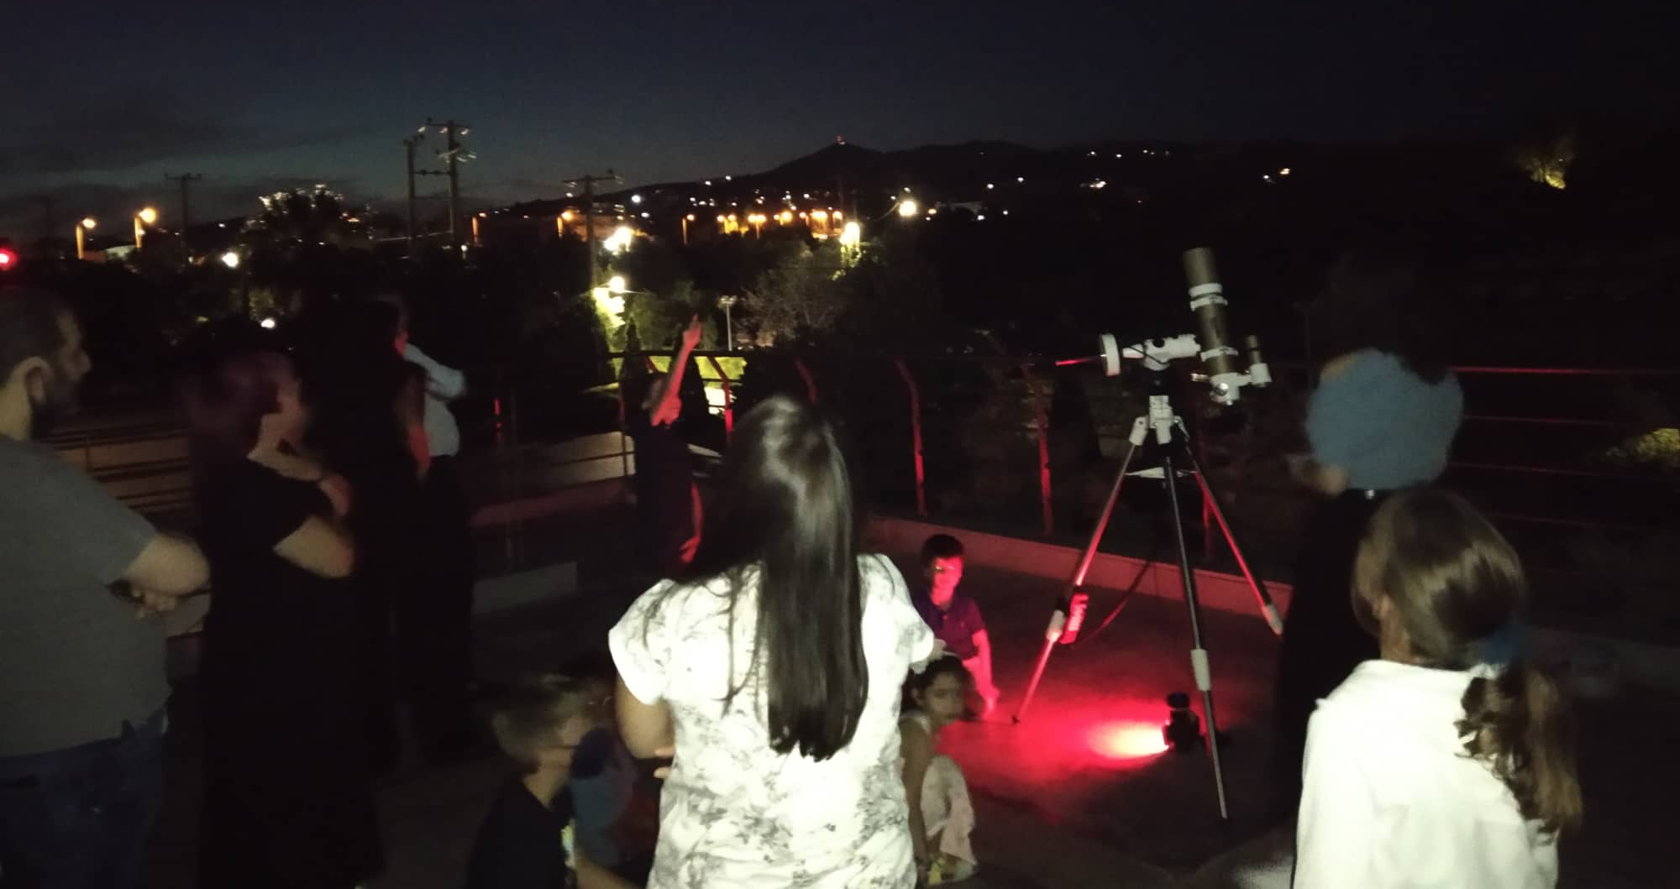
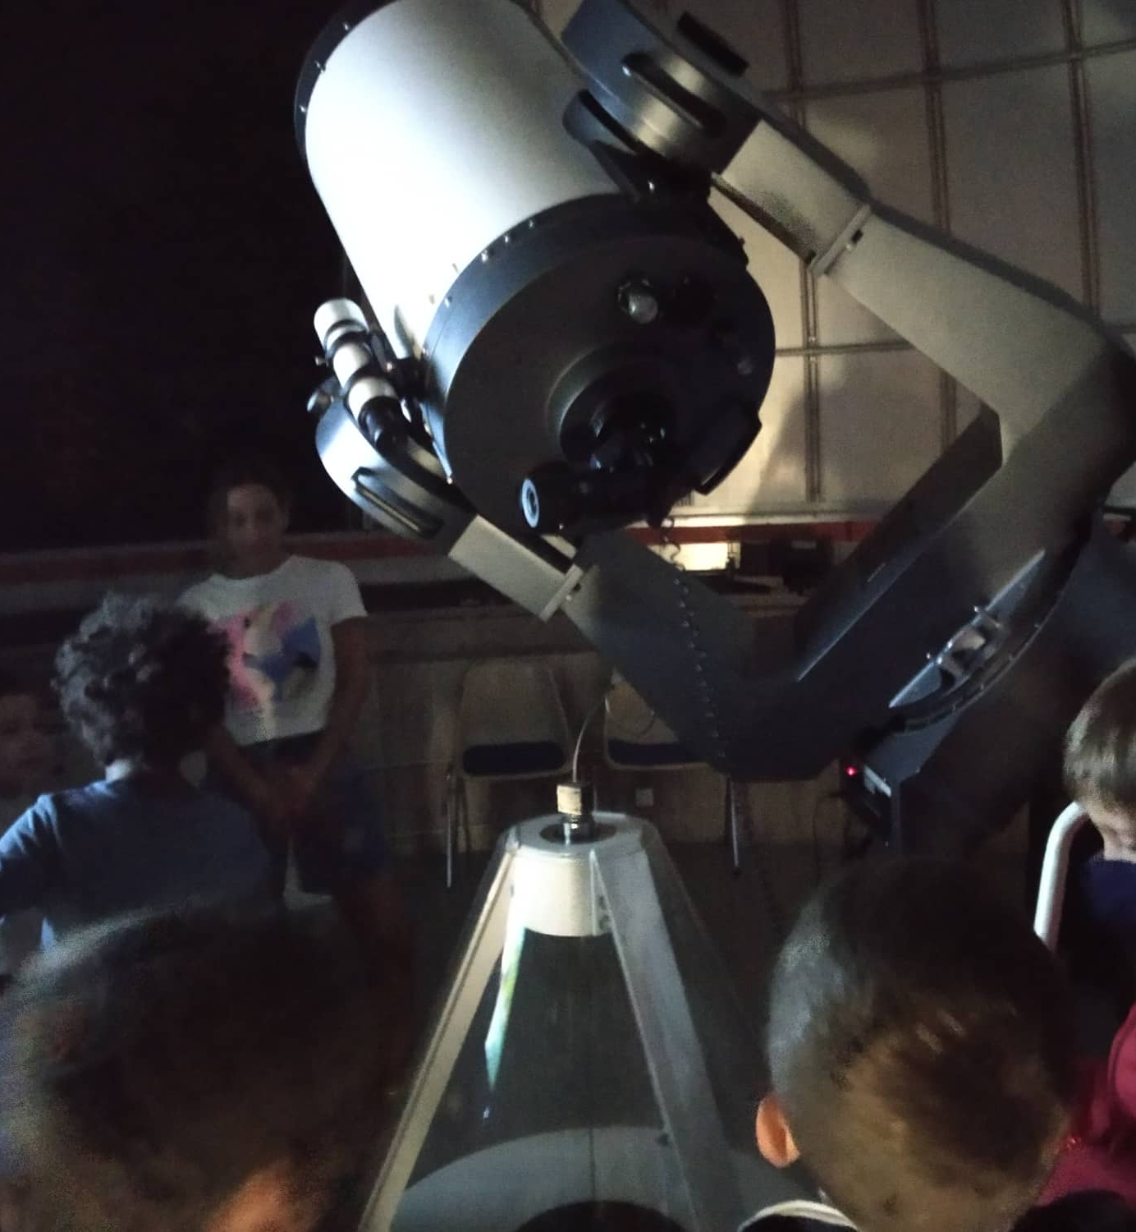
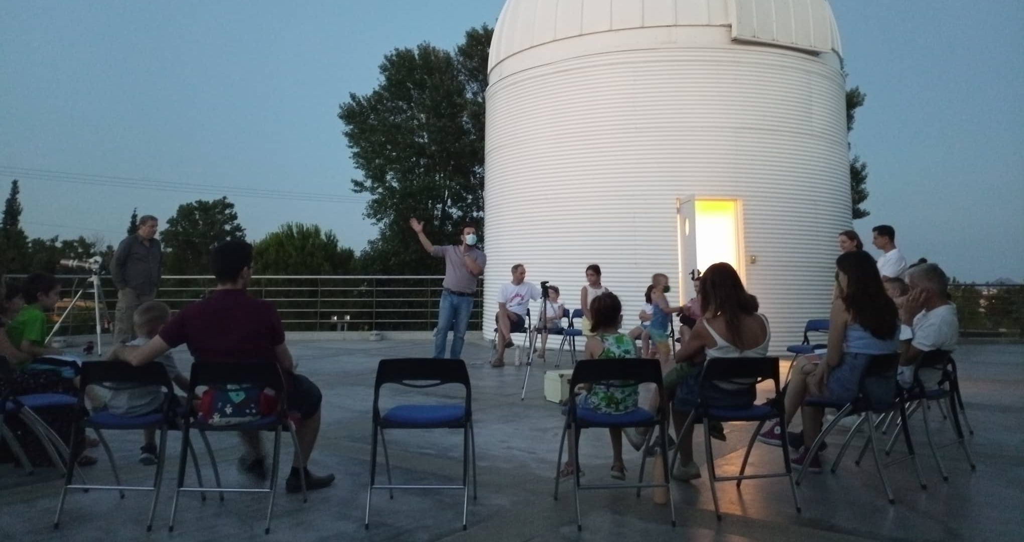
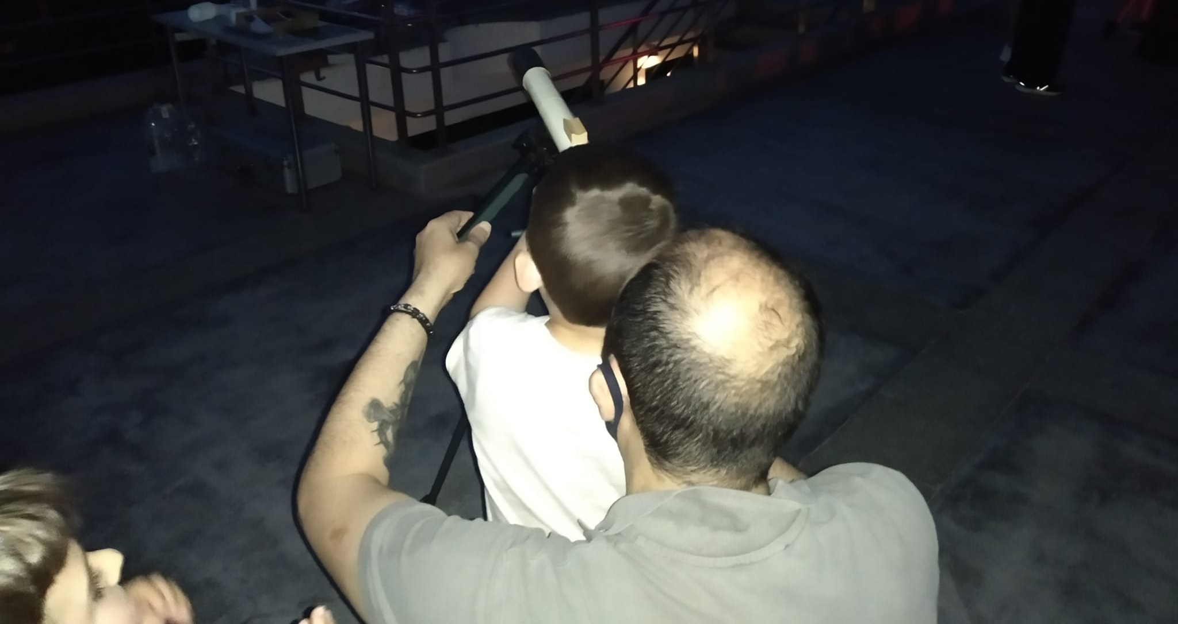
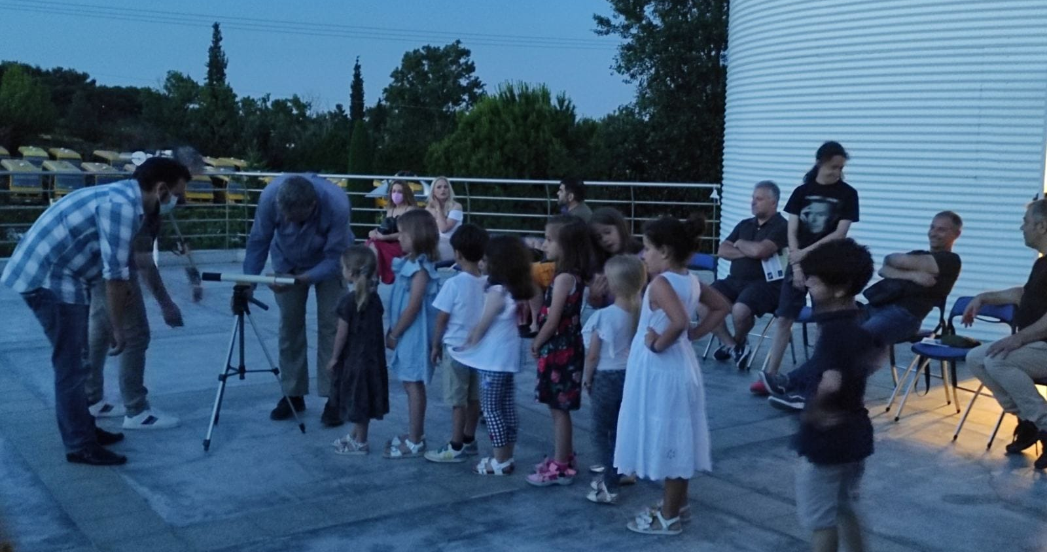
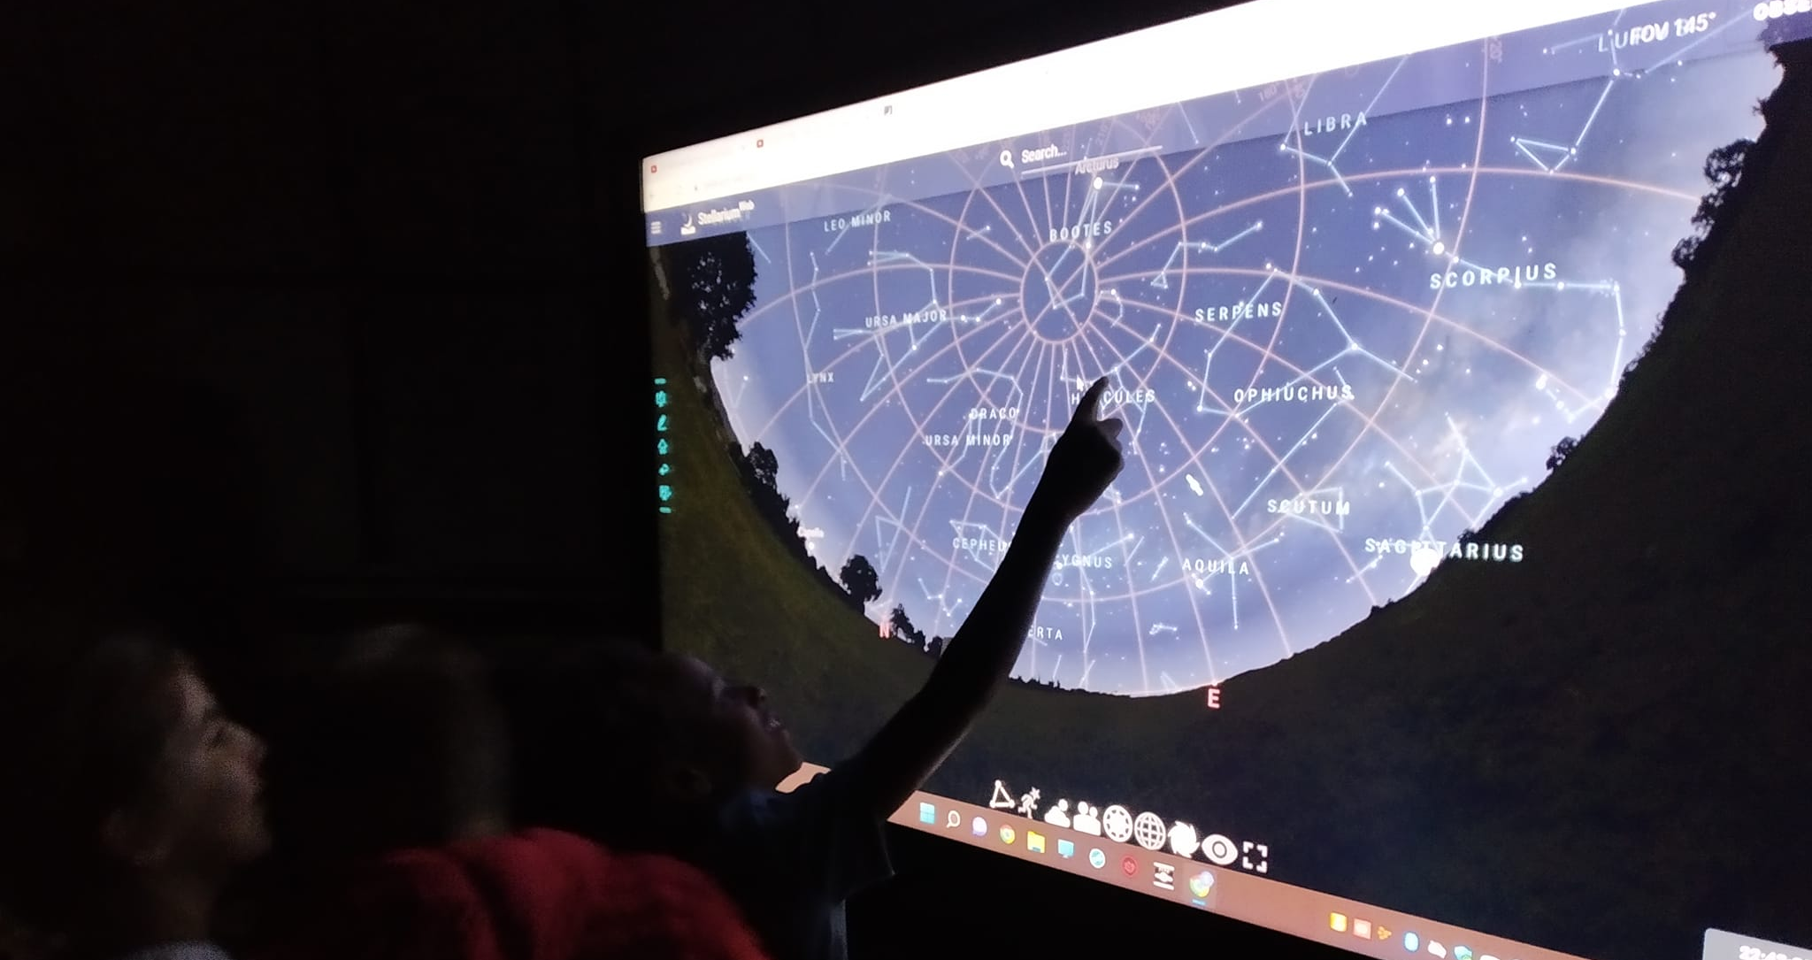
Events for the public

Slide 12
What activities would you include at an event open to the public?
https://padlet.com/mariapanago/27hun9hwmwe66wr7

Slide 13
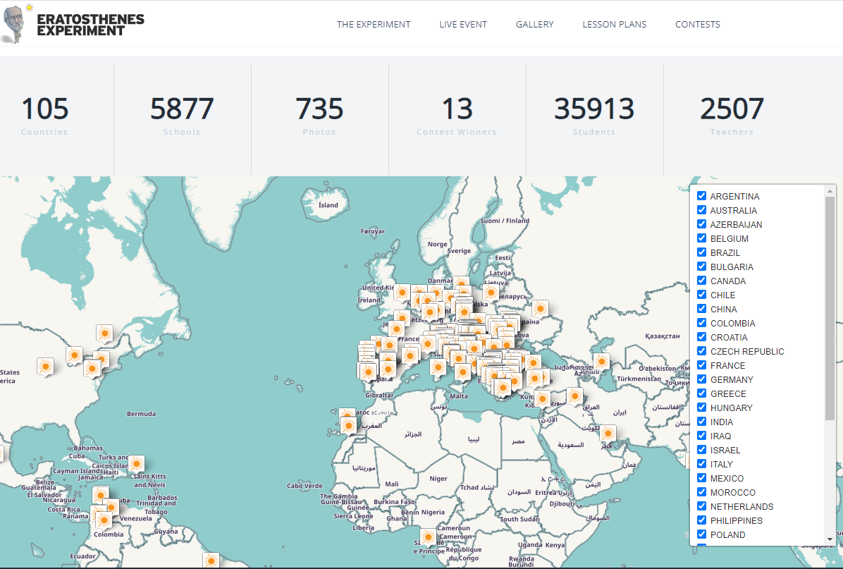
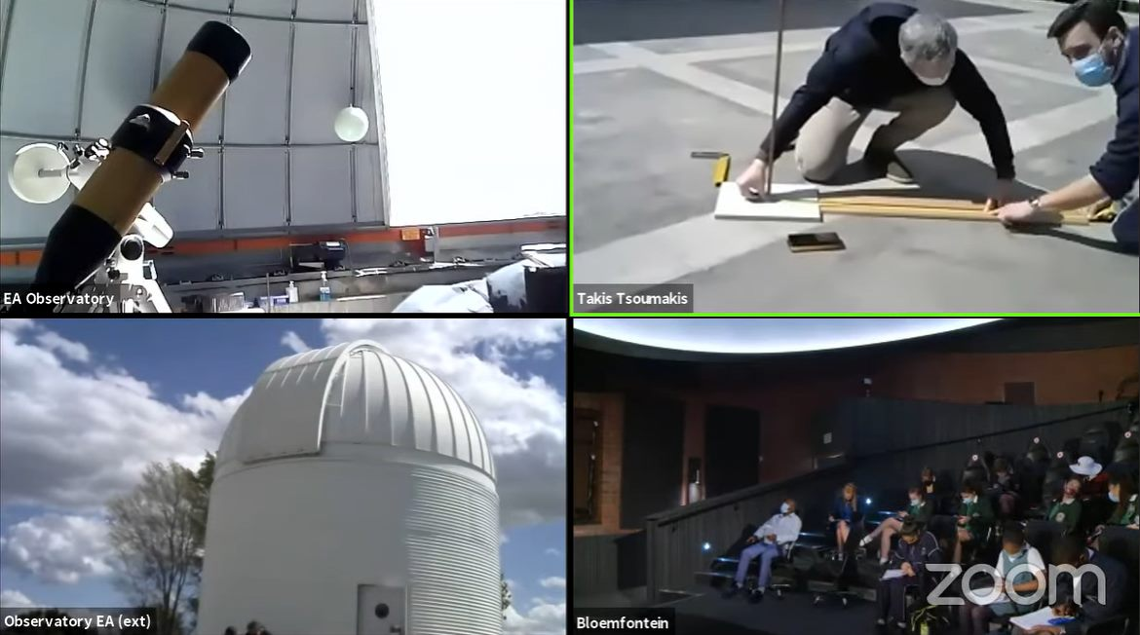
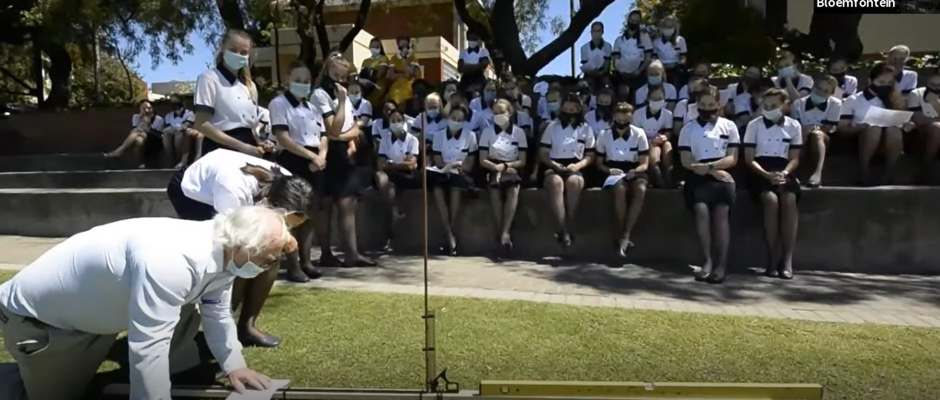
Supporting the organization and implementation of big events

Slide 14
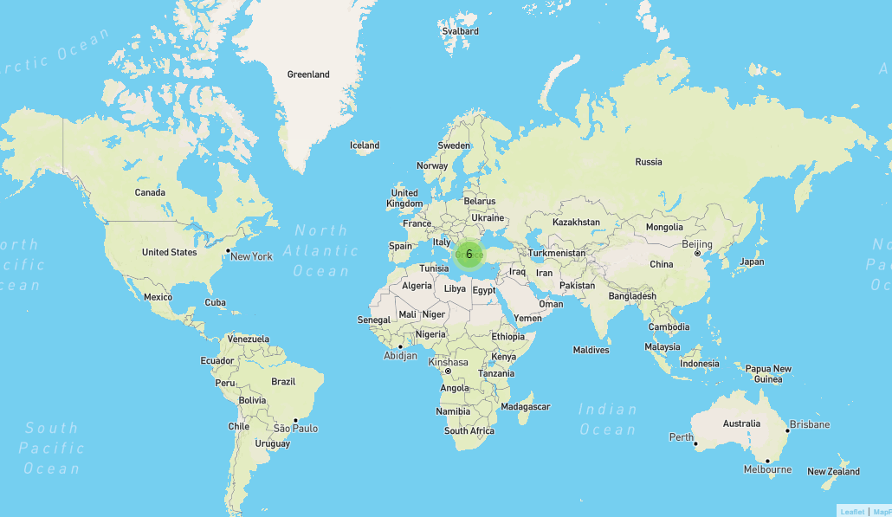
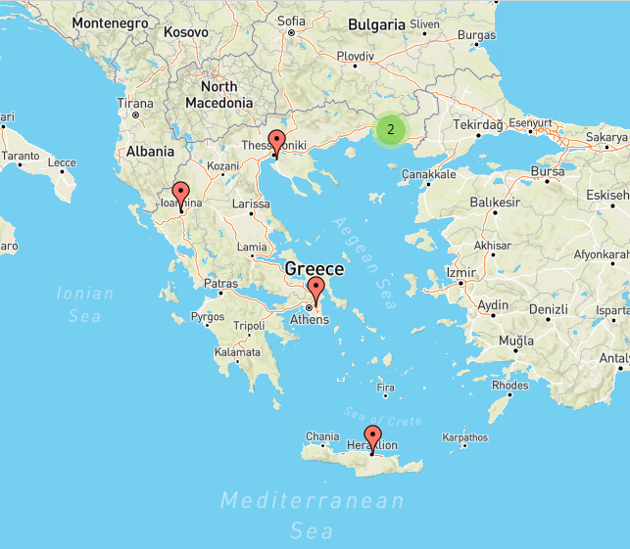

Spreading to more schools

Slide 15
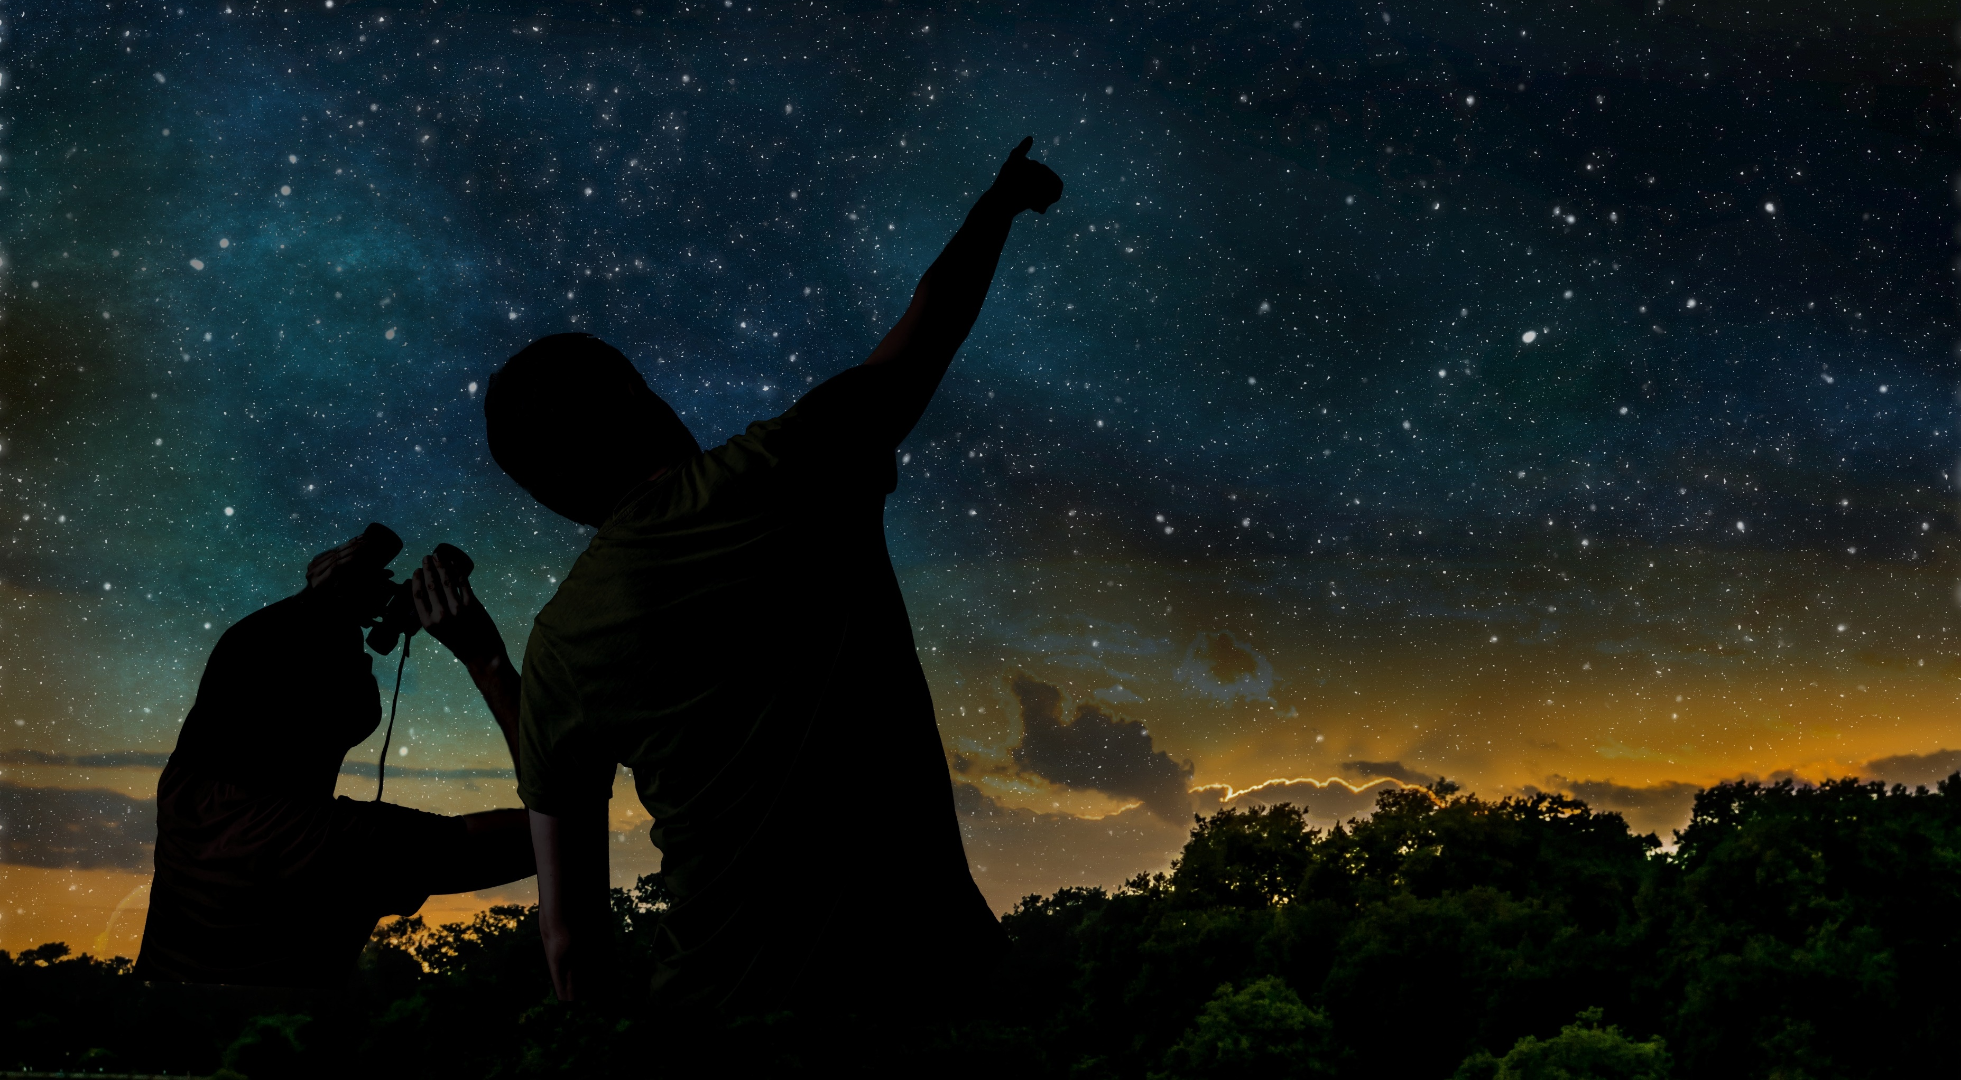
The LaSciL project has been co-funded with support from the Erasmus+ funding scheme of the European Commission with grant agreement: 2020-1-UK01-KA226-SCH-094579
The project was supported by the Hellenic Foundation for Research and Innovation (H.F.R.I.) under the “3rd Call for Action “Science and Society” “Research, Innovation and Dissemination Hubs”” (Project Number: 02181).

