Slide 1
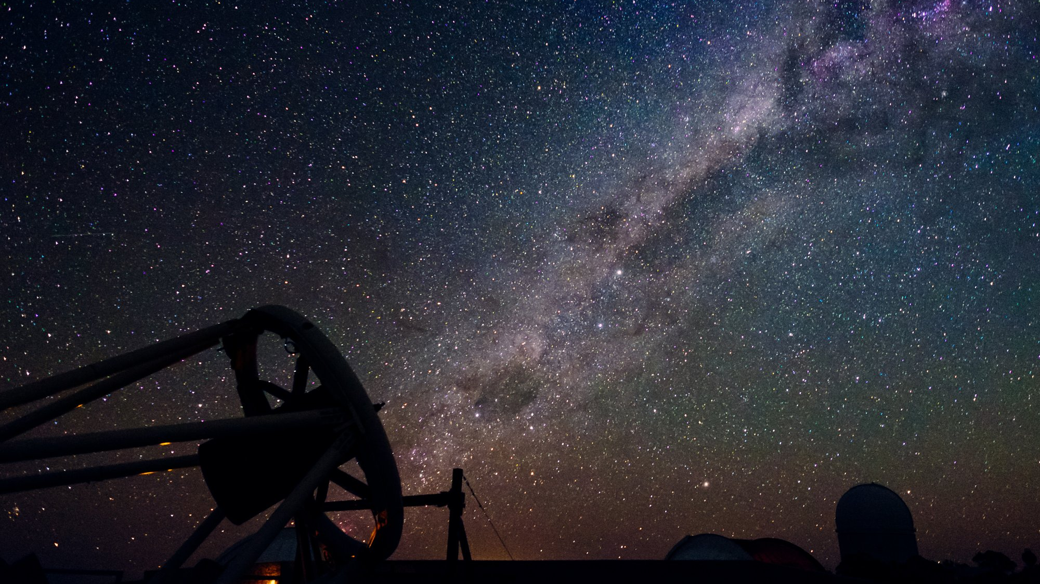
Introduction to LaSciL
Large Scientific Infrastructures enriching online and digital Learning
Maria Panagopoulou, Physicist
Research and Development Department, Ellinogermaniki Agogi
4th of July, LaSciL summer school

Slide 2
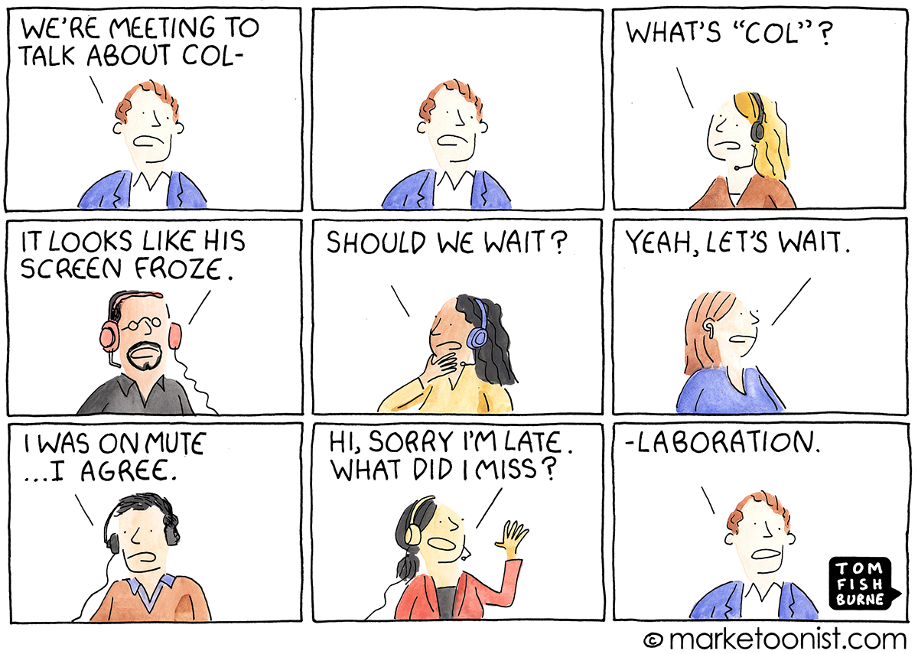
Teaching during Covid-19
Educators not prepared for remote teaching
Hard to keep the students’ interest up
New obstacles and difficulties

Slide 3
What difficulties did you face?
https://www.mentimeter.com/app/presentation/f608ac819582cb99c077fc56b6961eb6/145d85e674ab

Slide 4
Teaching from home

Slide 5
Searching for digital tools
To connect, communicate and interact with the students
To keep them engaged
To implement laboratory classes

Slide 6
In this context
How can we support teachers?
How can we increase students’ interest for science?
What digital tools can we use and how do they work?

Slide 7
Large Scientific Infrastructures enriching online and digital Learning

Slide 8
Acts on these questions by…
Bringing together Large Scientific Infrastructures in Astronomy, schools, educational research and teacher training institutions
Collecting educational resources and tools for introducing Astronomy to the classroom
Producing and cocreating educational material focused on Astronomy and strongly connected to the school curriculum
Utilizing robotic telescopes, real data and scientific inquiry to make students familiar with scientific practices and give them the opportunity to observe the sky through real research infrastructures

Slide 9
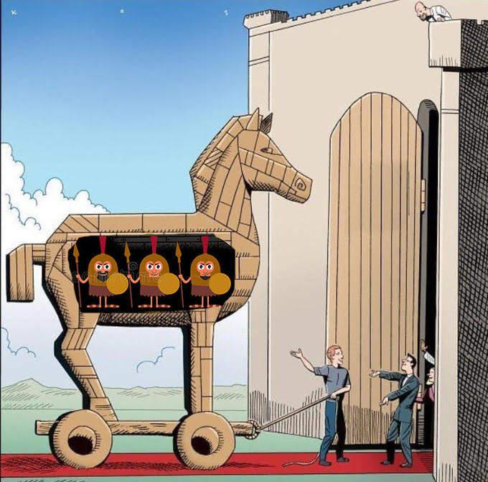
Why Astronomy?

Slide 10
1. The team
Bringing together Large Scientific Infrastructures in Astronomy, schools, educational research and teacher training institutions

Slide 11
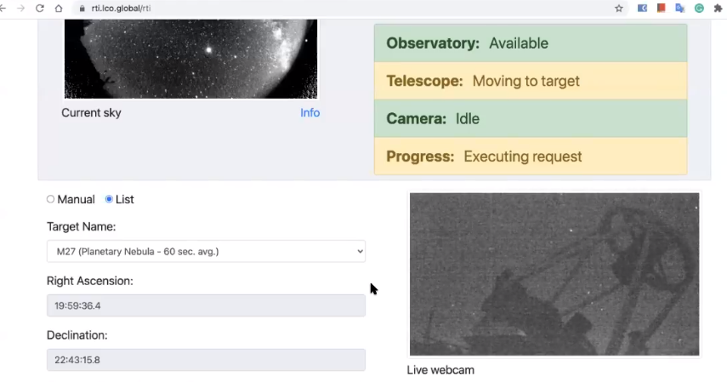
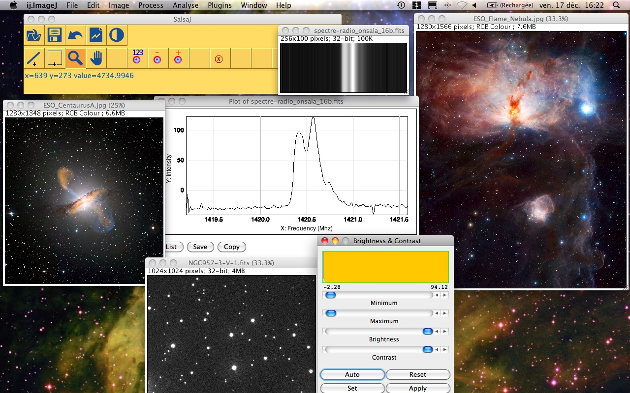
2. Tool collection
Collecting educational resources and tools for introducing Astronomy to the classroom

Slide 12
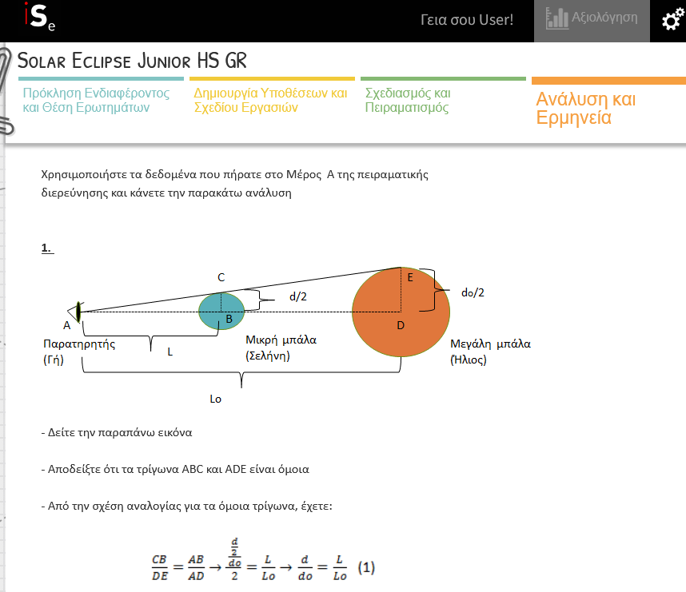
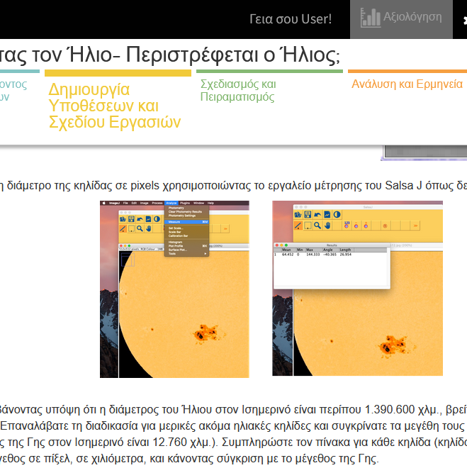
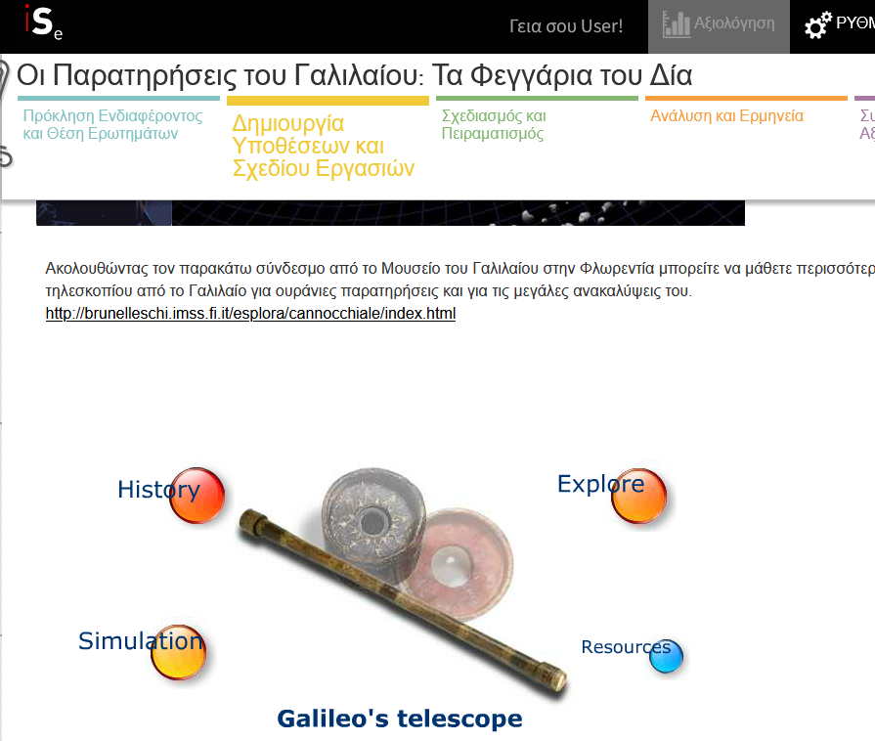
3. Creating open educational material
Producing and cocreating educational material focused on Astronomy and strongly connected to the school curriculum

Slide 13
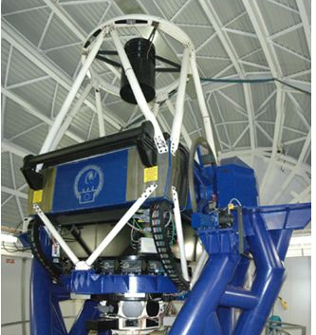
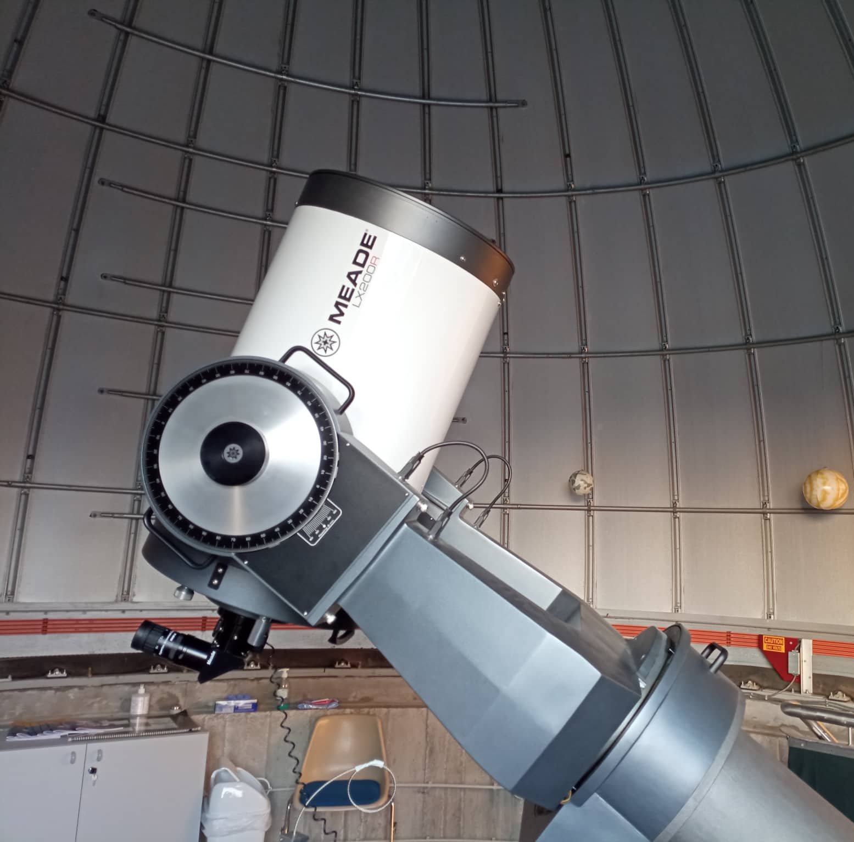
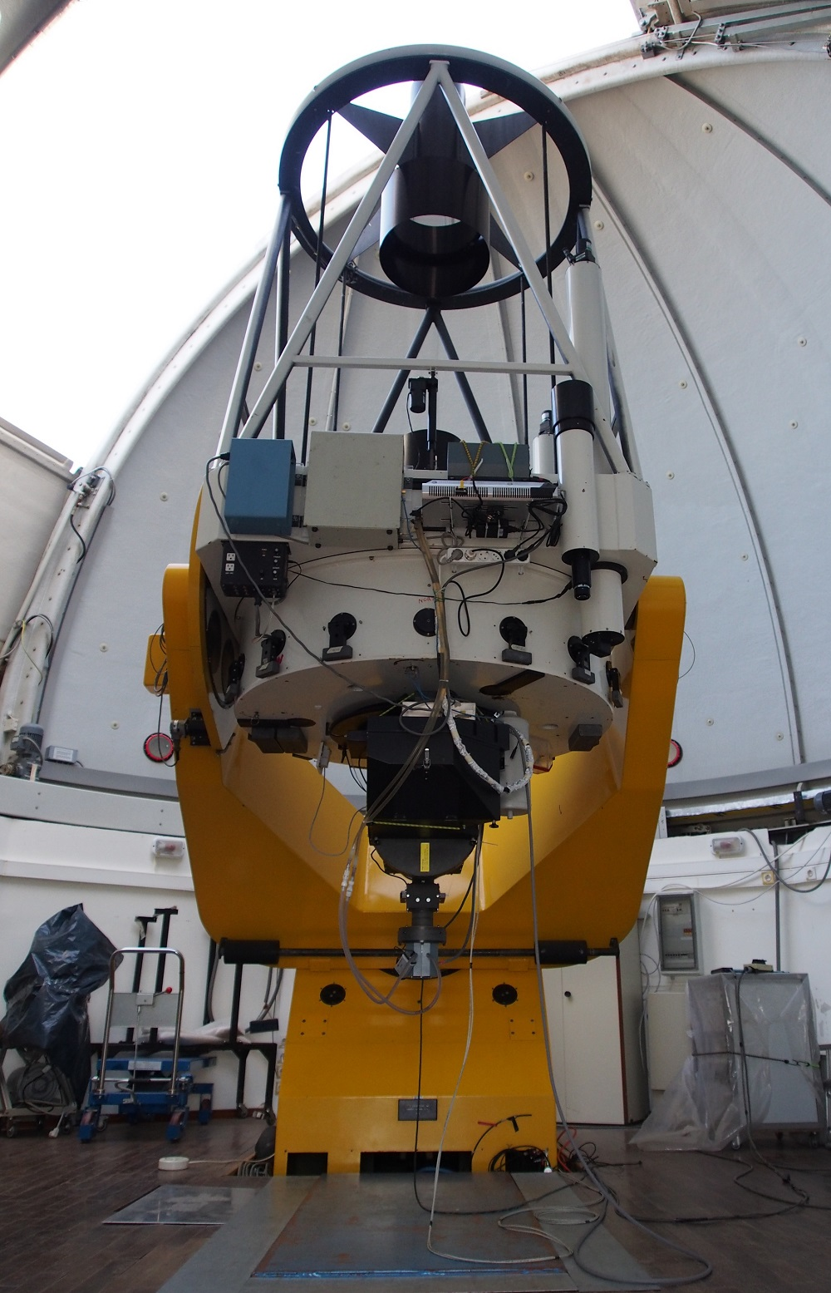
4. Telescopes

Slide 14
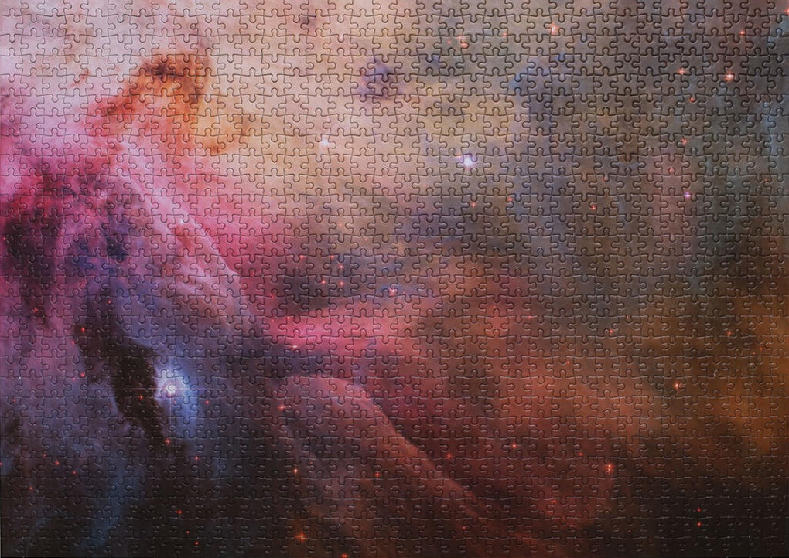
Connecting the pieces

Slide 15
Creating your own educational scenario

Slide 16
We are here to support you

Slide 17
Hero teachers

