Slide 1
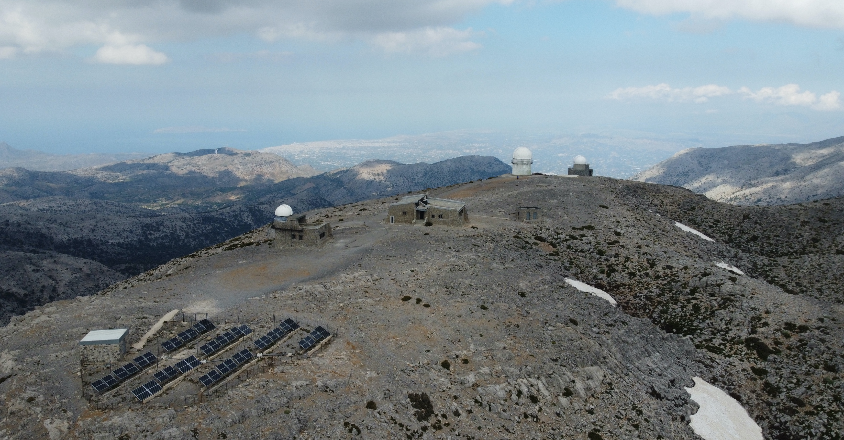
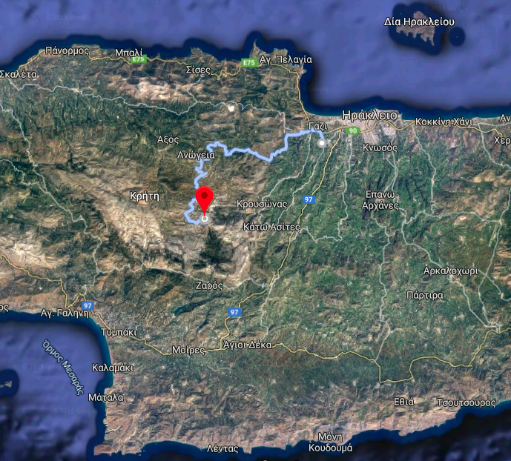
1.3m telescope
New dome for 1.0-m telescope
to be named “200+”
Ioannis Papamastorakis
guest house
0.3m telescope
Photovoltaic park
Gasoline
Generators

Slide 2
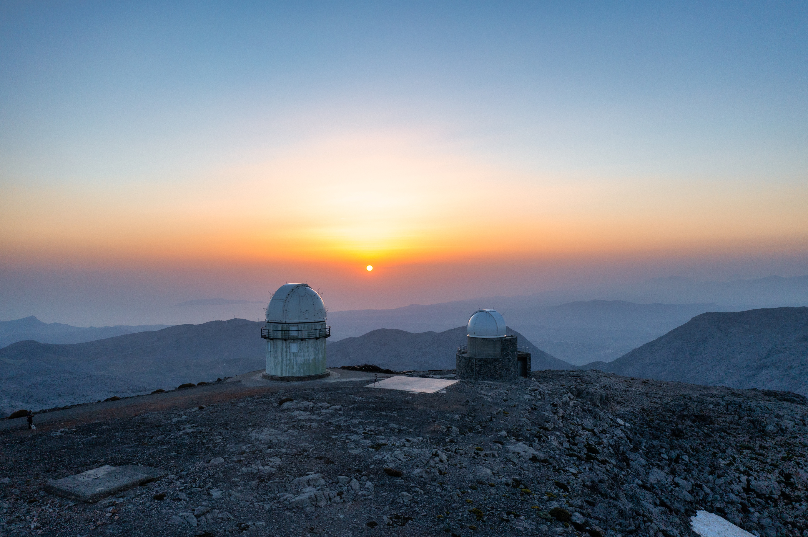
IA-FORTH: The sky is not our limit…
A bright future for Astrophysics in Greece

