Slide 1




Best practices from the
European project FRONTIERS on science outreach and education
during the pandemic and beyond.
Emmanuel Chaniotakis
Research and Development Department
Ellinogermaniki Agogi, Greece
FRONTIERS Summer School, 12- 16 July 2021

Slide 2
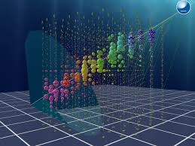
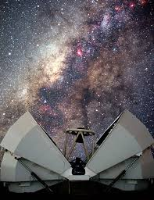
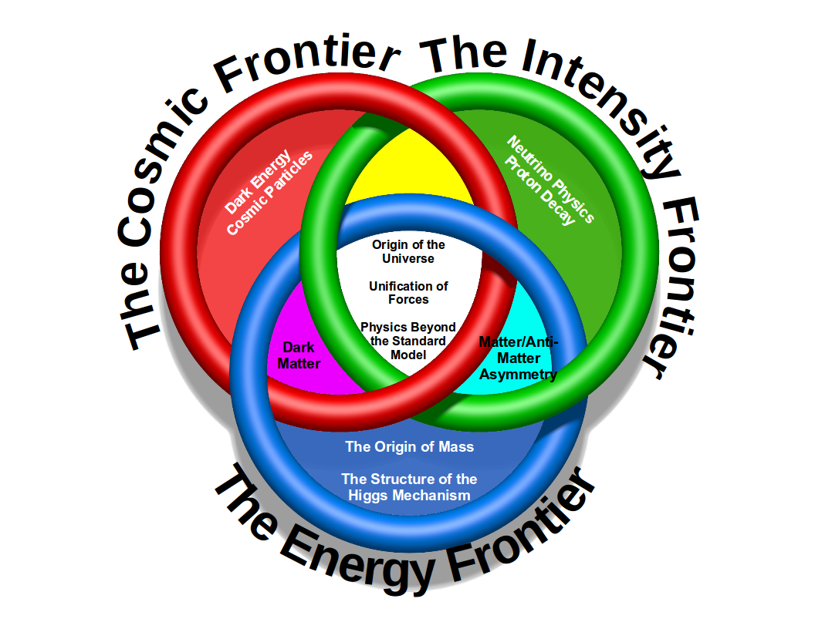
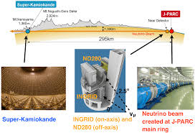
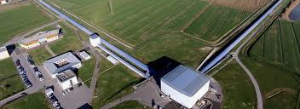
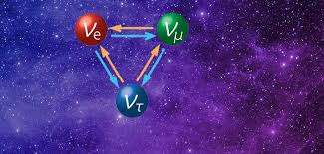
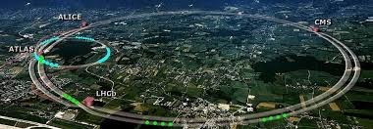
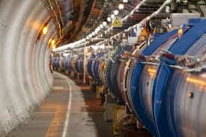
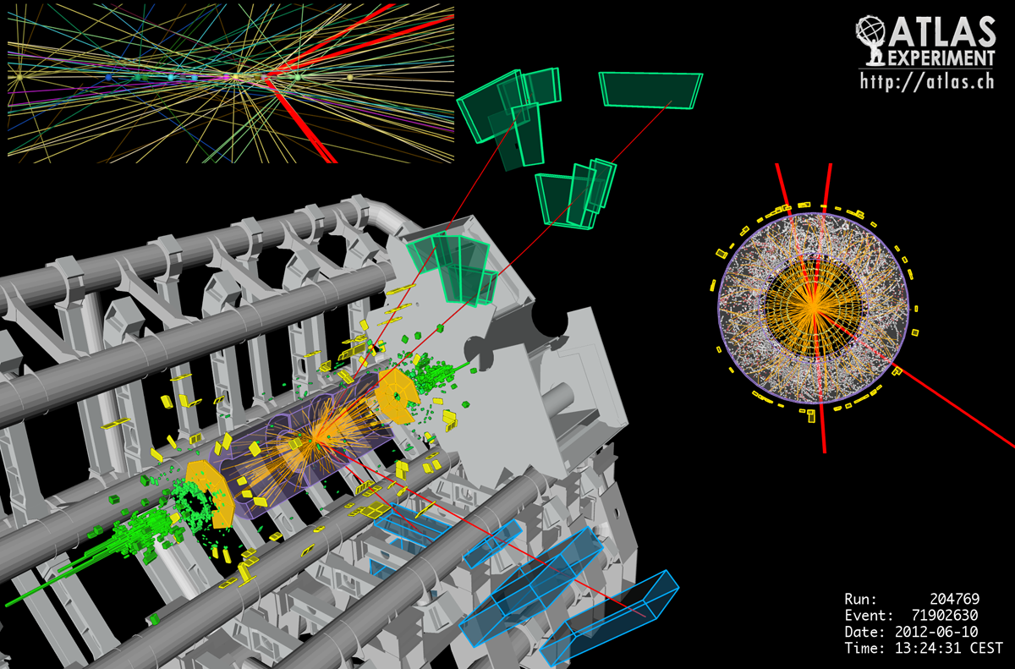
FRONTIERS in fundamental physics

Slide 3




bringing together research and educational institutions from all over Europe
is an EU funded project
Scientific Research
Science Education
Teacher Training Networks and Astrophysics Outreach

Slide 4
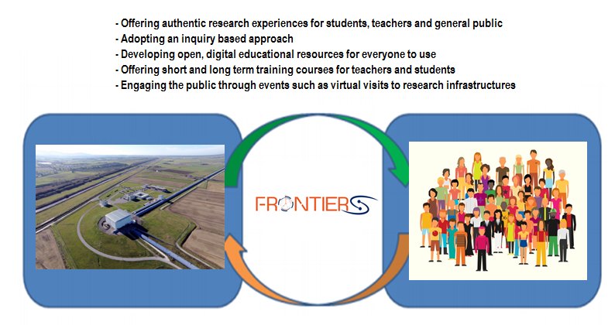
Aiming to bridge the gap between frontier science and education as well as society
Offering authentic research experience for students, teachers, and the general public.
Adopting an inquiry based approach.
Developing open, digital educational resources for everyone to use.
Creating and supporting national and international communities.
Offering short and long term courses for teachers and students.
Engaging the public through events such as Virtual Visits to Research Infrastructure.
The FRONTIERS tool-kit

Slide 5
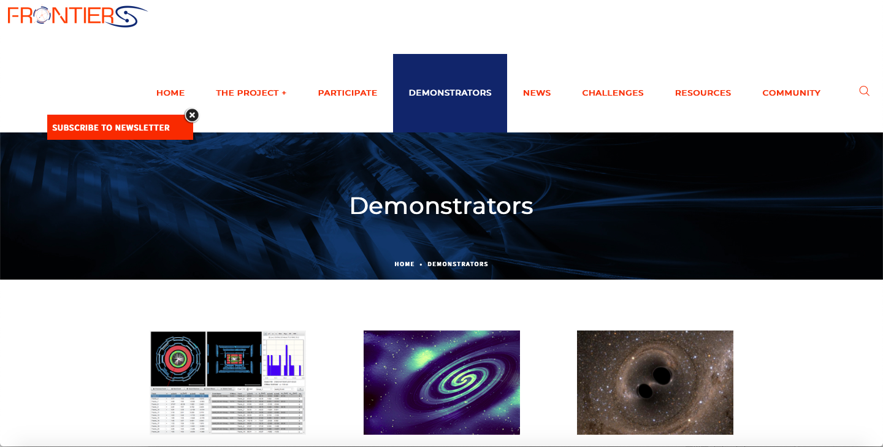
The Demonstrators
  21 pedagogical scenarios for secondary school+ Activities developed by teachers trained by the FRONTIERS team
  Fully online ready to use in 5 different languages.
  Follow an inquiry methodology.
  Free, open source, completely editable and adaptable.
http://www.frontiers-project.eu/demonstrators/

Slide 6
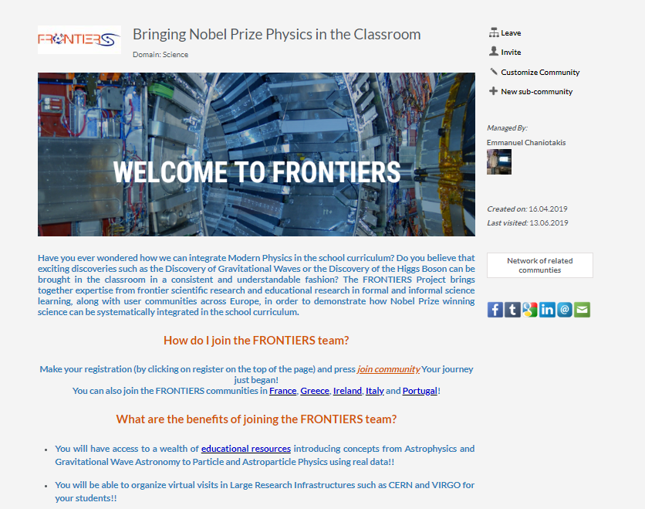
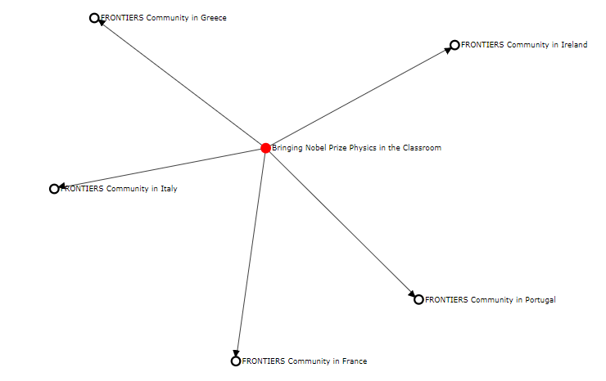
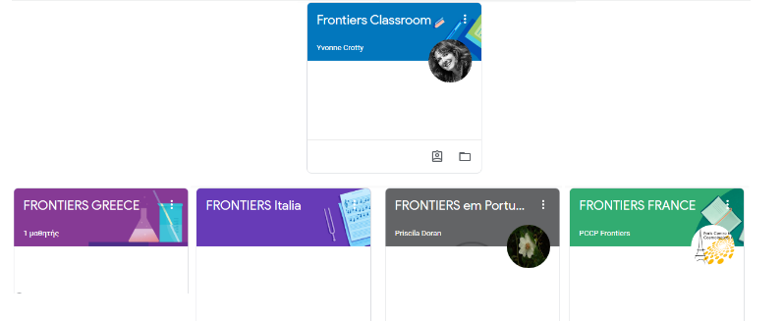
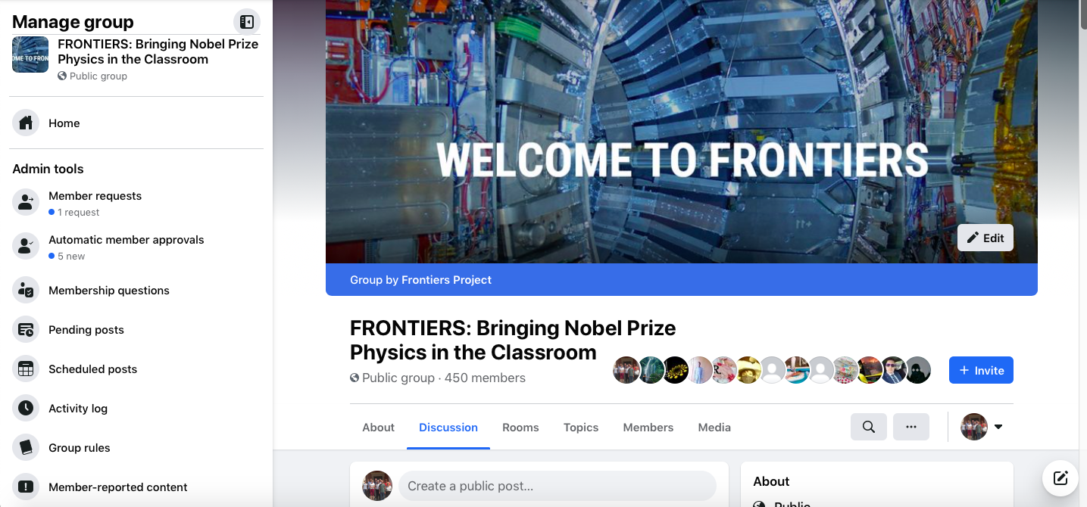
Developing national and international communities

Slide 7
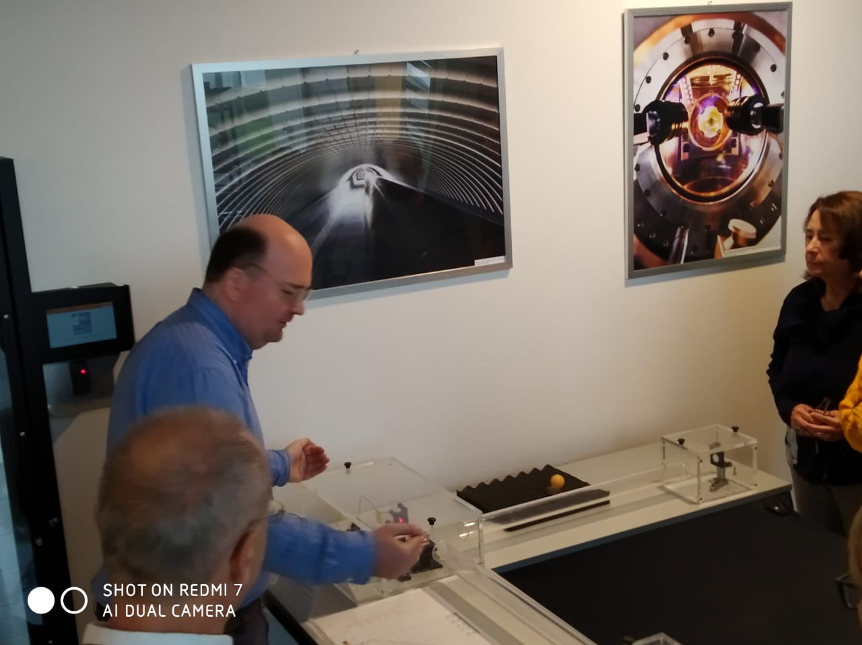
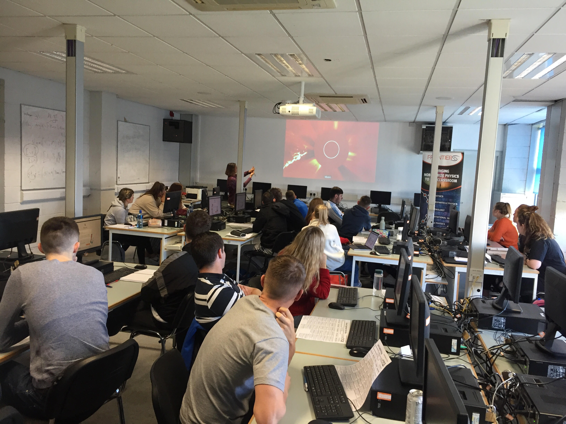
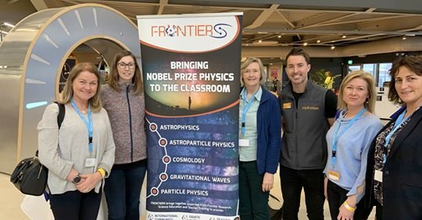
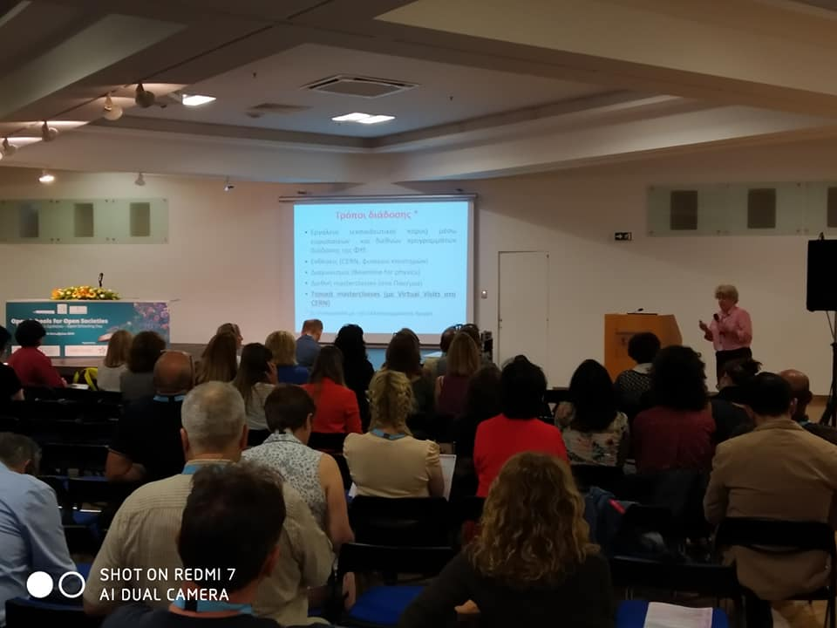
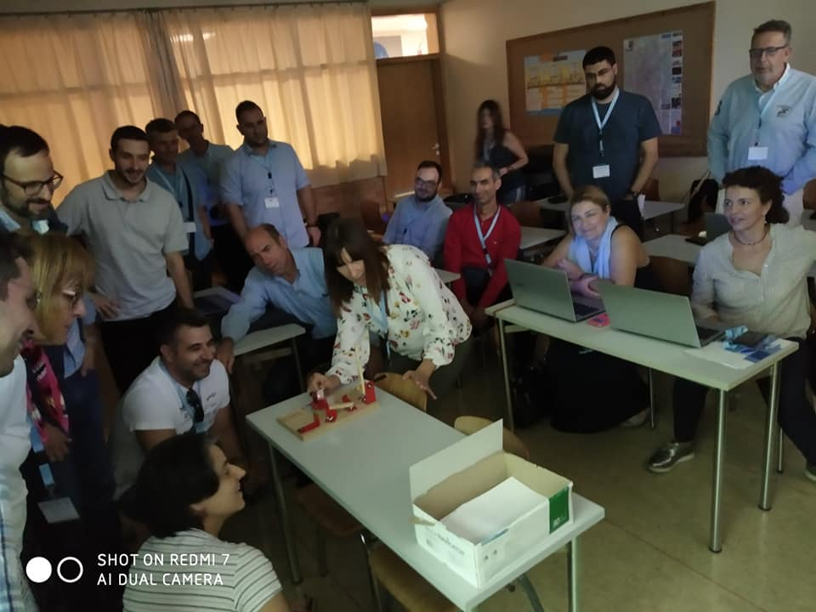
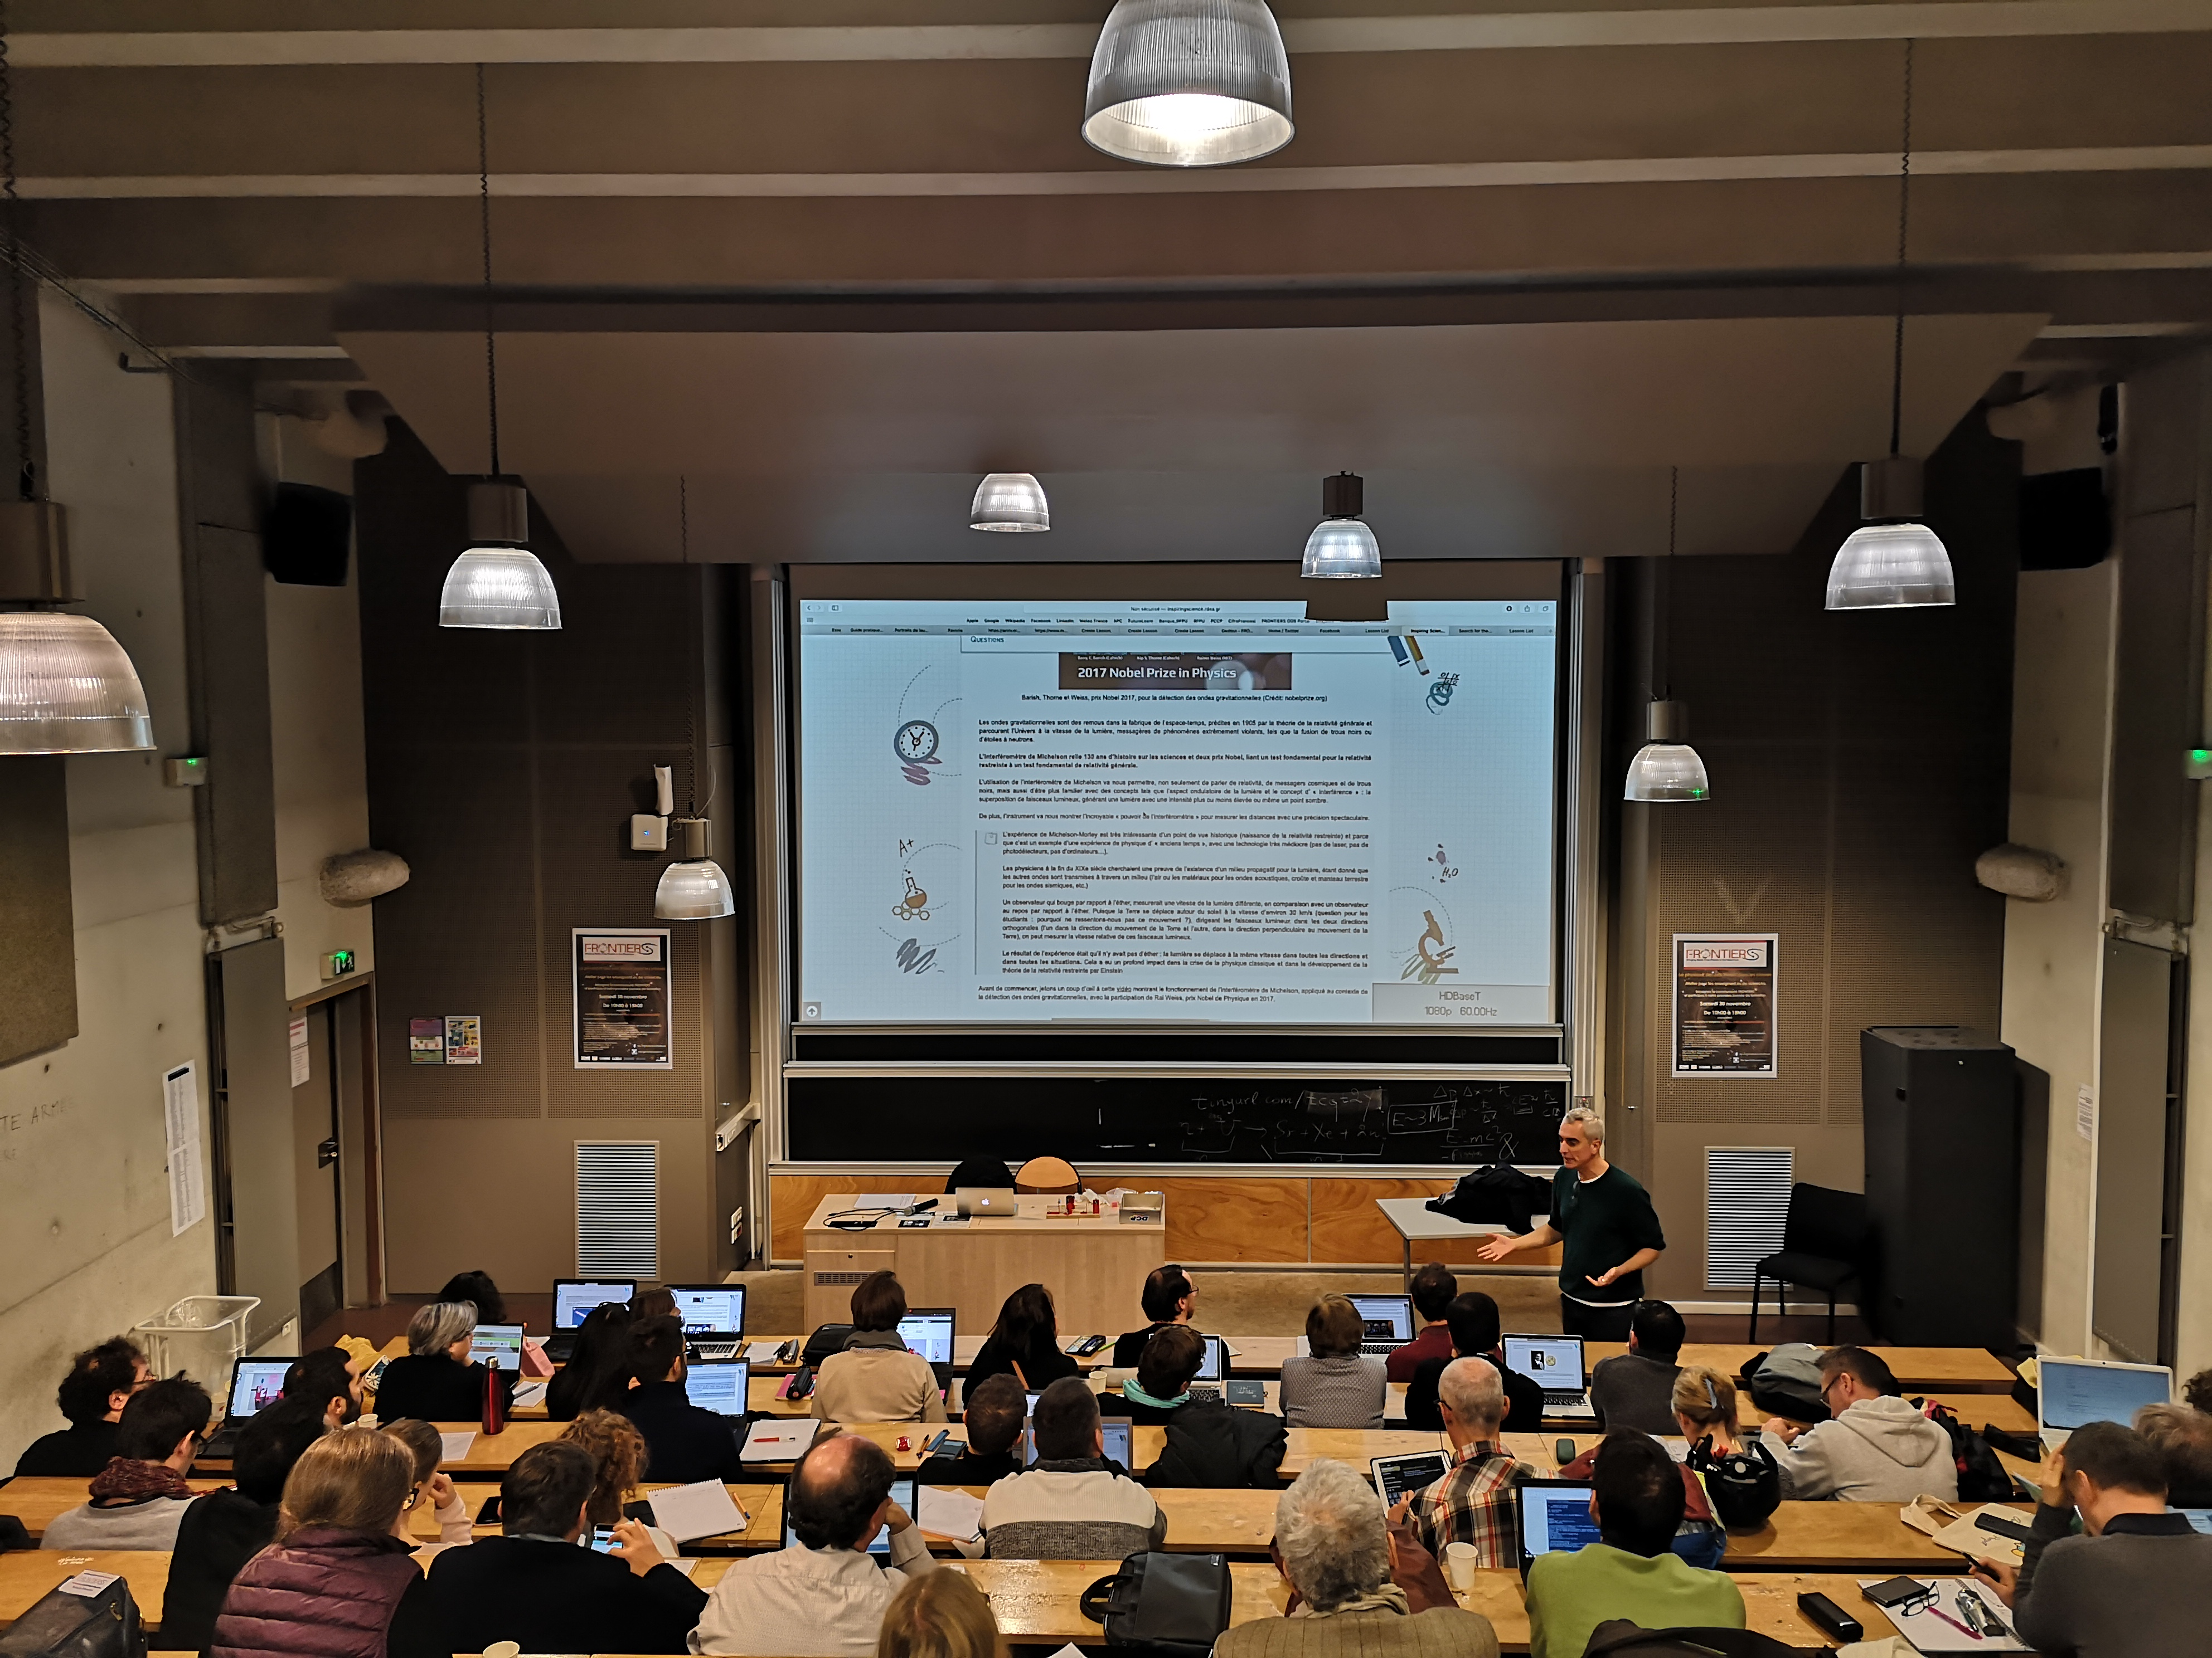
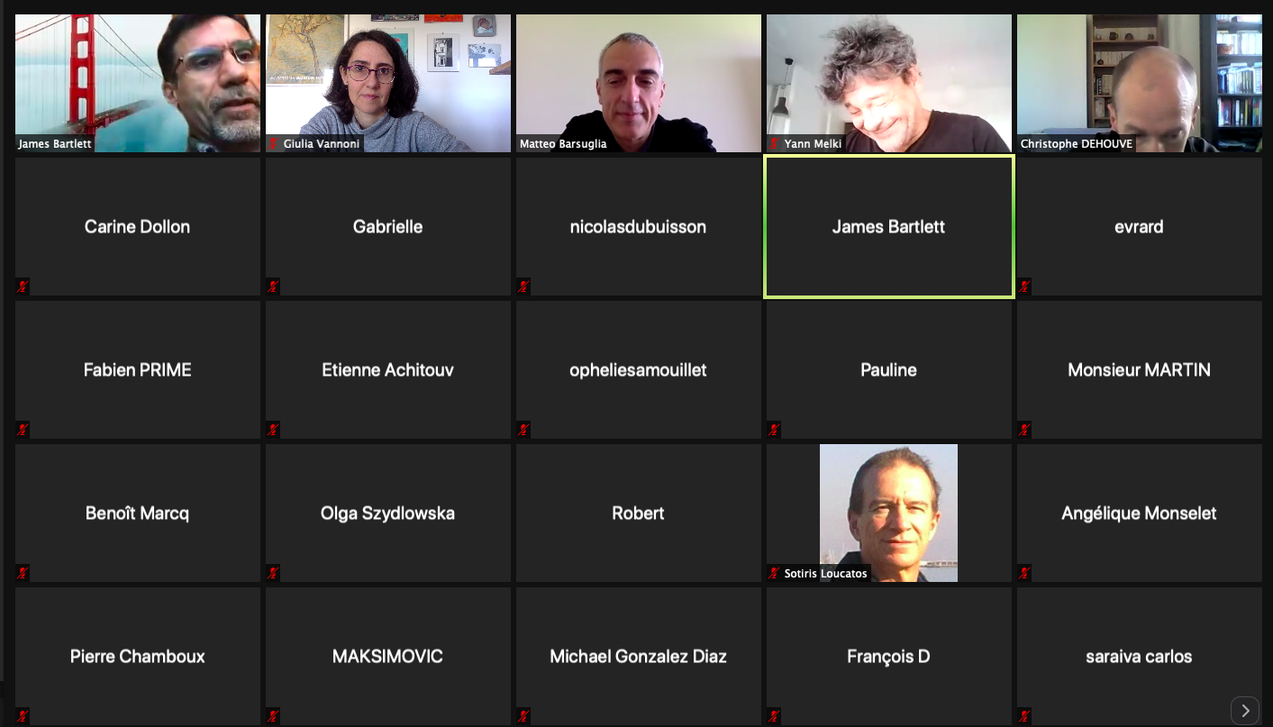
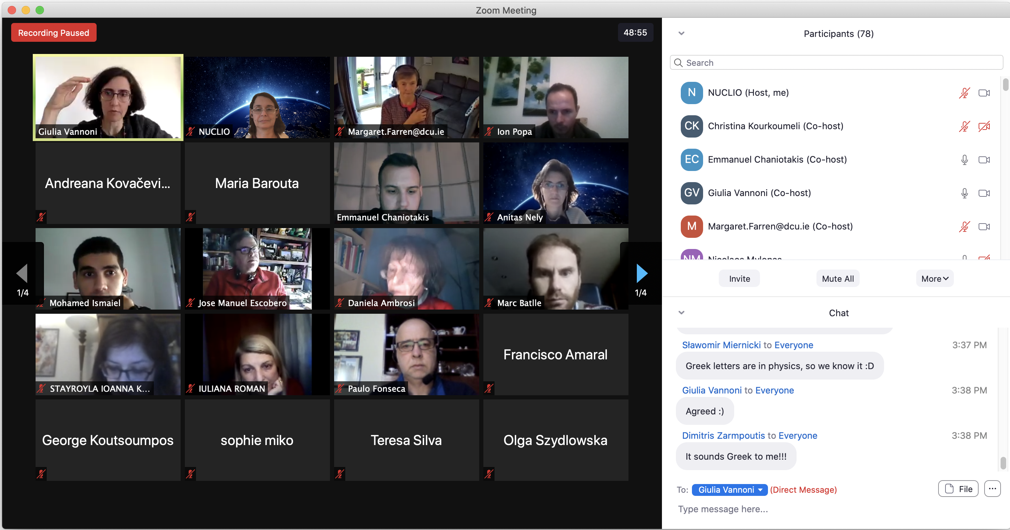
Training and support
  Year-round training workshops for continuous professional development
Pre-COVID
During the pandemic

Slide 8
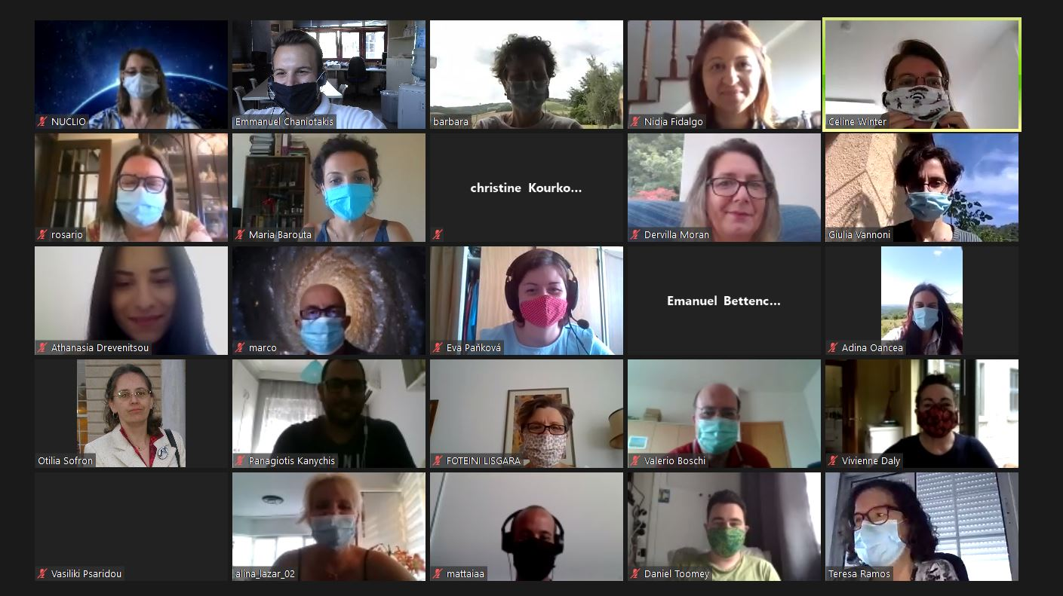
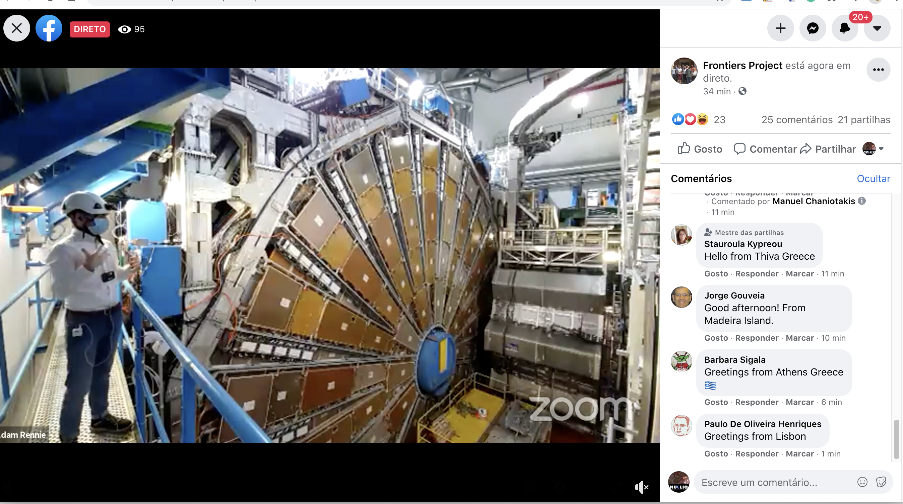
Training and support
  International online Schools
+FRONTIERS Summer School 2021
E-Summer School :
13 – 24 July 2020
https://indico.ego-gw.it/event/73/timetable/
E-Winter School :
29 Jannuary – 7 February 2021
https://indico.ego-gw.it/event/133/timetable/

Slide 9
Example:
E-Winter School
206 registered participants from India to Chile.
Peaks of over 80 participants simultaneously connected on Zoom.
34 participants to Working Groups.
9 new pedagogical scenarios produced.
Over 4 000 people reached on Facebook over the first weekend.
  Training forced to transfer online by pandemic:
  Challenge won: high attendance, effectiveness unaffected.
  Opened up new possibilities → local to global participation.
            → offering access to RIs around the World.

Slide 10
Example of best practices for students:
Virtual Visits for Students

Slide 11
In a nutshell
7 visits from April 20th 2021 – May 25th 2021
24 schools
Greece (15); Italy (2); Romania (2); France (1); Pakistan (1); Portugal (1); Bangladesh (1); Austria (1)
More than 500 students
Mainly High school, also 1 primary school and 1 kindergarten
101 Students answered pre- post questionnaires before and after visit, answered polls during visit, asked chat questions and some of them created follow-up videos to explain gravitational waves on their own. Teachers submitted reports with observations.
Notes:
Add infographic

Slide 12

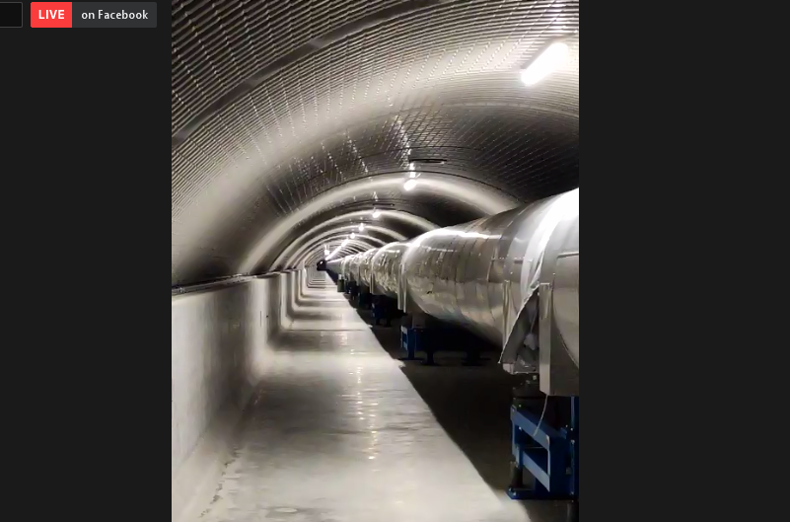
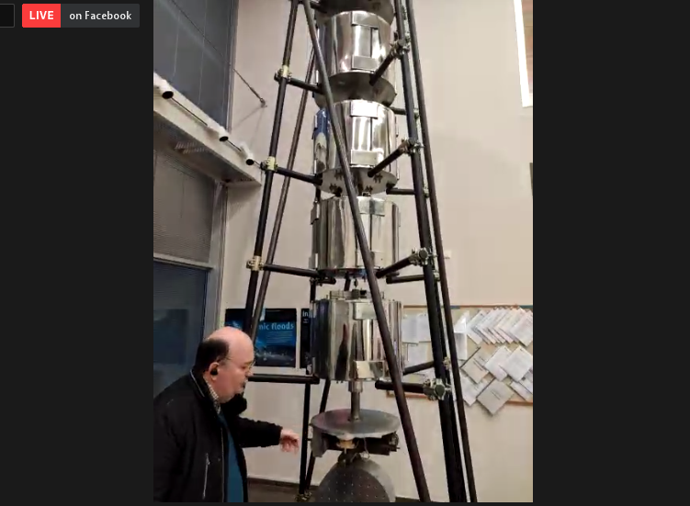
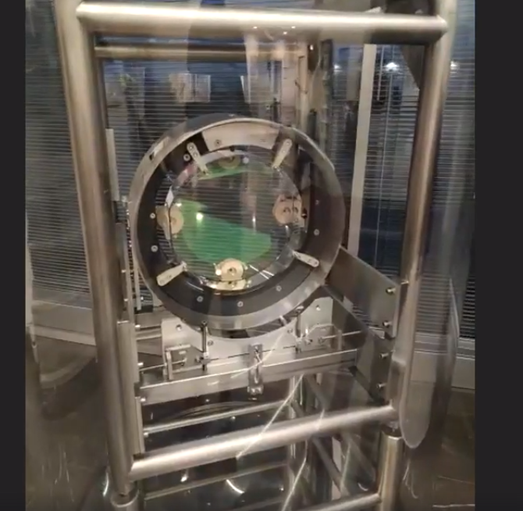
Virtual Visits to RIs

Slide 13
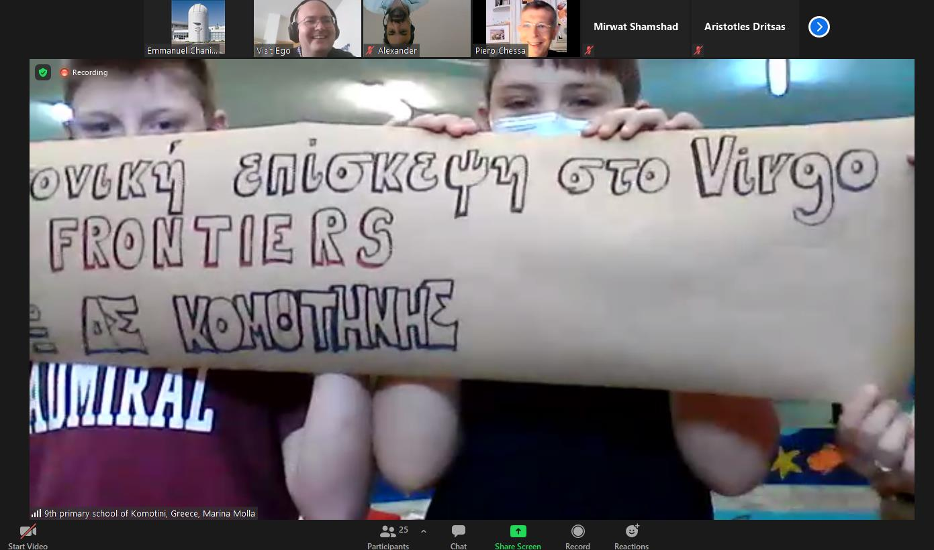

Slide 14
What did the students think?

Slide 15
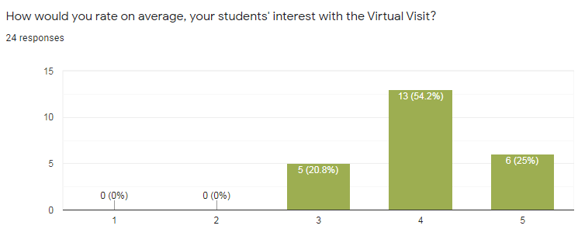
How teachers rate their students’ interest with the visit

Slide 16
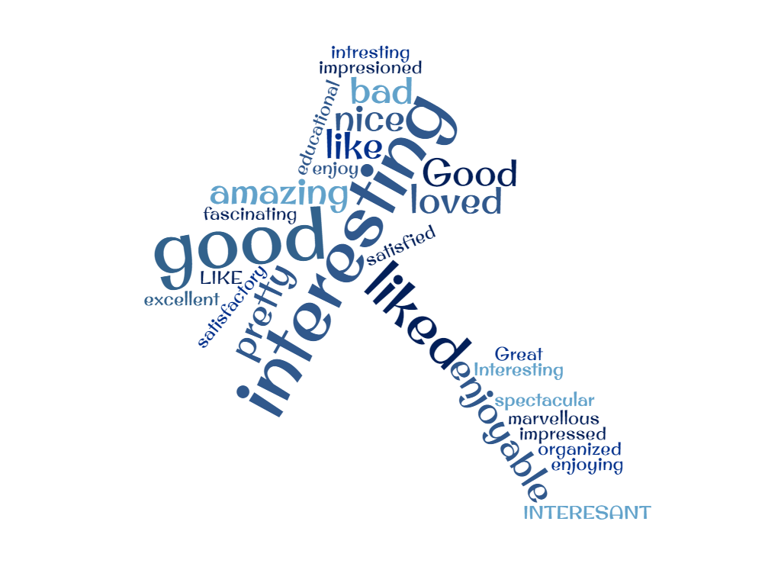
What are your overall impressions of the Virtual Visit? (N=60)

Slide 18
Highlights from students’ comments
“It was an amazing experience, one that I enjoyed immensely. It was extremely informative and I learned a lot from it. The teachers also did a marvellous job explaining the topic.”
“Very sympathetic, well-educated people who enjoy passing on their knowledge. It was incredible seeing the observatory from the inside.”
“It was pretty good and informative. Everything about the facility was very fascinating and all the questions were handled very professionally, catering all aspects of the answer. However, a little understanding issues were faced because of the different accent of the speaker. Other than that the whole visit was very helpful and gave a great insight of the internal working of the facility.”
“It was a very nice effort and I really appreciated the ‘meraki’ (passion) of the presenters, because they didn’t show any kind of indifference and were constantly asking if there are questions, which shows interest from their part.“

Slide 19
What did the students learn?
(Findings from 100 high school students)

Slide 21
0 10 20 30 40 50 60 70 80

Slide 22
5
4
3
2
1

Slide 23
How would you explain gravitational waves to a friend?
60% of students report that they don’t know/remember (26) or copy and paste google based answers (35).
Students more interested in Physics seem to display better learning regarding GWs
Students still have a Newtonian (or pre-Newtonian) worldview regarding gravity.
We have a significant increase in students’ confidence to explain gravitational waves to a friend of theirs.

Slide 24
COMMENTS
We conclude that the virtual visit can help inspire students to explore further, gain familiarity with concepts or be able to participate in a discussion.
As General Relativity is beyond the scope of school curricula in the countries addressed here, we believe that knowledge acquisition about GR is superficial.
In order to provide in depth knowledge acquisition, visits need to be coupled with workshops for students. Furthermore, visits should take place after an introduction to Gravity and Spacetime as students (95%) don’t explain gravity in a different fashion before and after the visit.

Slide 25
Draw a research lab and a scientist
(12 primary school students before and after visit)

Slide 26
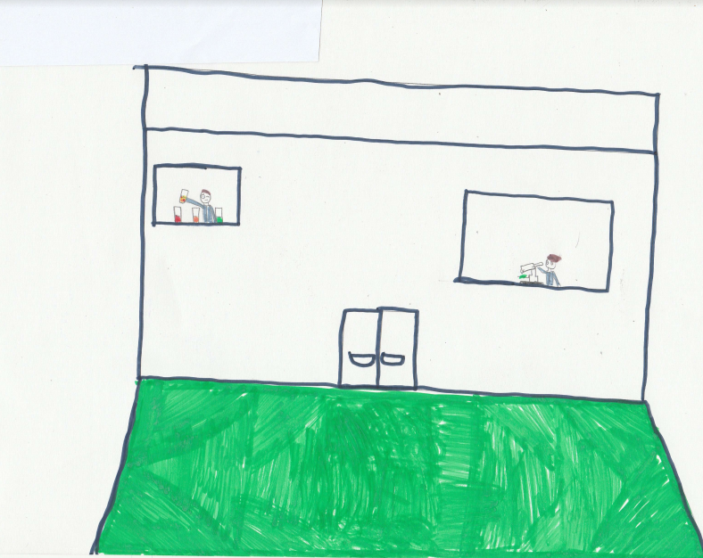
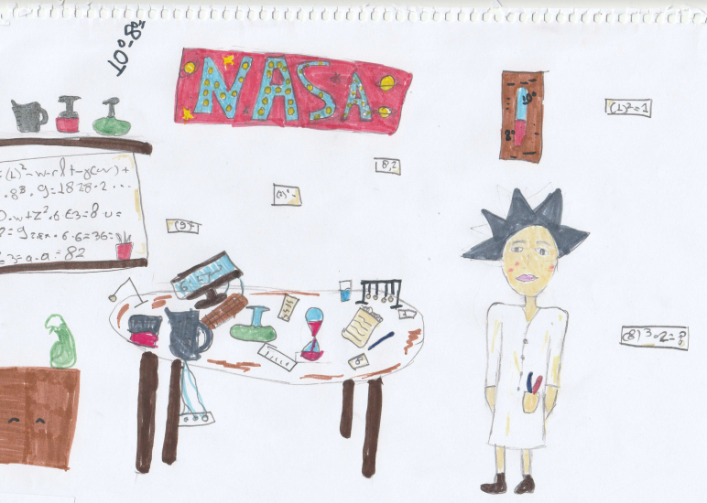
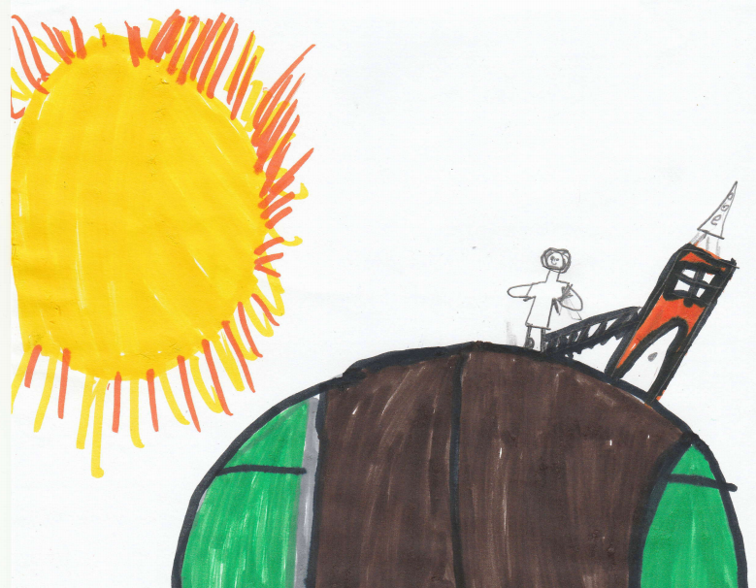
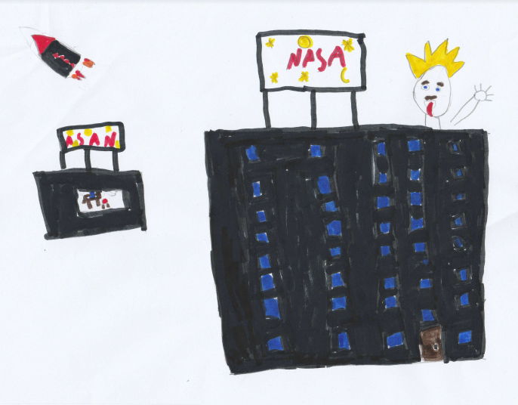
Before visit

Slide 27
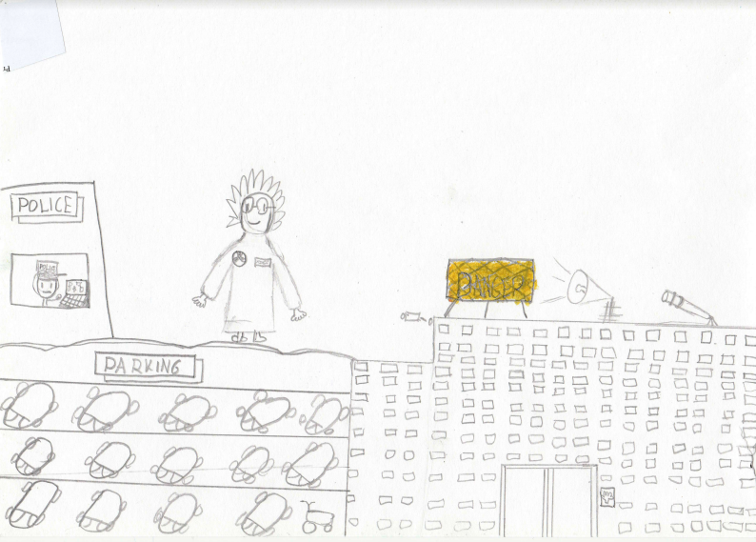
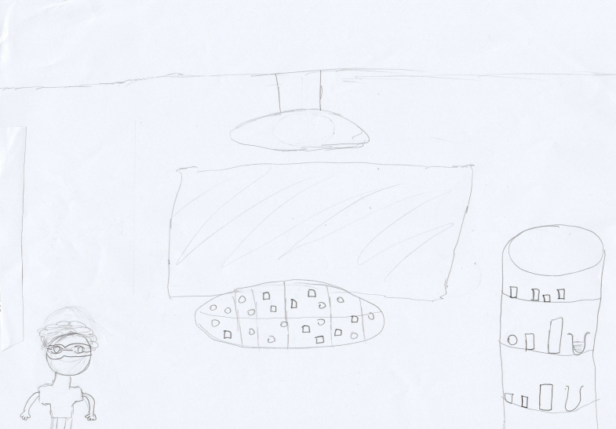
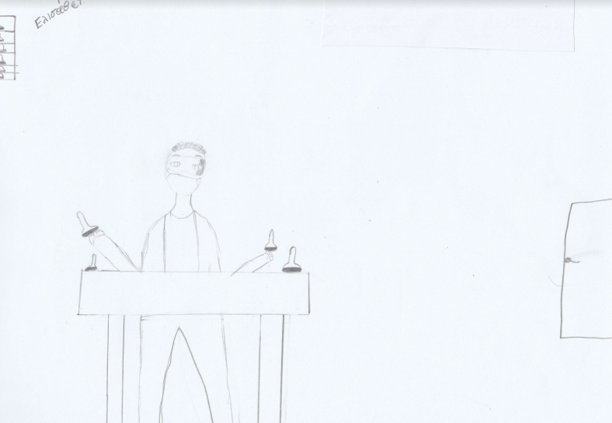
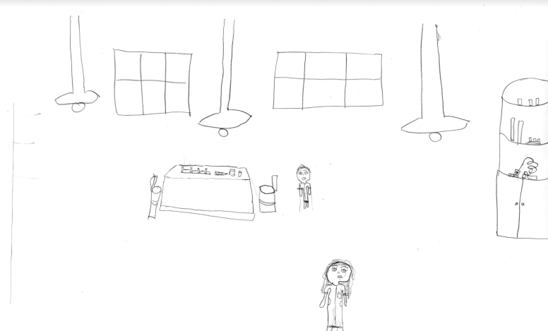

Slide 28
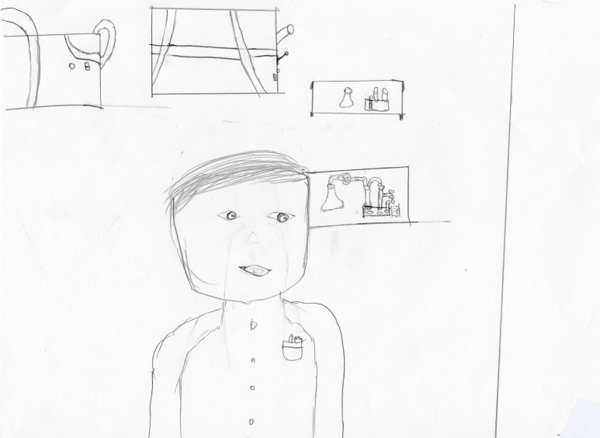
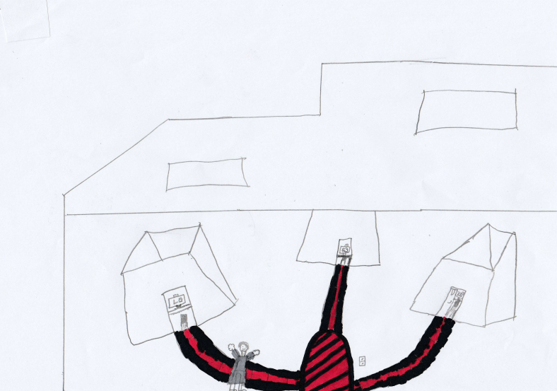

Slide 29
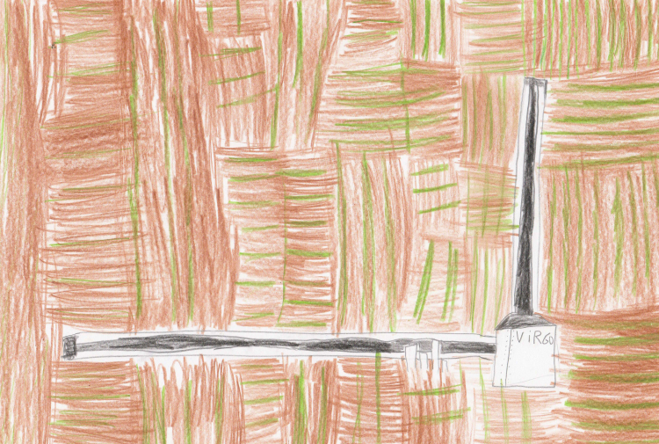
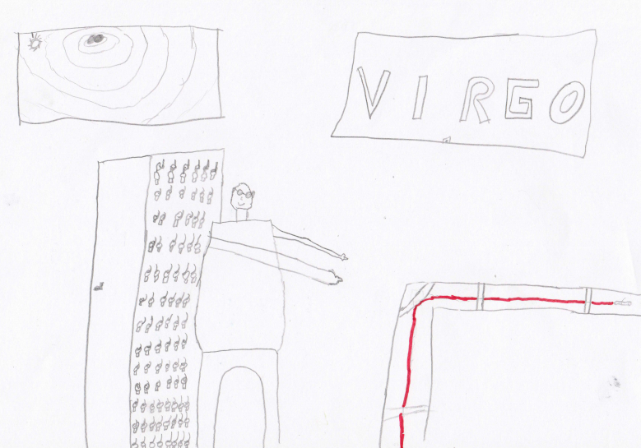
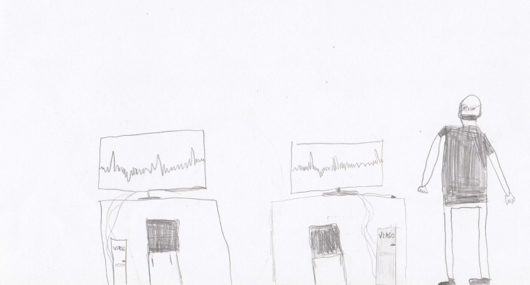
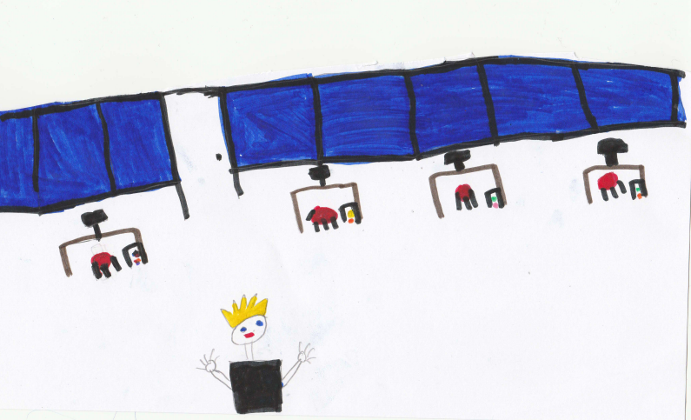
After visit

Slide 30
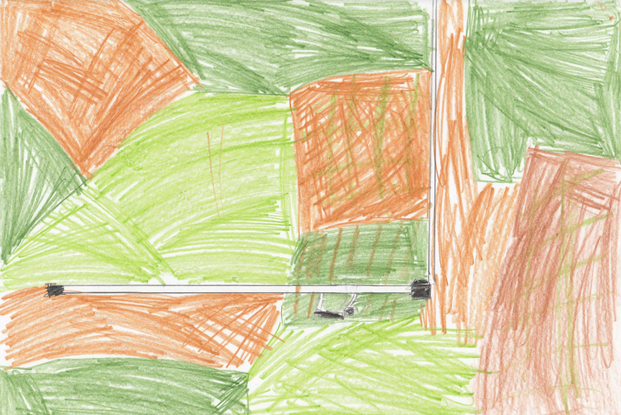
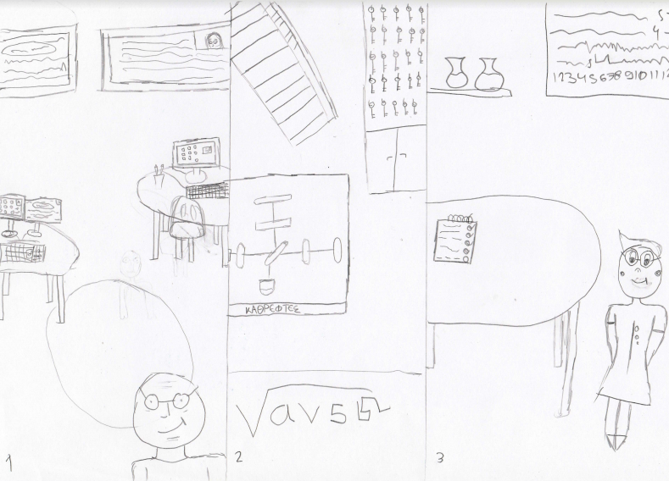
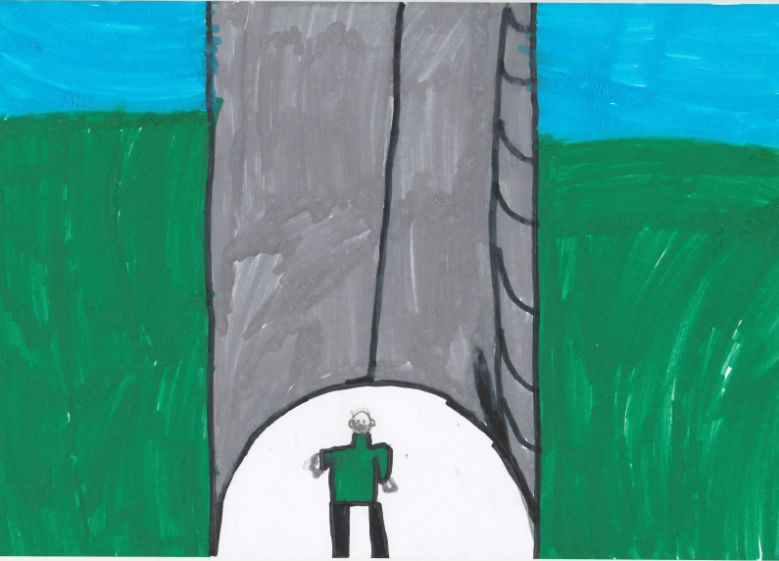
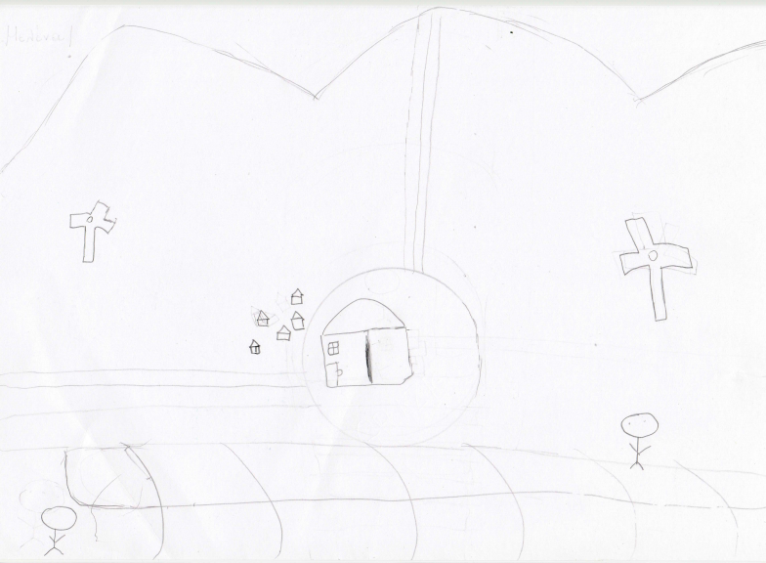

Slide 31
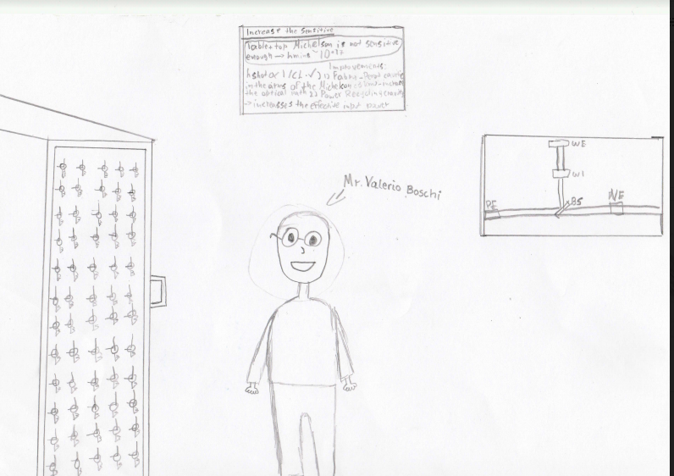


Slide 32
Comments
Even though GWs are far beyond the grasp of primary school students, their feedback and drawings indicate that they are able to understand what a research lab looks like, and they get impressions by the scientists involved in the visit.
For primary school students, an “enculturation” visit would be more appropriate: to show them what a research lab looks like.
Primary students were impressed by the fact that their questions were answered and we were accessible. They considered it as proof that we care for them. It seems that the benefits for primary students lie more in the affective domain.

Slide 33
High School Students’ follow up video projects. Selected videos

Slide 34

Student Abeeha Hussain from the School of Astronomy and Physics by Mirwat Uzair, in Pakistan https://www.youtube.com/watch?v=E4Mz2N9nRzU

Slide 35

Students from the 4th High School of Kallithea, Greece discuss Gravitational Waves and their detection. https://www.youtube.com/watch?v=AyKyAU3t5Uk

Slide 36
Conclusions
  FRONTIERS is an education-oriented project with a strong outreach impact. Best practices such as the selected virtual visits presented here attest to that.
  More than 20 teacher training workshops, 30 activities, 2 e-Summer Schools, 1 e-Winter School, engaging more than 700 teachers worldwide.
  Many activities in the classroom even in the covid era.
  Already begun co-organising virtual visits to the Virgo Gravitational Wave detector for European students. Will soon co-organise visits to other large RIs.

Slide 37
Many thanks to
The outreach teams of EGO-Virgo, ATLAS experiment and Pierre Auger Observatory for offering us the opportunity to co-organize these visits.
REINFORCE EU project and ESIA for their support.

Slide 38
Thank you for your attention!
  For further details visit:
  FRONTIERS website:
  www.frontiers-project.eu
  Facebook page:
  https://www.facebook.com/frontierseu
  Facebook group :
  https://www.facebook.com/groups/665957563876838/
  Twitter :
  https://twitter.com/FrontiersProj
  Don’t hesitate to contact us : info@frontiers-project.eu

