Slide 1


Demonstrators & Inquiry based approach
Dr. Margaret Farren, Dr. Yvonne Crotty, Joann Dempsey,
School of STEM Education, Innovation and Global Studies,
Dublin City University Institute of Education,
Ireland.
Date: Monday 12th July 2021

Slide 2

http://www.frontiers-project.eu/

Slide 3

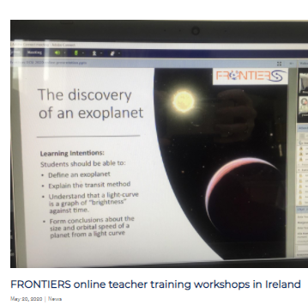
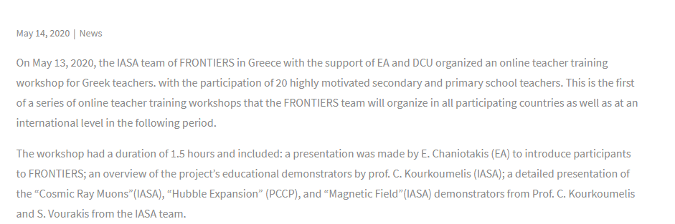

Slide 4
Demonstrators
…a series of innovative learning activities for teachers and students.
Astrophysics & Cosmology
High Energy
Physics
Gravitational Waves & Astronomy
Astroparticle
Physics
Notes:
Photo by Katerina Bartosova on Unsplash

Slide 5
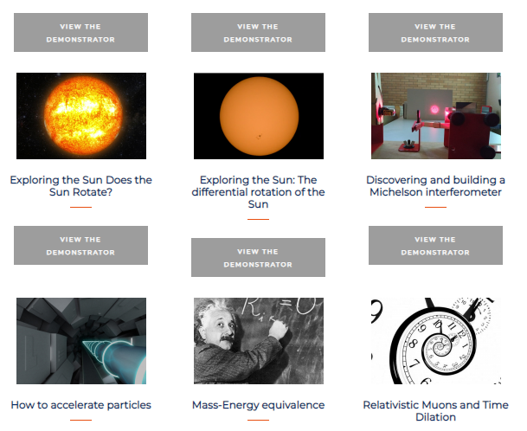
http://www.frontiers-project.eu/demonstrators/

Slide 6
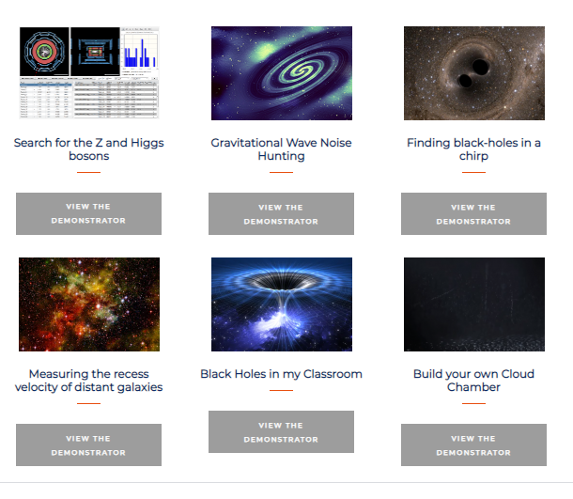
http://www.frontiers-project.eu/demonstrators

Slide 7
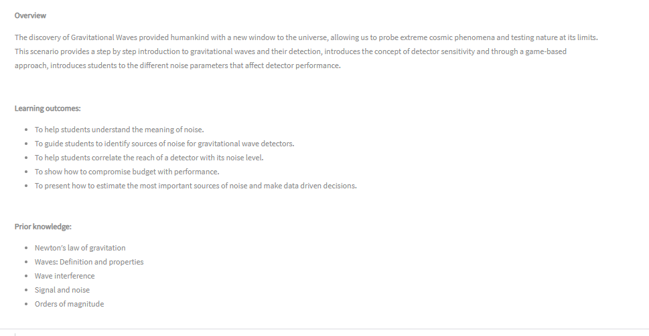


Slide 8
The FRONTIERS
5-step inquiry approach.
Orientating and Asking Questions
Conclusion and Evaluation
Hypothesis Generation and Design
Analysis and Interpretation
Planning and Investigation
Notes:
5-step Inquiry Model
It enables teachers to divide any science topic on the syllabus into five distinct inquiry based learning activities.

Slide 9
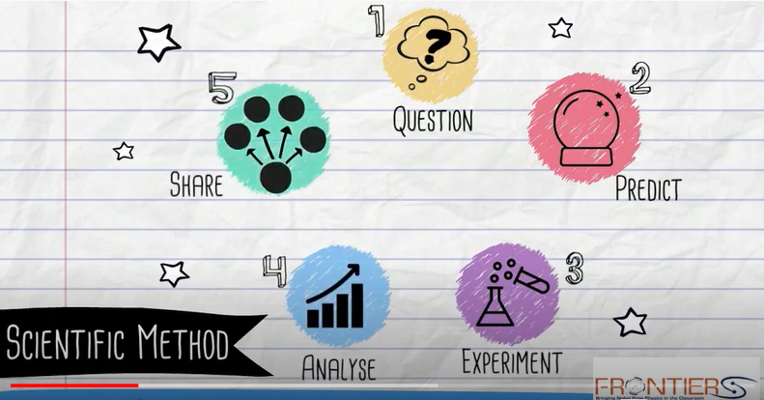
https://www.youtube.com/watch?v=aMjmowIBrOg

Slide 10
Students generate questions to investigate.
Students observe, ask questions and report on their discoveries.
Students extend their present understanding.
Orientating and Asking Questions
The teacher initiates students’ interest.
Teacher assess students’ prior knowledge.
Notes:
Orientating and Asking Questions
The teacher initiates students’ interest.
In this learning activity the teacher plays a very important role in engaging students’ interest, by open class discussions, attention grabbing videos that students can relate to.
These can be used as a springboard for discussions.
Teacher starts the lesson by stimulating the curiosity of the student with open-ended questions or demonstrations as opposed to starting the lesson with a definition or explanation.
The teacher generates productive dialogue to motivate students to formulate their own scientifically oriented questions.
The science or maths teacher asks students questions that require them to reason, reflect and explain.
Teacher assesses students’ prior knowledge.
The teacher basically promotes dialogue to active prior knowledge.
By engaging in classroom discussions the teacher assesses students prior knowledge and adjust the classes learning activities.
It is important to activate prior knowledge so that new learning will be linked to existing knowledge.
Teachers encourage students to observe, ask questions, find answers and report on their discoveries within the parameters of their classroom goals
This learning activity focuses on students answering their own questions by exploring and manipulating resources provided by their teacher.
The teacher divides the class into groups to encourage collaborative and corporative learning.
Each group will search for information and document their findings.
The teachers can prepare a worksheet with inquiry questions to guide the students in their exploration.
Teacher will monitor students as they explore scientific problems and questions using the resources provided.
Students document and collect information to supplement their prior knowledge about the topic. They also identify limitations, barriers and constraints to their research questions.
Teacher encourages students to document their findings and uses this as a means to assess their progress and needs of the learner.
Students generate questions to investigate.
Teacher provides opportunities and resources, inquiry tools for students to explore and formulate research questions.
Students research and process information.
Students identify problems to be solved.
Students extend their present understanding.
Teachers provide opportunities and resources for students to extend their thinking.
In order for students to develop questions that can be investigated this activity must allow them time to explore resources related to the topic.
Teacher moves throughout the room providing limited assistance to ensure students do not become too frustrated.
Teacher continually monitors and observes students and intervenes only when needed.

Slide 11
Hypothesis Generation and Design
Planning and Investigation
Analysis and Interpretation
Teacher encourages students to formulate a hypothesis.
Students test their hypothesis.
Students organise and interpret collected data.
Students plan their investigations and set investigative goals.
Students examine their data to see if their hypothesis is valid.
Students make predications based on observations.
Students design an experiment.
Students collect data.
Students formulate explanations.
Notes:
Hypothesis generation and design
Teacher encourages students to formulate a hypothesis
Teacher asks the students to think of and propose a hypothesis and to set the goals of their research.
A teacher provides eLearning tools and resources to help them formulate their hypothesis.
Teacher scaffolds students as they form their research question that steer their investigation.
Teachers guide students to questions that can be answered with means at their disposal.
Guide students to reframe their questions into forms that can be investigated.
Teacher asks questions to encourage students to formulate their own hypothesis.
Students make predications based on observations.
Each group formulates a hypothesis they want to investigate using the information they gathered in first learning activity and their prior knowledge.
The students will try to link the different elements and concepts together and construct hypotheses that they can investigate.
The teacher monitors their progress and accesses their learning journals and checks all hypothesis are valid and inline with the learning objectives.
After teacher approval the students proceed to design an artifact or an experiment
Students design an experiment or artifact that is appropriate for testing their research question.
Planning and Investigation
Students test their hypothesis and plan their investigation and investigative goals
After students have formulated their hypothesis and the teacher has validated it, students can proceed to plan how to investigate their hypothesis, or test it using simulation and elearning tools.
After interaction with e Learning tools students are able to clarify their hypothesis and plan their investigation.
Teacher Guide students as they determine procedures of investigation.
Students collect data using eLearning tools, simulations, measuring equipment.
Analysis and Interpretation
Students organise and interpret collected data.
Students organize their collected data and interpret their result.
Students analysis their data for relevancy.
The teacher might suggest methods of presenting data and guide students as they interpret their results.
They examined their data to see if their hypothesis was valid.
If the results of students’ investigation do not validate their hypothesis predictions they can revisit previous learning activities to reevaluate their original idea.
Students formulate explanations.
They compare their results to real life experiences and results they might have got in a simulation in previous learning activity.
Students can compare their results with experts and other groups in the classroom.
If there is a difference in the compared results, this can lead students to generate new questions for investigations

Slide 12
Students reflect on what they have learnt.
Students share their discoveries and evidence with the class.
Teacher reflects on the inquiry process.
Conclusion and Evaluation
Notes:
Conclusion and Evaluation
Students share their discoveries and evidence with the class.
Students present and justify their result to the class.
The other students are encouraged to ask questions, give feedback and suggest alternatives.
Students reflect on what they have learnt
Teacher encourages critical reflection on what students have learnt and how this can be applied to real life.
Teacher encourages students to return to their original research questions and examine if they have achieved the desired result and if not how could they amend their investigation.
Reflective process allows students to think of ways of improvement, to evaluate what have they learnt, or why they did not achieve their learning goals.
This will enable them to transfer and apply what they have learnt to other science lessons.
Without reflection my students saw each lesson as an isolated experience.
Teacher reflects on the inquiry process
This learning activity enables teachers to evaluate if learning goals have been achieved and evaluate the progress of students.
I concluded the lessons with open classroom discussions and reflection which assisted me in evaluating students’ progress.
By revisiting any learning activity I can introduce any concepts that were over looked at the conclusion of the lesson.
The teachers can document any barriers or constraints the class encountered and amend the lesson plan if needed.
This activity enabled me to gain insight into what the students were learning and thinking.

Slide 13
Teacher engages the students.
The students ask questions, manipulate resources to formulate a hypothesis.
They plan an investigation to test their hypothesis.
They analysis their results.
They present their conclusion to the class.
The class concludes with class discussion and reflection.
Orientating and Asking Questions
Conclusion and Evaluation
Hypothesis Generation and Design
Students are expected to participate in groups and individually in each learning activity.
Analysis and Interpretation
Planning and Investigation

Slide 14
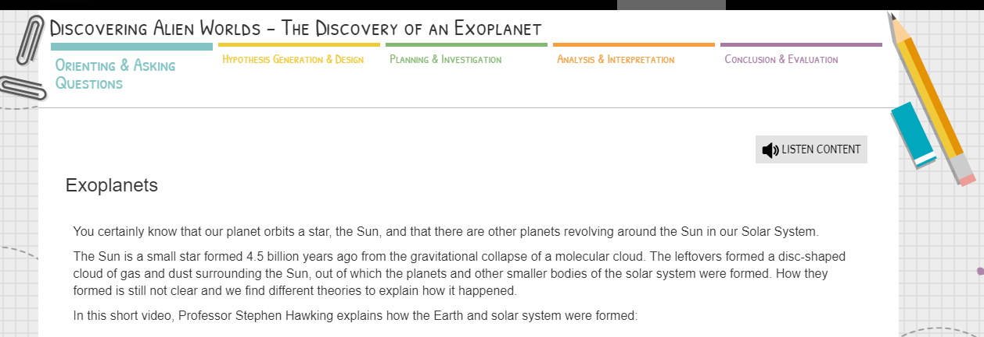

Slide 15
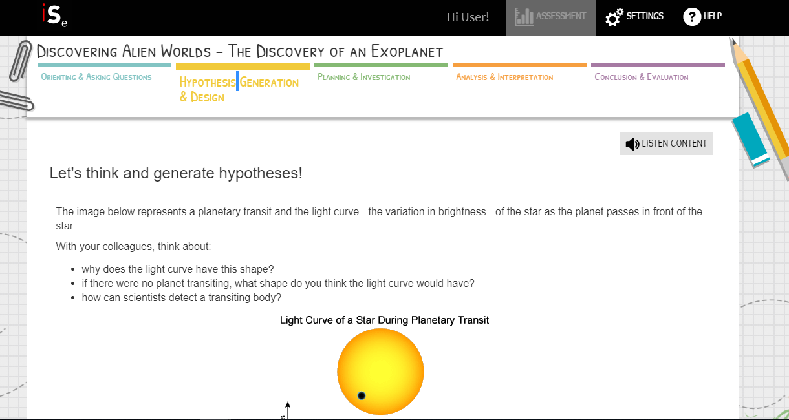

Slide 16
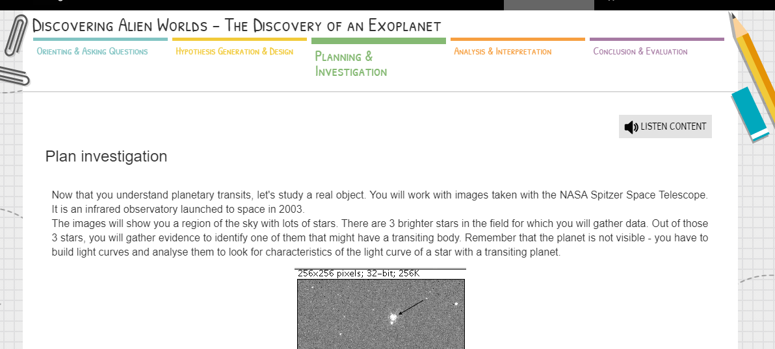

Slide 17
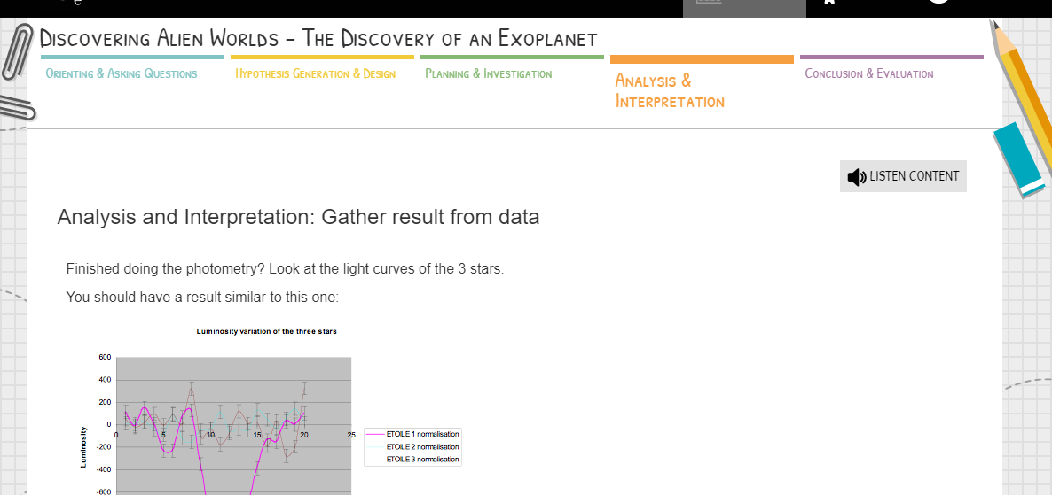

Slide 18
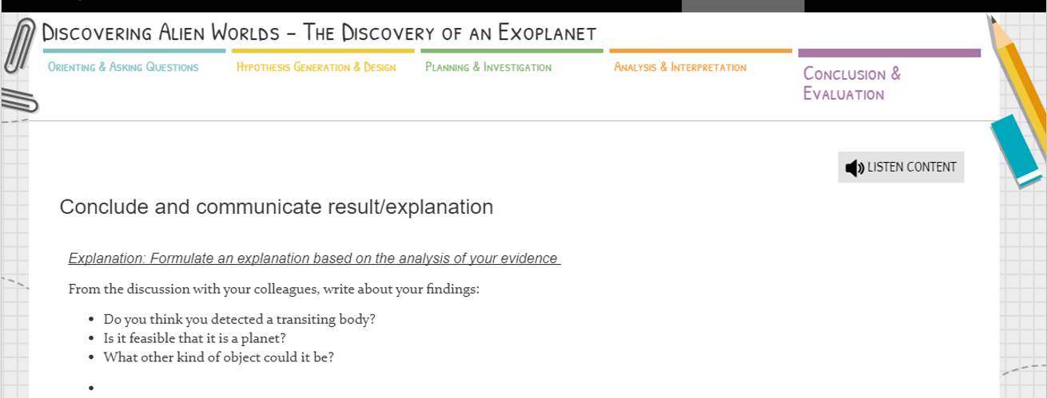

Slide 19
We hope you enjoy the 2021 summer school!

